Slide 1
Lab: BST and AVL
CSCI104

Slide 2
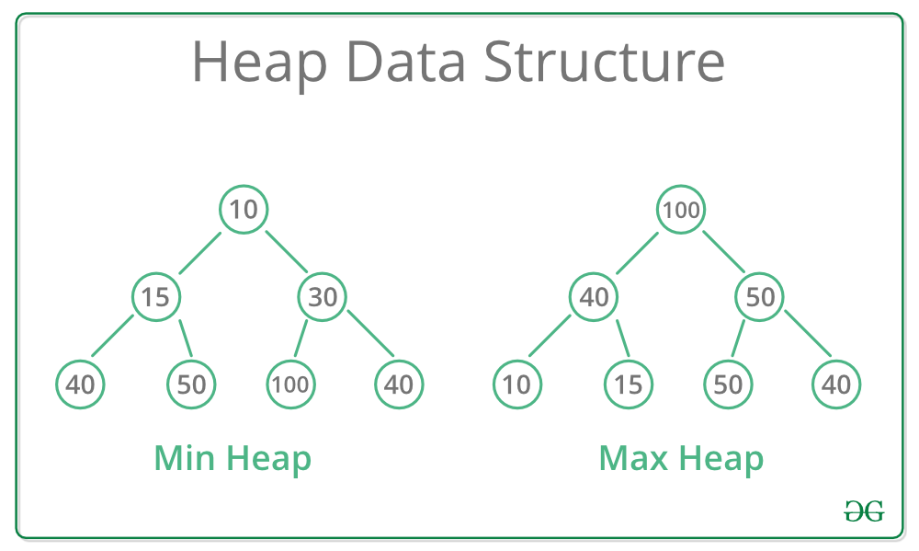
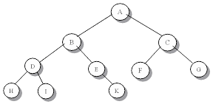
REMEMBER: Heaps
COMPLETE d-ary tree
All levels except the last are completely filled
All leaves in last level are to the left side
Every parent is “better” than both of its children
Min Heap: node is less than or equal to all children
Max Heap: node is greater than or equal to all children
Could this be a heap??

Slide 3
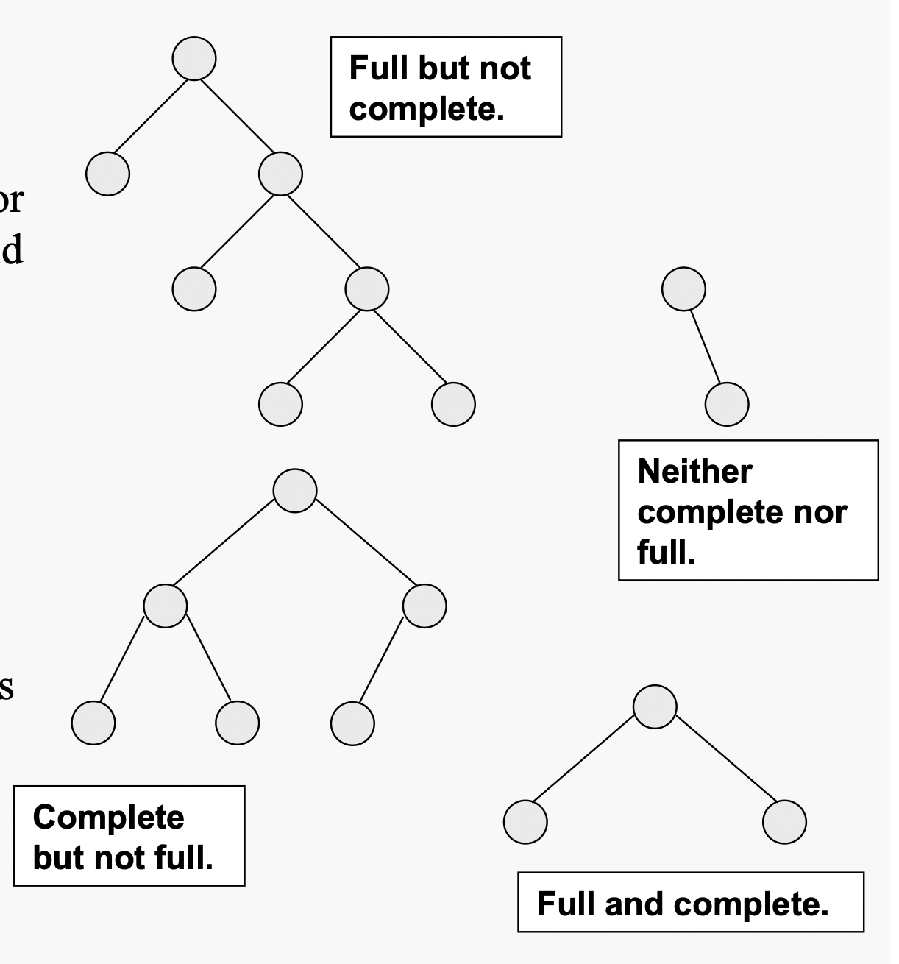
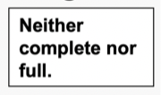
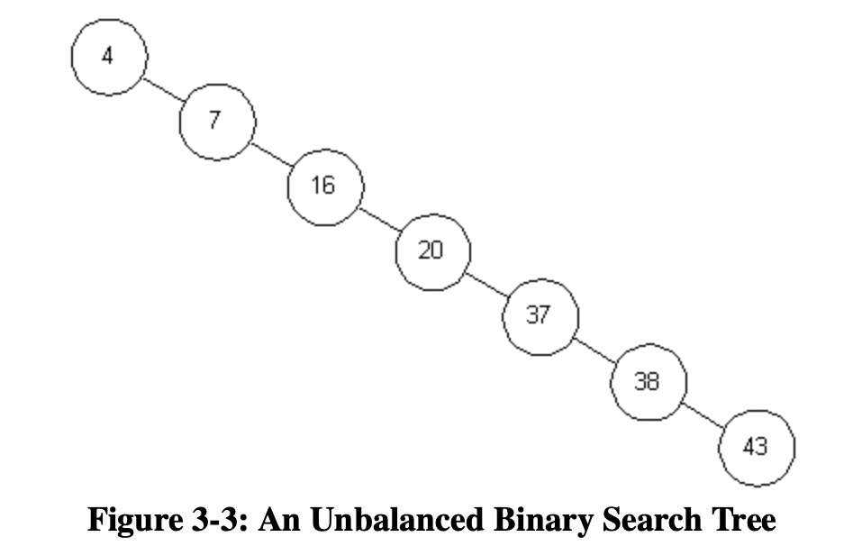
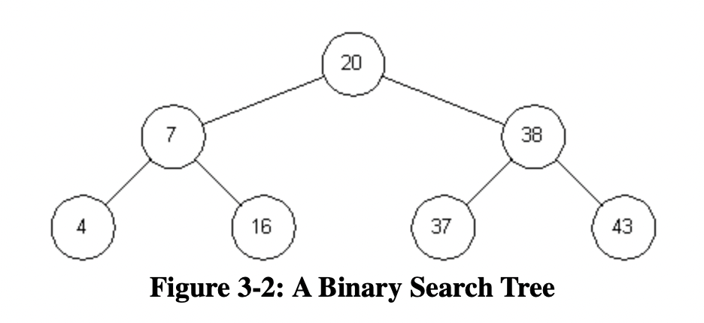
Binary Search Trees (BST)
Not necessarily a complete or full tree
Left children (left subtree) hold values LESS THAN or equal to parent’s values
Right children (right subtree) hold values GREATER THAN parent’s value

Slide 4
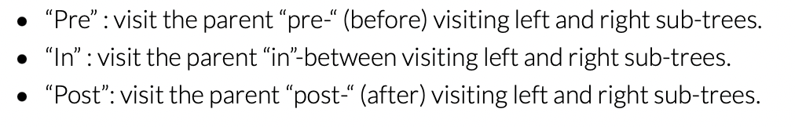
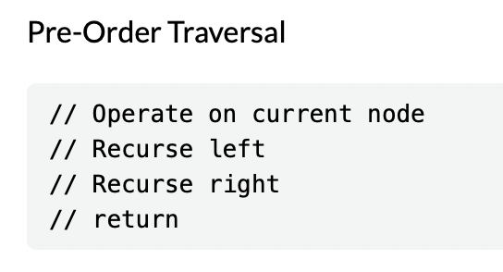
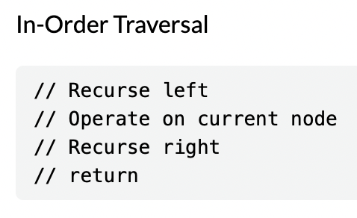
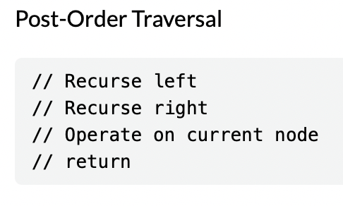
Traversals: Pre-Order, In-Order, Post-Order
All traverals operate on EVERY node eventually–just in different orders

Slide 5
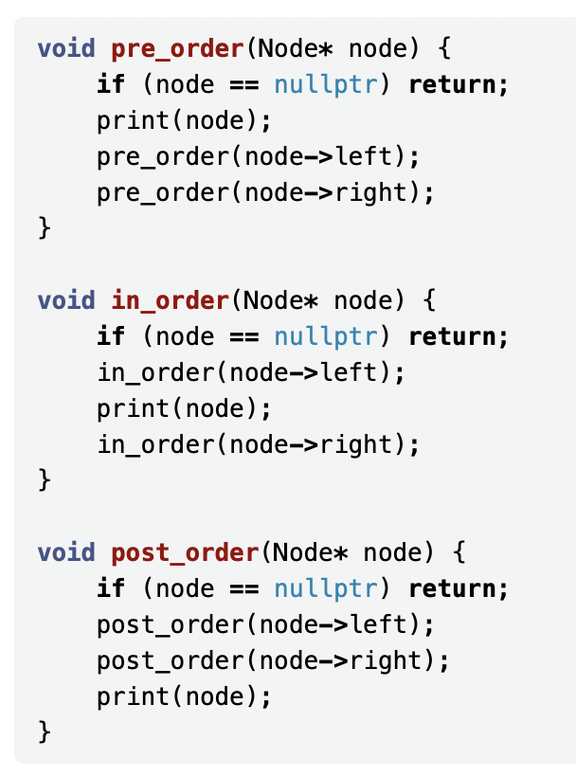
Traversals in C++
For a BST, what is special about operating on elements using an in-order traversal? If we were printing integers using this traversal, what would the output look like?

Slide 6
Why BSTs? SEARCHING!
Enable (potentially) faster searching
Why do we say potentially? What is an example where the search is slow, even if it’s a valid BST?

Slide 7
Why BSTs? SEARCHING!
Slower search: O(n)
Basically like a linked list
Faster search: O(logn)

Slide 8
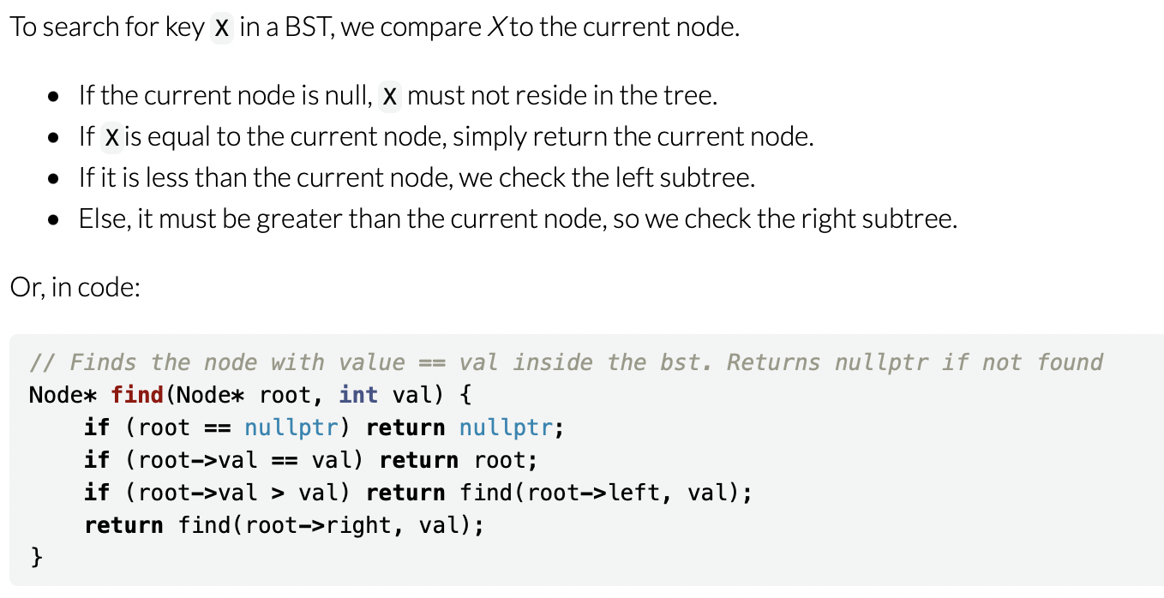
Search Function
Can do it iteratively or recursively
Recursive example

Slide 9
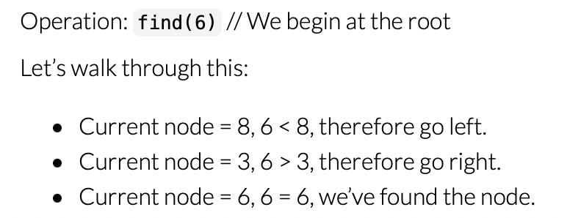
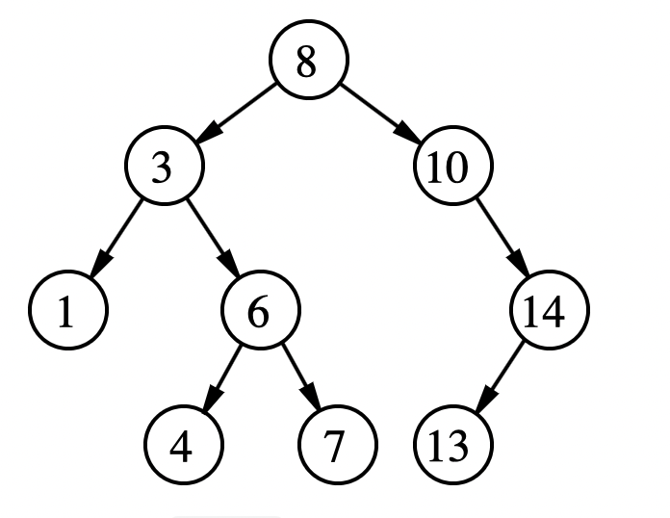
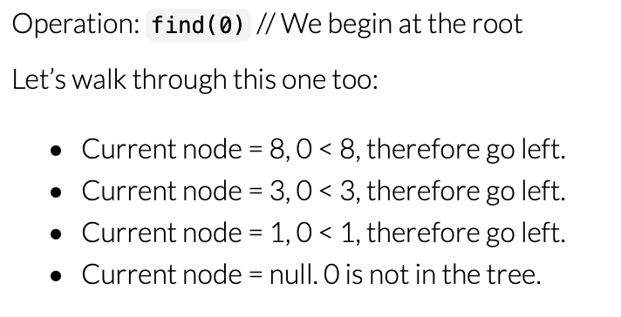
Search Example

Slide 10
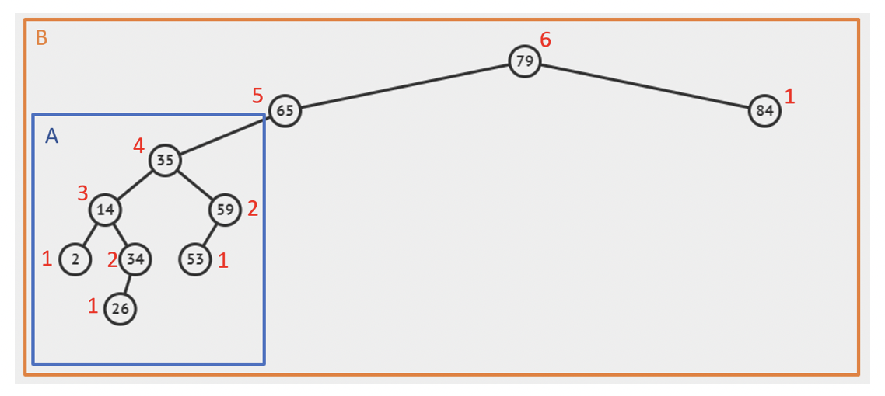
Balanced Binary Tree
Height-balancing property: heights of each subtree differ by no more than 1
Avoids the slower search times!
Keeps the height of the tree log(n)
A is balance, B is not

Slide 11
Maintaining BST Property
REMEMBER: BST Property = left subtree node keys less than parent’s and right subtree node keys greater than parent’s
Maintained by smart insertion and deletion
Insert function
Traverse the tree based on key to be inserted
Insert once you encounter a situation where you cannot traverse further
Remove function
Need to choose which node to promote
If node you want to remove has 0 children: just remove it
If node you want to remove has 1 child: promote the child of the node
If node you want to remove has 2 children: swap with its predecessor OR successor

Slide 12
Self-Balancing BSTs
We will be focusing on AVL trees
You keep the tree balanced even after insertions or deletions
This involves using rotations!
Foundation of AVL trees

Slide 13
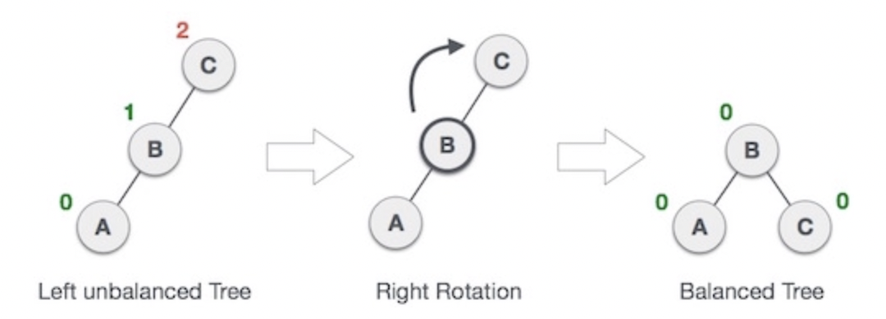
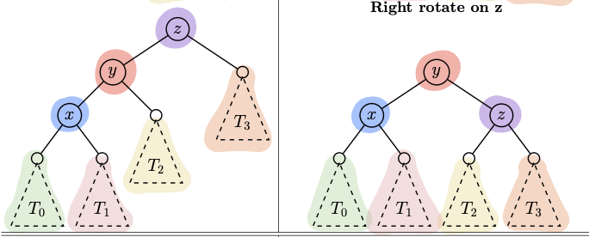
Single Rotations
RIGHT

Slide 14
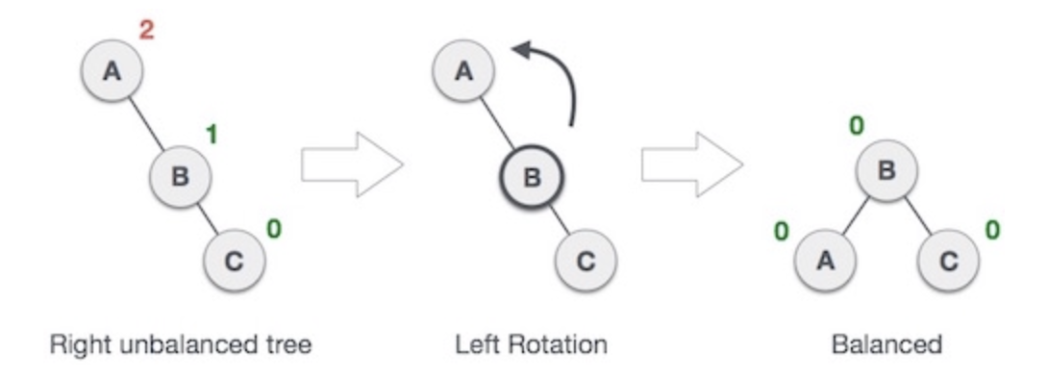
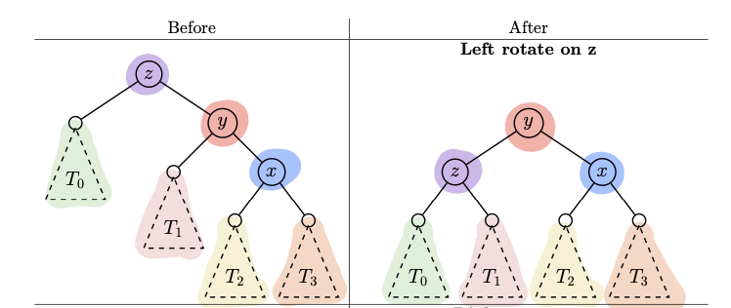
Single Rotations
LEFT

Slide 15
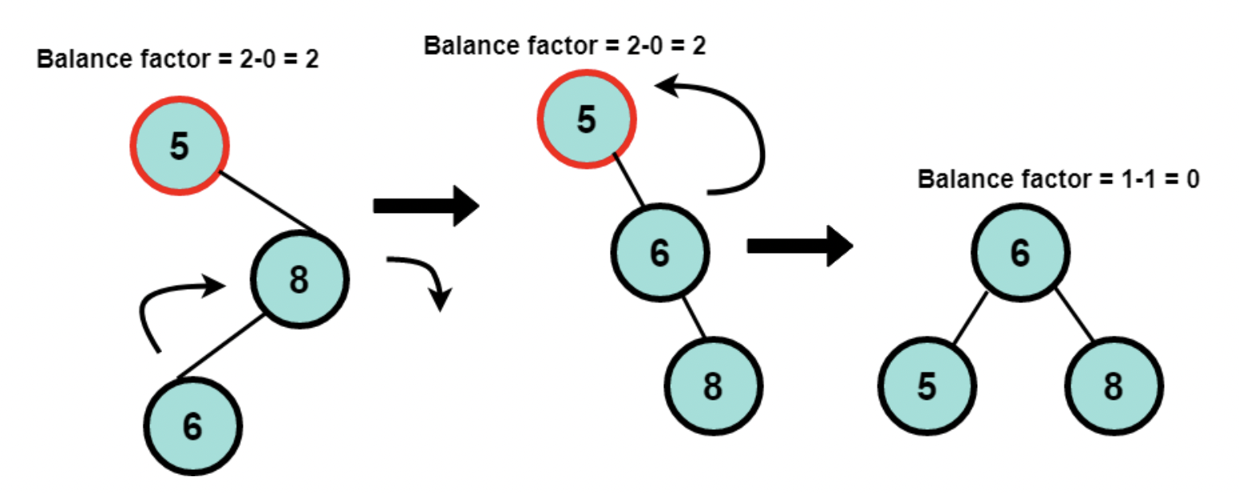
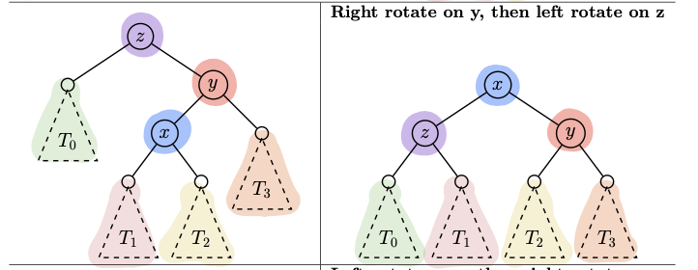
Double Rotations
RIGHT LEFT

Slide 16
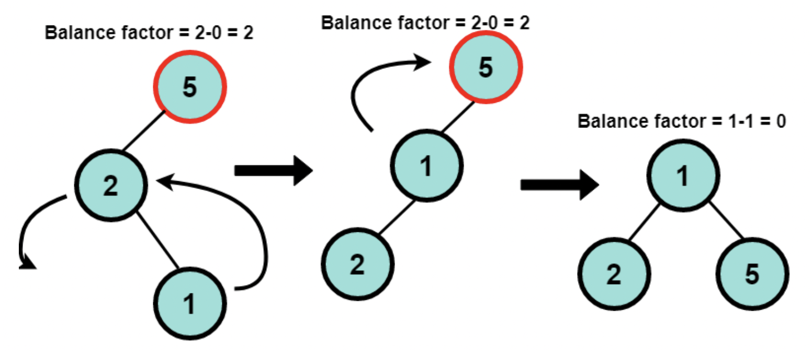
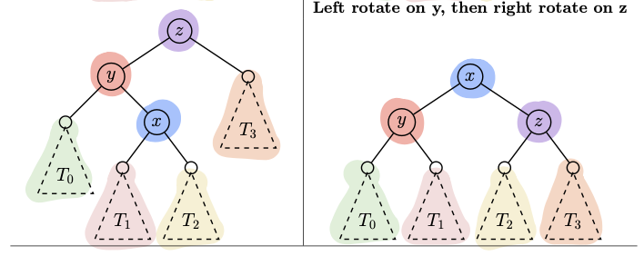
Double Rotations
LEFT RIGHT

Slide 17
AVL Insert and Remove
Insert
Insert as you would in a BST
Fix the tree if it is unbalanced after inserting the node (ROTATION)
Need at most 1 rotation (either a single or double rotation)
Remove
Remove as you would in a BST
Keep traversing up the tree and fixing tree if unbalanced (ROTATIONS)
You may need multiple rotations to fully fix the tree

Slide 18
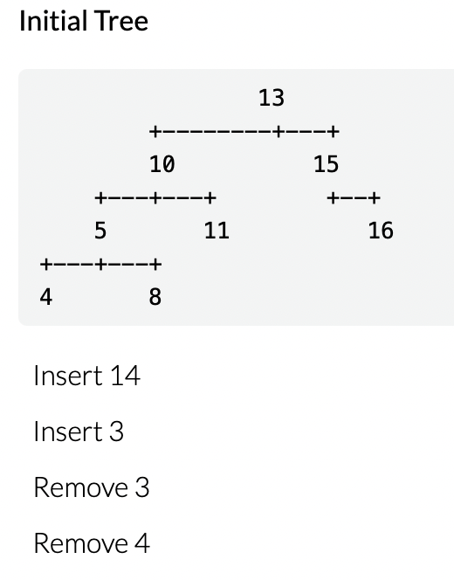
The Lab
Draw or type out operations on tree
Try your best to not do it with your neighbors; you will need to personally understand this for the next PA!

