Slide 1
CSCI 104 Lab: Hash Tables

Slide 2
What is a Map?
Recall that a map is a data structure used mostly for fast lookups or searching data.
It stores data in the form of key, value pairs, where every key is unique. Each key maps to a value, hence the name “map.”
The look up speed and ordering of map elements depends on the data structure we use to implement our map.

Slide 3
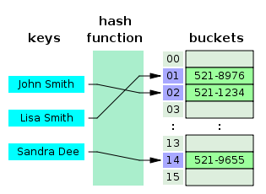
Hash Tables
Like an array, but to find the index we use a hash function.
A hash function converts the input into an index location that the input is then stored into.
Hashing is a function - O(1)
With a good hash function that distributes keys uniformly around the table so to minimize collisions, all commands have average runtimes of O(1).

Slide 4
Hash Functions
Hash function - a function that converts an object into an index location within our array.
Goals of a hash function:
Easy and fast to compute
Uniformly distributes keys across the hash table
Deterministic!

Slide 5
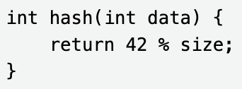
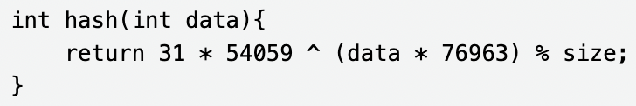
Hash Functions (continued)
A bad hash function:
This is fast (only one operation) but always returns the same value!
A good hash function:
A few more operations (but still constant), and gives a variety of output numbers, and is deterministic!

Slide 6
Collisions
So what happens if the hash function outputs the same index for multiple objects?
This is called a collision.
Two approaches to handling collisions:
Open addressing
Closed addressing (chaining or buckets)

Slide 7
Open Addressing
The idea with open addressing is that every location in the array can only have 1 thing in it. This means that we will have to find a free spot that we can place the object in. Linear probing is a very simple solution.
Linear probing is where you just keep incrementing up/looking at the next index until you find a free location.
Other examples of open addressing are:
Quadratic Probing
Double Hashing

Slide 8
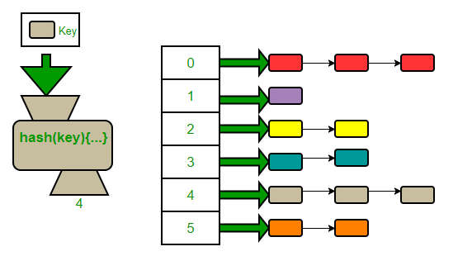
Closed Addressing (Chaining)
Chaining allows for multiple objects to reside within the same array location. The array is changed to be an array of lists or some other data structure, allowing us to store multiple items per index. We often use an array of linked lists, hence the name “chaining.”
Because chaining allows for buckets, n objects could all be placed within the same bucket. The worst case runtime is O(n). Ideally, this should not occur if the hash function is good and the size of the hash table is big enough.

Slide 9
OrderedMap
Function | Runtime
get(key) | O(log n)
push(key, value)) | O(log n)
remove(key) | O(log n)
An ordered map uses a balanced binary search tree as its underlying data structure.
We haven’t yet gone over it in lecture yet, but for now, it is sufficiently to know that it is used in the implementation of std::map (it usually uses a version of balanced binary search tree called a Red-Black Tree)
Notes:
It is called a “ordered map” because doing an in-order traversal of a binary search tree would give you a ordered traversal of all the keys in the map.

Slide 10
UnorderedMap
Function | Runtime
get(key) | O(1) on average
push(key, value)) | O(1) on average
remove(key) | O(1) on average
An unordered map uses a hash table as its underlying data structure. This means that access operations are O(1) on average, but because of this, no order can be inferred
You must explicitly create an unordered map using std::unordered_map.
Notes:
By improving the runtime of operations, we had to sacrifice the ordering property.

Slide 11
Lab Assignment
Implement remove function for an open addressing hash table

