Slide 1
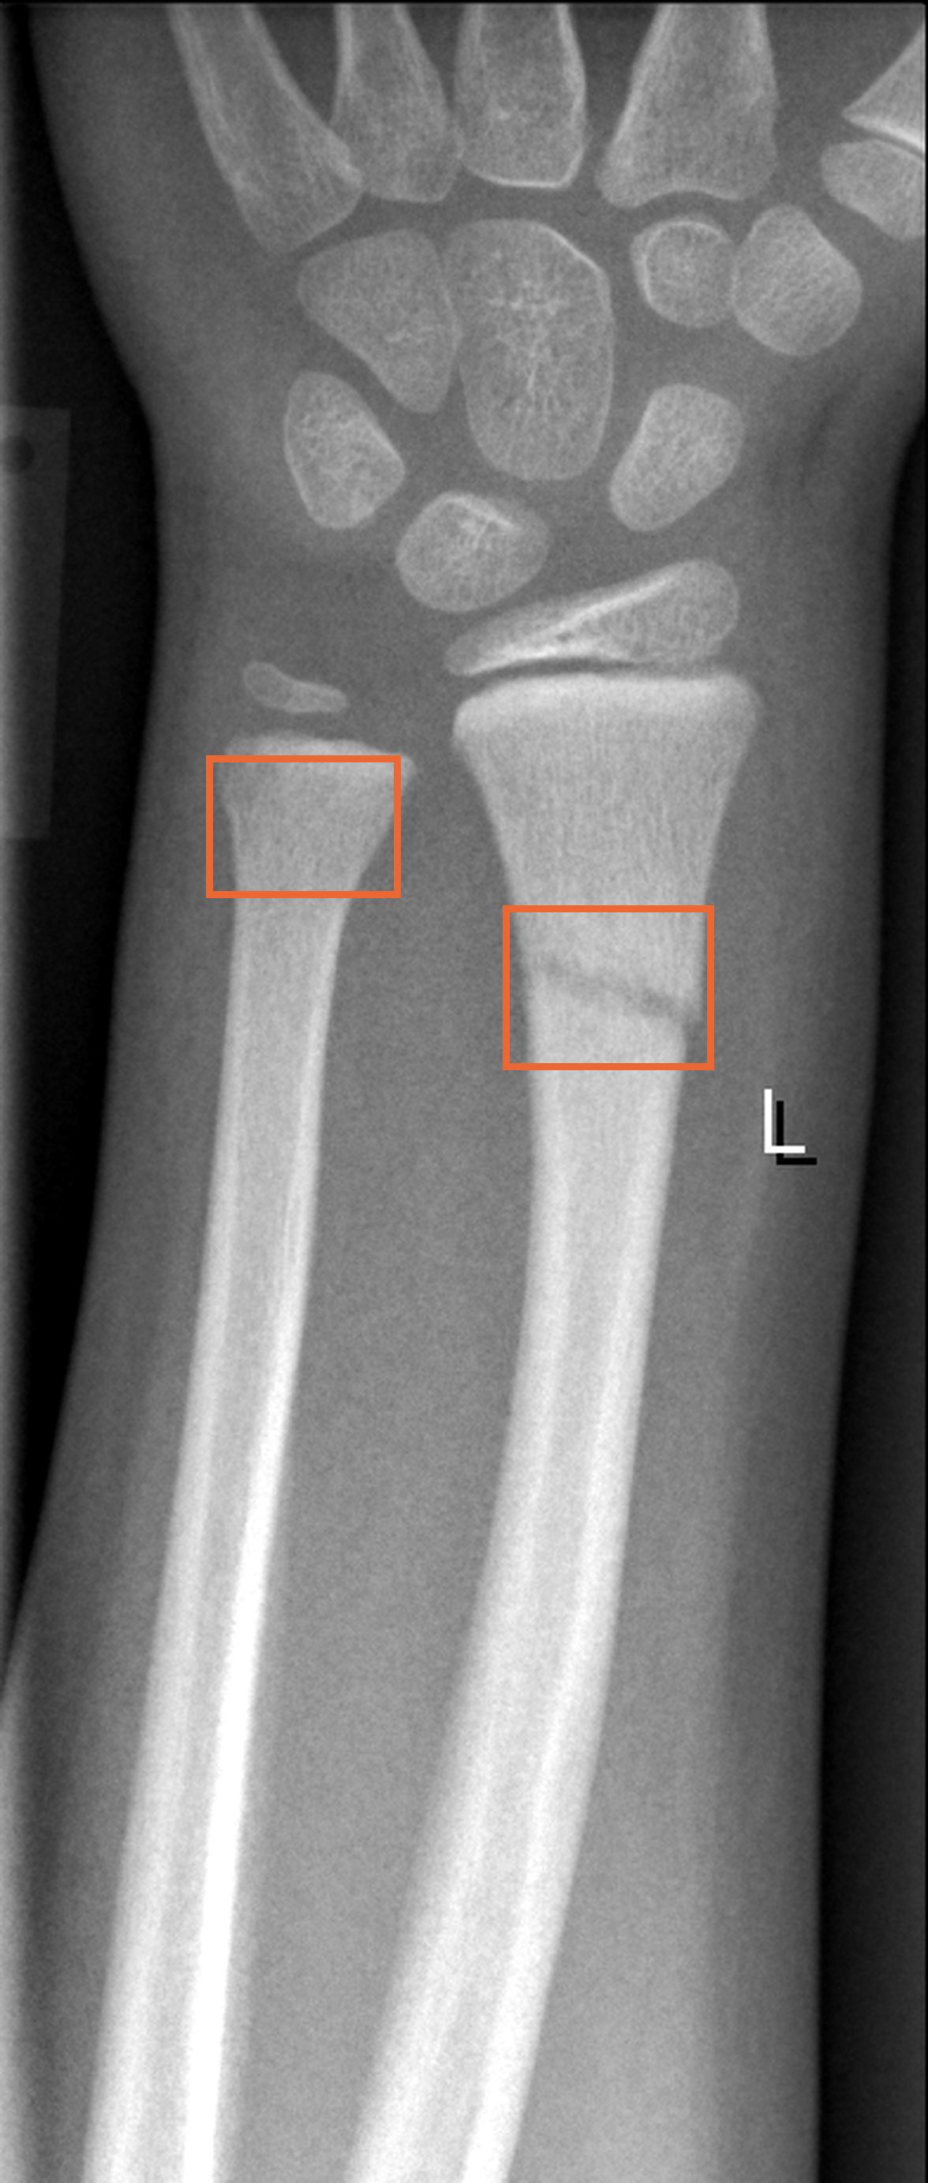
Shortcut learning in
pediatric wrist
fracture detection
Team Snap
Fahim Ahamed · Zahra Khan · Lloyd Empedrado
CSC I1910 · Nov 10, 2026

Slide 2
Problem and motivation
Problem
Children's wrist fractures are common and easy to miss
Growth plates can look like cracks
ER doctors often read them first; a reliable tool would help
Motivation
Models could score well by spotting casts and follow-ups instead of the fracture
No one has tested whether these cues drive the scores

Slide 3
Related work
Same dataset
Patwary and Toma 2026
Cross-dataset test
Did not generalize
Called every outside image a fracture
Nagy et al. 2022
YOLOv5m detector
High detection accuracy
Random image-level split
Ju and Cai 2023
YOLOv8 detectors
Marginal accuracy gain
No explainability analysis
Shortcut learning
Zech et al. 2018
Pneumonia
Shortcut: which hospital
Failed at new hospitals
DeGrave et al. 2021
COVID-19
Shortcut: text markers
Ignored the lungs
Geirhos et al. 2020
General overview
Defines shortcut learning
Calls for out‑of‑distribution tests
Gap
No one has tested whether casts and follow-ups drive the scores or the outside failures

Slide 4
Data overview: GRAZPEDWRI-DX
20,327
6,091
67%
images
children
show a fracture
Format
Pitfalls
File
16-bit grayscale PNG
Same child in many images
28% of images show a cast
L/R text marker on almost every image
Resolution
Varies, about 560 × 1,030 px
Size
About 16 GB of images
Views
Front and side
Ages
0 to 19, median 11
Source: University Hospital Graz, Austria · Nagy et al., Scientific Data 2022

Slide 5
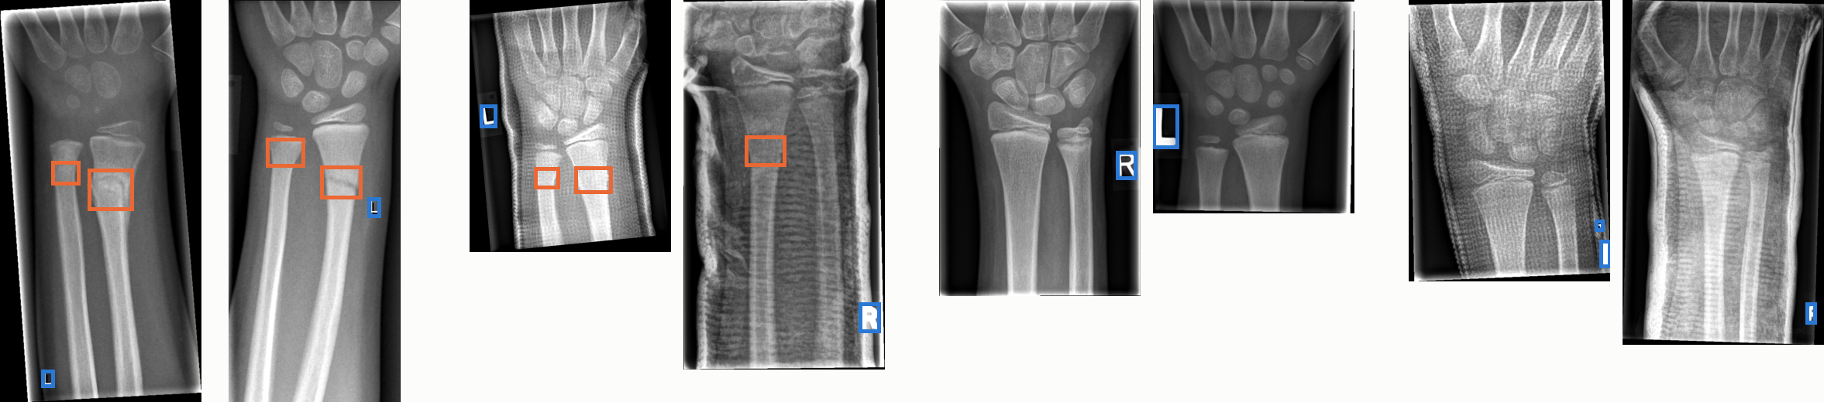
Example images
Fracture
no cast
Fracture
cast
Normal
no cast
Normal
cast
Fracture box
L/R marker box

Slide 6
Fracture rate by visit and cast
All 20,327 GRAZPEDWRI-DX images, grouped by visit and cast
Fracture
No fracture
First visit, no cast
10,859 images
4%
42%
237 of 5,776 casts are normal
Follow-up, no cast
3,692 images
93%
28%
Follow-up, cast
5,774 images
96%
of all images show a cast
Not shown: 2 first-visit images with a cast

Slide 7
Datasets and splits
GRAZPEDWRI-DX
Train, validation, test
Austria · 20,327 images · 13,550 fractured
FracAtlas
External test
Bangladesh · 1,538 images · 440 fractured
PediURF
External test
China · 6,748 images · all wrist‑end fractures
Each child in only one split (70 / 15 / 15)
Clean test: first visits, no cast (1,637 images)
Metrics: AUROC, sensitivity, specificity; sensitivity only on PediURF

Slide 8
Models
Model
Setup
Baselines
Logistic regression
Features extracted with ResNet
Gradient boosting
Features extracted with ResNet
Deep models
Small CNN
Trained from scratch
ResNet-18
ImageNet, fine-tuned
DINOv2 ViT-S/14
Frozen, trained head

Slide 9
Explainability and error analysis
Explainability
Deep models: Grad-CAM on fracture boxes
All models: deletion and insertion curves
Error analysis
Misses and false alarms
Split by cast, follow-up, age, site
Reliability
3 seeds · bootstrap 95% intervals · weight randomization

Slide 10
Schedule
Nov 10
Nov 17
Nov 24
Dec 1
Dec 8
Dec 15
Proposal
Final
Pipeline and baselines
Deep model training
Test on unseen data
Explainability, error analysis
Report and slides

Slide 11
Thank you
Team Snap
Fahim Ahamed · Zahra Khan · Lloyd Empedrado

Slide 12
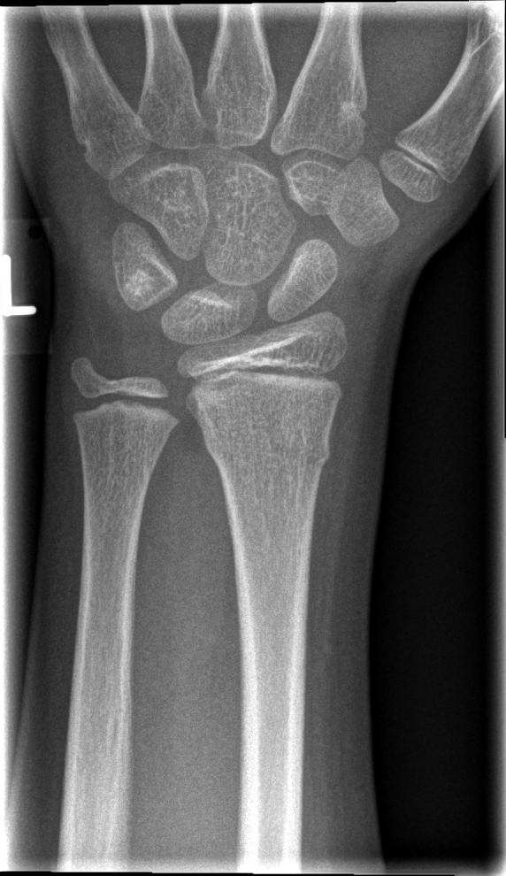
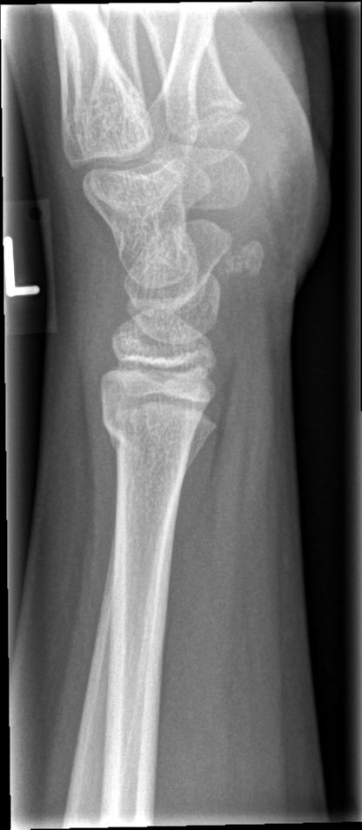
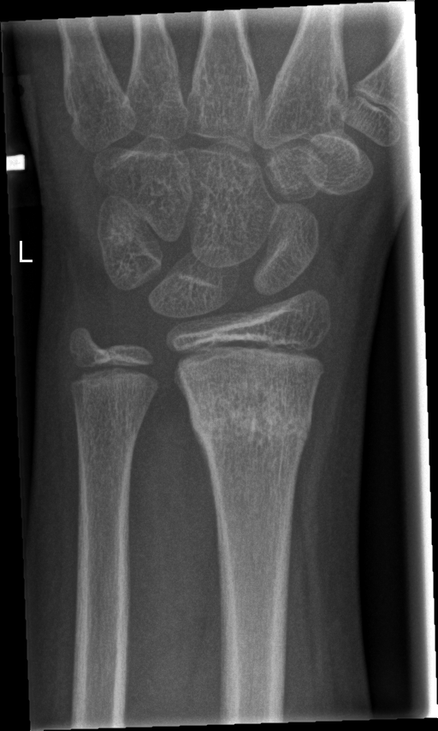
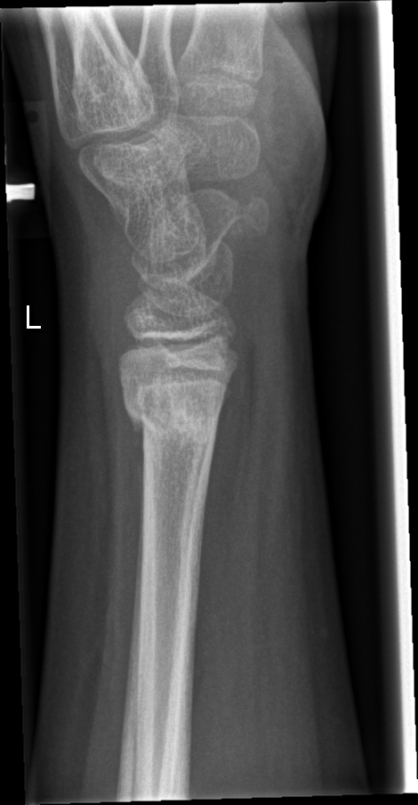
Same child, two visits
Visit 1
Visit 2
Front
Side
Front
Side
One child, age 9.6, left wrist, no cast; all four images labelled fracture

Slide 13
Age distribution
Images
2,500
11.2
2,000
median age in years
1,500
6%
1,000
of images under age 5
500
0
0
2
4
6
8
10
12
14
16
18
Age (years)

Slide 14
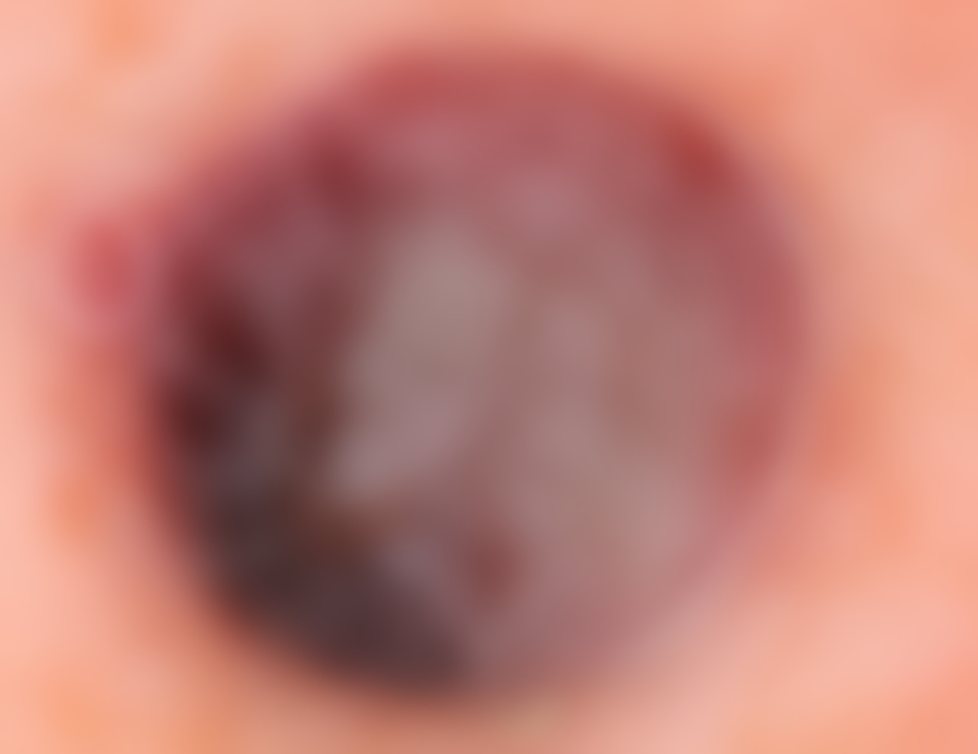
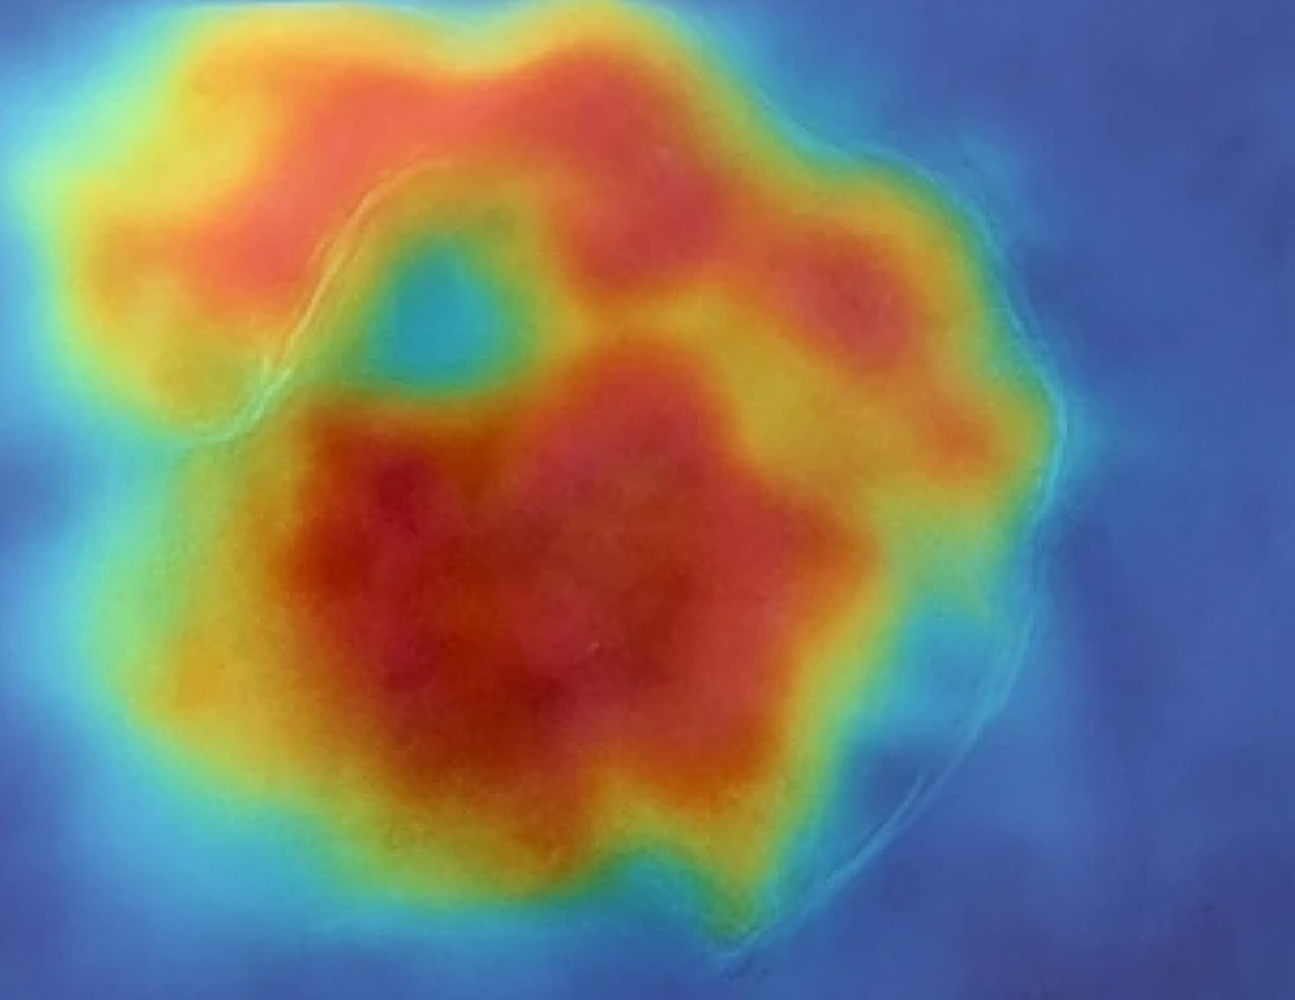
Grad-CAM example
Input image (blurred)
Grad-CAM heatmap
Source: https://doi.org/10.1177/20552076261438923

