Slide 1

TensorFlow and Higher Order Functions
Daniil Garusov, Tyler Moll and Kevin Jacob

Slide 2
What is TensorFlow?
Tensor flow is a Google-developed, open-source machine learning tool that makes large scale neural networks
Helps computers make decisions with limited human interaction.
Used for finding patterns in data, with everything from filtering out bad words to identifying possible health complications through imaging, and catering relevant search results

Slide 3
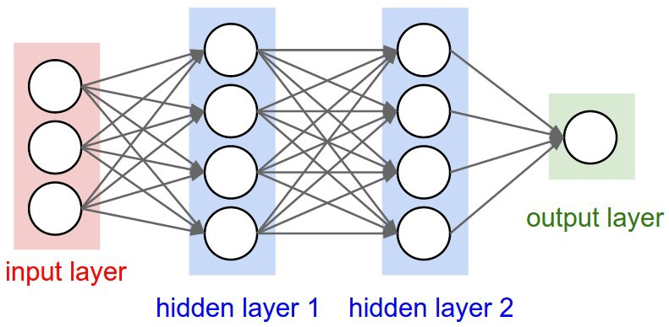
Basics of Machine Learning
A data structure with layers of simple nodes
Each node has a randomized start
Based on the input, each node passes forward a true or false
Based on the learning type, after the inputs are processed, the model adjusts

Slide 4
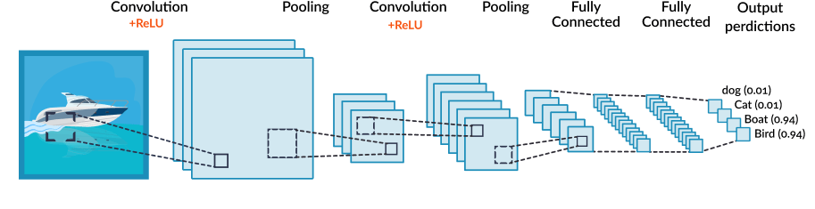
Convolutional Neural Networks
Starts with an input image
The pooling layer downsizes the image to its relevant components
Th convolution layer transform more relevant pieces of the image into compressed numerical values

Slide 5
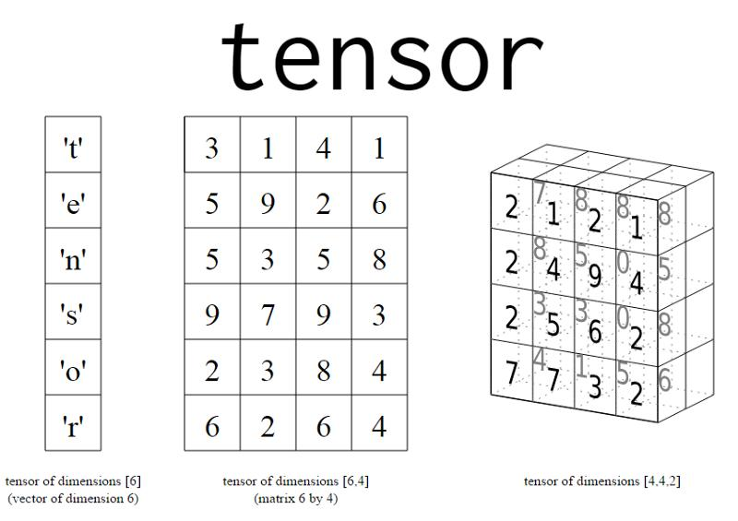
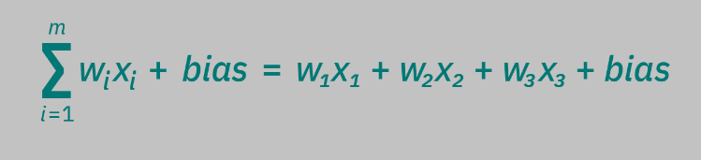
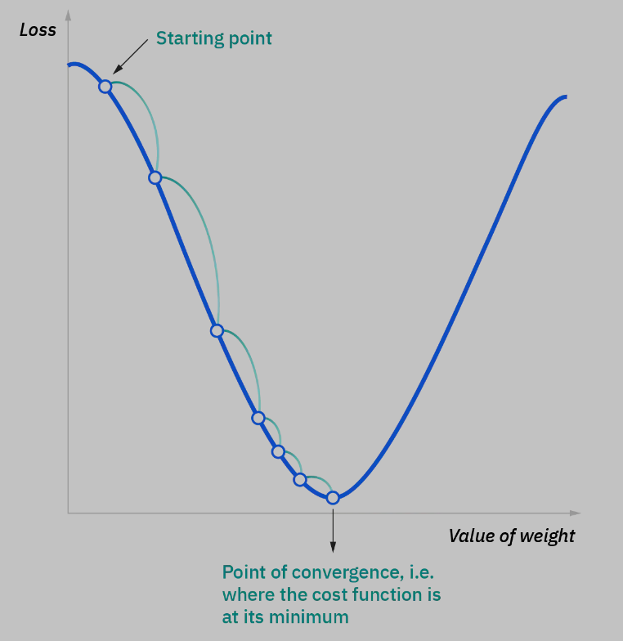
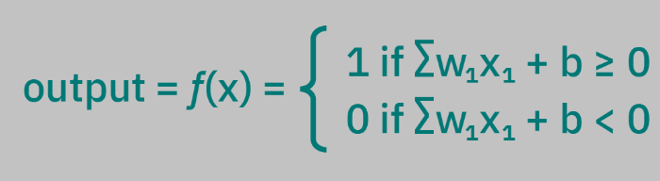
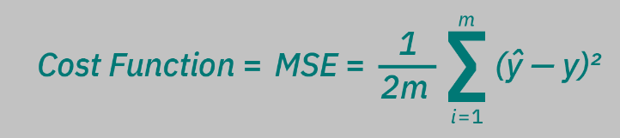
How work?
Tensors Are Generalizations for sets of algebraic objects. Each node is a linear regression model.

Slide 6
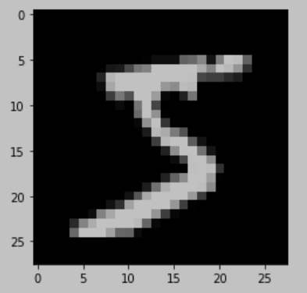
Our Demonstration
Takes handwritten numbers and translates them to integers
5

Slide 7
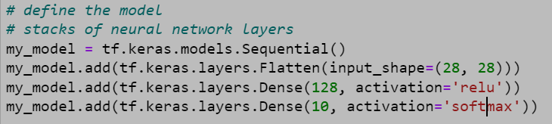
Higher Order Functions
Relu is a function that can essentially be described as max(x,0)
Softmax is a function that converts vectors of values into probability distributions.
These relatively basic functions get applied to different nodes and layers where higher order functions decrease the amount of code you have to write.

