Slide 1
chibicc: A small C compiler
Jack Sangdahl, CSCI3155

Slide 2
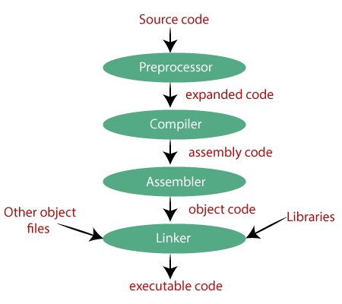
Introduction
A small C compiler named chibicc
C compiler has multiple steps to produce something your computer can run
Compilers you may already be familiar with: GCC, Clang/LLVM
Next: how a compiler works
Notes:
I will be talking about a small C compiler, named Chibicc.
For those unfamiliar, the C programming language is a language that is
compiled into an executable that your computer can run. Thus, a
compiler infrastructure is needed. I will first quickly go over very
generally how a typical compiler works. Most commonly used C compilers
(at least for x86_64) include GCC and Clang/LLVM, which you may be
familiar with.

Slide 3
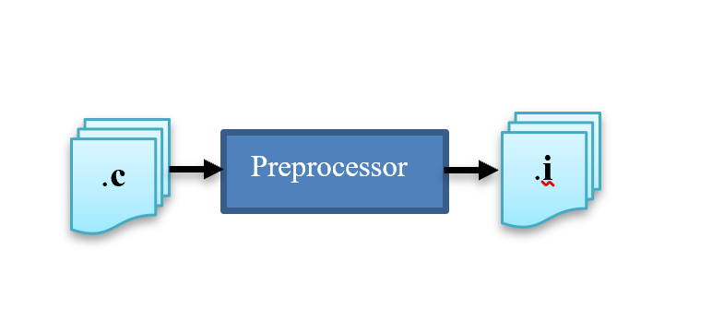
Compiler Internals – Preprocessor
Expands macros in the form of direct text replacement
Replaces header file includes directly with the content of the file
Resolves conditional directives like #ifdef/#else, and omits code that is not to be compiled
Notes:
From a high-level view, the first step in this process is the
preprocessor. This expands the code in the form of expanding macros,
replacing `#include` directives with the content from the included
file(s), and resolve preprocessor conditional directives, like `#ifdef`
that the C language provides.

Slide 4
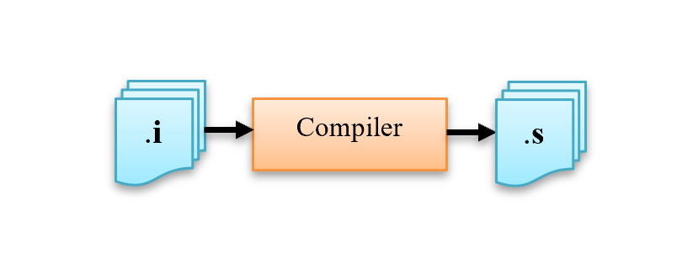
Compiler Internals – Compiler
Converts preprocessor output to architecture specific Assembly code
Output is closer to something readable by a computer, rather than a human
Includes mnemonic symbols like MOV & ADD that directly represent CPU instructions
Notes:
The next step is referred to as compilation. This converts the output
of the preprocessor to architecture specific assembly code. This
assembly code that is generated is closer to something readable by a
CPU, rather than a human. It includes mnemonic symbols like `MOV` &
`ADD` that directly represent CPU operations.

Slide 5
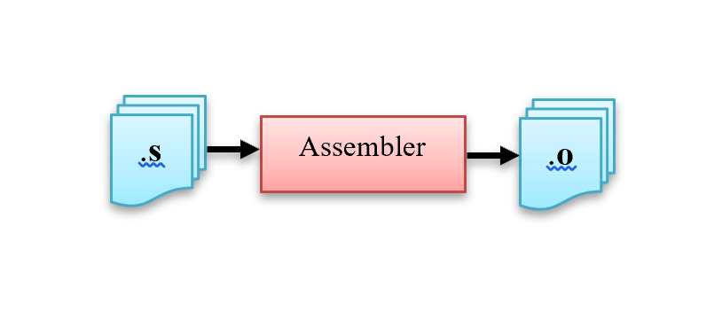
Compiler Internals – Assembler
Assembly instruction consists of an opcode (eg. 0b0110)
Followed by an operand, like a memory address
At this stage, original C codes’ functions have been turned into machine code understandable by a CPU
Notes:
The third step is assembling. An assembly instruction generally
consists of a opcode, which correlates to a binary sequence known to
the CPU. For example, the `PUSH` instruction on x86 maps to `0b0110`.
Opcodes are determined the CPU's ISA, however I digress. Following this
opcode is generally an operand, like a memory address. Generally, this
stage will produce an object file (`*.o`) that contains machine-level
code representing the original code's functions. This is not quite an
executable file.

Slide 6
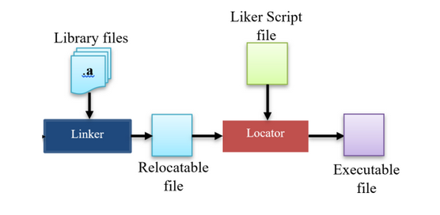
Compiler Internals – Linker
Merges all object code from previous step into a single executable file
Resolves function call references in object files to actual symbols known by the OS
Heavily architecture dependant and complex process
Fun fact: this process requires significant amounts of recursion
Notes:
The final stage of compilation is linking. The linker merges all the
object code from the previous stage into a single one. This stage is
far too complex to discuss here in detail, however this step will
magically output a executable file you can run.

Slide 7
Relating this to chibicc
In common compiler infrastructures, the stages are delegated to individual programs (cpp, as, ld)
Tools you may be familiar with (GCC/Clang) bundle all these steps into one program
$ cc foo.c
$ ./a.out
chibicc provides a preprocessor and compiler. Assembling and linking is handled by aforementioned utilities
Supports all mandatory features of C11, as well features like floating point numbers.
Does not support GCC inline assembly or optimisation.
Notes:
In most common compiler infrastructures, these stages are delegated to
individual programs that are actually separate from the "compiler".
I.e. your Linux system has a standalone `cpp` program (preprocessor),
`as` program (assembler), and `ld` program (linker) that can all be
manually invoked to perform the familiar step of `cc foo.c`, where
this is all done for you (and for good reason).
The project being discussed, Chibicc, provides a preprocessor and
compiler. Assembling and linking is handled by the aforementioned
programs. Now, a bit more about Chibicc; it supports almost all
mandatory features of C11, as well as support for many things often not
contained in small compilers like floating point numbers, variable
length arrays, functions that return `struct`'s as values, and more.
Chibicc does not support things like complex numbers, inline assembly,
or optimisation for the sake of simplicity.

Slide 8
chibicc Internals
chibicc consists of the following stages:
Tokeniser: takes a string as input and breaks it into a list of tokens and returns this
Preprocessor: takes a list of tokens as an input, and outputs a new list of macro-expanded tokens
Parser: recursively descends and constructs abstract syntax trees from the preprocessor output. Also adds a type to each AST node
Code Generator: outputs an assembly text for given AST nodes
Notes:
Chibicc consists of the following stages:
1. **Tokeniser**: takes a string as an input, break it into a list of
tokens, and returns this.
2. **Preprocessor**: takes a list of tokens as an input, and outputs a
new list of macro-expanded tokens. It interprets preprocessor
directives while also expanding macros.
3. **Parser**: recursively descends and constructs abstract syntax
trees from the output of the preprocessor. It also adds a type to each
AST node.
4. **Code Generator**: emits an assembly text for given AST nodes.

Slide 9


Observations & Comparisons
Something interesting: chibicc does not free memory as needed, which may be a foreign concept
Compilers are generally short lived and meant to run as fast as possible, which freeing memory impedes, so it’s simply done once at the end of execution
chibicc of course does not produce binaries that run as fast as those made by larger compilers like GCC or Clang/LLVM
chibicc is still able to compile large code bases like git, sqlite, and more
Notes:
An interesting design aspect of Chibicc is the fact that allocated
memory is not freed as needed. This was a fairly odd and new concept
to me. After looking into this, the D programming languages' compiler
also does this. Compilers are short lived programs and should generally
try to execute as quickly as possible. This means allocating memory
without freeing until the entire process is done. This is why there are
no calls to `free()` in Chibicc.

