Slide 1
ILP Graph Coloring
By: Sean and Sean

Slide 2
Motivation
Embedded systems can be extremely memory restricted, as memory is quite expensive, so variable spilling must be kept to a minimum
Also becoming more and more critical for embedded systems to operate as fast as possible

Slide 3
Our Questions
Greedy approach may be fast but can result in unnecessary spilling
Integer Linear Programs will produce optimal results but can take substantially longer to run
We want to see what sort of memory improvements ILP can give us compared to the computational cost
Whether we can improve upon the barebones ILP implementation

Slide 4
Initial results
Forming very simple ILP formulation resulted in a comical number of constraints, in excess of 100,000 for fairly simple programs, that would take forever to solve
So we added some optimizations to cut down the constraints

Slide 5
Optimization 1: Double Edge
Initial implementation added constraints in between certain edges in both directions causes a large increase in constraints.
Our first optimization was to only add edge constraints in a single direction

Slide 6
Optimization 2: Pre-Coloring
Adding constraints for pre-colored edges makes the problem easier to solve as well as decreases the total number of constraints

Slide 7
Optimization 3: Spill Cost
More advanced version of saturation from the greedy algorithm
Calculate the actual number of memory access that would result from a spill, instead of just number of interference edges
Actually increased compile time, but increased coloring optimality

Slide 8
Overall Optimization Improvement
Overall constraint reduction on the order of 22%
Example 67524 -> 52748 constraints

Slide 9
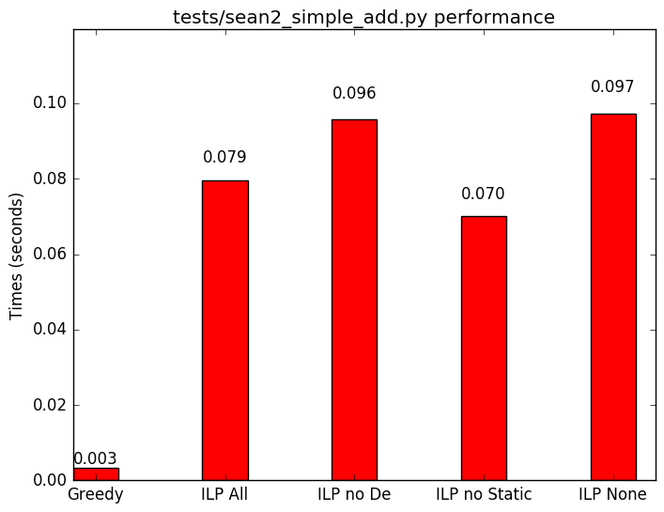
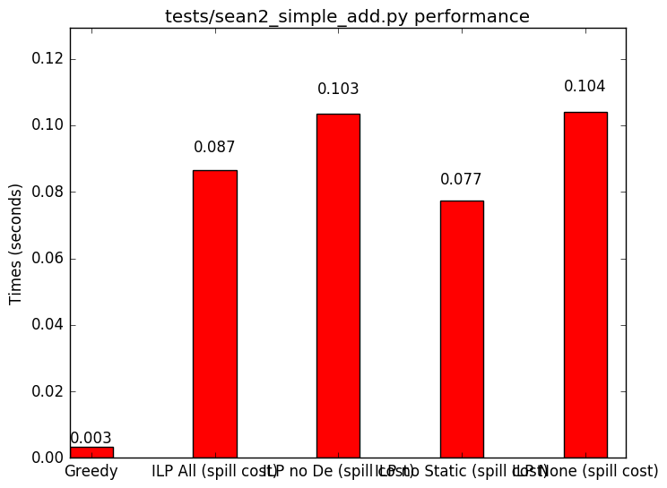
Compile Time Comparison
*GRAPH

Slide 10
Hybrid Approach (aka the Prius)
This improvement still was not enough…
so we thought we could steal some of the speed from the greedy approach, and some optimality from ILP

Slide 11
Hybrid Implementation
Start by running a single pass of greedy to get a guess
Apply a probability of this guess being correct into ILP
Run ILP

Slide 12
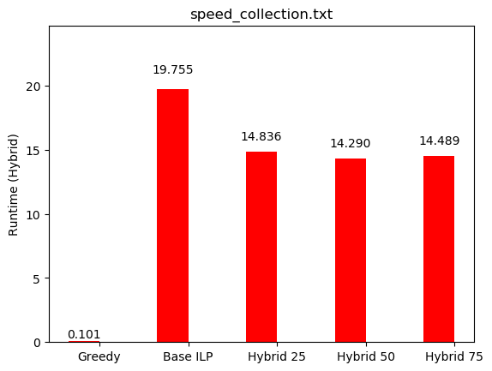
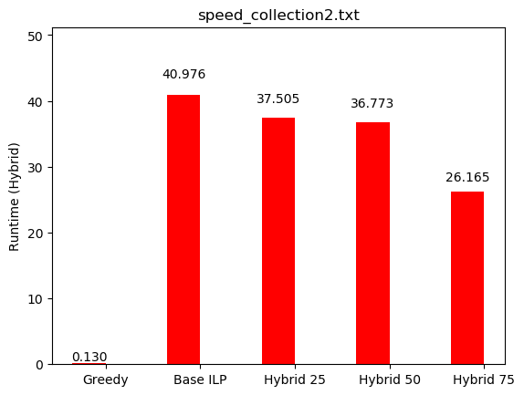
Speed Efficiency Comparison

Slide 13
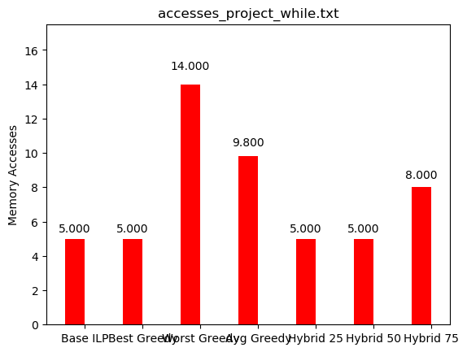
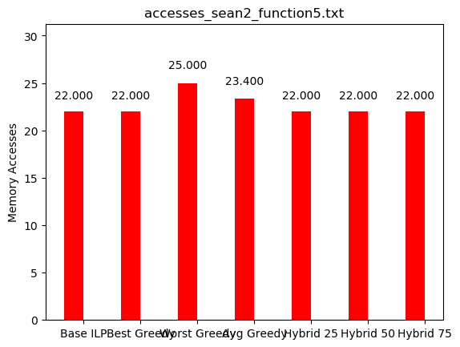
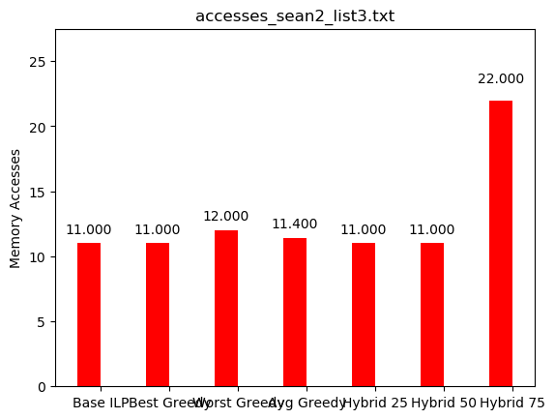
Memory Efficiency Comparison
*GRAPH

Slide 14
Bottlenecks
Flattening and explicating introduces so many temporary variables that the number of constraints explodes
This causes massive slowdowns in ILP calculations

Slide 15
Future Work
Coalescence
We think there is the possibility that coalescence of variables (determining they can be the same color without actually coloring them) through static analysis could reduce the constraints
Complete Formulation
Ours is currently not fully optimal as we don’t consider introduced temporaries

Slide 16

Questions

