Slide 1
Runtime Instrumentation of Python for Serverless Acceleration
CSCI5355 Spring 2020
University of Colorado Boulder
Dylan Fox & Erika Hunhoff

Slide 2
Overview
Introduction to Serverless
Introduction to Serverless Acceleration
Overview of Trace Generation
Example

Slide 3
Serverless Overview
Serverless Provider
Gateway
Func
Requests
Func
...
...
Func
...
Customers
Notes:
There has been a trend towards abstracting the datacenter away from service (application) development, and also a trend toward micro-service architectures.
Serverless is one of the highest levels of abstractions

Slide 4
Serverless Overview
Developer only has to care about this part!!!
Serverless Provider
Gateway
Func
Requests
Func
...
...
Func
...
Customers
Other benefits: scale to zero, autoscaling, etc
Notes:
There has been a trend towards abstracting the datacenter away from service (application) development, and also a trend toward micro-service architectures.
Serverless is one of the highest levels of abstractions. Developers like it because:
They don’t have to worry about deployment, cluster management, networking, etc.
Pay model is nice. No functions running? No money lost
A con: can be slow. We’ll come back to this later.

Slide 5
Serverless
Architecture
Serverless Provider
Start funct1 in VM1
VM1
func1
Invoker
Run
Func1 on server1
Please run func1
Gateway
Notes:
Transition to next slide: running functions in VMs is slow

Slide 6

“A Language-Based Serverless Function Accelerator”
Run JavaScript functions via Node.js in containers (or VMs) as normal, but have them JSON output execution traces in an Intermediate Representation (IR).
Emily Arjun
Herbert & Guha
University of Massachusetts Amherst
Notes:
This is possible due to safety constraints in Rust to preserver isolation and system integrity

Slide 7
“A Language-Based Serverless Function Accelerator”
Run JavaScript functions via Node.js in containers (or VMs) as normal, but have them output execution traces representing an Intermediate Representation (IR)
After several traces, compile that IR to Rust
Emily Arjun
Herbert & Guha
University of Massachusetts Amherst
Notes:
This is possible due to safety constraints in Rust to preserver isolation and system integrity

Slide 8
“A Language-Based Serverless Function Accelerator”
Run JavaScript functions via Node.js in containers (or VMs) as normal, but have them output execution traces representing an Intermediate Representation (IR)
After several traces, compiler that IR to Rust
Instead of running VM + Node.js + JavaScript func, run pre-compiled Rust executable natively
Emily Arjun
Herbert & Guha
University of Massachusetts Amherst
Notes:
This is possible due to safety constraints in Rust to preserver isolation and system integrity

Slide 9
“A Language-Based Serverless Function Accelerator”
Can we generate IR from tracing Python code instead of JavaScript?
Run JavaScript functions via Node.js in containers (or VMs) as normal, but have them output execution traces representing an Intermediate Representation (IR)
After several traces, compiler that IR to Rust
Instead of running VM + Node.js + JavaScript func, run pre-compiled Rust executable natively
Emily Arjun
Herbert & Guha
University of Massachusetts Amherst
Notes:
This is possible due to safety constraints in Rust to preserver isolation and system integrity

Slide 10
“A Language-Based Serverless Function Accelerator”
Can we generate IR from tracing Python code instead of JavaScript?
Run JavaScript functions via Node.js in containers (or VMs) as normal, but have them output execution traces representing an Intermediate Representation (IR)
After several traces, compiler that IR to Rust
Instead of running VM + Node.js + JavaScript func, run pre-compiled Rust executable natively
Emily Arjun
Herbert & Guha
University of Massachusetts Amherst
Note: due to scope constraints, we did not edit the invoker
Notes:
This is possible due to safety constraints in Rust to preserver isolation and system integrity

Slide 11
Write Python
Code
Transform to A-Normal Form
Insert Trace Statements
Run Transformed Code
Extract Trace
Since it must compile to existing IR we only implemented features allowed in the JavaScript version
A-Normal form provides constraints on loops, variable scoping, and more
This allows a trace to be generated while the function runs
We wrote a simple runner program
Trace should be valid IR in a JSON format
Towards Function Acceleration for Python Functions
Notes:
This is our contribution

Slide 12
Implementation
About 2k LOC
Comprised of 3 modules:
ANF Transformation
Insertion of tracing statements
Runtime tracing

Slide 13
A-Normal Form
A-Normal Form is a program transformation sometimes used before compilation.
All intermediate function calls named.
func(func1()) -> x = func1(); func(x);

Slide 14
A-Normal Form - Containerless
All function applications named
func() -> x = func()
All for loops de-sugared to while loops
for x in some_iterator -> while index < len(some_iterator)
All variables declared/initialized to None at top of scope
Modifies Python AST

Slide 15
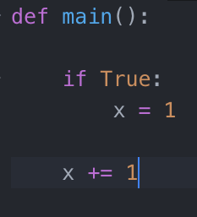
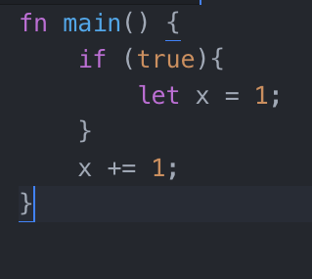
Variable Scope

Slide 16
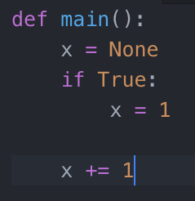
Variable Scope - Solution

Slide 17
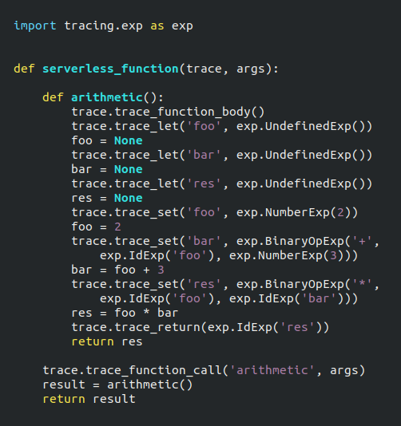
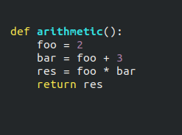
Example: Python to
Transformed Python

Slide 18
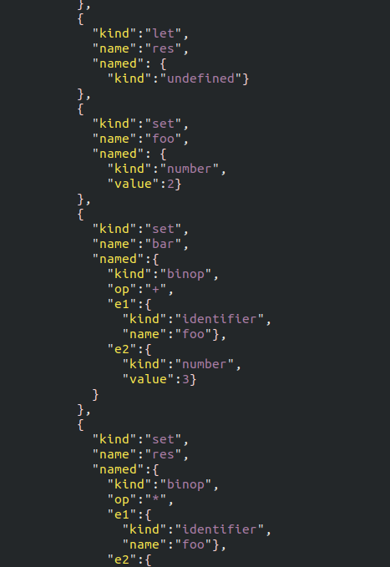
Example: Transformed
Python to Trace
(Just a small snippet)

Slide 19
Questions?

