Slide 1
Advancements in Forest Fire Prediction Integrating AI and Statistical Inference

Slide 2
Context
Forest fires pose significant threats to ecosystems, lives, and infrastructure.
The increasing frequency and severity of forest fires underscore the need for effective prediction methods.
Conventional prediction systems are costly and inaccurate, especially in developing countries.
Efficient and cost-effective prediction methods are essential for mitigating risks.

Slide 3

Complications
Predicting forest fires is complex due to various environmental factors.
Conventional systems rely heavily on extensive monitoring, leading to inaccuracies.
Inaccurate weather predictions contribute to errors in fire risk assessment.
Developing reliable prediction methods poses challenges, especially for developing countries.

Slide 4
Question
How can machine learning techniques enhance forest fire prediction accuracy?
What methodologies can address the challenges in developing reliable prediction systems?
How do reduced parameter sets and statistical inference techniques improve prediction efficiency?
What role do cost-effective methods play in mitigating forest fire risks, particularly in developing countries?

Slide 5
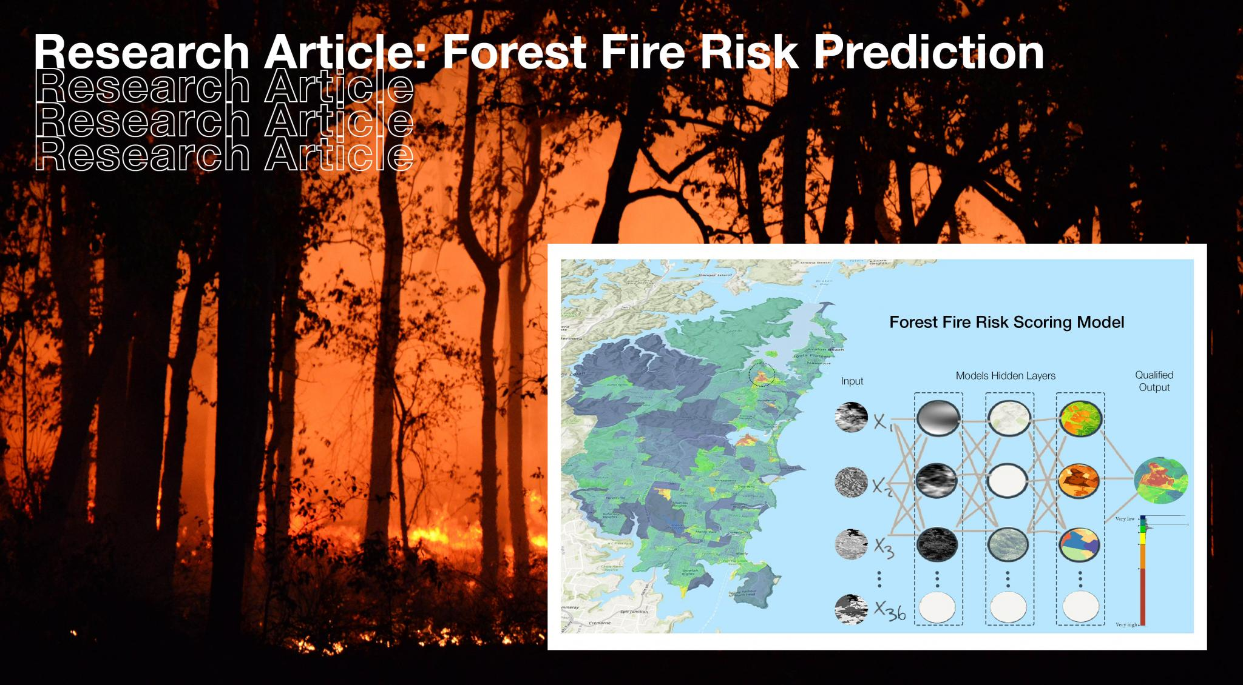
Hypothesis
H1: Machine learning techniques will significantly improve forest fire prediction accuracy compared to conventional methods.
H2: The integration of reduced parameter sets and statistical inference techniques will enhance the efficiency of forest fire prediction models.
H3: Cost-effective prediction methods will be developed, addressing the challenges faced by developing countries.
H4: Comprehensive methodologies will lead to the development of reliable prediction systems for forest fire management.

Slide 6
Thank You!!!

