Slide 1


CSCI 595 Comparison of SVM and Random Forests for Heart Disease Risk Prediction
Lakshmi Chandana Narra
Graduate Student
Department of Computer Science

Slide 2
CONTENT OUTLINE
Introduction
Background
Methodology
Results
Discussion
Conclusion
References

Slide 3
INTRODUCTION
Cardiovascular diseases pose a significant global health challenge, with their prevalence escalating due to shifting lifestyle patterns and societal influences.
Limited access to medical resources in certain regions emphasizes the urgency for timely detection and continuous monitoring of heart diseases.
Our research focuses on leveraging machine learning algorithms, specifically Support Vector Machines (SVM) and Random Forests (RF), to address the predictive challenges associated with heart disease risk assessment.
The question guiding our study is: "How do SVM and RF algorithms differ in accuracy, efficiency, and interpretability when predicting the risk of heart disease?"
We hypothesize that through a comparative analysis of SVM and RFs algorithms using real-world patient heart health data, we can analyze their respective strengths and limitations, thereby facilitating informed decision-making in cardiovascular health monitoring.

Slide 4
Data Set Description
Dataset Source : Kaggle Heart Disease Dataset (David Lapp, 1988)
Samples: 1025
Attributes: 14
Features:
Demographic (age, sex)
Medical history (chest pain type, resting blood pressure, serum cholesterol, etc.)
Electrocardiographic results
Exercise test results
Thalassemia status
Target Variable: Presence of heart disease (1 = yes, 0 = no)

Slide 5
SVM and RF Data Analysis for Heart Disease Prediction
Support Vector Machine (SVM)
A supervised machine learning approach used for classification and regression tasks
Finds the hyperplane in the input data set that best divides different classes
Optimizes the margin, or the distance between the hyperplane and the nearest data point from each class (support vectors)
Uses a small amount of memory and performs well in high-dimensional spaces
Suitable for datasets with a large number of features
Random Forest
An ensemble learning technique used for classification and regression tasks
Creates many decision trees during training
Each tree is trained using a subset of the training set
The ultimate prediction is determined by polling (for classification) or by averaging the predictions of all the trees (for regression)
High accuracy, scalability, and the capacity to handle big datasets with high dimensionality

Slide 6
Data Preparation and Cleaning for SVM and Random Forest
Dataset Loading and Data Type Definition
Categorize columns based on data types
Import dataset from CSV file into a Pandas DataFrame
Handling Missing Values
Check for missing values in the dataset
Analyze the dataset and find 0 missing values
No values needed to be replaced
Eliminating Duplicate Values
Detect and eliminate duplicate entries
Remove 723 duplicate entries from the dataset
Preserve the first occurrence of a duplicated row
Data Cleaning Outcomes
Improved data quality and readiness for model training
Enhanced consistency and accuracy of the dataset

Slide 7
Evaluation Metrics for Model Assessment
F1 Score
Harmonic mean of Precision and Recall
Better performance indicated by higher values (0-1)
Robust for skewed datasets
F1 Score Calculation
F1 = 2 × Precision × Recall / (Precision + Recall)
Accuracy
Percentage of correctly predicted instances
Calculated as: Accuracy = (Number of Correct Predictions / Total Number of Predictions) × 100
Precision
Proportion of true positive predictions among all positive predictions
Calculated as: Precision = True Positives / (True Positives + False Positives)
Recall
Proportion of true positive predictions among all actual positive instances
Calculated as: Recall = True Positives / (True Positives + False Negatives)
Confusion Matrix
Table describing the performance of a classification model
Contains four important metrics: TN, FP, FN, TP
Evaluation Metrics Importance
Comprehensive understanding of model performance
Accuracy, Precision, and Recall should be used together for better assessment

Slide 8
Training and Testing Models
Training Set (80%): Used to train the models and learn patterns in the data
Testing Set (20%): Used to evaluate the performance of the models on unseen data
Why 80-20 Split?: To ensure enough data for training and accurate assessment of model performance, while also preventing overfitting

Slide 9
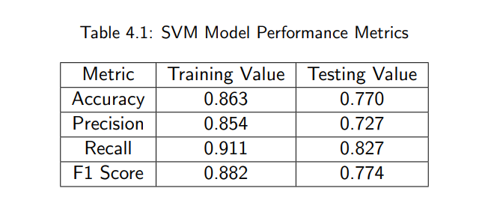
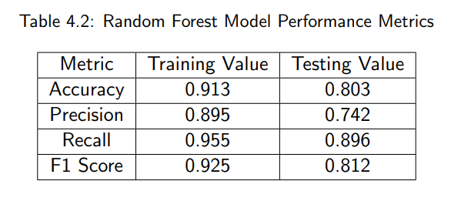
RESULTS SVM AND RF MODEL PERFORMANCE METRICS

Slide 10
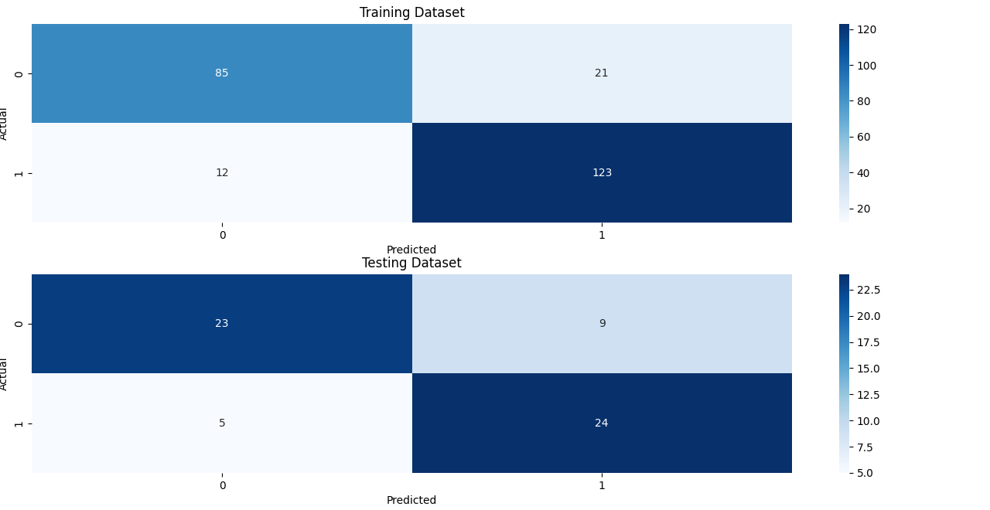
Support Vector Machine Confusion Matrix

Slide 11
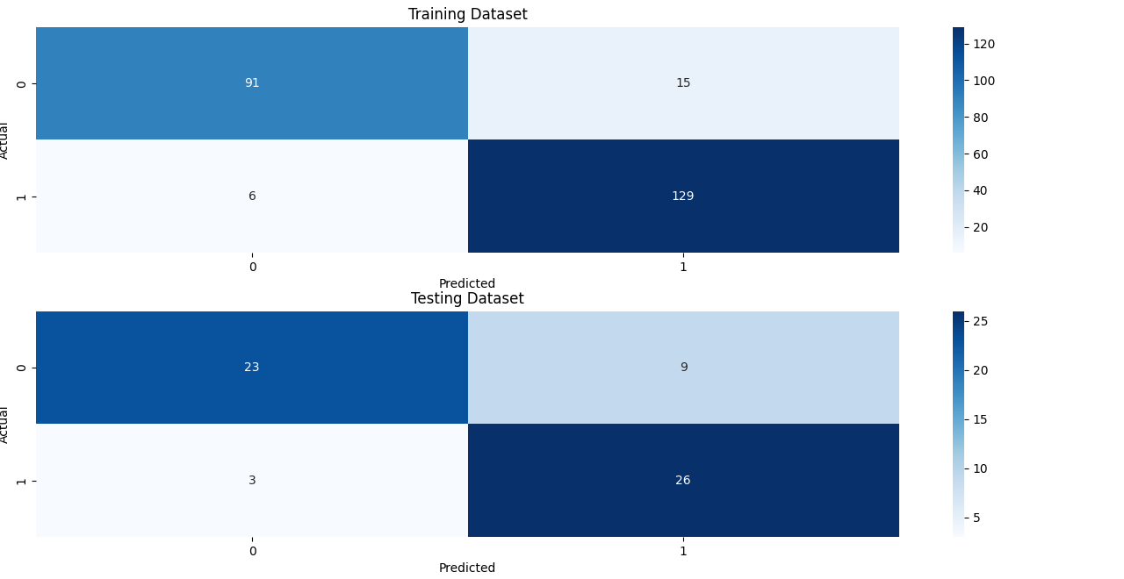
RANDOM FOREST CONFUSION MATRIX

Slide 12
Conclusion
The Random Forest model outperformed the SVM model in heart disease classification, achieving higher accuracy, precision, recall, and F1 score values for both training and testing datasets.
This suggests that the Random Forest model is more effective in capturing the complex relationships between the features in the heart disease dataset.
The potential for Random Forest models to improve the accuracy of heart disease diagnosis is significant, as it can lead to better patient outcomes.
However, there are some limitations to this study, including the use of a relatively small dataset, the impact of missing data or data imputation methods, and the fixed set of hyperparameters for the Random Forest model.
Future studies should consider using larger and more diverse datasets, comparing the performance of the Random Forest model to other machine learning models, and exploring the impact of missing data and data imputation methods on model performance.
Overall, this research contributes significantly to the heart disease classification field by showing the potential of machine learning models to enhance the accuracy of heart disease diagnosis.

Slide 13
Thank you

