Slide 1


Healthcare Predictive Analysis
Presented by Yashwanth Dasararaju

Slide 2




Research Work: Lung Disease Outbreak Prediction
Why this research is important?
Increasing num and changing patterns of respiratory disorders provide a serious threat to worldwide public health. With the time, the complexity and dynamics of these diseases change, making manual analysis more and more difficult. Advanced prediction models are essential for efficiently addressing respiratory infections, as demonstrated by recent events like the COVID-19 pandemic.
What we know and don’t know?
There are Many factors affect the diagnosis and treatment of respiratory illnesses. Especially in times of pandemics or outbreaks, traditional techniques are frequently ineffective to adequately capture the ever-changing nature of these infections. Furthermore, precise prediction and management techniques are made more difficult by the complex nature of respiratory disorders, which are impacted by environmental, genetic, and socioeconomic variables.
Our Experiment:
Considering the difficulties caused by respiratory illnesses, the purpose of our study is to look at the following question: How can respiratory disease patterns be better understood and predicted with greater accuracy with the use of predictive modeling?
Our Hypothesis:
Our hypothesis is that utilizing deep learning techniques and machine learning algorithms can greatly improve our capacity to assess and forecast changes in respiratory diseases. Through the use of extensive datasets with lung X-ray pictures labeled with different respiratory diseases, predictive models are trained, and we expect to achieve higher disease prediction accuracy and efficiency as compared to human processes.

Slide 3

Predictive Modeling Approach
1
Data Collection
A large variety of information from many sources is collected to have a thorough knowledge of the variables that lead to lung disease epidemics.
2
Data Processing
The dataset is split into training, validation, and testing parts to train the model efficiently and produce precise predictions. Data augmentation techniques are used to increase the diversity of the input data and prevent overfitting.
3
Model Training
Convolutional neural network models like VGG19, MobileNet, and ResNet are trained on the lung disease dataset. The models are optimized using the Adam optimizer to improve their performance and accuracy.

Slide 4
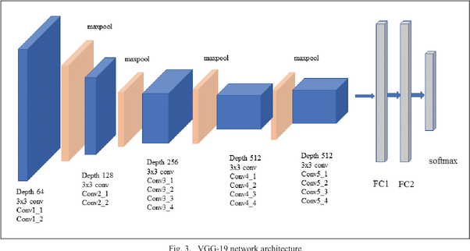
VGG19 Model for Lung Disease Prediction
VGG19 is a complex convolutional neural network architecture with 16 convolutional layers and 3 fully connected layers. Its depth allows it to represent intricate hierarchical features, improving its performance in image classification tasks.
Model Architecture
The VGG19 model is trained for 20 epochs on the lung disease dataset. The training process leverages the model's ability to extract relevant patterns from medical images to accurately classify different lung conditions.
Training Process
The VGG19 model achieves an accuracy of 0.7793 on the test dataset. The confusion matrix provides insights into the model's performance on each lung disease class, helping identify areas for further improvement.
Evaluation Metrics

Slide 5

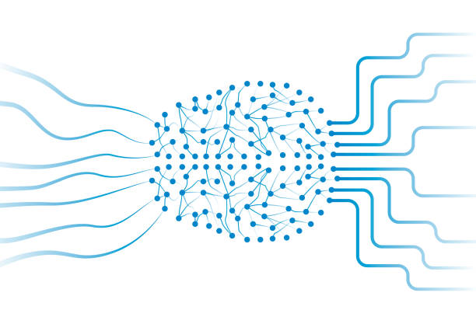
MobileNet for Efficient Lung Disease Prediction
Computational Efficiency
Balanced Accuracy and Model Size
MobileNet is designed to operate efficiently on embedded systems and mobile devices, making it well-suited for real-time lung disease prediction applications in healthcare settings.
MobileNet strikes a balance between model precision and size, allowing for accurate lung disease classification without excessive computational requirements.
Improved Prediction Accuracy
The MobileNet model achieves an accuracy of 0.8286 on the lung disease dataset, outperforming the VGG19 model and demonstrating its effectiveness in this healthcare predictive analytics task.

Slide 6
ResNet for Robust Lung Disease Prediction
Residual Learning
ResNet's unique architecture, which includes residual connections, helps overcome the vanishing gradient problem and enables the training of very deep neural networks for complex tasks like lung disease prediction.
Transfer Learning Capabilities
ResNet's deep layers and robust feature extraction make it well-suited for transfer learning, allowing the model to be fine-tuned on specific lung disease datasets for improved performance.
Adaptability to Medical Imaging
ResNet's ability to handle diverse imaging modalities, such as X-rays and CT scans, makes it a versatile choice for healthcare predictive analytics applications targeting various lung disease types.

Slide 7



Optimizing Model Performance with Adam Optimizer
Adaptive Learning Rate
Momentum-based Updates
Bias Correction
The Adam optimizer's adaptive learning rate technique continuously adjusts the learning rate for each parameter, improving the model's convergence and overall performance.
Adam's bias correction mechanism helps address the initialization bias, further enhancing the model's ability to converge to the optimal solution.
Adam's use of momentum-based updates helps the model navigate complex optimization landscapes, reducing the likelihood of getting stuck in local minima.

Slide 8
Evaluating Model Performance
Evaluation Metric
Description
Importance
Accuracy
The proportion of correct predictions out of the total predictions made.
Provides an overall measure of the model's performance, but can be misleading in imbalanced datasets.
F1-Score
The harmonic mean of precision and recall, providing a balanced measure of the model's performance.
Crucial for evaluating the model's ability to correctly identify different lung disease classes, especially in the presence of class imbalance.
Confusion Matrix
A table that shows the number of true positives, true negatives, false positives, and false negatives for each class.
Offers detailed insights into the model's performance on individual lung disease classes, guiding further model improvements.

Slide 9
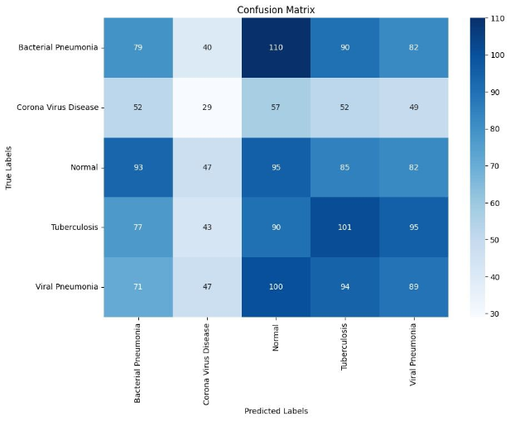
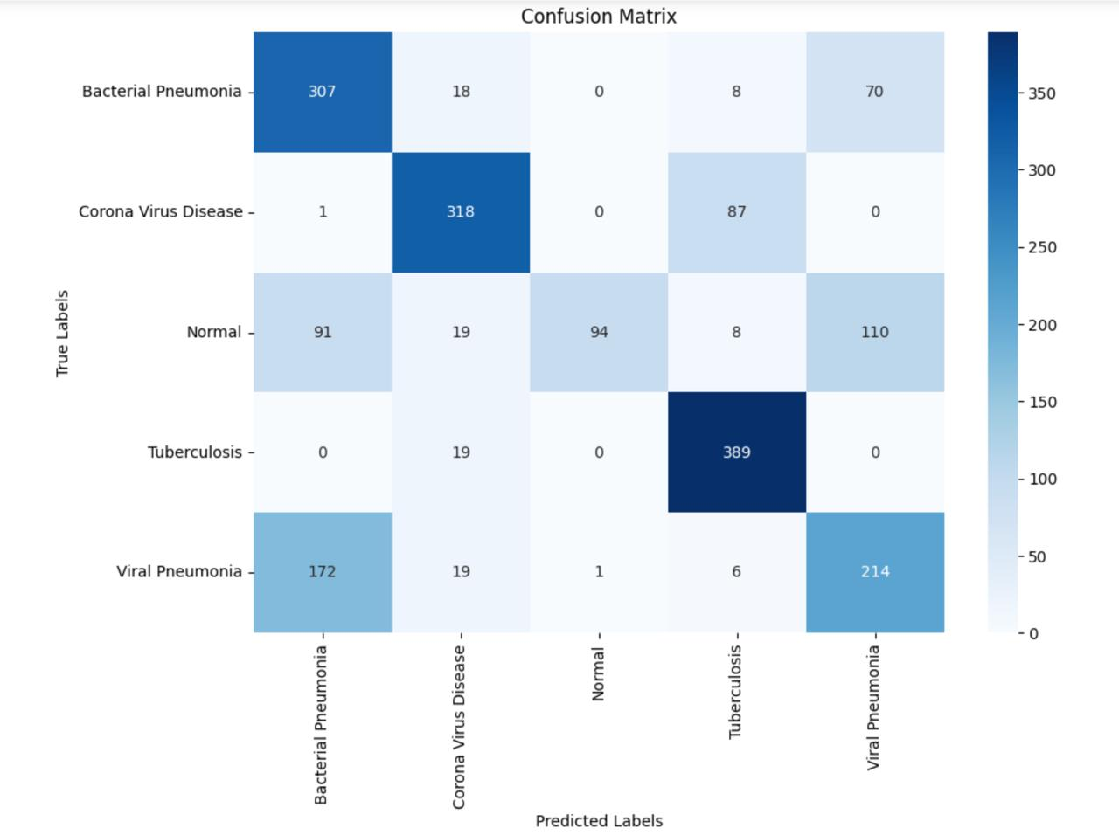
Results
VGG 19 Model
MobileNet Model

Slide 10



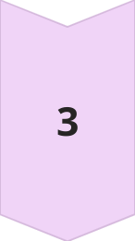
Challenges and Limitations
Data Availability
Obtaining a comprehensive and diverse dataset of lung disease images can be challenging, limiting the model's ability to generalize to real-world scenarios.
Computational Resources
Training complex deep learning models like VGG19 and ResNet requires significant computational power, which may not be readily available in all healthcare settings.
Model Interpretability
The black-box nature of deep learning models can make it difficult to understand the underlying reasons for their predictions, hindering their acceptance in clinical decision-making.

Slide 11
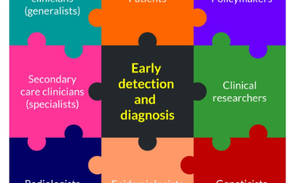

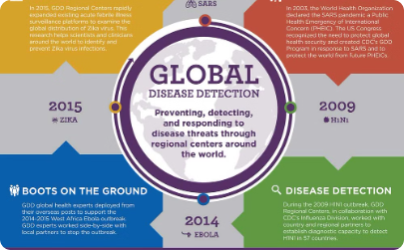
Potential Impact and Future Directions
Early Disease Detection
Personalized Treatment
Global Disease Management
Accurate and efficient lung disease prediction models can enable early detection and intervention, leading to improved patient outcomes and reduced healthcare costs.
By identifying specific lung disease patterns, predictive analytics can support the development of personalized treatment plans, tailored to the individual patient's needs.
Integrating predictive models into public health systems can enhance the ability to monitor, predict, and respond to lung disease outbreaks on a global scale, improving overall healthcare outcomes.

Slide 12
Conclusion
This research demonstrates the potential of advanced predictive modeling techniques, such as deep learning, in the field of lung disease detection and outbreak prediction
By leveraging powerful models like VGG19, MobileNet, and ResNet, combined with optimization techniques like the Adam optimizer, the study has shown promising results in accurately identifying different lung conditions based on X-ray images
By analysing the power of predictive modeling, the healthcare industry can take significant strides towards improving patient outcomes and enhancing public health on a global scale

Slide 13

Thank you

