Slide 1
Skja: Adversarial Logic on Steroids
Sai Lalith Kumar Aka
University of Colorado Boulder
Final Project, CSCI – 7135
ECCE 1B47

Slide 2
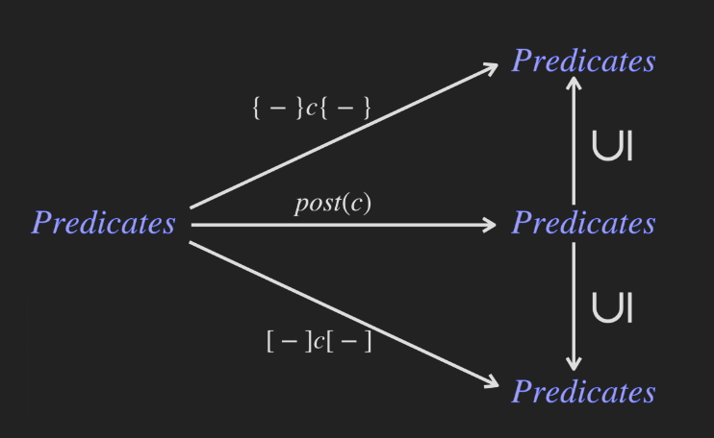
Incorrectness Logic [1][2]
Very interesting paradigm of under-approximate triples

Slide 3
Non-Trivial Triples
<T> x := y; z := x <z = y> -- Not Valid
As final states satisfying x not equal to y are not reachable
<T> x := y; z := x <z = y ^ x = y> -- Valid

Slide 4
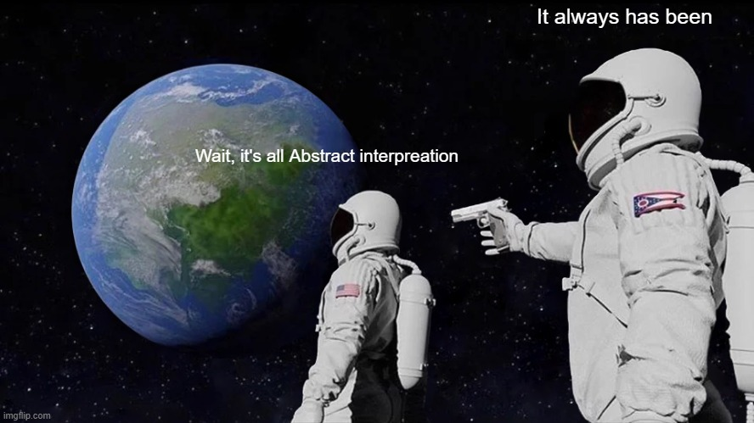

Meme [3]

Slide 5
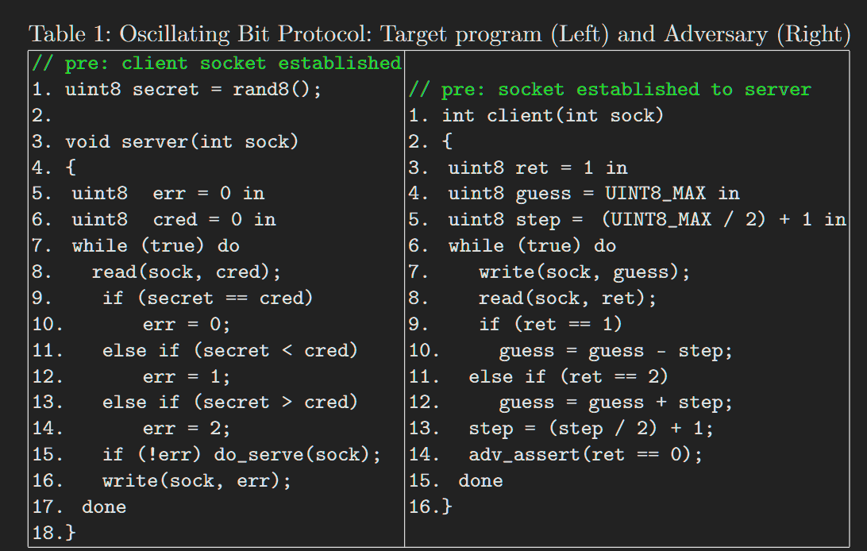
Adversarial Logic
A program and adversary
Extends Incorrectness to channels which leads to composition of attacker and program

Slide 6
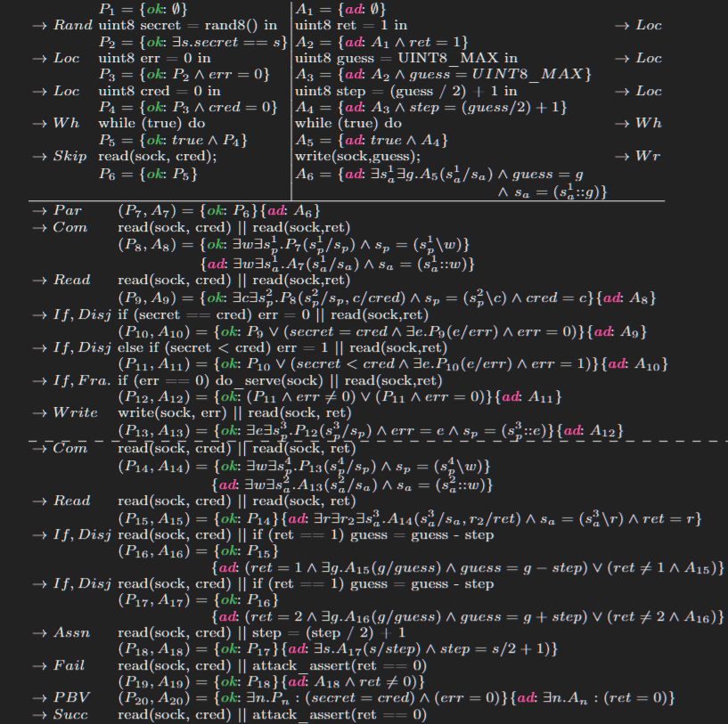
Attack trace

Slide 7

Limitations
You can compose multiple programs in AL itself as pointed by Kirby
The "Monolithic State" Problem (You have to model separation of concern)
Replication and Asynchrony (!P)
Topology is fixed at start, spi-calc gives us more flexibility to model changes

Slide 8
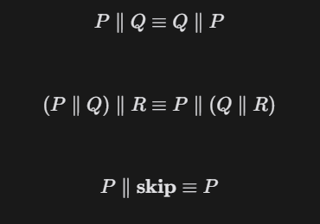
Composition as a Monoid (||)

Slide 9


New Goal State

Slide 10
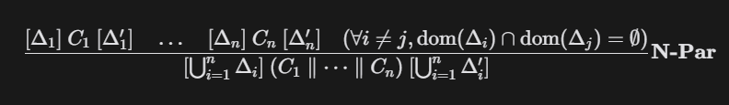


New N-Par rule

Slide 11
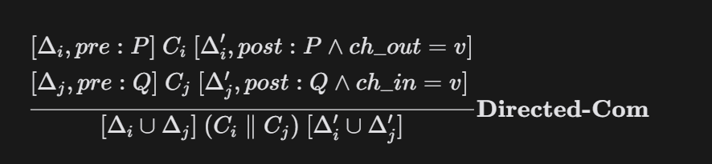
Directed Com Rule (The MitM Enabler)

Slide 12
Proof sketches will be provided for
Soundness for the new rules
Logic is robust under structural congruence
"Adversarial Isolation" Lemma –cannot differentiate if attacker is acting as intercept

Slide 13
Future work after the current scope is achieved
Handling Encrypted states – Dolev Yao adversary
Automated Protocol Synthesis
Quantitative Adversarial Logic for Availability – [er: crash] or [er: exhausted]

Slide 14

Thank you and questions

Slide 15
References
[1] O'Hearn, Peter W. "Incorrectness logic." Proceedings of the ACM on Programming Languages 4.POPL (2019): 1-32.
[2] De Vries, Edsko, and Vasileios Koutavas. "Reverse hoare logic." International Conference on Software Engineering and Formal Methods. Berlin, Heidelberg: Springer Berlin Heidelberg, 2011.
[3] Cousot, Patrick. "Calculational design of [in] correctness transformational program logics by abstract interpretation." Proceedings of the ACM on Programming Languages 8.POPL (2024): 175-208.

