Slide 1
Certifying Differential Invariants in Backpropagation of Neural Networks using Abstract Duals
Chandra Kanth Nagesh
University of Colorado Boulder
CSCI 7135 – Principles and Practice of Program Analysis
12-09-2025

Slide 2
[Catch]

Slide 3


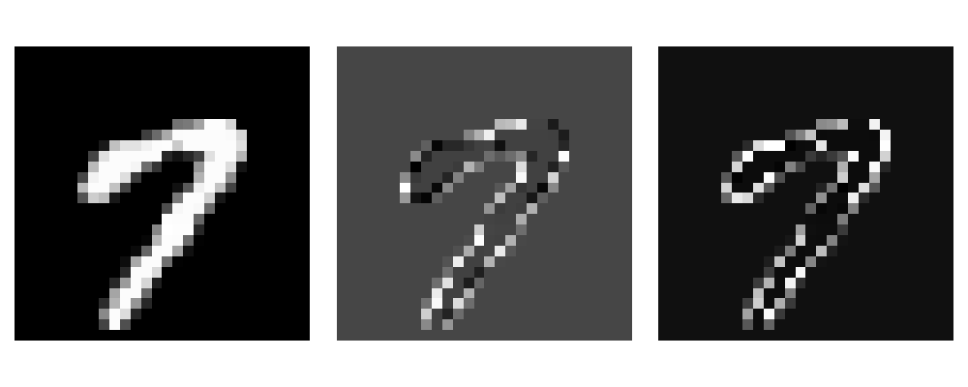

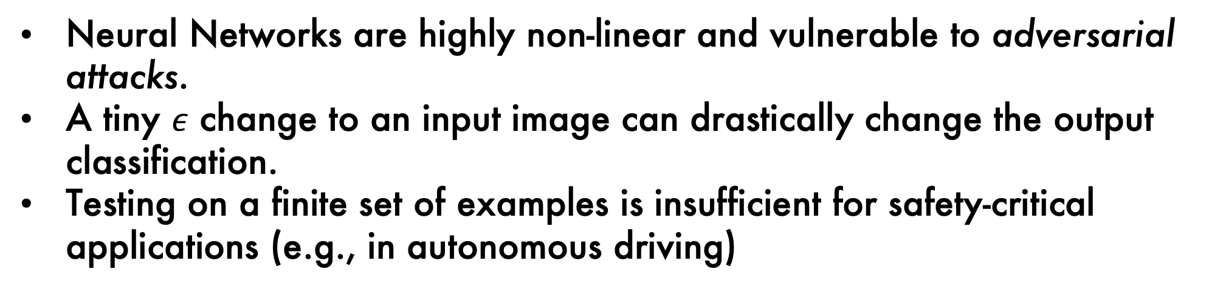

[What is the problem?]
Neural Networks are highly non-linear and vulnerable to adversarial attacks.
A tiny $ε$ change to an input image can drastically change the output classification.
Testing on a finite set of examples is insufficient for safety-critical applications (e.g., in autonomous driving)
Original Image
Original Image
+ $ε=0.25$
Original Image
+ $ε=0.1$

Slide 4
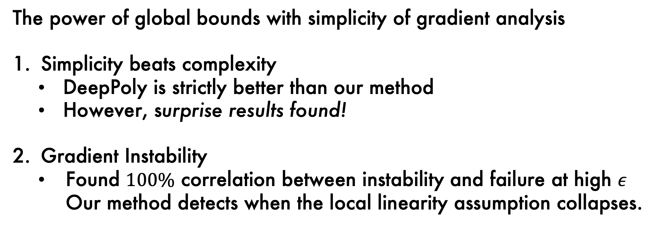
[Why is it interesting?]
The power of global bounds with simplicity of gradient analysis
Simplicity beats complexity
      DeepPoly is strictly better than our method
      However, surprise results found!
Gradient Instability
  Found $100\%$ correlation between instability and failure at high $ε$ Our method detects when the local linearity assumption collapses.

Slide 5
[Why is it hard?]

Slide 6
[What is the contribution?]

Slide 7
Contributions

Slide 8
[Contribution 1]

Slide 9
[Contribution 2]

Slide 10
Evaluation

Slide 11
Conclusion

