Slide 1
Towards Reasoning About Adversarial Protocol Interaction
Kirby Linvill
December 9th, 2025
Notes:
10 minute presentation + 1 minute for questions

Slide 2
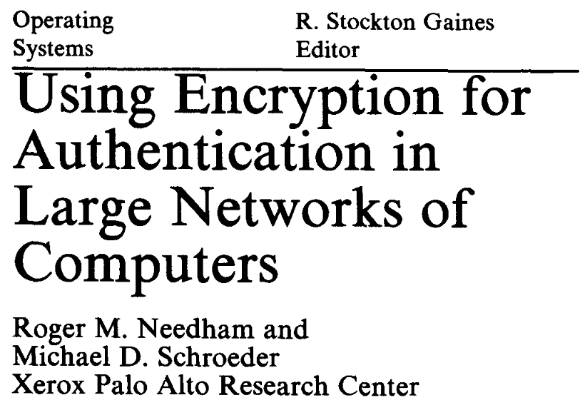
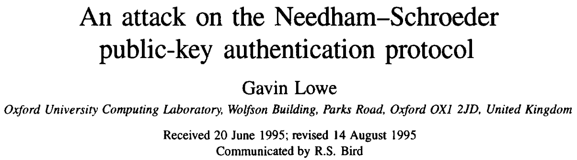
Protocols that provide security properties are hard to design correctly
1978
1995

Slide 3
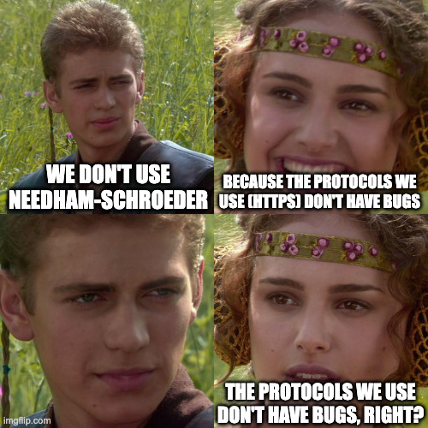

Protocols undergo expert review, but...
SSL Stripping
POODLE
BEAST
Lucky 13
TIME
CRIME
BREACH
DROWN
Triple Handshake
SKIP
Heartbleed
FREAK
STARTTLS
LogJam
ALPACA
* No major attacks yet on TLS 1.3

Slide 4
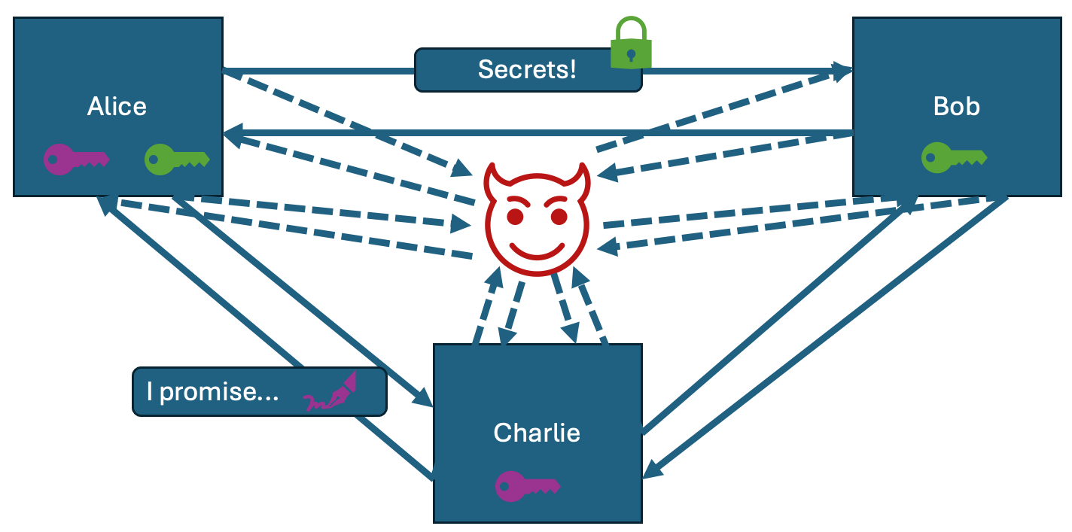
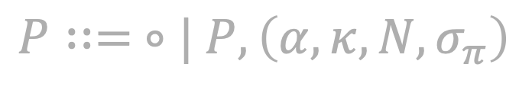
Roadmap
$$P∷= ∘| P,\left(α,κ,N,σ_{π}\right)$$
Modeling Adversaries & Protocols
Collected Properties

Slide 5




Key protocol characteristics to model
Alice
Bob
Secrets!
Need to model:
Participants
Network channels
Cryptographic primitives
Encryption
Signatures
etc.
I promise...
Charlie

Slide 6
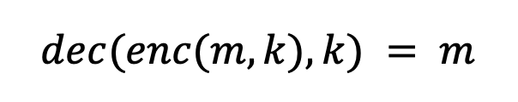

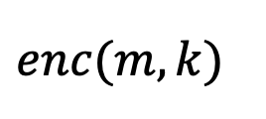
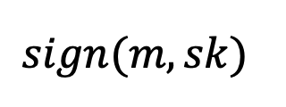
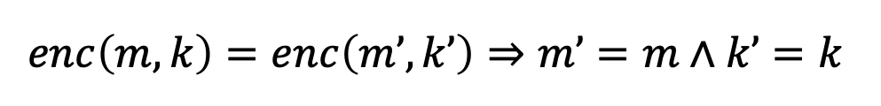
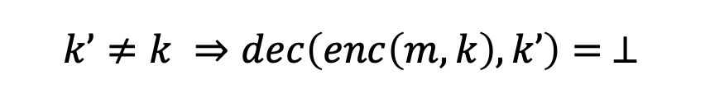
Modeling cryptographic operations (UF + Axioms)
Uninterpreted function
$$enc(m, k)$$
Injective
$$enc\left(m,k\right)=enc\left(m’,k’\right)⇒m’=m∧k’=k$$
Symmetric Encryption:
$$dec(enc(m, k), k) = m$$
Decryption requires
same key
$$k’≠k ⇒dec\left(enc\left(m,k\right),k’\right)= ⊥$$
$$sign(m, sk)$$
Digital Signatures:
$$...$$

Slide 7
Key adversary characteristics to model
Alice
Bob
Secrets!
Need to model:
Network control (MITM)
Attacker computation
Charlie
I promise...

Slide 8
Modeling adversaries
Knowledge
“agree”
“Hi Bob!”
“Hi Bob!”
“sucks”
“sucks”
...
Alice
Bob
Hi Bob!
Bob sucks
Charlie
Attacker can:
Learn sent messages
Derive new terms
Deliver known messages
*Aside: this kind of adversary is called a Symbolic Adversary (or Dolev-Yao Adversary)

Slide 9
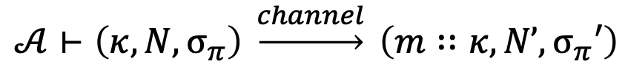
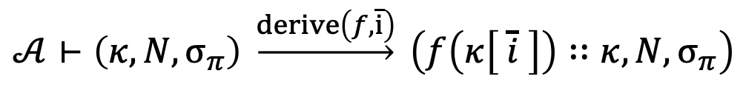
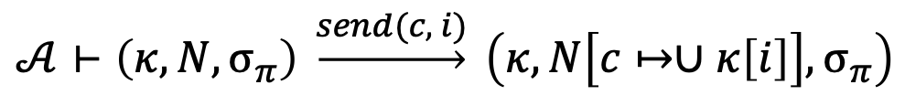
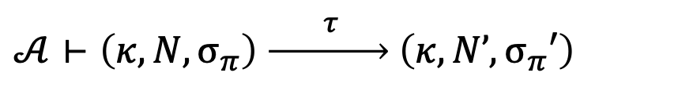
Putting it all together: adversarial reactive protocols
System state = Knowledge ($κ$) $×$Incoming messages ($N$) $×$Protocol state $(σ_{π})$
Concrete Semantics:
Adversary (term constructors/destructors)
Protocol internal transitions:
$$𝒜⊢\left(κ, N,σ_{π}\right) \underset{→}{ τ } \left(κ, N’,σ_{π}′\right)$$
Protocol observable transitions:
$$𝒜⊢\left(κ, N,σ_{π}\right) \underset{→}{channel} \left(m∷κ, N’,σ_{π}′\right)$$
Adversary send message:
$$𝒜⊢\left(κ, N,σ_{π}\right) \underset{→}{send(c, i)} \left(κ, N\left[c↦∪κ\left[i\right]\right],σ_{π}\right)$$
Adversary derive new term:
$$𝒜⊢\left(κ, N,σ_{π}\right) \underset{→}{derive\left(f,\overline{i}\right)} \left(f\left(κ\left[ \overline{i} \right]\right)∷κ, N,σ_{π}\right)$$

Slide 10
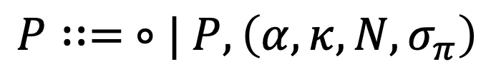
Roadmap
$$P∷= ∘| P,\left(α,κ,N,σ_{π}\right)$$
Modeling Adversaries & Protocols
Collected Properties

Slide 11




Properties we would like to verify
Knowledge ($κ$)
Secrecy
Observational equivalence
$message∉κ$
$$∥$$
$$∥$$
Protocol 1
Protocol 2
Observations X
Observations Y
Observations X
Observations Y

Slide 12

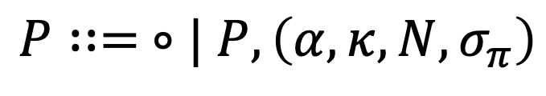
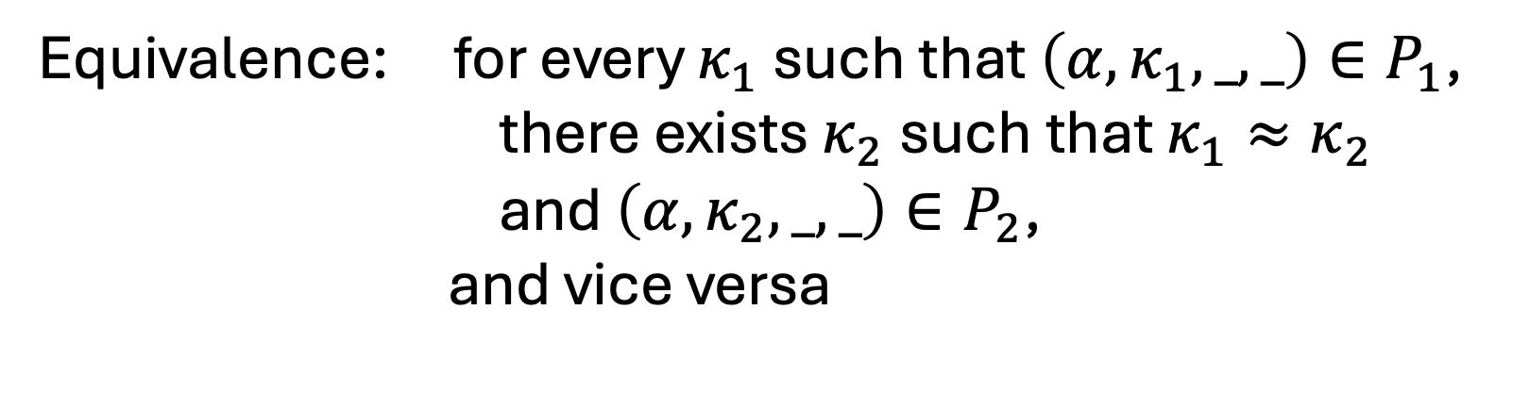
Collected properties
Observable effects
& adversary actions
Adversary Knowledge
Adversarial interaction properties
$$P∷= ∘| P,\left(α,κ,N,σ_{π}\right)$$
Secrecy: if $\left(_,κ,_,_\right)∈P$, then $message∉κ$
Equivalence: for every $κ_{1}$ such that $\left(α,κ_{1},_,_\right)∈P_{1}$,
there exists $κ_{2}$such that $κ_{1}≈κ_{2}$
and $\left(α,κ_{2},_,_\right)∈P_{2}$,
and vice versa
Attacker cannot distinguish what it’s learned

Slide 13


Verification challenges
Attacker’s knowledge is unbounded
Learning new terms leads to deriving even more terms, so coarse abstractions quickly reach top
Manual proof burden is significant (kind of bisimulation relation)
$$enc\left(enc\left(enc\left(…\right),k\right),k\right)$$

