Slide 1
Mitigating Context Pollution in Neurosymbolic Widening via Slicing and Caching

Slide 2
AbsInt-AI Overview
Abstract Interpreter
More Precise Static Analysis
Will this grow infinitely?
Yes, abstract it.
LM Guide

Slide 3

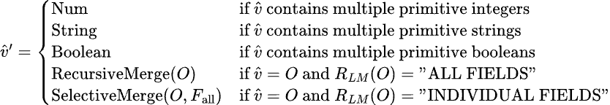
AbsInt-AI Overview: Abstract Semantics & Soundness
Neural-Symbolic Widening for Heap Abstractions
Summarize

Slide 4
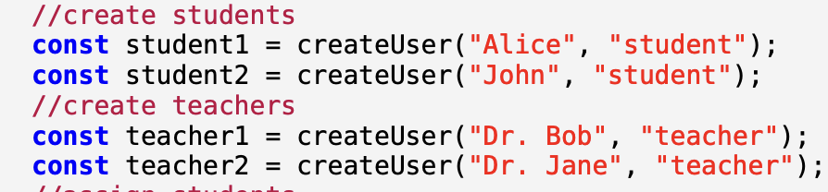
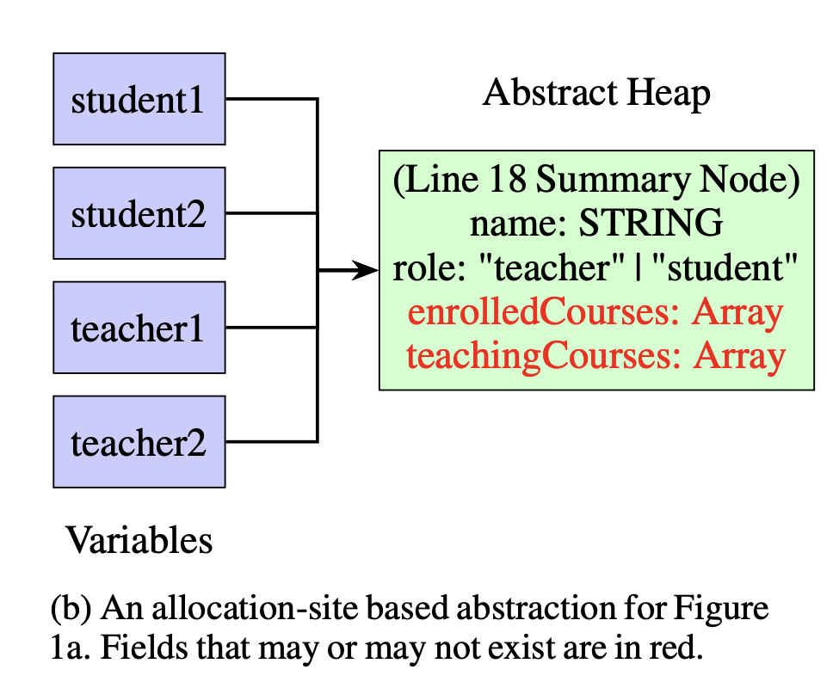
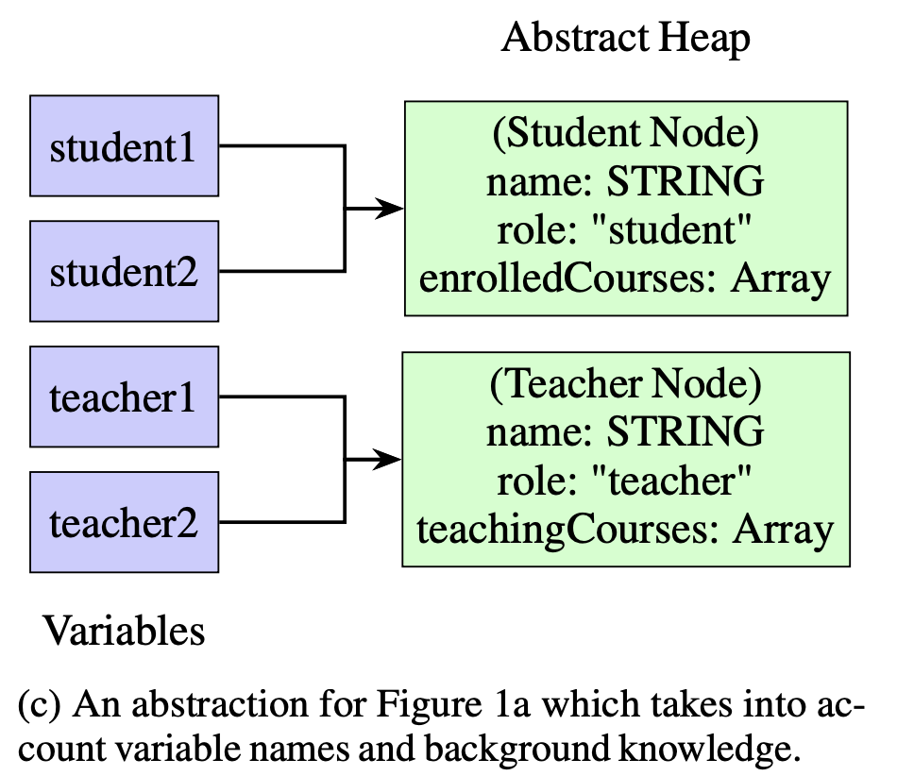
AbsInt-AI Overview: Abstract Semantics Pt.2
Allocation site abstraction
LM-guided abstraction

Slide 5
Why Solve?
Soundness is Promised… But Is Precision Reliable?
LM Error Type 1: LM Decides to abstract when it shouldn’t
LM Error Type 2: LM Decides not to abstract when it should

Slide 6
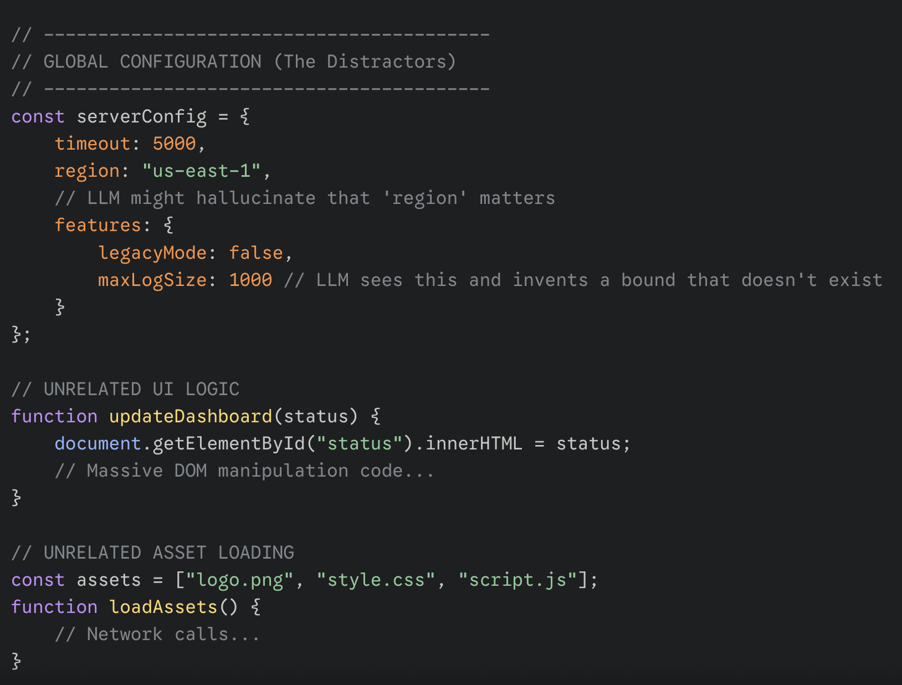
THE PROBLEM: Query Explosion/Hallucination
Theory: Irrelevant Context -> Imprecise Abstraction

Slide 7
THE PROBLEM: Analysis Time

Slide 8
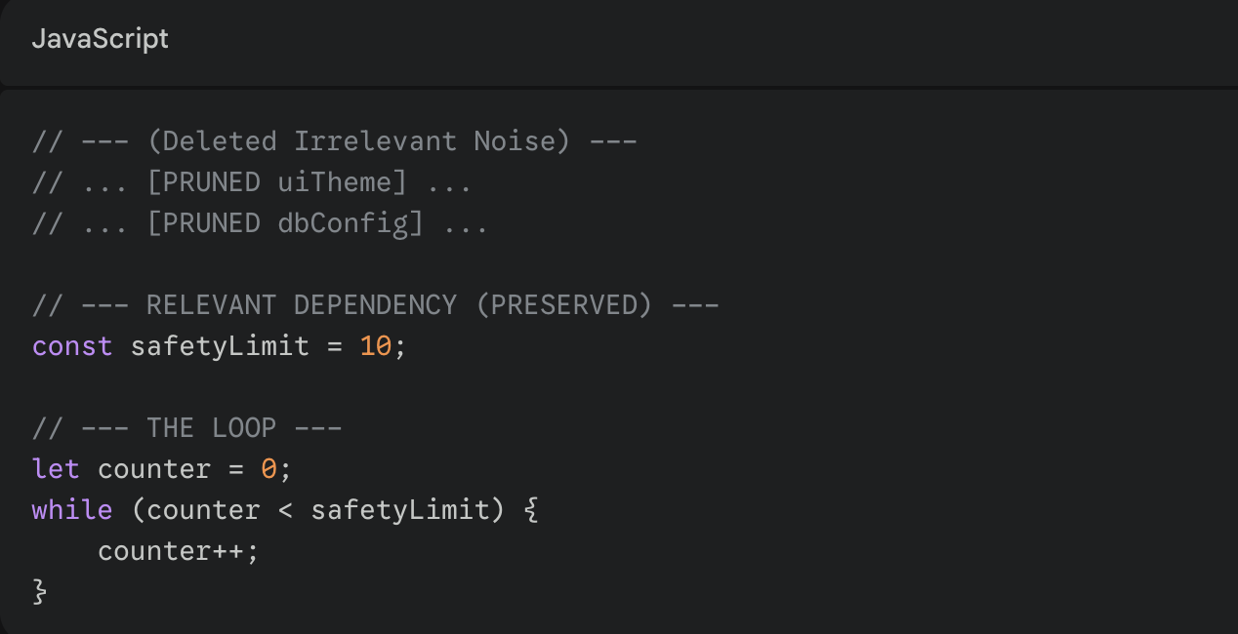
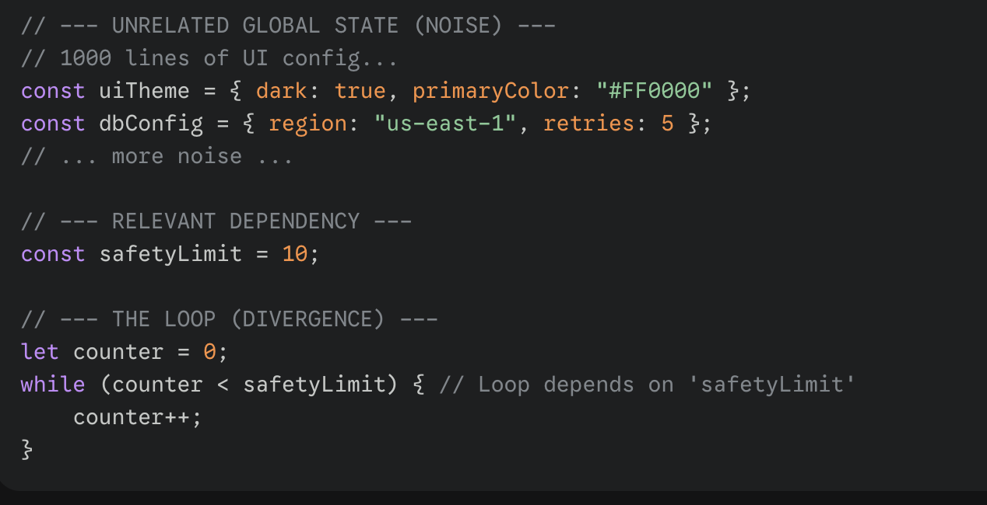
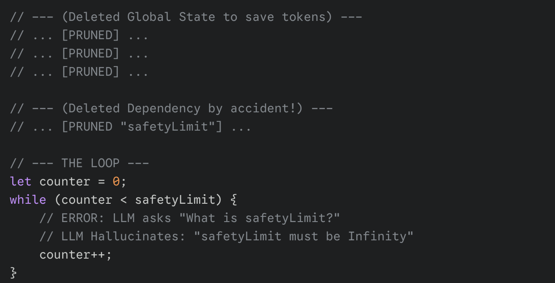
Why is it Challenging?
CONTEXT
=
CONSTRAINTS
Sustaining Semantic Properties of Code
For the LLM
Discarding Irrelevant Code that might confuse LM

Slide 9
Contribution 1: Notation/Abstract Semantics
How can we make
?

Slide 10

Contribution 1: What is important? What is not?
How can we exclude
Irrelevant Code (Does not flow into )
Irrelevant State
While still keeping
Semantic understanding code
Necessary Control Flow Properties
Relevant State

Slide 11


Contribution 1: Backwards Slicing Algorithm (Mark Wieser 1980)
Finding the Dependency Closure
Data Dependency
Control Dependency

Slide 12

Contribution 1: Semantic Slicing Algorithm Pt.2
Option 1: Iterate Backwards until fixed point →O(N * passes)
Option 2: Build a Program Dependence Graph → O(Nodes * Edges)

Slide 13
Contribution 2: Query Caching & Parallelization with Program Dependence Graph
Analysis speed is bottlenecked by the number of LM calls we run
Change Impact Analysis:
Cache a hashed PGD with LM responses for each query after first run
On second run, if specific dependencies haven’t changed return older response
Update cache if needed
Parallelization via PDG:
Identify sub-graphs that do not rely on each other
Run independent sections concurrently

Slide 14
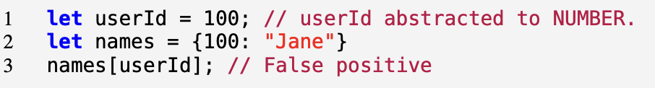
Evaluation (Plan).
Allocation-Site AI vs. LM-Guided AbsInt vs. Sliced LM-Guided Absint
Looking for:
False positive rate (Precision)
  Checking whether false positives are due to aggressive widening.
Runtime & Performance
  perf
Convergence & Scalability
  Define specific non-convergence thresholds
  Observe analysis behaviour during loop execution

Slide 15
Conclusion
Semantic Understanding of Code
Soundness Guarantees
LLM Oracle
Static Analysis

