Slide 1

Advanced Python
Marehan Waly

Slide 2
Topics
What is a twitter bot?
What can twitter bots do (that is beneficial)?
How can I make my own twitter bot?

Slide 3
What is a twitter bot?
A Twitter bot is a type of bot software that controls a Twitter account via the Twitter API.
Twitter bots can perform actions independently such as:
Tweeting
Retweeting
Liking
Following
Unfollowing

Slide 4
What can a twitter bot do?
Twitter bots can do more than spam!
Some helpful twitter bots:
Twisst ISS alerts bot: Sends a direct message whenever the international space station (ISS) will be visible at your location.
Earthquake Robot: Tweets about any earthquake greater than 5.0 on the Richter Scale as it happens.
Accidental Haiku: Retweet your tweets that are accidental Haiku’s
Dear Assistant: Has answers to a wide range of questions with the help of Wolfram Alpha
Pixel Sorter: Takes any image you tweet at it and resorts the rows of pixels according to one of a few predetermined rules.

Slide 5
Things you will need
A Twitter account
An IDE

Slide 6
1) Create an application
Create a twitter account or use your own to create a new Twitter application
(Make sure to add your phone number to your Twitter account)
Once created, click Modify App Permissions and change the access level to Read and Write OR Read, Write and Access Direct Messages.
Next switch to the Keys and Access Tokens tab and click the Create My Access Token button. Twitter will generate the Consumer Keys and Access tokens needed in the next step.

Slide 7
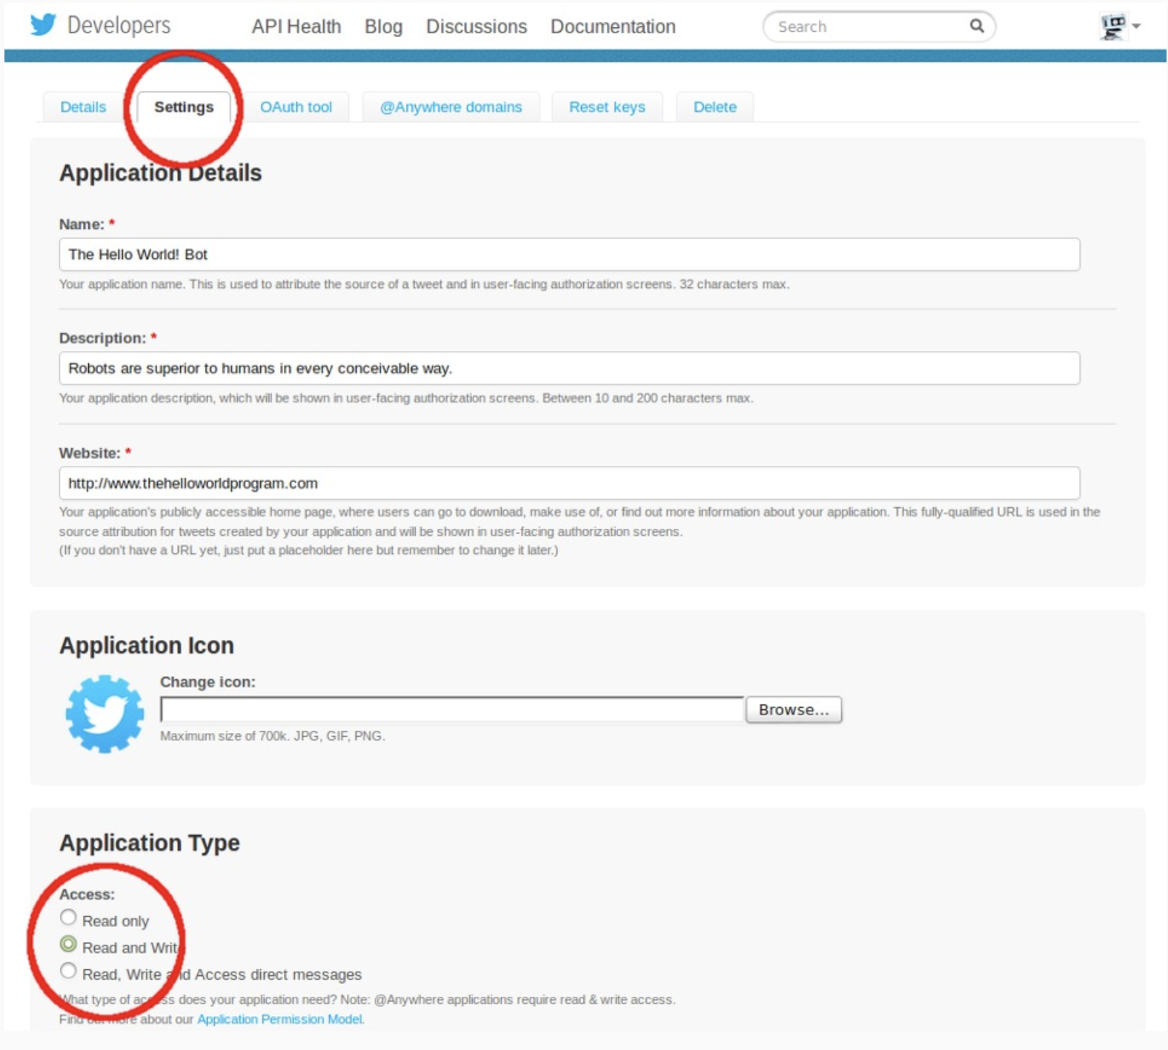

Slide 8
1) Install tweepy
Tweepy is the library used to access the Twitter API with Python.
From the command line, run:

Slide 9
Save as helloworld.py
Open your IDE and create a new file. Save it as helloworld.py
Create a new text file in the same directory as helloworld.py. Save it as helloworld.txt.

Slide 10
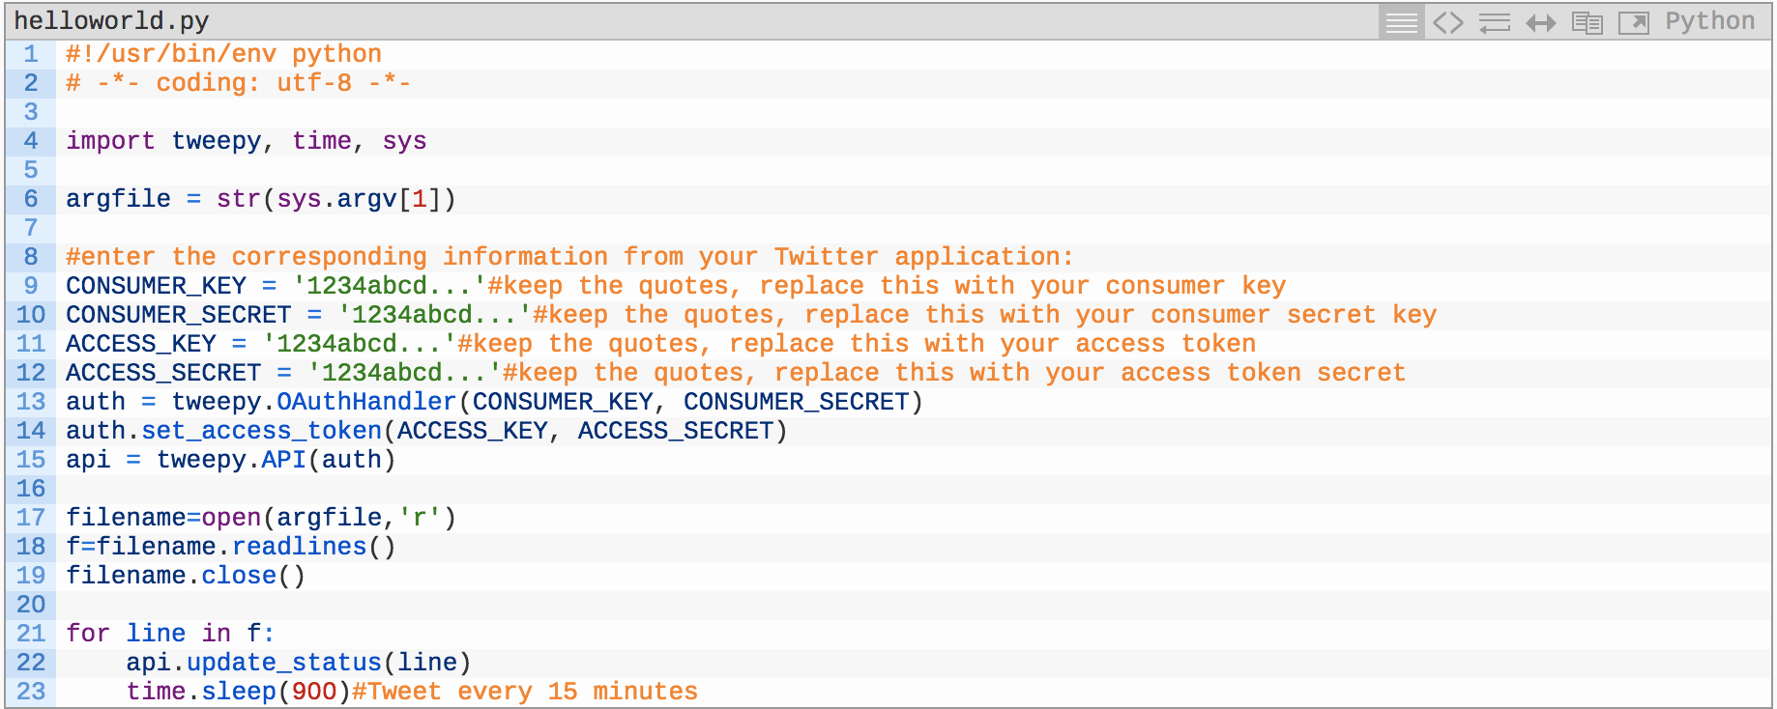
Enter your Twitter application keys and tokens accordingly

Slide 11
1 2 3 4 5 6 7 8 9 10 11 12 13 14 15 16 17 18 19 20 21 22 23 | #!/usr/bin/env python # -*- coding: utf-8 -*- import tweepy, time, sys argfile = str(sys.argv[1]) #enter the corresponding information from your Twitter application: CONSUMER_KEY = '1234abcd...'#keep the quotes, replace this with your consumer key CONSUMER_SECRET = '1234abcd...'#keep the quotes, replace this with your consumer secret key ACCESS_KEY = '1234abcd...'#keep the quotes, replace this with your access token ACCESS_SECRET = '1234abcd...'#keep the quotes, replace this with your access token secret auth = tweepy.OAuthHandler(CONSUMER_KEY, CONSUMER_SECRET) auth.set_access_token(ACCESS_KEY, ACCESS_SECRET) api = tweepy.API(auth) filename=open(argfile,'r') f=filename.readlines() filename.close() for line in f: api.update_status(line) time.sleep(900) #Tweet every 15 minutes

Slide 12
There are thousands of applications that you can tailor to you and your interests!

