Slide 1
DART Data Model Proposed Model Components for Review
July 8, 2014

Slide 2
Proposed DART Data Models for:
DARTData Input –all data must come in with these data elements
Program/Project Data Models
Clinical Data
DICOM Data
Comments & Questions are based on the current data model.
Simpler model proposed for consideration
DART User/Person
MINT
Questions are written in the slide or in the “Notes” section under the slide; Matt I. had some initial comments noted – need others to comment/review
Visio and PDF versions are available on the Sharepoint site “Data Flow and Architecture Workstream”

Slide 3
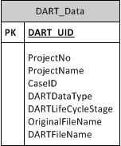
Proposed DART Data Model
Example
ProjectNo: 6654, ProjectName: NLST, CaseID: 5708, DARTDataType: Radiology, DARTLifeCycleStage: TBD.
The purpose of this data table is to outline the minimum data elements that each image study needs to come in with. These are captured in the data file itself e.g. DICOM tags or with associated XML or other type of form e.g. if a NIFTI file comes in, what are the additional data elements that it needs to come with to be tagged?
Questions
1. Proposed potential DARTLifeCycleStage elements:
New
Submitted
Resubmitted
Pending
PassedQC
Published
2. How do we tag or name the files so that it carries a universal/GUID:
MI: MD5 Hash based on data elements, like Study+Case+FileName. (Does the file contain all images for Study)
3. Are the DART DataTypes Permissible Values List sufficient?
DARTDataTypes:
ImageType_DICOM
ImageType_MINT
ImageType_NIFTI
ImageType_XML
ImageType_JPEG
ImageType_PNG
ImageType_DigPath
ClinicalForm_XML
ClinicalForm-Text
Biospecimen
Genomic
MEG
Matlab_Script
Matlab_DataSet
R_Script
R_DataSet
SAS_Script
SAS_DataSet

Slide 4
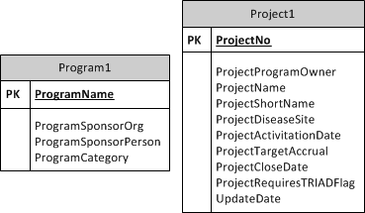
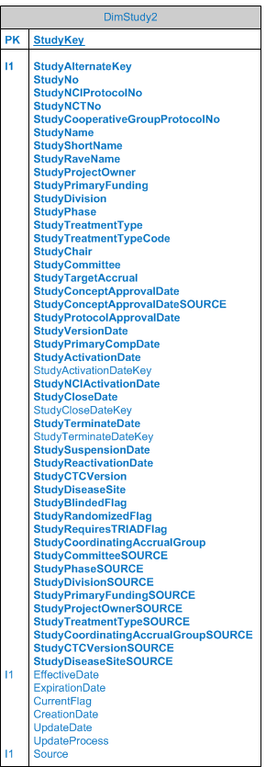
Proposed Program Project Data Model
Example
ProgramCategory: NCI Trials, ProgramName: ECOG-ACRIN, ProgramSponsorOrg: NCI
ProjectNo: 6654, ProjectName: NLST, ProjectProgramOwner: ECOG-ACRIN
Questions
1. How do we reconcile the Project data elements with the ECOG-ACRIN Study data elements in the common classes? MI: We can just place the 8 fields from Program and Project and new attributes to the Common Classes
2. Are there any other project attributes we should add?
3. Where do we put the audit data elements? Do we need to track these elements e.g. CreationDate, UpdateDate MI: Are we providing study level auditing from this system, are end users going to use that data, does it hurt to keep the data around?
4. How do we tie the fact that ProjectProgramOwner should be the same as ProgramName? MI: Foreign Key, replication of data. This means make a single table of this information, and repeat Program information for each line in Project Table.
ProjectNo 6654, NLST,ECOG-ACRIN, ProgramCategory: NCI Trials ProgramSponsorOrg: NCI
ProjectNo 8787, NewProject, NOT-ACRIN, ProgramCategory: NIH, ProgramSponsorOrg:NIH

Slide 5
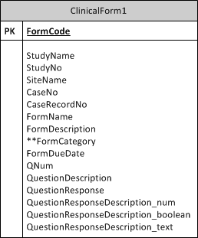
Proposed Clinical Data Model
Questions
1. FormDueDate came from CTDW – should this be FormSubmittedDate? Need to verify. Or do we track FormDueDate and FormSubmittedDate? MI: If we have both values for any Case or data set, we should track both.
2. It is not clear what the CaseRecordNo means?
3. Global question – StudyName should be changed to ProjectName? MI: The ETL process/mapping process could perform these types of fields name changes.
4. Suggest change – ‘QuestionResponse’ to ‘QuestionResponseValue”
5. FormCategory – we used this to classify form as demographic, radiology, pathology, etc. in early Clinical Form Search Tab. Do we need to tag forms like this moving forward?
6. Is Elasticsearch ‘_index’ e.g. ‘eadw’ and Elasticsearch ‘_type’ e.g. ‘record’ needed in the model or are these just Elasticsearch ingested values. MI: These are generated values from Elasticsearch, equivalent to Database name, and database table.
7. Are we missing any other key attributes to describe Clinical Forms e.g. Connectome MI: This table covers all the fields from Connectome data set.
** Denotes attribute that is not currently in Elasticsearch

Slide 6
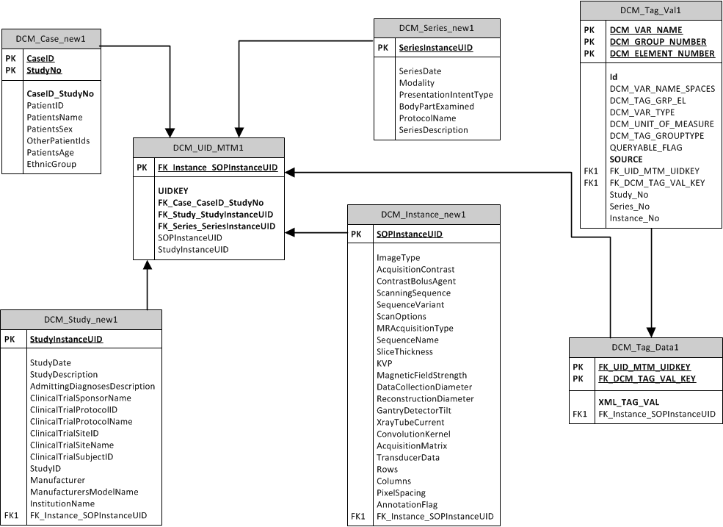
Proposed Imaging DICOM Model
Original one in use in DART shown – Propose removing X area - Details in text below in “NOTES” ection – See Orange Box for new terms.
Notes:
Questions
ACR BAH Team identified top 50 DICOM tags that may be useful to directly query on, and created an ACR assignment to study series instance across segments (see specific tablse). All the other elements, including the top 60, could be accessed through DCM_Tag_Val1. Note: this was applied to only one instance from one series at a time (e.g. image #5 of a series). Do we keep the top 60 or do we just use DCM_Tag_Val1 table with case information, etc.
MI: Store the data without the top 50 tags, allow ES to perform query function, and just use the DW as master store. Since we are moving down the DART as master Record, post- SQL DB, we can just dump all the DICOM records within a row- DCM_Tag_Val1. Also this Star is becoming a snowflake(more de-normalized) so removing the top 50 idea and just going with the Tag_val table should remove that one level.
2. How would we create a MINT/MICA version of this data model? We would receive one large file with all the unique tags at the study, series, instance levels.
MI: The MINT version should have zero impact on the data model. It holds all the needed information more compactly, but all the same data is there. I believe its one file with all study, series, and instance’s metadata.
MI: By placing the Study, Series, and Instance No here, query time could be reduced, if the query does not need series details, but can separate it by Series No if needed.
OR if the FK_UID_MTM_UIDKEY – Is a hash of Study+Series+Instance – this data is present with the Key itself, saving joins as well.

Slide 7
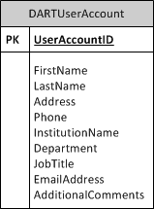
Proposed DART User Model
1. What else should be included?

Slide 8
Proposed MINT Model
TBD

Slide 9
DART Data Model Discussion
June 25, 2014

Slide 10
Topics
DART latest Architecture Slide
Data Models:
Type of Data Tables/Model in the current DW:
Clinical Data (small table –directly to DW)
DICOM: Simple DICOM model for tags to be ingested (1 image from each series)
Basic Search Database Tables (from an Excel Spreadsheet, showing Connections to the subject and DICOM/Path data sets)
SSIS – Operational Reports –covering Common Classes (EA Site, Subject, SubjectTreatment, etc.) – this has a star-schema/cubes that are also generated.
Screenshots showing the models for:
Basic Search Tables (mWebWare)
DICOM (final data model in use) (mWebWare)
Other Tables (mWebWare)
Operational Reports (ACR Philly)

Slide 11

Data Archive and Research Toolkit Enabling Precision Medicine
Research Users
Other Data Sources
DART Portal
ACUO
Data Provenance
Authentication
Portal DB
Data
Mapper
Authorization
Object Store
TRIAD
*Services listed below
Elastic Search
Kibana
Triad User Interface
Pipeline/ Analysis / BI SSIS / Python/ Statistical Tools/Different Image Viewers
Integrated Data Repository
Integrated Meta Data
Clinical Data
Image MetaData
PACS
Triad System Interfaces
Biospecimen Data
Site/Membership Data
ACR Connect Services (Relevant Services Listed Below)
TRIAD AutoRun Service notifies ACR Repository about new studies available in TRIAD
TRIAD Study Information Web Services - to list Study/Series/Image file identifiers (StudyInstanceUID, WADO)
TRIAD DICOM Metadata Web Service to export DICOM header information (SOPInstanceUID needed)
Image Viewer Services (TRIAD WADO, Other Web Services) for web-based image viewers
Notes:
ACR Connect Services (Relevant Services Listed Below)
TRIAD AutoRun Service notifies ACR Repository about new studies available in TRIAD
TRIAD Study Information Web Services - to list Study/Series/Image file identifiers (StudyInstanceUID, WADO)
TRIAD DICOM Metadata Web Service to export DICOM header information (SOPInstanceUID needed)
Image Viewer Services (TRIAD WADO, Other Web Services) for web-based image viewers

Slide 12
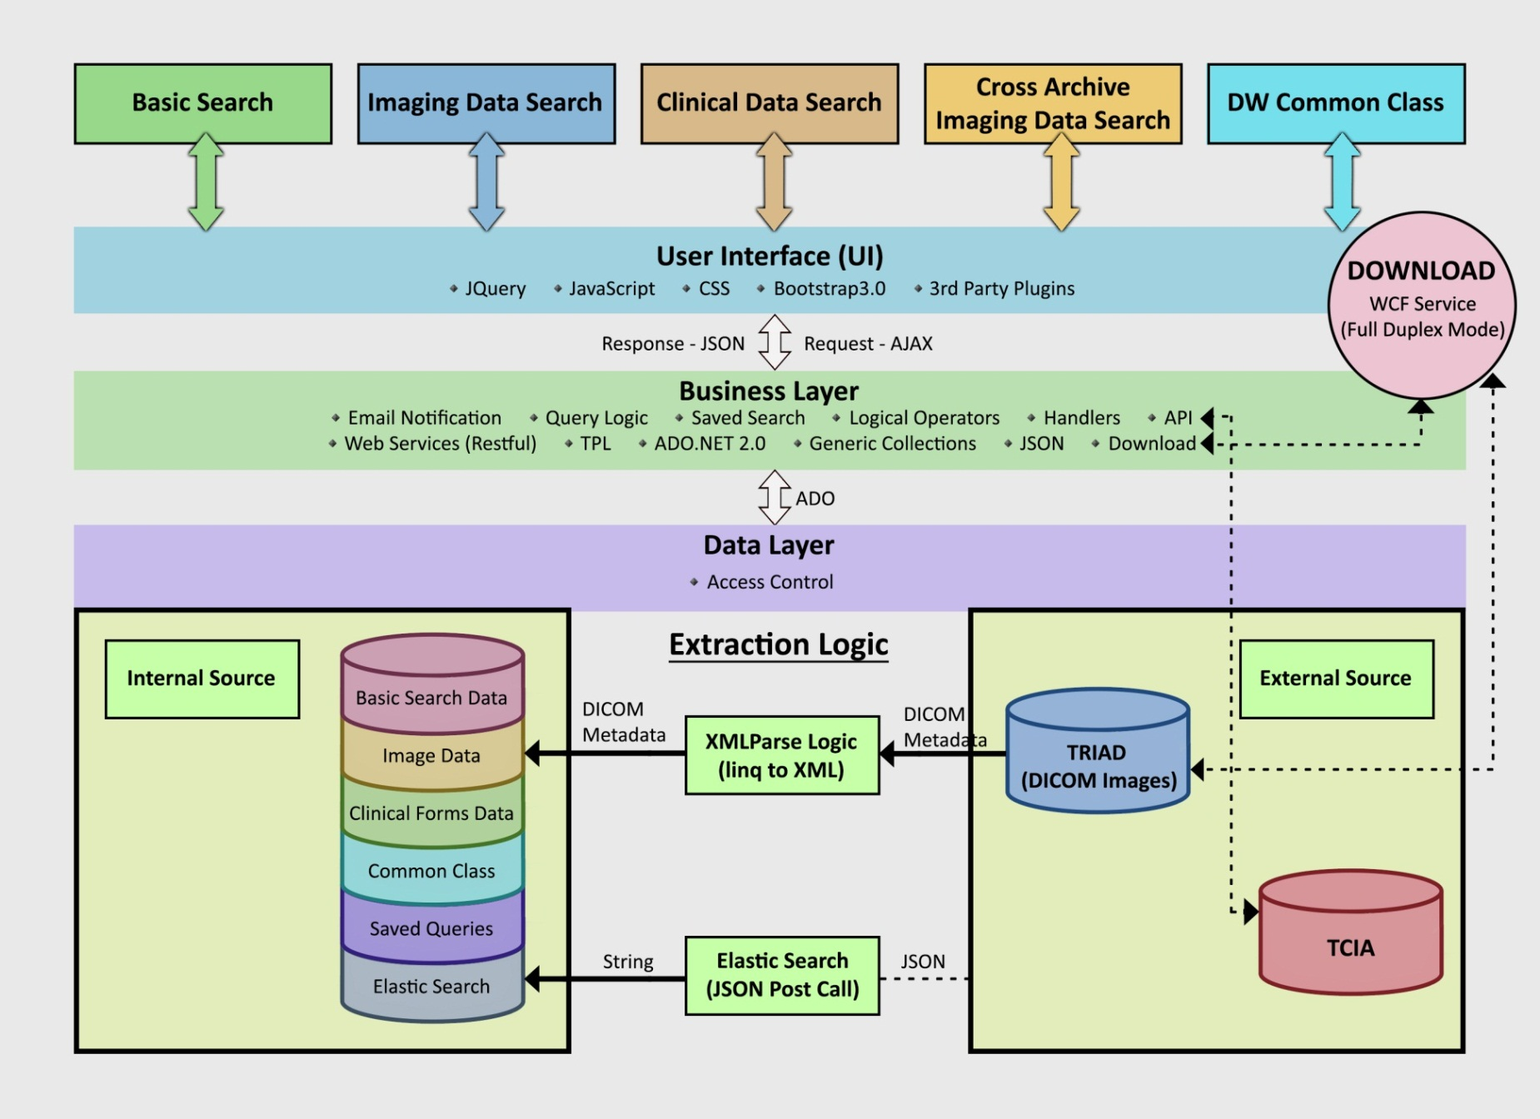
DW User Interface Portal Flow (pre June 2014, from mWebware)

Slide 13
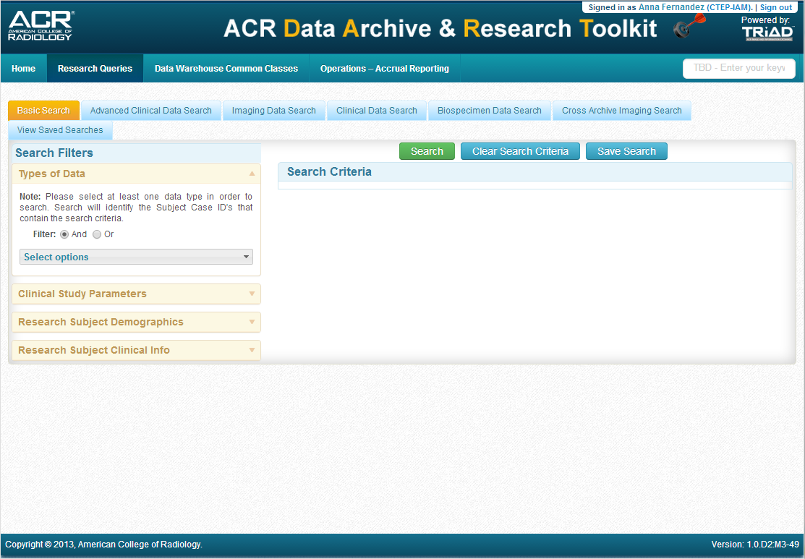

Slide 14
New Proposed Models

Slide 15
Existing Data Models

Slide 16
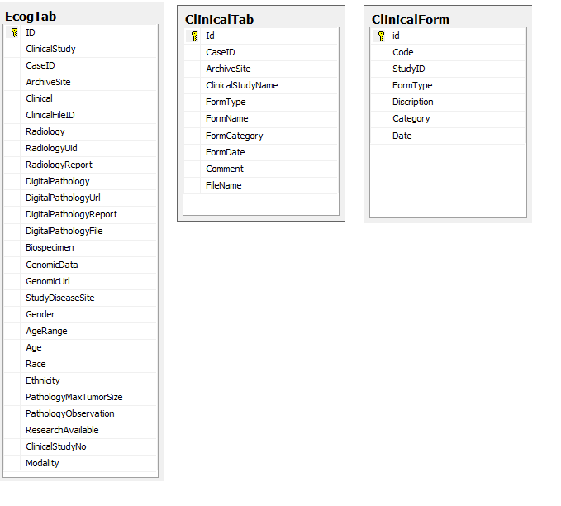
Basic Search
Source: mWebWare; Currently used in DART Data Warehouse

Slide 17
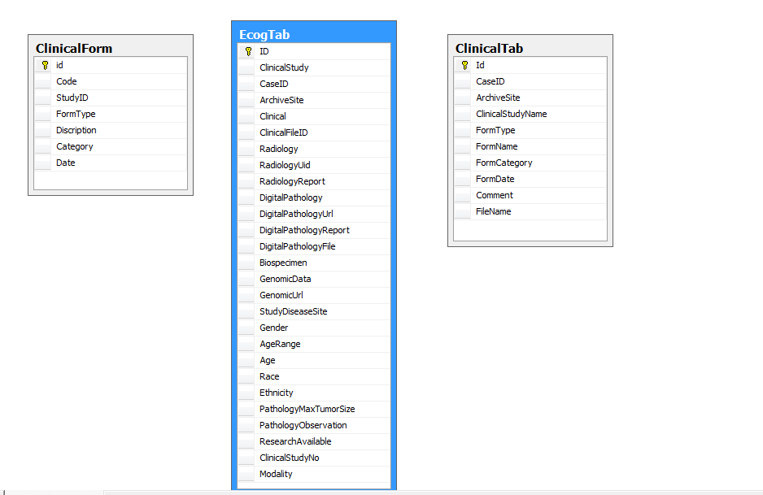
Clinical Data Search (Simple Tab – search by Froms
Source: mWebWare; Currently used in DART Data Warehouse, Note: Not Elasticsearch

Slide 18
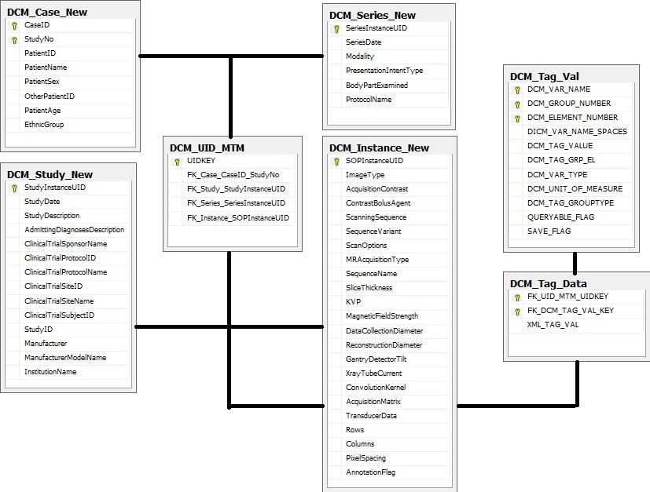
Imaging Tab Data Search - Current Data Model – DICOM (View 1)
Source: mWebWare; Currently used in DART Data Warehouse. See questions in note section.

Slide 19
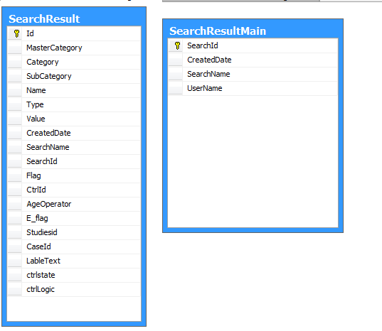
Saved Search
Source: mWebWare; Currently used in DART Data Warehouse

Slide 20
Operational Reports
SQL – Philly Team developed based on ECOG-ACRIN Common Classes requirements
Basic Tables, then use Fact Tables and Cubes

Slide 21
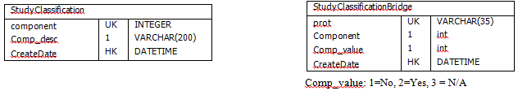
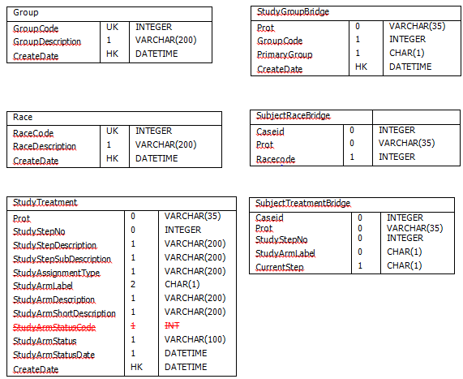
Operational Reports - DW Data Staging (1/2)
Data Warehouse data staging for operational reports leverages the Common Classes. Source: ACR IT Team

Slide 22
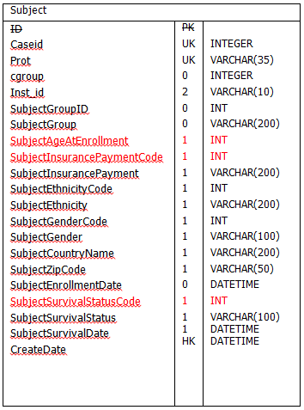
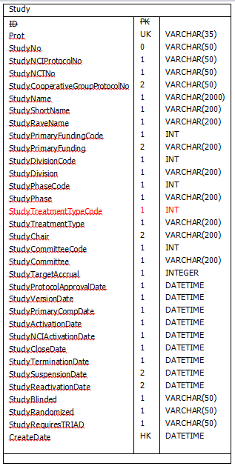
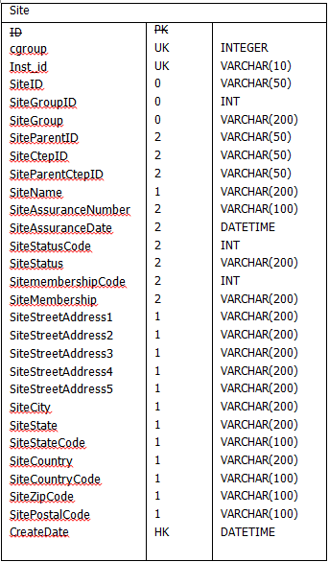
Operational Reports - DW Data Staging (2/2)
Data Warehouse data staging for operational reports leverages the Common Classes. Source: ACR IT Team

Slide 23
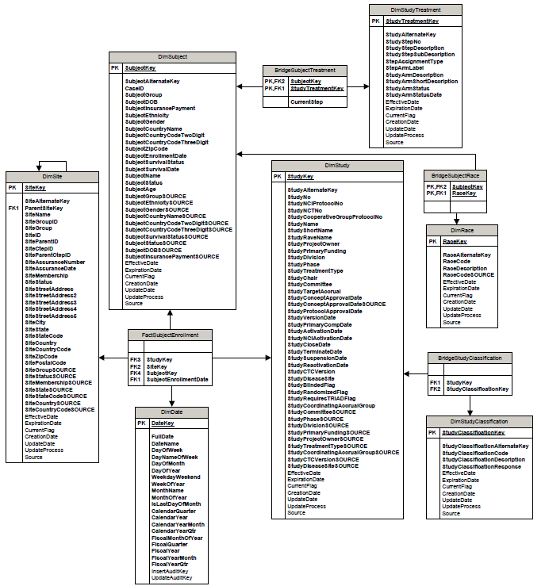
ER Subject Enrollment, Source: ACR IT Team

Slide 24
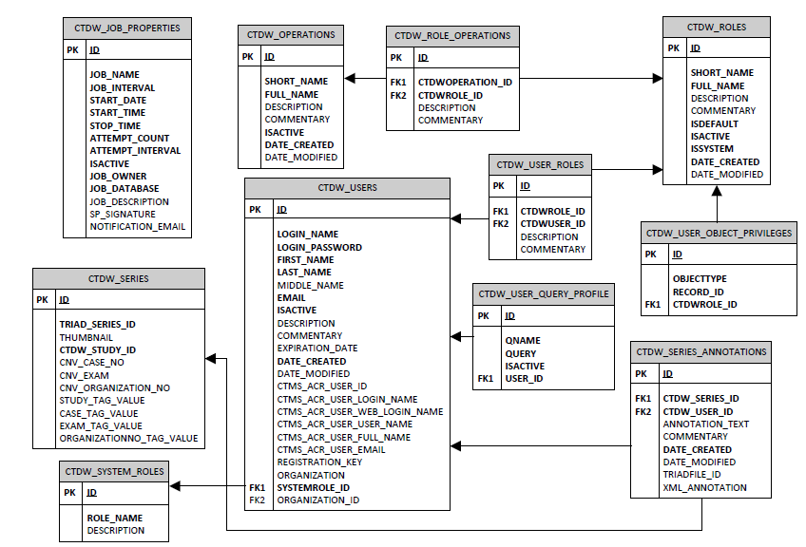
Old CTDW (up to 2013) ER Diagram. Source: ACR IT Team

Slide 25
Appendix
Other Proposed Models – Not Implemented

Slide 26
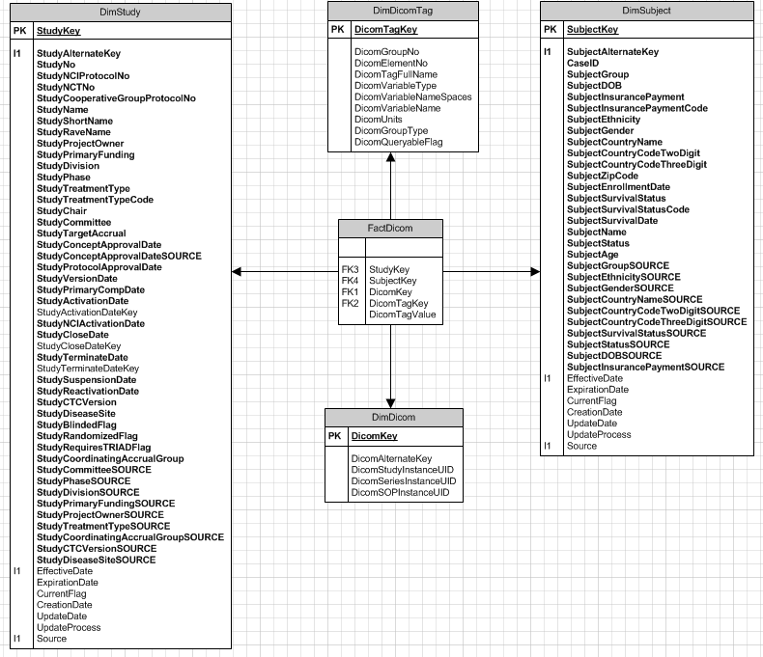
DICOM Fact Table – proposed by ACR Philly team (not in use in current DW)
Proposed by Dinakar/Ravi; Not implemented in DART Data Warehouse. Model based on cubes/star schema.

Slide 27
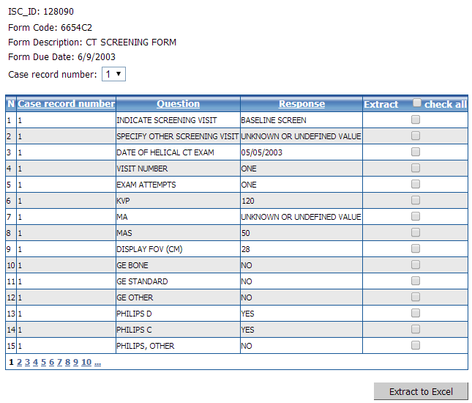
Clinical Data

Slide 28
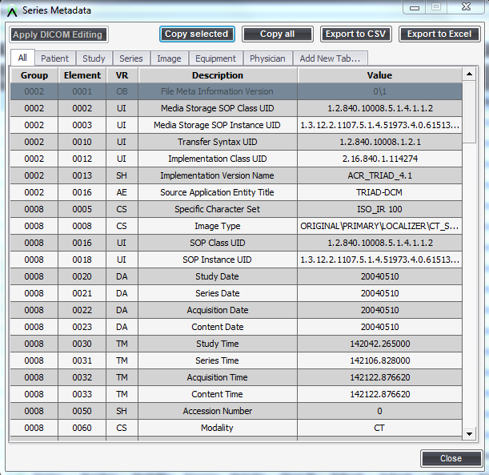
DICOM Tag

Slide 29
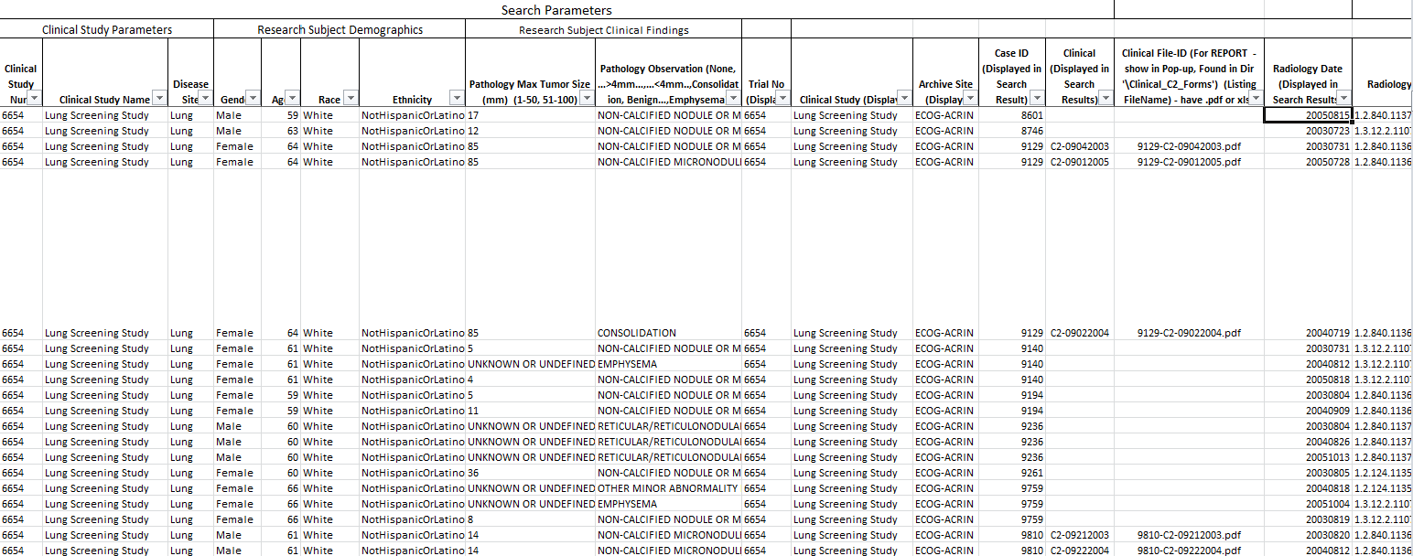
Basic Search Database Table

Slide 30
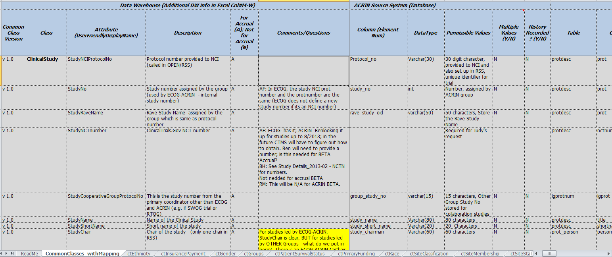
Operational Reports Built off Operational Reports

Slide 31
ACR Data Warehouse Arch Diagram - (Version-1.2)
External Systems
Other Reporting Websites (e.g.. NCI Specimen Navigator)
Statistical Centers
ACR Data Access Portal
(query, download)
NCTN – CTSU
(RSS, CTEP-IAM)
WS
WS
WS
WS or VPN
WS
WS
Orchestrator
External Access – Business Layer
Integrated Meta-Data Layer
DW-Core
Staging Area (Ingestion of Incoming Data)
Lab Data Sources (e.g., LIS, Biospecimen Management Systems)
Clinical Data Sources
Other Data Sources
NCTN - CTSU
Imaging Data

Slide 32


ACR Data Warehouse Arch Diagram - (Version 1.2)
External Systems
Other Reporting Websites (e.g.. NCI Specimen Navigator)
Statistical Centers
Data Access Portals (query, download)
NCTN – CTSU
(RSS, CTEP-IAM)
WS or VPN
WS
WS
WS
WS
WS
Orchestrator
Audit • ETL • Logs • Security Service/Authentication * Scheduler
External Access – Business Layer
API• Web Services (REST, etc.)•“Cube generation“• Ad-hoc Querying • Operational Reporting • Security Access • Data Scrubbing Conditions • Email Notifications
Cubes for commonly accessed data
Data Pull for Ext. Sources (e.g. Navigator)
Query Templates/Saved ”Experiments” …
Integrated Meta-Data Layer
Semantics WorkBench • ID – cross walk mapping • Access Control
Data Repository Warehouse Component
DW-Core
Common Classes
Site Info
SitePersonnel
Subject
ClinicalStudy
StudyTreatment
Study
Other Data Marts
Image Data
Image Results (AIM, DICOM-SR, Dig. Path)
Operational Query Data Warehouse Component
Clinical Data
Lab Inventory
MetaData Extraction (ACR TRIAD services)
Lab Results
Trial Data Description
MetaData Extraction
MetaData Extraction
MetaData Extraction
Registration Data
Archive Component
Special Use Archive Data Sets
(Pub-associated, External requests, Publications)
MetaData Extraction
Roster Data
Other … …
Staging Area (Ingestion of Incoming Data)
• Data Entry (via web service or Data Push from site) • ETL or related processes • Clean –up/Q&A • Aggregation • “Decoder” secure ETL/matching
Lab Data Sources (e.g., LIS, Biospecimen Management Systems)
RAVE
Archive
Digital Pathology MetaData & URL Links
Lab Inventory – A
Clinical Data Sources
Lab Inventory – B
Other Clinical Data
Radiology Images (TRIAD)
AIM XML DB
Other Data Sources
Imaging Data
NCTN - CTSU
Powered by

Slide 33
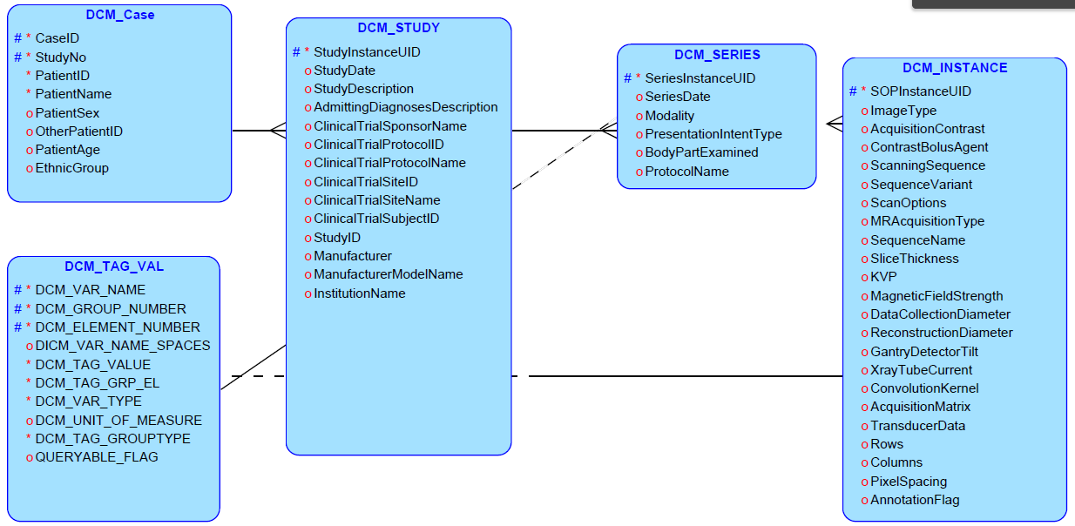
DRAFT DICOM - Relational Model, Not Used

Slide 34
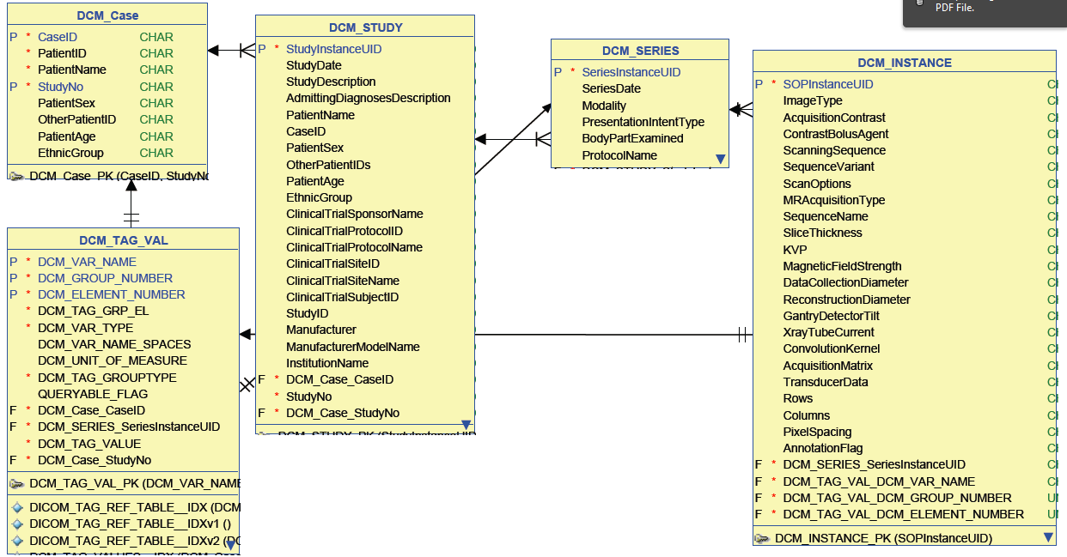
DRAFT DICOM - Logical Model, Not Used

Slide 35
Common Classes – Data Elements

Slide 36
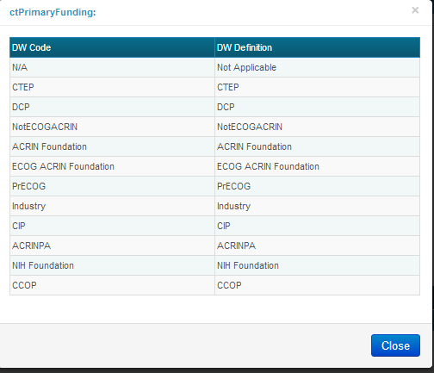
Study Field Parameter List
These are the parameters we can put in columns in the reports today
StudyNo
StudyNCIProtocolNo
StudyNCTNo
StudyCooperativeGroupProtocolNo
StudyCoordinatingAccrualGroup
StudyName
StudyShortName
StudyRaveName
StudyPrimaryFundingCode
StudyPrimaryFunding
StudyDivisionCode
StudyDivision
StudyPhase
StudyTreatmentType
StudyChair
StudyStatus
StudyClassification
StudyCommitteeCode
StudyCommittee
StudyTargetAccrual
StudyTreatmentType
StudyProtocolApprovalDate
StudyVersionDate
StudyPrimaryCompDate
StudyActivationDate
StudyActivationDate(Formatted)
StudyNCIActivationDate
StudyCloseDate
StudyCloseDate(Formatted)
StudyTerminationDate
StudySuspensionDate
StudyReactivationDate
StudyBlindedFlag
StudyCurrentFlag
StudyRandomizedFlag
StudyRequiresTRIADFlag
Go to https://eadw-test.acr.org under “Common Classes” to click and find Code Tables (list of values) for some of these parameters.

Slide 37
Site Field Parameter List
These are the parameters we can put in columns in the reports today
SiteID
SiteGroupID
SiteGroup
SiteParentID
SiteCtepID
SiteParentCtepID
SiteName
SiteAssuranceNumber
SiteAssuranceDate
SiteStatusCode
SiteStatus
SitemembershipCode
SiteMembership
SiteStreetAddress
SiteCity
SiteState
SiteStateCode
SiteCountry
SiteCountryCode
SiteZipCode
SitePostalCode
CreateDate
SiteCurrentFlag
SiteHieararchy
SiteLevel1
SiteLevel2
SiteLevel3
SiteLevel4

Slide 38
Subject Field Parameter List
These are the parameters we can put in columns in the reports today
SubjectArmDescription
SubjectArmLabel
SubjectArmShortDescription
SubjectArmStatus
SubjectArmStatusDate
SubjectAssignmentType
SubjectCurrentStep
SubjectStepDescription
SubjectStepNo
SubjectStepSubDescription
SubjectAge
SubjectCountryCodeThreeDigit
SubjectCountryCodeTwoDigit
SubjectCountryName
SubjectGroupID
SubjectGroup
SubjectDOB
SubjectInsurancePayment
SubjectEthnicityCode
SubjectEthnicity
SubjectGenderCode
SubjectGender
SubjectCountryName
SubjectID
SubjectRace
SubjectZipCode
SubjectEnrollmentDate
SubjectSurvivalStatus
SubjectSurvivalDate

Slide 39
Subject Enrollment Date Field Parameter List
These are the parameters we can put in columns in the reports today
Date
DayNameofWeek
DayofMonth
DayofWeek
DayofYear
Month
MonthName
Quarter
WeekofYear
Year
YearMonth
YearQtr

