Slide 1
DART Data Model Discussion
June 25, 2014

Slide 2
Topics
DART latest Architecture Slide
Data Models:
Type of Data Tables/Model in the current DW:
Clinical Data (small table –directly to DW)
DICOM: Simple DICOM model for tags to be ingested (1 image from each series)
Basic Search Database Tables (from an Excel Spreadsheet, showing Connections to the subject and DICOM/Path data sets)
SSIS – Operational Reports –covering Common Classes (EA Site, Subject, SubjectTreatment, etc.) – this has a star-schema/cubes that are also generated.
Screenshots showing the models for:
Basic Search Tables (mWebWare)
DICOM (final data model in use) (mWebWare)
Other Tables (mWebWare)
Operational Reports (ACR Philly)

Slide 3
Data Archive and Research Toolkit Enabling Precision Medicine
DW Portal
ACUO
Data Provenance
Authentication
Portal DB
Other Clinical Data
Data
Mapper
Authorization
Kibana
Object Store
Elastic Search
TRIAD
Triad User Interface
DW (SQL Server,
Cassandra, Other?)
Pipeline/ Analysis / BI SSIS / Python/ Statistical Tools
Clinical Data
Image MetaData
Other DICOM
Biospecimen Data
Site/Membership Data
Triad System Interfaces

Slide 4
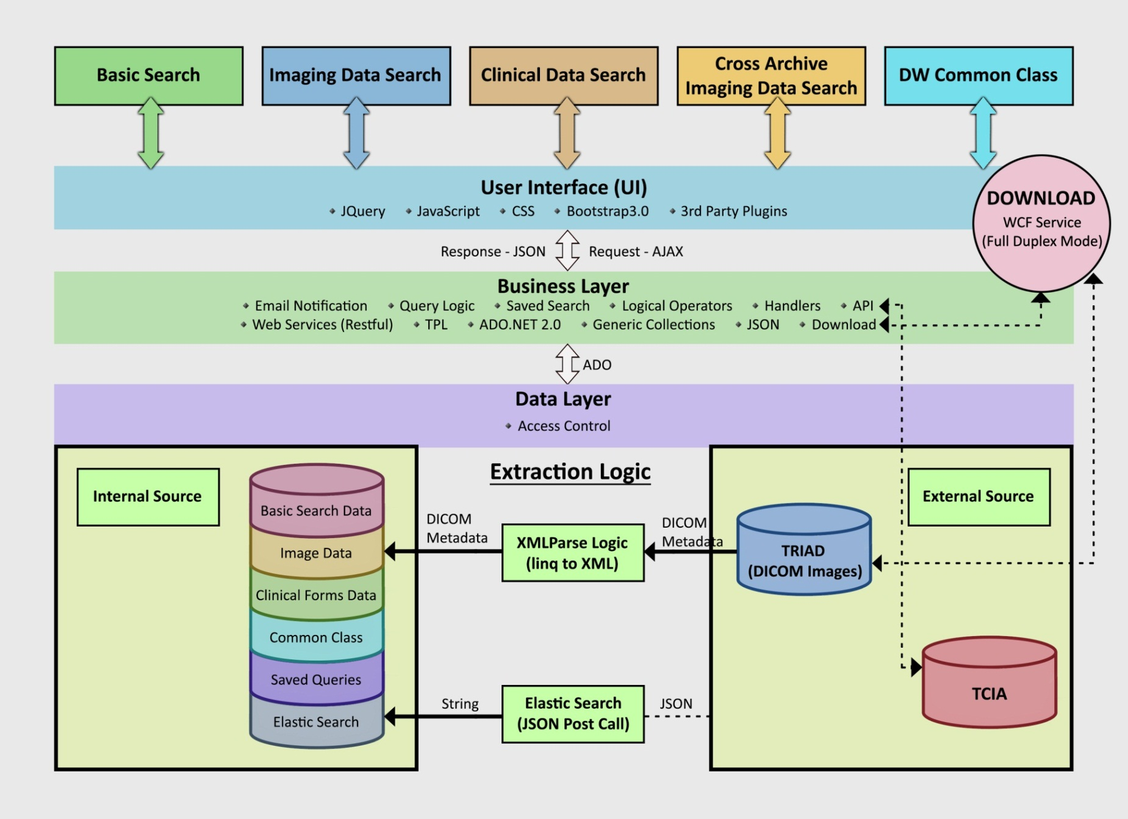
DW User Interface Portal Flow (pre June 2014, from mWebware)

Slide 5
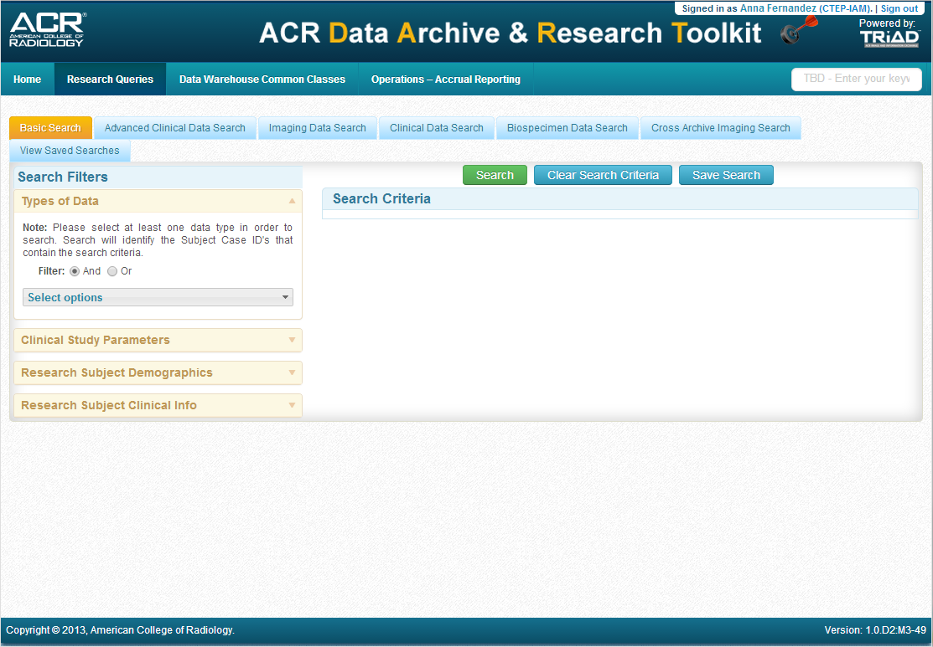

Slide 6
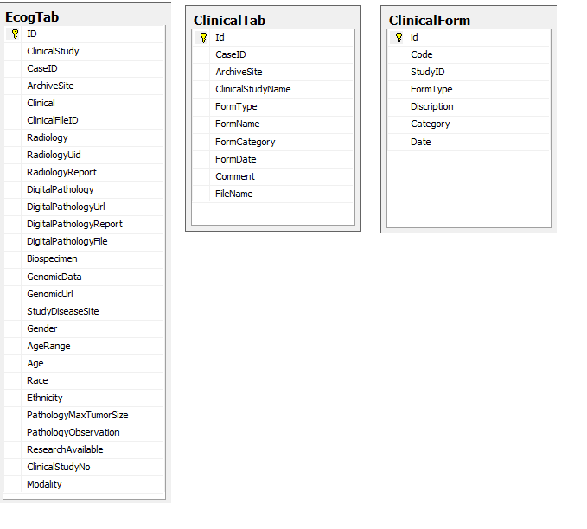
Basic Search
Source: mWebWare; Currently used in DART Data Warehouse

Slide 7
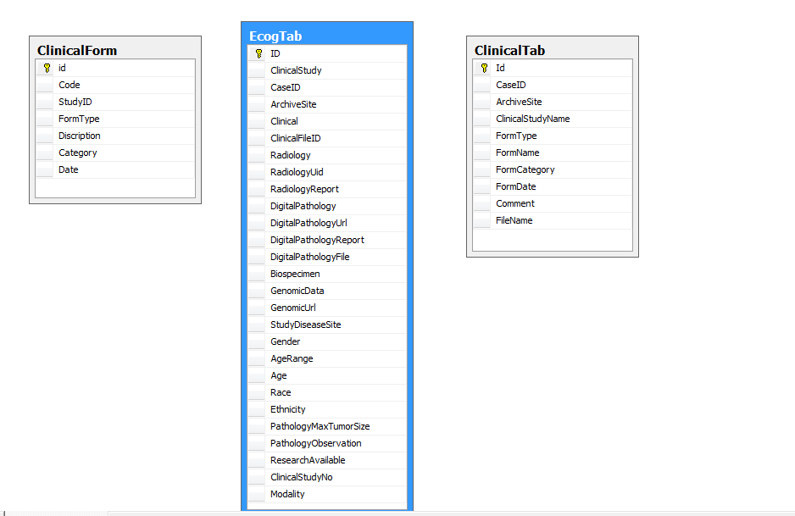
Clinical Data Search (Simple Tab – search by Froms
Source: mWebWare; Currently used in DART Data Warehouse, Note: Not Elasticsearch

Slide 8
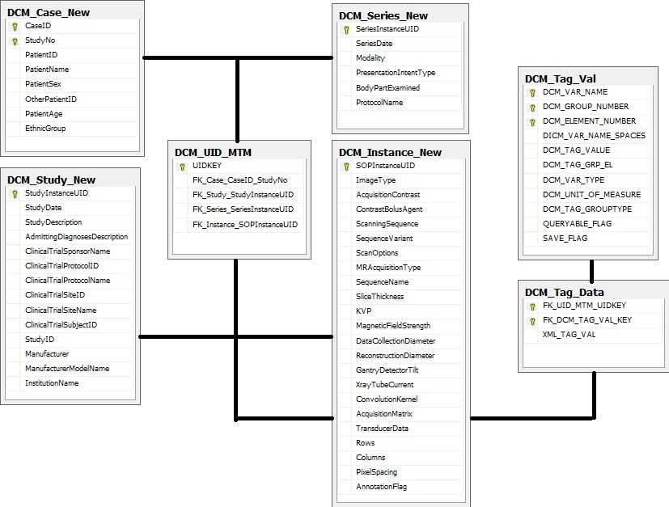
Imaging Tab Data Search - Current Data Model – DICOM (View 1)
Source: mWebWare; Currently used in DART Data Warehouse

Slide 9
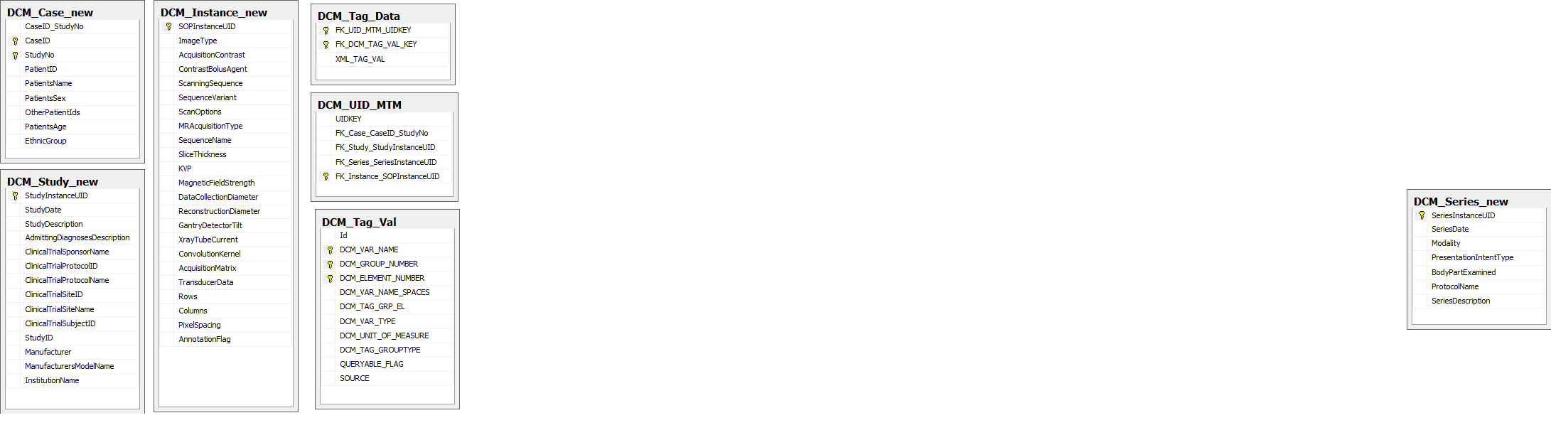
Imaging Tab Data Search - Current Data Model – DICOM (View 2)
Source: mWebWare; Currently used in DART Data Warehouse

Slide 10
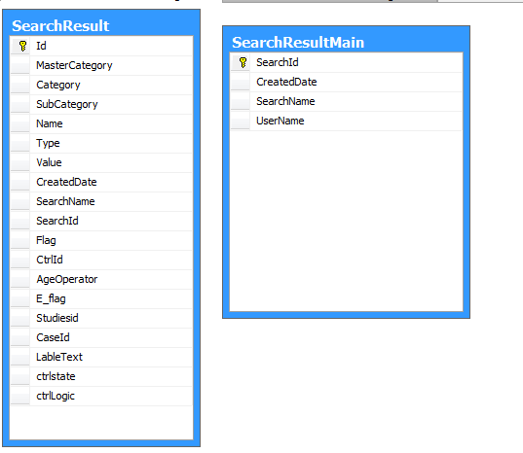
Saved Search
Source: mWebWare; Currently used in DART Data Warehouse

Slide 11
Operational Reports
SQL – Philly Team developed based on ECOG-ACRIN Common Classes requirements
Basic Tables, then use Fact Tables and Cubes

Slide 12
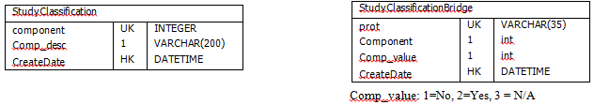
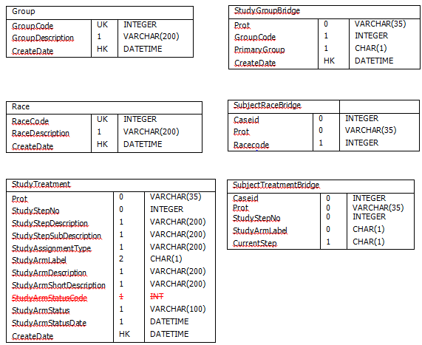
Operational Reports - DW Data Staging (1/2)
Data Warehouse data staging for operational reports leverages the Common Classes. Source: ACR IT Team

Slide 13
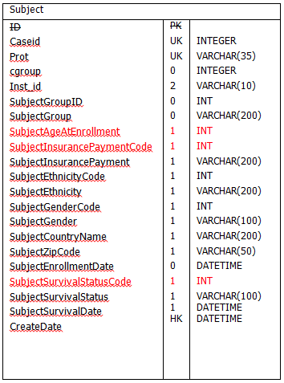
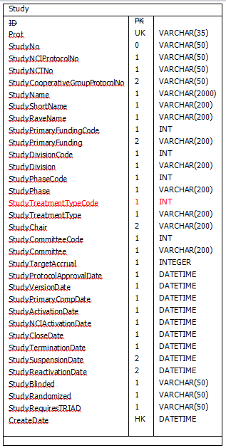
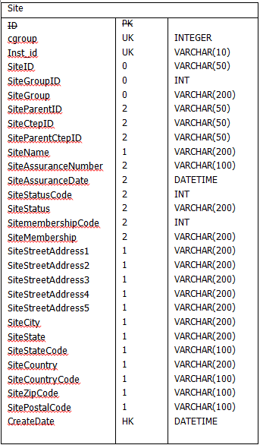
Operational Reports - DW Data Staging (2/2)
Data Warehouse data staging for operational reports leverages the Common Classes. Source: ACR IT Team

Slide 14
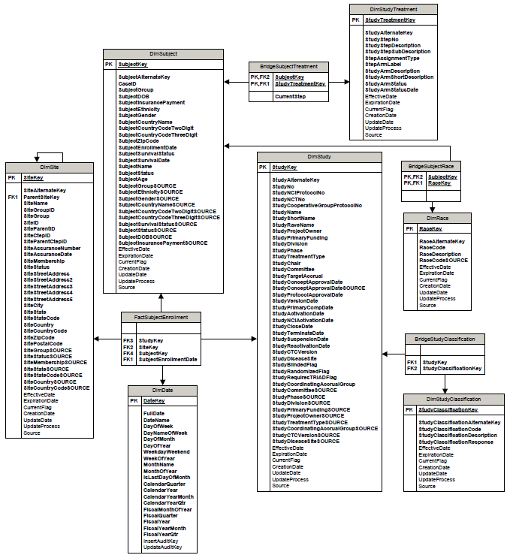
ER Subject Enrollment, Source: ACR IT Team

Slide 15
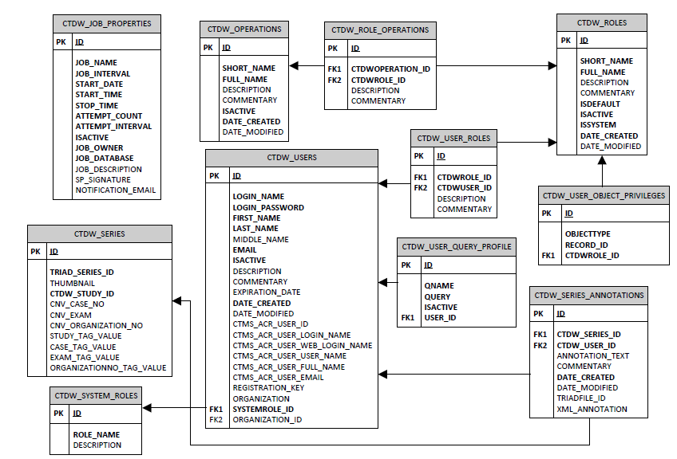
Old CTDW (up to 2013) ER Diagram. Source: ACR IT Team

Slide 16
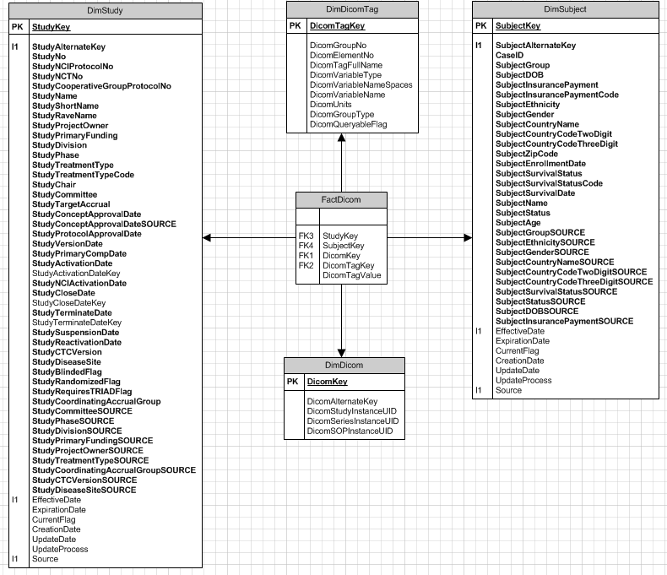
DICOM Fact Table – proposed by ACR Philly team (not in use in current DW)
Proposed by Dinakar/Ravi; Not implemented in DART Data Warehouse. Model based on cubes/star schema.

Slide 17
Appendix
Other Proposed Models – Not Implemented

Slide 18
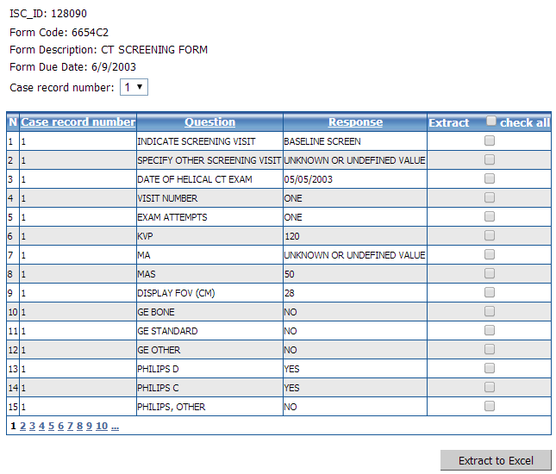
Clinical Data

Slide 19
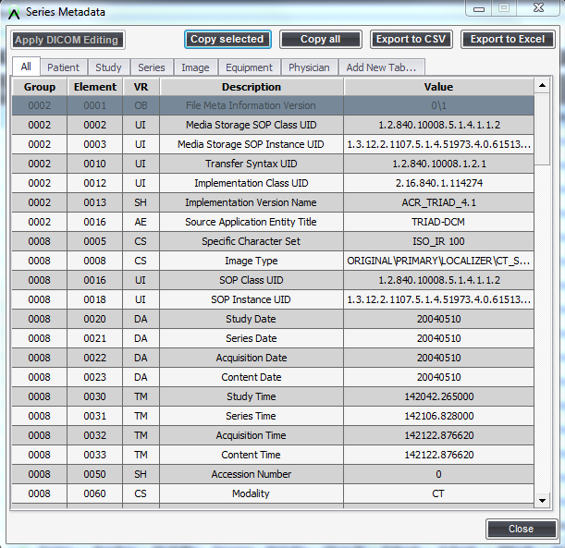
DICOM Tag

Slide 20
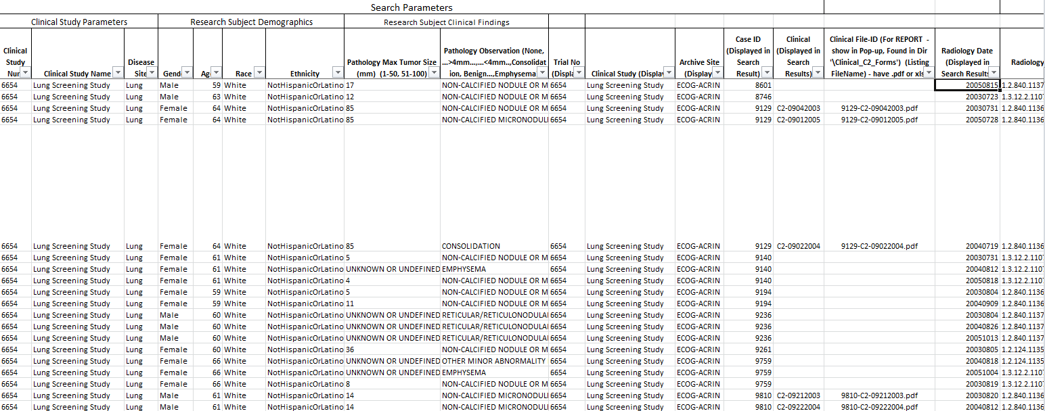
Basic Search Database Table

Slide 21
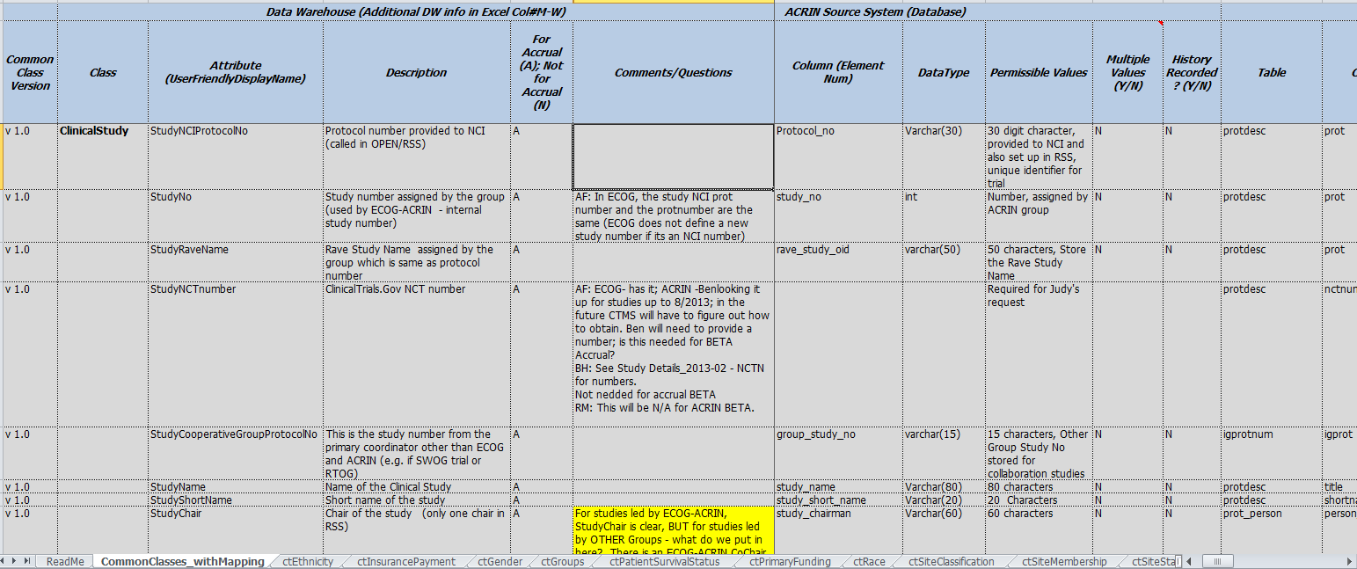
Operational Reports Built off Operational Reports

Slide 22
ACR Data Warehouse Arch Diagram - (Version-1.2)
External Systems
Other Reporting Websites (e.g.. NCI Specimen Navigator)
Statistical Centers
ACR Data Access Portal
(query, download)
NCTN – CTSU
(RSS, CTEP-IAM)
WS
WS
WS
WS or VPN
WS
WS
Orchestrator
External Access – Business Layer
Integrated Meta-Data Layer
DW-Core
Staging Area (Ingestion of Incoming Data)
Lab Data Sources (e.g., LIS, Biospecimen Management Systems)
Clinical Data Sources
Other Data Sources
NCTN - CTSU
Imaging Data

Slide 23


ACR Data Warehouse Arch Diagram - (Version 1.2)
External Systems
Other Reporting Websites (e.g.. NCI Specimen Navigator)
Statistical Centers
Data Access Portals (query, download)
NCTN – CTSU
(RSS, CTEP-IAM)
WS or VPN
WS
WS
WS
WS
WS
Orchestrator
Audit • ETL • Logs • Security Service/Authentication * Scheduler
External Access – Business Layer
API• Web Services (REST, etc.)•“Cube generation“• Ad-hoc Querying • Operational Reporting • Security Access • Data Scrubbing Conditions • Email Notifications
Cubes for commonly accessed data
Data Pull for Ext. Sources (e.g. Navigator)
Query Templates/Saved ”Experiments” …
Integrated Meta-Data Layer
Semantics WorkBench • ID – cross walk mapping • Access Control
Data Repository Warehouse Component
DW-Core
Common Classes
Site Info
SitePersonnel
Subject
ClinicalStudy
StudyTreatment
Study
Other Data Marts
Image Data
Image Results (AIM, DICOM-SR, Dig. Path)
Operational Query Data Warehouse Component
Clinical Data
Lab Inventory
MetaData Extraction (ACR TRIAD services)
Lab Results
Trial Data Description
MetaData Extraction
MetaData Extraction
MetaData Extraction
Registration Data
Archive Component
Special Use Archive Data Sets
(Pub-associated, External requests, Publications)
MetaData Extraction
Roster Data
Other … …
Staging Area (Ingestion of Incoming Data)
• Data Entry (via web service or Data Push from site) • ETL or related processes • Clean –up/Q&A • Aggregation • “Decoder” secure ETL/matching
Lab Data Sources (e.g., LIS, Biospecimen Management Systems)
RAVE
Archive
Digital Pathology MetaData & URL Links
Lab Inventory – A
Clinical Data Sources
Lab Inventory – B
Other Clinical Data
Radiology Images (TRIAD)
AIM XML DB
Other Data Sources
Imaging Data
NCTN - CTSU
Powered by

Slide 24
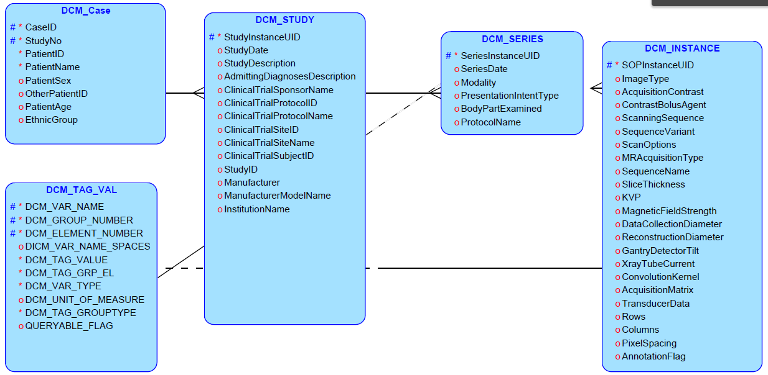
DRAFT DICOM - Relational Model, Not Used

Slide 25
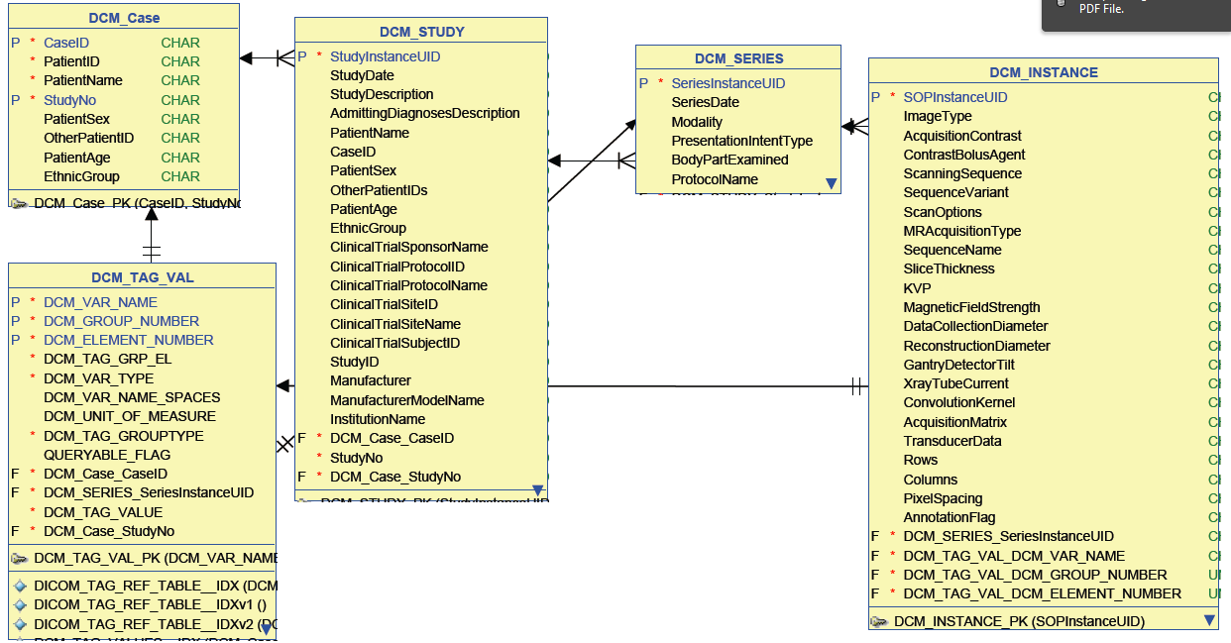
DRAFT DICOM - Logical Model, Not Used

