Slide 1
Language-level Transactions for Modular Reliable Systems
C. Scott Ananian Martin Rinard
cananian@csail.mit.edu rinard@csail.mit.edu
Computer Science and Artificial Intelligence Laboratory
Massachusetts Institute of Technology
HPEC 2004

Slide 2
Outline
Problems with traditional software development
  lock ordering
  proper atomicity
  fault-tolerance
  priority inversion
Language-level Transactions
How?
  Software implementation
  Hardware implementation
  Both!
Conclusions

Slide 3
Programming Reliable Systems
(is hard)

Slide 4
Conventional Locking: Ordering
When more than one object is involved in a critical region, deadlocks may occur!
  Thread 1 grabs A then tries to grab B
  Thread 2 grabs B then tries to grab A
  No progress possible!
Solution: all locks ordered
  A before B
  Thread 1 grabs A then B
  Thread 2 grabs A then B
  No deadlock

Slide 5
Conventional Locking: Ordering
Maintaining lock order is a lot of work!
Programmer must choose, document, and rigorously adhere to a global locking protocol for each object type
  development overhead!
All symmetric locked objects must include lock order field, which must be assigned uniquely
  space overhead!
Every multi-object lock operation must include proper conditionals
  which lock do I take first? which do I take next?
  execution-time overhead!
No exceptions!

Slide 6
Multi-object atomic update
Programmer's mental model of locks can be faulty
Monitor synchronization: associates locks with objects
Promises modularity: locking code stays with encapsulated object implementation
Often breaks down for multiple-object scenarios
End result: unreliable software, broken modularity

Slide 7
A problem with multiple objects
public final class StringBuffer ... {
private char value[ ];
private int count;
...
public synchronized StringBuffer append(StringBuffer sb) {
...
A:int len = sb.length();
int newcount = count + len;
if (newcount > value.length)
expandCapacity(newcount);
// next statement may use state len
B:sb.getChars(0, len, value, count);
count = newcount;
return this;
}
public synchronized int length() { return count; }
public synchronized void getChars(...) { ... }
}

Slide 8
Fault-tolerance
Locks are irreversible
When a thread fails holding a lock, the system will crash
  it's only a matter of time before someone else attempts to grab that lock
What are the proper semantics for exceptions thrown within a critical region?
  data structure consistency not guaranteed
Asynchronous exceptions?

Slide 9
Priority Inversion
Well-known problem with locks
Described by Lampson/Redell in 1980 (Mesa)
Mars Pathfinder in 1997, etc, etc, etc
Low-priority task takes a lock needed by a high-priority task -> the high priority task must wait!
Clumsy solution: the low priority task must become high priority
What if the low priority task takes a long time?

Slide 10
Outline
Problems with traditional software development
  lock ordering
  proper atomicity
  fault-tolerance
  priority inversion
Language-level Transactions
How?
  Software implementation
  Hardware implementation
  Both!
Conclusions

Slide 11
Programming Reliable Systems
(is easy?)

Slide 12
Language-level Transactions
Locks are the wrong model for expressing synchronization!
Atomicity is a more natural (and modular) way to specifying the system
Let's use transactions to implement atomic regions
What sort of transactions do we want?

Slide 13
Transactions (definition)
A transaction is a sequence of loads and stores that either commits or aborts
If a transaction commits, all the loads and stores appear to have executed atomically
If a transaction aborts, none of its stores take effect
Transaction operations aren't visible until they commit or abort
Simplified version of traditional ACID database transactions (no durability, for example)

Slide 14
Non-blocking synchronization
Although transactions can be implemented with mutual exclusion (locks), we are interested only in non-blocking implementations.
In a non-blocking implementation, the failure of one process cannot prevent other processes from making progress. This leads to:
  Scalable parallelism
  Fault-tolerance
  Safety: freedom from some problems which require careful bookkeeping with locks, including priority inversion and deadlocks
Little known requirement: limits on trans. suicide

Slide 15
Making StringBuffer atomic
public final class StringBuffer ... {
private char value[ ];
private int count;
...
public synchronized StringBuffer append(StringBuffer sb) {
...
A:int len = sb.length();
int newcount = count + len;
if (newcount > value.length)
expandCapacity(newcount);
// next statement may use state len
B:sb.getChars(0, len, value, count);
count = newcount;
return this;
}
public synchronized int length() { return count; }
public synchronized void getChars(...) { ... }
}

Slide 16
Making StringBuffer atomic
public final class StringBuffer ... {
private char value[ ];
private int count;
...
public atomic StringBuffer append(StringBuffer sb) {
...
A:int len = sb.length();
int newcount = count + len;
if (newcount > value.length)
expandCapacity(newcount);
// next statement may use state len
B:sb.getChars(0, len, value, count);
count = newcount;
return this;
}
public atomic int length() { return count; }
public atomic void getChars(...) { ... }
}

Slide 17
Solving the lock ordering problem
void pushFlow(Vertex v1, Vertex v2, double flow) {
v1.excess -= flow; /* Move excess flow from v1 */
v2.excess += flow; /* ...to v2 */
}
Simple network flow algorithm
“Flow” moved from node to node in the graph
Updates to two different objects
Serial version above requires a complicated parallel version when using locks

Slide 18
Solving the lock ordering problem
void pushFlow(Vertex v1, Vertex v2, double flow) {
v1.excess -= flow; /* Move excess flow from v1 */
v2.excess += flow; /* ...to v2 */
}
void pushFlow(Vertex v1, Vertex v2, double flow) {
Object lock1, lock2;
if (v1.id < v2.id) { /* avoid deadlock */
lock1 = v1; lock2 = v2;
} else {
lock1 = v2; lock2 = v1;
}
synchronized (lock1) {
synchronized (lock2) {
v1.excess -= flow; /* Move excess flow from v1 */
v2.excess += flow; /* ...to v2 */
}
}
}

Slide 19
Solving the lock ordering problem
void pushFlow(Vertex v1, Vertex v2, double flow) {
v1.excess -= flow; /* Move excess flow from v1 */
v2.excess += flow; /* ...to v2 */
}
void pushFlow(Vertex v1, Vertex v2, double flow) {
atomic {
v1.excess -= flow; /* Move excess flow from v1 */
v2.excess += flow; /* ...to v2 */
}
}
Specifying desired atomicity property directly is much simpler for the programmer!

Slide 20
Addressing reliability, fault tolerance, and priority inversion
A proper implementation of the transaction mechanism allows constant-time abort
  Allows us to solve priority inversion by aborting the low-priority thread!
Atomicity properties are modular – no global lock ordering required
A reasonable semantics for exceptions: critical region aborted/undone. No dangling locks.
Failure of one thread will not cause the system to fail!

Slide 21
Programming Reliable Systems
(is hard)
Problems with traditional software development
  lock ordering
  proper atomicity
  fault-tolerance
  priority inversion
Language-level Transactions
How?
  Software implementation
  Hardware implementation
  Both!
Conclusions

Slide 22
Software Transaction Implementation
Goals:
  Non-transactional operations should be fast
  Reads should be faster than writes
  Minimal amount of object bloat
Solution:
  Use special FLAG value to indicate “location involved in a transaction”
  Object points to a linked list of versions, containing values written by (in-progress, committed, or aborted) transactions
  Semantic value of FLAGged field is: “value of the first version owned by a committed transaction on the version list”
  Values which are “really” FLAG are handled with an escape mechanism

Slide 23
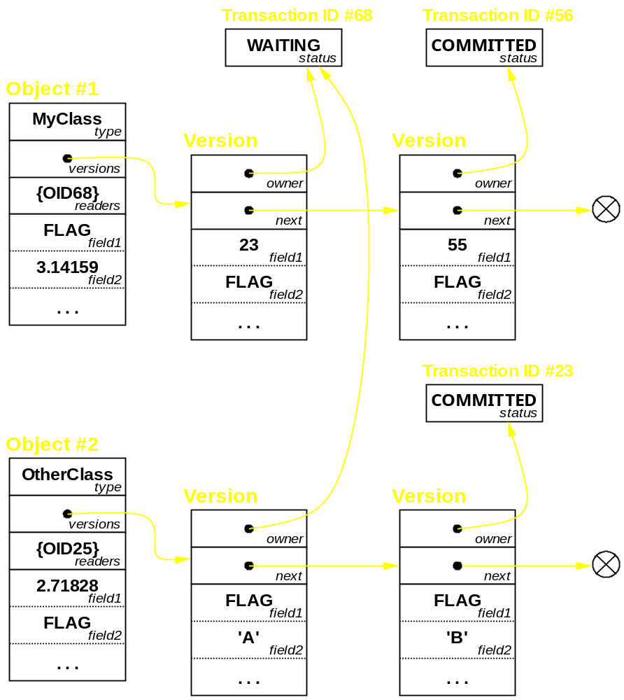
Transactions using version lists

Slide 24
Performance
Non-transactional code only needs to check whether a memory operand is FLAG before continuing.
  On superscalar processors, there are plenty of extra functional units to do the check
  The branch is extremely predictable
  This gives only a few % slowdown
Once FLAGged, transactional code operates directly on the object’s “version”
Creating versions can be an issue for large arrays; use “functional array” techniques

Slide 25
Non-blocking algorithms are hard!
In published work on Synthesis, a non-blocking operating system implementation, three separate races were found:
  One ABA problem in LIFO stack
  One likely race in MP-SC FIFO queue
  One interesting corner case in quaject callback handling
It's hard to get these right! Ad hoc reasoning doesn't cut it.
Non-blocking algorithms are too hard for the programmer
Let's get it right once (and verify this!)

Slide 26
The Spin Model Checker
Spin is a model checker for communicating concurrent processes. It checks:
  Safety/termination properties
  Liveness/deadlock properties
  Path assertions (requirements/never claims)
It works on finite models, written the Promela language, which describe infinite executions.
Explores the entire state space of the model, including all possible concurrent executions, verifying that Bad Things don't happen.
Not an absolute proof – pretty useful in practice
Make systems reliable by concentrating complexity in a verifiable component

Slide 27
Spin theory
Generates a Büchi Automaton from the Promela specification.
  Finite-state machine w/ special acceptance conditions
  Transitions correspond to executability of statements
Depth-first search of state space, with each state stored in a hashtable to detect cycles and prevent duplication of work
  If x followed by y leads to the same state as y followed by x, will not re-traverse the succeeding steps
If memory is not sufficient to hold all states, may ignore hashtable collisions: requires one bit per entry. # collisions provides approximate coverage metric

Slide 28
Verified Software Transactions
Modelled the software transaction implementation in Promela
Low-level model – every memory operation represented
Spin used 16G of memory to exhaustively verify the implementation within a 6-version 2-object scope.

Slide 29
Hardware Implementation
Following earlier work by Knight '86, Herlihy and Moss '92, '93
Cache is used to store uncommitted transactional state (marked with a T bit)
Main memory contains 'backup state'
Cache-coherence protocol extended to coordinate transactions
Our recent work (Ananian, Asanović, Kuszmaul, Leiserson, Lie HPCA 2005) overcomes transaction-size limitations in earlier designs
Near-zero performance overhead.
  Piggy-backs on existing cache coherency traffic

Slide 30
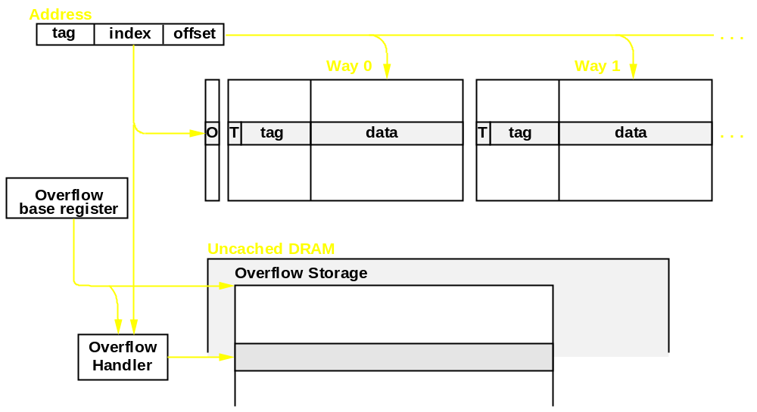
Hardware Transaction Cache Organization
Each cache line gets a “T” bit indicating that this line is involved in a transaction
On abort, “T” lines are invalidated
On commit, the T bits are cleared
Overflow mechanism

Slide 31
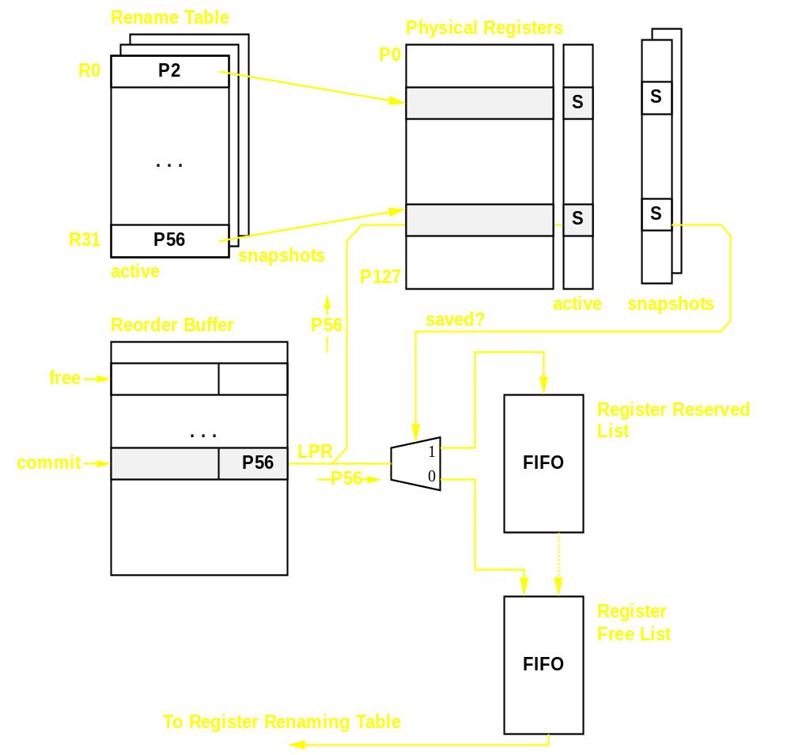
Register File Modifications
Minor modifications to the processor rename table to support register restore after transaction abort.

Slide 32
Hardware/Software Implementation
Hardware transaction implementation is very fast! But it is limited:
  Slow once you exceed Cache capacity
  Transaction lifetime limits (context switches)
  Limited semantic flexibility (nesting, etc)
Software transaction implementation is unlimited and very flexible!
  But transactions may be slow
Solution: failover from hardware to software
  Simplest mechanism: after first hardware abort, execute transaction in software
  Need to ensure that the two algorithms play nicely with each other (consistent views)

Slide 33
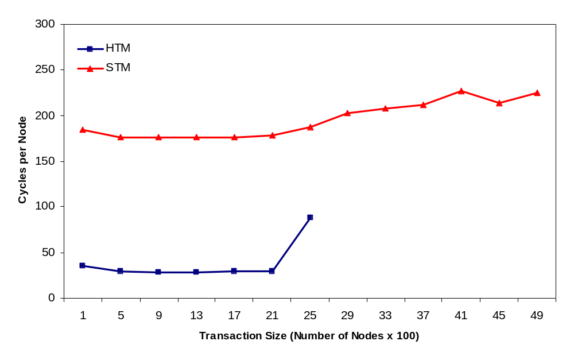
Overcoming HW size limitations
Simple node-push benchmark
As xaction size increases, we eventually run out of cache space in the HW transaction scheme
HTM Transactions stop fitting after this point

Slide 34
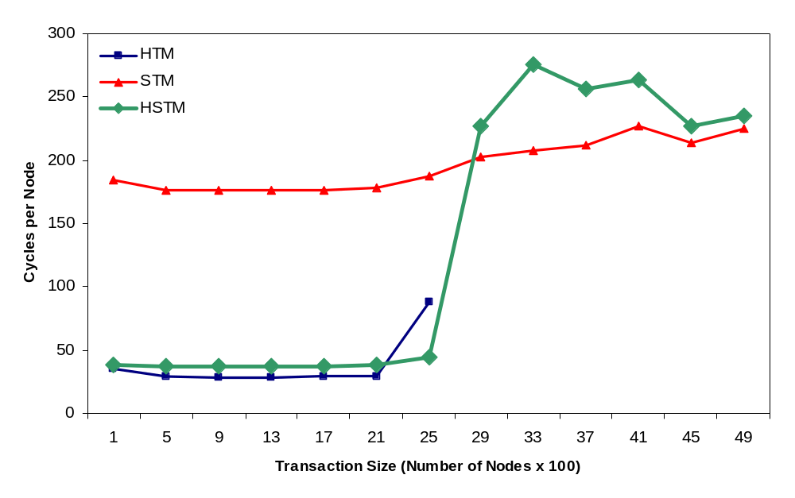
Overcoming HW size limitations
Simple node-push benchmark
Hybrid scheme best of both worlds!

Slide 35
Conclusions
Language-level transactions provide a more-modular way to build reliable concurrent systems.
Transactions can reduce software complexity and eliminate common programmer mistakes
We've implemented a transaction mechanism for Java programs using software, hardware, and (in progress) joint approaches using the FLEX compiler infrastructure.
Transactions can be efficient and practical to use!

