Slide 1

One Laptop per Child
Growing up with Nell:
A Narrative Interface for Literacy
Dr. C. Scott Ananian <cscott@laptop.org>

Slide 2
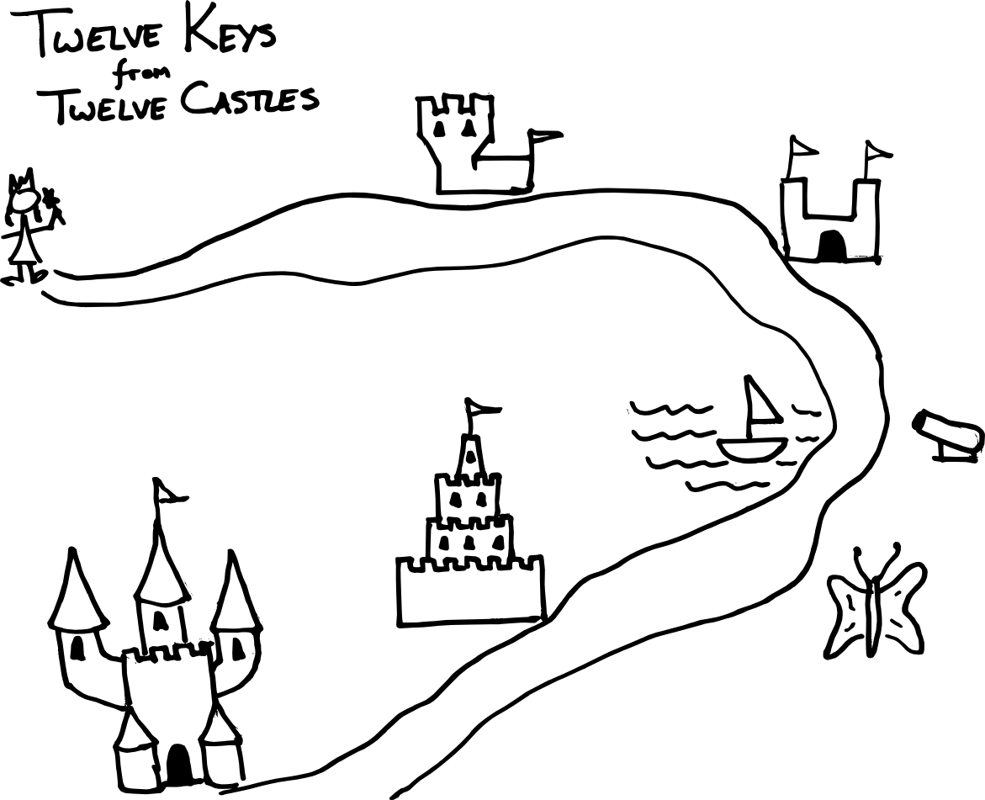
Paths to Learning

Slide 3
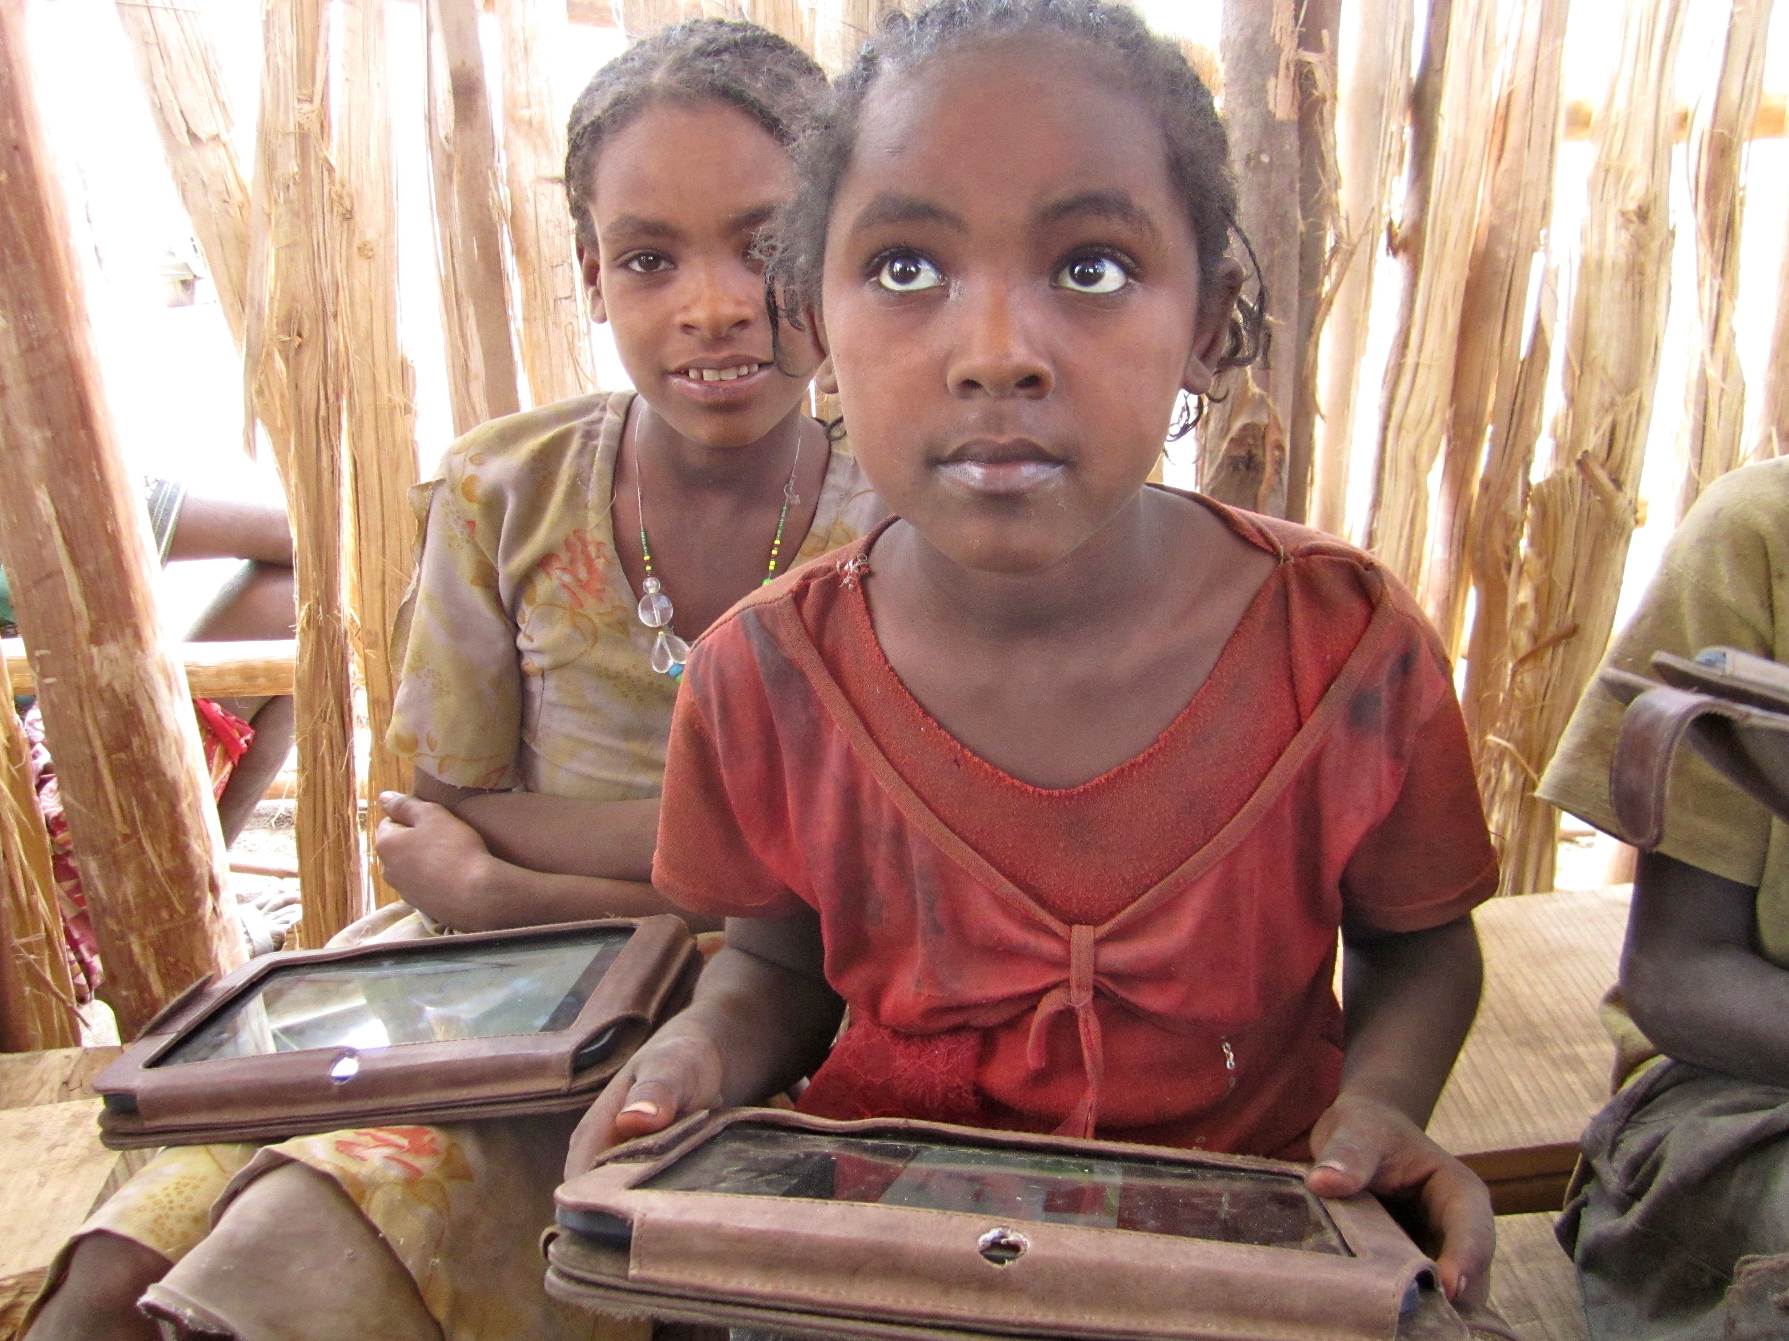
Ethiopia

Slide 4
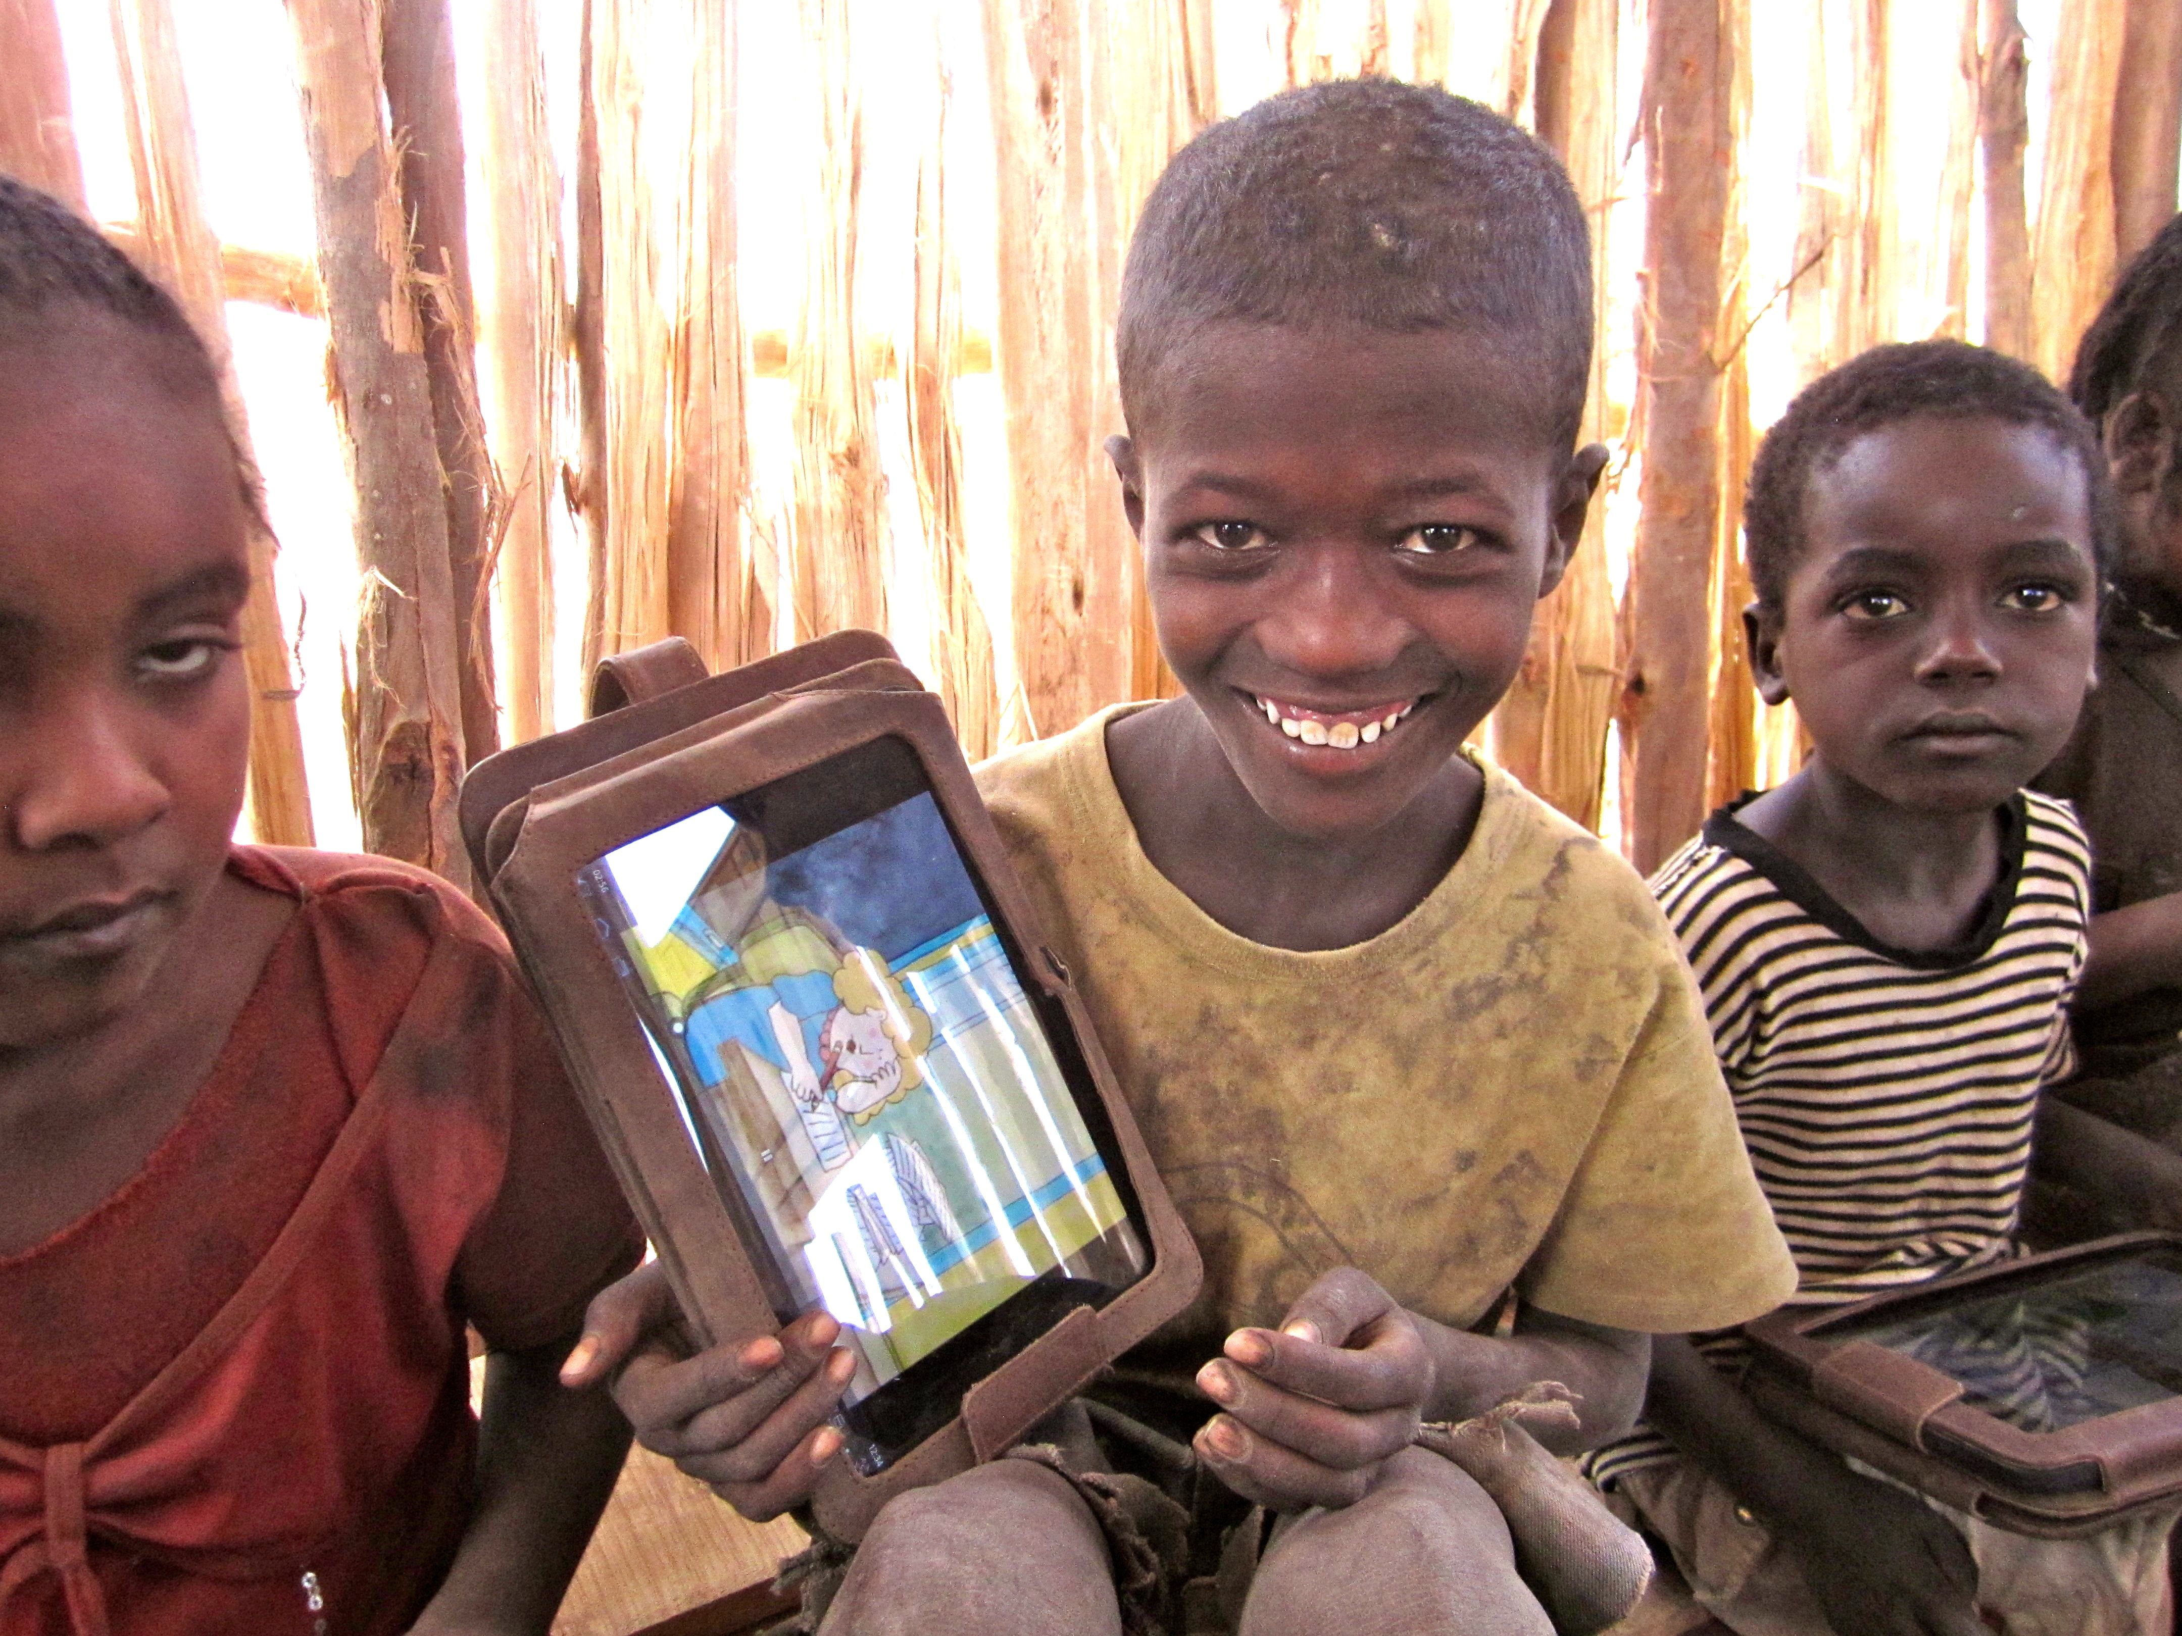
Ethiopia

