Slide 1
A New Approach to Finding Aid Displays with Web CMS
Christian James
Web Application Librarian
The Catholic University of America
Notes:
Slide deck theme by SlidesGo: http://bit.ly/2X9RQ9U
All images credited except for logos, which are the by the tech company represented.
Slides and demo files available at https://github.com/cscottjames/cascade-finding-aids
Our presentation today talks about our “new” approach to displaying our archival finding aids. This isn’t necessarily a “better” approach to displaying finding aids. It’s just the one that works best for us, as I’ll explain later, based on our needs and the resources that were given to us. But hopefully it will give you some ideas about things that you can do at your institution or information about the state of the field.

Slide 2
OVERVIEW
01
03
Background
Research
02
04
Project Requirements
and Goals
Solutions
05
Lessons Learned
Institutional Context
Environmental Scan
Options
What we wanted/needed
What we chose to do
Plus continuing work, and future research
Notes:
This presentation assumes that you have some knowledge of archival description, HTML, XML, EAD.

Slide 3

About Us:
Institutional Context
~6K students (3,279 undergraduate + 2,492 graduate)
Library: ~30-35 f/t employees
Archives + Special Collections unit
collection areas: university records,U.S. Catholicism, labor history
~225 finding aids at folder-level description
little support from University IT
Image credit: The Catholic University of America
Notes:
Some background on our institution helps you understand some of the decisions we made and why we made them.
Also:
Major research areas include social science, nursing, theology/religious studies
special collections in early Christianity, Brazilian history
we rely on WRLC virtual servers!

Slide 4
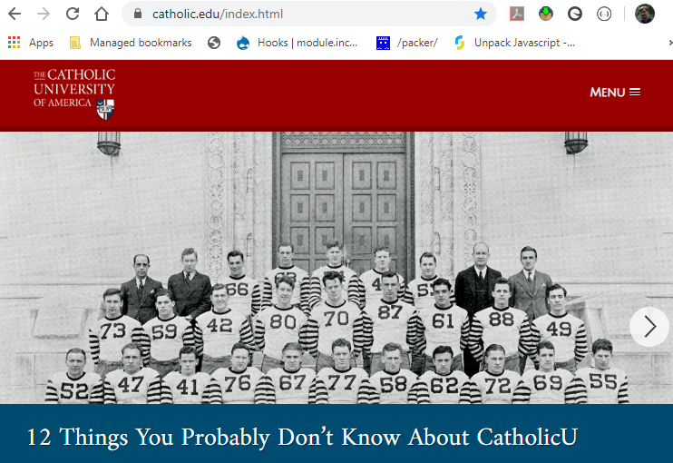





University Libraries Web Presence
University CMS
Old system: “Topaz”
WRLC+Open Source
WordPress, Omeka, Islandora
3rd-Party Sites
LibGuides, Alma/Primo, etc.
http://www.catholic.edu
Notes:
I divide our University Libraries web presence into three different tiers. There is the one catholic.edu domain, which our main Libraries website is a part of, that has information on research, staff, building hours, contact info, et cetera. But as I said the University IT has limited support for our web services so if we want to use any other CMS platforms or databases, we’ve had to work with WRLC.
On our WRLC virtual servers, we have WP, Drupal, Omeka…. etc.
This multifaceted web presence works for us, but it’s a lot of different platforms and we’re always looking to simplify or consolidate our web-based tools. This would minimize the amount of maintenance for upgrades, security updates, theme updates, etc. For example, we have several Drupal sites, but we try to use the Drupal multisite capability to build them on the same software.

Slide 5
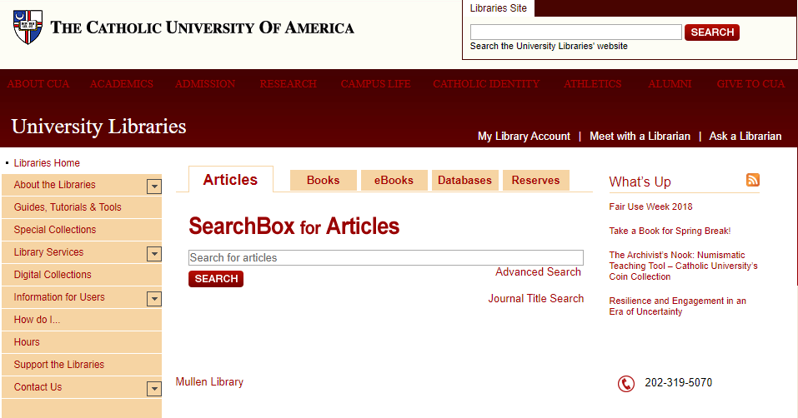
Old System: Topaz
Pro: quick updates
Cons:
poor, out-of-date theme
not responsive (mobile/tablets)
difficult to develop custom scripts around
Old finding aid workflow:
Use IE to generate HTML from EAD files
Notes:
Our old web CMS for libraries.cua.edu was very clunky. We were used to using the WRLC virtual servers to host custom scripts or even supplemental websites.
Our old workflow used a very rudimentary process for uploading XML finding aids. We would transform the XML into HTML tags using Internet Explorer. Then we would copy and paste the HTML tags into the old “Topaz” CMS system. This is less than ideal. As I said in a meeting the other day, I avoid Internet Explorer like I avoid the coronavirus. It was a tedious process, and it’s not the intended use of the software, so it introduces room for error.
The Topaz CMS was first introduced in 2010. So it was in place about 10 or more years - definitely time for a change!
In 2018, we were notified about the University transitioning to a new web CMS. So that brought us to our ‘research’ question.

Slide 6
And if so, what?
Project Question:
Should we take a new approach to displaying our finding aids to researchers?
Notes:
With the change to our website CMS came the opportunity to improve our workflow and display of our finding aids. So we asked ourselves this question: “Should we take a new approach to displaying our finding aids to researchers? And if so, what?”

Slide 7
Project Requirements
Minimal upload work (simplify the XML -> HTML conversion process)
Usability
Complicated for novices
Interfaces suffer from “ambiguous and/or unintuitive labeling, unclear relationships between tabs, and insufficient visual cues for certain navigational features” (Walton, 2017)
Studies show users struggle with display, jargon, and search in online finding aids (Walters, 2010)
Notes:
We’ve also been talking for years about alternative ways to display finding aids for usability. I take this really seriously because I have a Master’s in History and love historical research. I want to help people find historical resources in the best way possible, and I can see the failings of the current system.

Slide 8
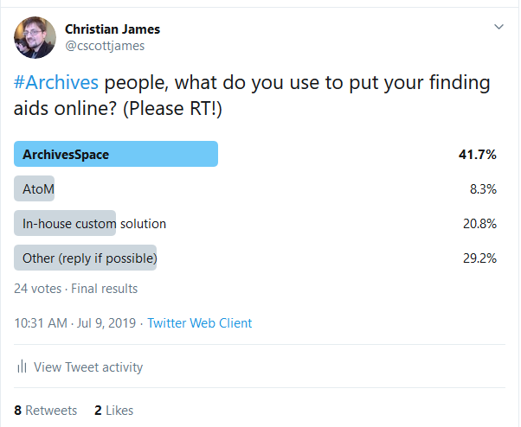




Environmental Scan
Notes:
So before we chose a new system, I decided to gather some data and see what other people are using. I got a fair amount of replies (24 votes): more than I expected, but maybe not enough to be ‘scientific.’ My hypothesis was that ArchivesSpace, Access to Memory, and in-house-created custom solutions were the top most-used systems, and my limited study sustained, that for the most part. Those three options accounted for two thirds (69%).
Twitter replies:
“Omeka- it ain’t perfect, but it’s functional”
scopeArchiv, by @scope_ag (Swiss institution)
“The most important thing is to have atomized, standards-compliant data. The second most important thing is to not be in your own boat so that others can help with your migration. Use ArchivesSpace or AtoM. There's more to archival management than resource description.”
“I'm not sure that asking people what they use is the best question! There's a lot of inertia and limping along in the archives world because migrating to a new tool is a heavy lift.”

Slide 9
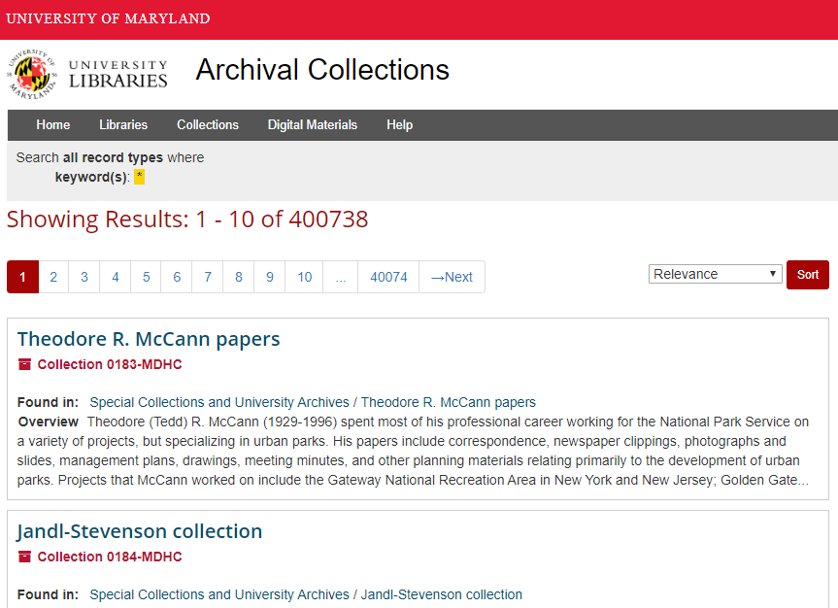
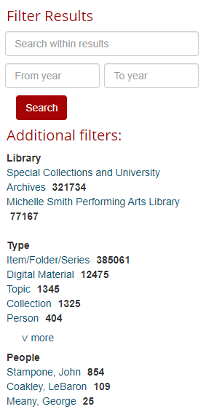
ArchivesSpace + AtoM Pros/Cons
ArchivesSpace
Pros:
high adoption, industry leader
powerful search
possible digital archives integrations
Cons
requires new virtual server
possible extra data conversion work
higher barrier to entry
no budget for membership
https://archives.lib.umd.edu
Notes:
I took a hard look at the top two systems and evaluated whether they would work for us.
I understand that WRLC has set up several instances of ArchivesSpace for member institutions, but according to Tom Boone at WRLC, only two of them use their instance for public-facing platforms. For the rest, they are only using them for description or management or are still in development. So that indicates to me that, even if WRLC can support ArchivesSpace, we just don’t have the peer models right now to provide a roadmap for us to employ this solution.

Slide 10
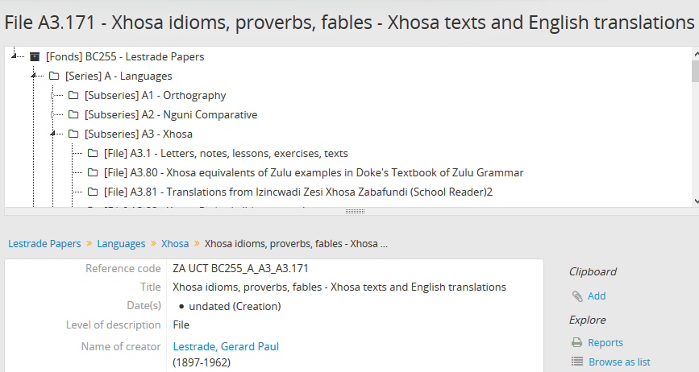
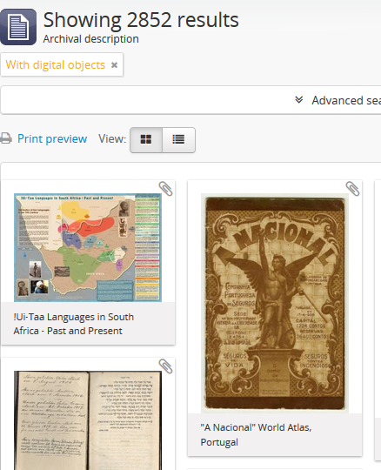
ArchivesSpace + AtoM Pros/Cons
Access to Memory (AtoM)
Pros:
easy finding aid import process
digital object integrations
possible integration with Archivematica
Cons
requires new virtual server
older than ArchivesSpace
smaller community; most users located outside of US
possible extra metadata conversion work
no budget for commercial support
University of Cape Town (S
https://atom.lib.uct.ac.za/index.php/
Notes:
Access to Memory is actually an attractive solution. It solves one of our requirements, to easily upload XML files without having to manually convert XML to HTML tags. But ultimately, I think we had to pass on this one because we would have to create another virtual server. We’re just worried about server proliferation.

Slide 11
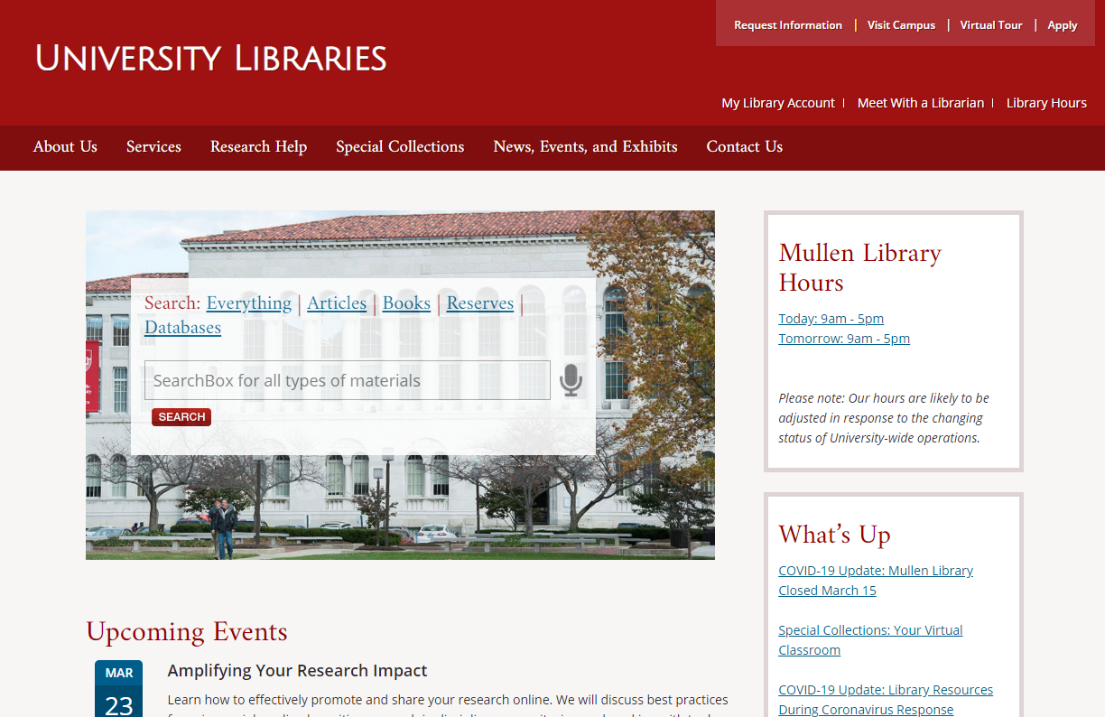
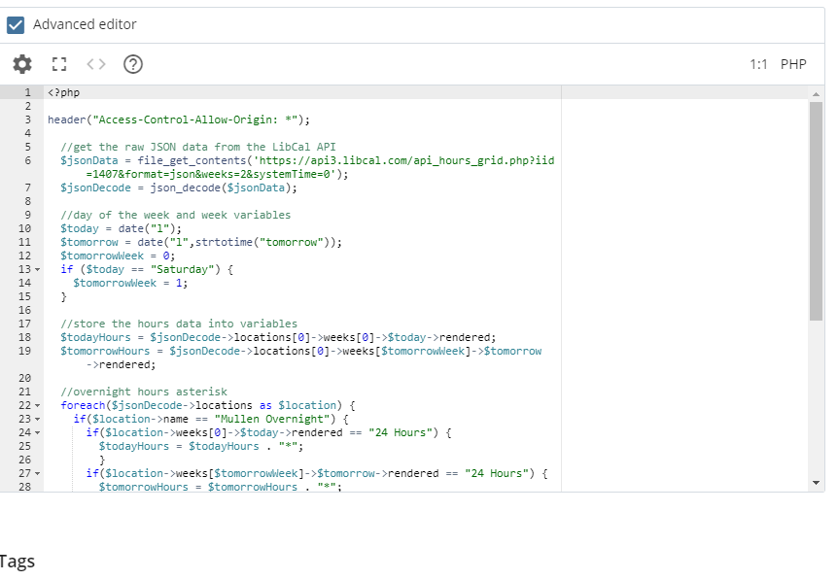
Meanwhile... New University CMS: Cascade
Many unexpected advantages:
Improved style/theme
Responsive design
CMS-based text editor
Supports PHP, jQuery, AJAX
Easy file uploading
Notes:
Meanwhile, we were pleasantly surprised with our experience using the new University “Cascade” CMS, which was developed by the vendor Hannon Hill. We initially had low expectations because the last one was so clunky. Also, the other Departments that had migrated to this web system had a more rigid style and was designed more to promote the University to undergraduate student applicants than transmit information. But our University’s Web Services department gave us even more flexibility to customize the site than we had initially imagined.

Slide 12
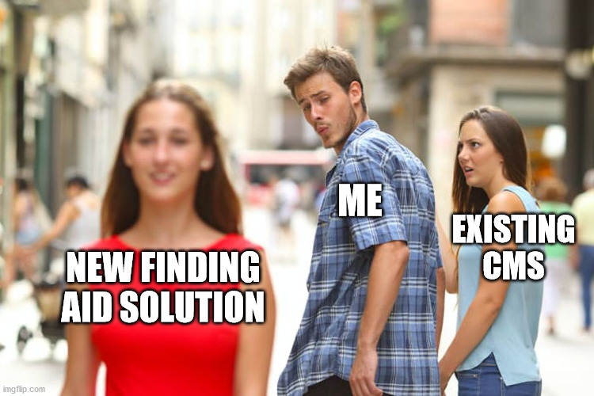
‘Distracted Librarian’
Notes:
So this gets us to the ‘hook’ of my presentation. All this time, I was looking at new solutions when there was a perfectly good one right in front of me.
Instead of using a fancy new solution, we decided to stick with our current partner: our web-based CMS, and enhance it with some extra features for maximum usability.

Slide 13

Back to Basics: Hand-Coded XSLT
Edit old “Topaz” XSLT stylesheet to match new website style/theme
Problem: not all browsers want to load XML files
Solution: AJAX + PHP + XSLT
PHP DOMDocument: applies XSLT to XML
PHP XSLTProcessor: converts XML to HTML
AJAX: loads PHP output in our HTML page
AJAX Loader wheel
https://www.ascensiongamedev.com/uploads/monthly_2017_06/loader.thumb.gif.d3adbbe2d68f5e2d2f0f5c3ed0e94564.gif
Notes:
To match new website style/theme: output the correct tags (i.e. h4 instead of h2), contain the right class names to match the University’s global CSS.
Fortunately, we already had working XSLT stylesheets to crosswalk the XML into HTML. This was first adapted from the EAD 2 cookbook by Jordan Patty, a former archivist here. My manager, Shanyun, worked to keep these up to date to match theme changes over the years. Instead of re-inventing the wheel and re-writing XSLT from scratch, I merely tweaked it to match the HTML output that we needed.
Don’t forget you can find the XSLT on GitHub at https://www.github.com/cscottjames/cascade-finding-aids
So we could now just “drag and drop” an XML file into Topaz to get it to display as HTML in our new web CMS. That did present one problem though. Not all browsers want to open XML files. So I’m using PHP to as a “XSLT processor” to convert XML to HTML.
Then, we have to use AJAX to load the PHP output into our web CMS.

Slide 14
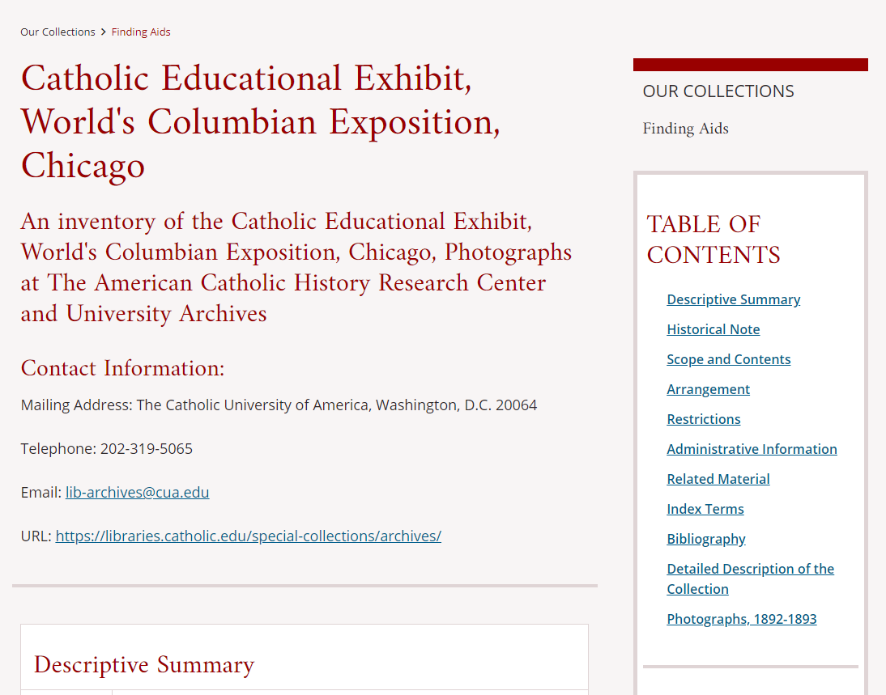
Result:
Notes:
https://libraries.catholic.edu/special-collections/archives/collections/finding-aids/finding-aids.html?file=cathedu

Slide 15
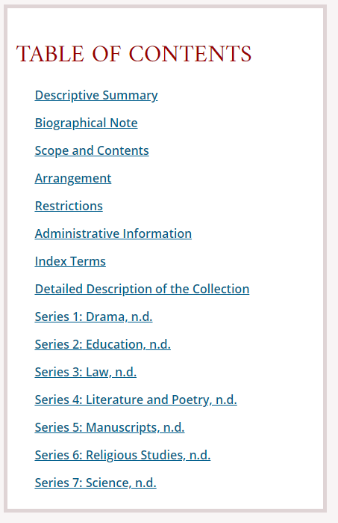
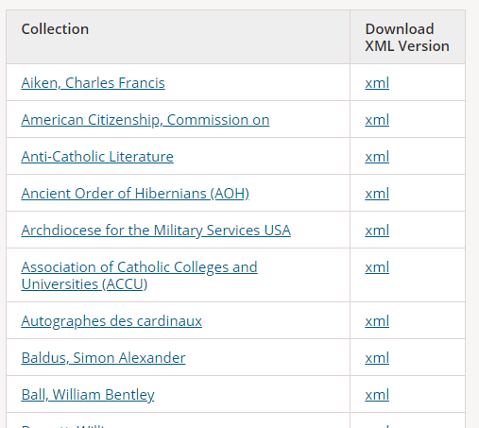
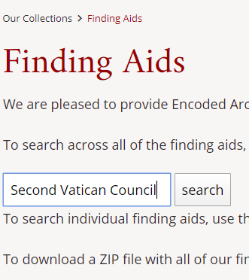
New Features/Enhancements
Persistent Navigation
Download Options
Google Site Search
Table of Contents freezes in place upon scrolling down
Users can download individual XML files or a ZIP with all files
Search box on Finding Aids index page
Notes:
One of the downsides to having the finding aids display in plain HTML is that some of them are just so long. Users could feel lost looking around at one section. Also, we’re not able to always take advantage of our side column in this CMS platform. With large documents on wide desktop screens, this side column ends up being empty. So we got around that by adding persistent (or “sticky” navigation) to the side menu
First, we send this “Table of Contents” to the side navigation to fill that void on the side. That can be easily done with jQuery commands like detach() or prepend(). This is only done based on screen width. Because if you have a small screen, then you don’t have that void.
Then we make it sticky. I won’t get into the weeds, but how this works is by having JavaScript measure the properties of the screen. If the user scrolls to a certain point in the screen, JavaScript can add a CSS class to the side navigation to stay put.
Also: smooth transitions.
For more: check out Chris Fernandini’s blog, “Go Make Things”
https://gomakethings.com/how-to-create-a-sticky-navigation-with-only-css/
https://gomakethings.com/how-to-animate-scrolling-to-anchor-links-with-one-line-of-css/
[Download options, including JS Zip]
[Search: include roadblocks!]
<form action="http://www.google.com/search" method="get"><input name="q" style="width: auto;" type="text"/> <input style="width: auto;" type="submit" value="search"/> <input name="q" type="hidden" value="-filetype:xml site:https://libraries.catholic.edu/special-collections/archives/collections/finding-aids/"/></form>

Slide 16
New Workflow
Archives Writes Finding Aid
XML / EAD Validation with Oxygen
Upload XML file to Cascade CMS
Create new hyperlink on index
Add new page link to sitemap in Google Search Console, request new sitemap crawl
Convert to MARC XML, ingest to Alma / Primo
EAD Revisions: archivists download XML file from website, return to Step 2

Slide 17

Continuing Work
Working with the Archives:
Orientation with Oxygen XML Editor
Identifying new finding aid authoring + editing software
Adjusting our EAD to MARC XML crosswalk
Notes:
This process led to more of a collaborative conversation with our Special Collections department about how archivists describe their collections. We’re still working to improve our workflow. I’ve done a demo on using Oxygen for marking up EAD, adding UTF characters, and validating XML. Until recently, they’ve used software like FileMaker, which is older, so Oxygen should be an improvement for them. I’m also investigating tools they could use to more easily write finding aids without using FileMaker or Word, before using Oxygen XML Editor.
[Also, improving Alma / Primo process]

Slide 18
Lessons Learned
No “industry standard” for finding aid display
...but maybe that’s not a bad thing?
Don’t make users open XML files!
Roadblocks: Google crawling can take a long time, especially if you have custom scripts with parameters!
Simple approaches still work
Research question: are finding aids becoming more like databases than documents?

Slide 19
THANK YOU!
Contact:
jamesc@cua.edu
Twitter: @cscottjames
https://github.com/cscottjames

Slide 20
Bibliography
Emily L. Walters (2010). Usability Studies of Online Finding Aids: A Content Analysis of the Literature, 1998-2008. (Master’s Thesis). Retrieved from https://cdr.lib.unc.edu/downloads/sq87bz287
Rachel Walton (2017). Looking for Answers: A Usability Study of Online Finding Aid Navigation. The American Archivist: Spring/Summer 2017, Vol. 80, No. 1, pp. 30-52. https://doi.org/10.17723/0360-9081.80.1.30

Slide 21
SLIDE THEME CREDITS
Presentation template by Slidesgo
Icons by Flaticon
Infographics by Freepik
Images created by Freepik
Author introduction slide photo created by Freepik
Text & Image slide photo created by Freepik

