Slide 1
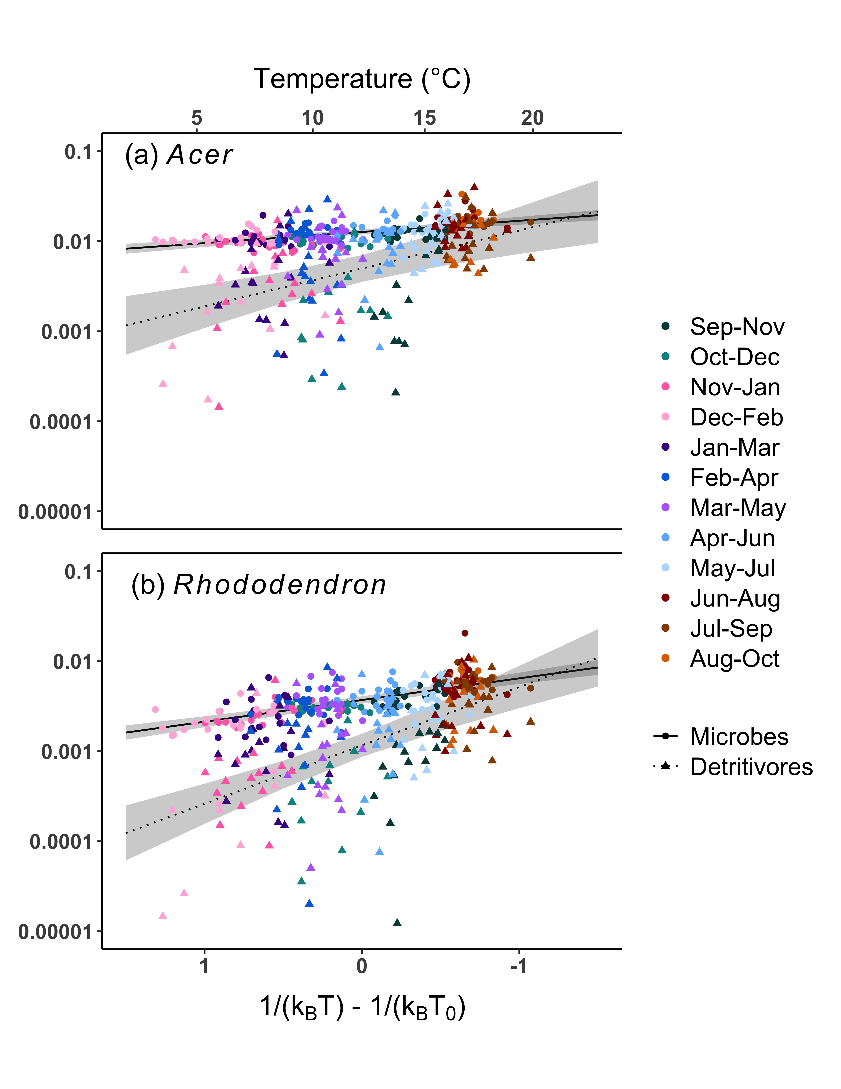
Breakdown rate (d⁻¹)

