Slide 1
Software Trajectory Analysis: an empirically based method for automated software process discovery
Pavel Senin
Collaborative Software Development Laboratory
Department of Information and Computer Sciences
University of Hawaii
senin@hawaii.edu
Committee: Philip M. Johnson (Chair), Kyungim Baek, Guylaine Poisson, Henri Casanova, Daniel Port

Slide 2
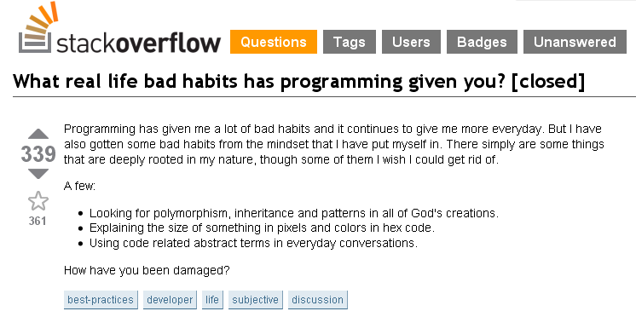




Notes:
People Are Creatures of Habit?
Programming habits -> Real life habits.
“Google everything”
“256 is a nice, round number”
“Whatever default is”
…
Recurrent behaviors

Slide 3
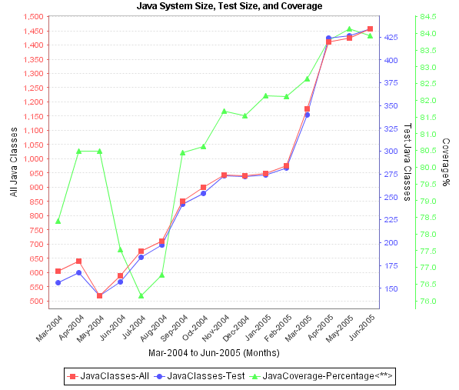
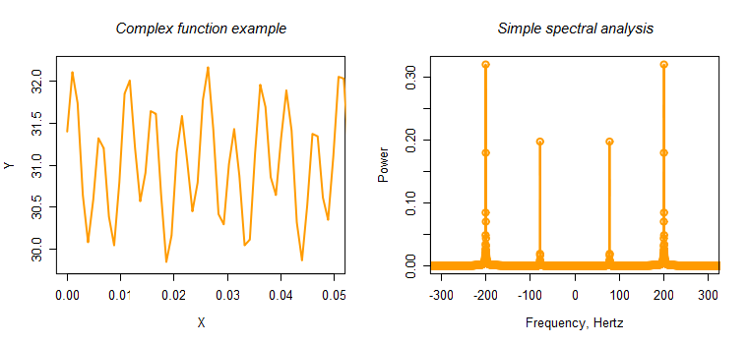
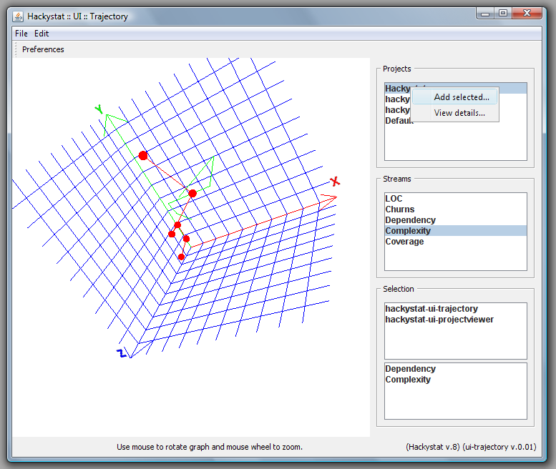
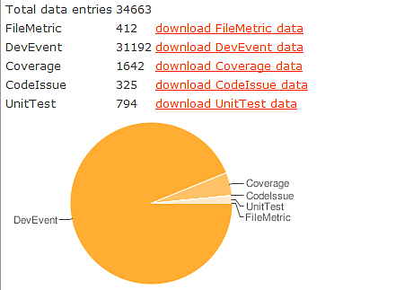
Capturing habits in telemetry
Notes:
Here I’m talking about my progress in short
Than switching to metrics
Hackystat v.7 Telemetry Streams – visual comparison, eyeballing
Discrete Fourier Transform – spectral decomposition, first coefficients + Euclidean distance
3D ,“Trajectory” visualization… - Euclidean distance
But
Euclidean distance doesn’t work…
I will add a slide explaining why, need to run R and make plots, etc…

Slide 4
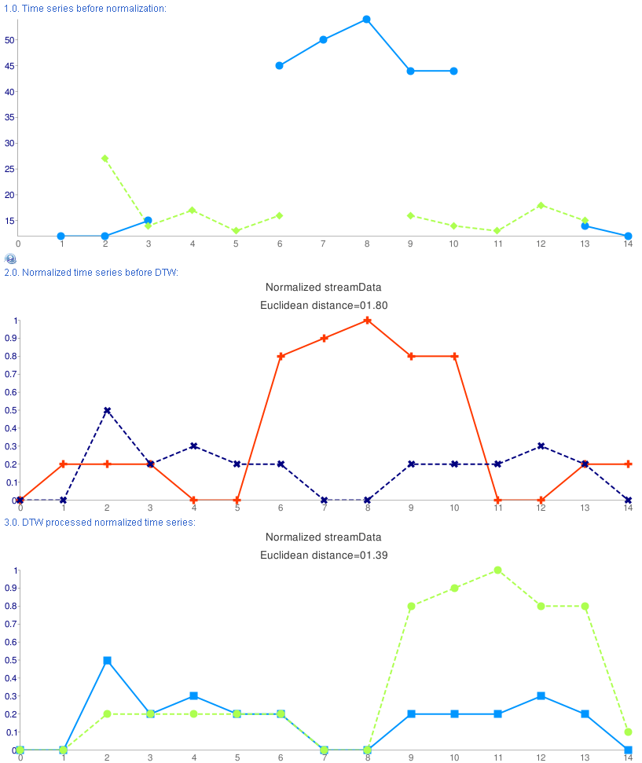
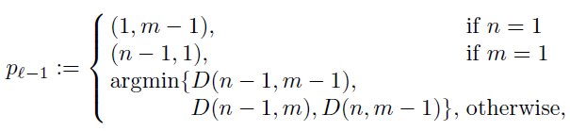

“Flexible” metrics
Dynamic Time Warping, DTW
(Sakoe, H. and Chiba, S., 1978)
Longest common subsequence, LCS
(David Maier, 1978)
Time series indexing
Sliding window + L², DTW or LCS
Notes:
Euclidean distance doesn’t work
We need flexible metrics like DTW, or LCS +Euclidean, or LCS + DTW, or maybe index with sliding window and than process with LCS+DTW? …
Will make explanation slide too

Slide 5
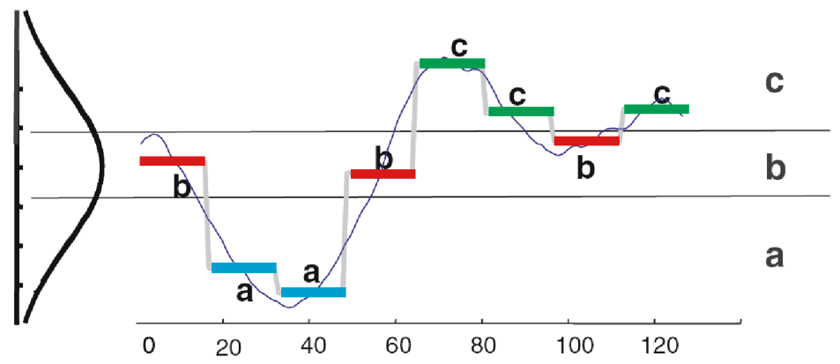
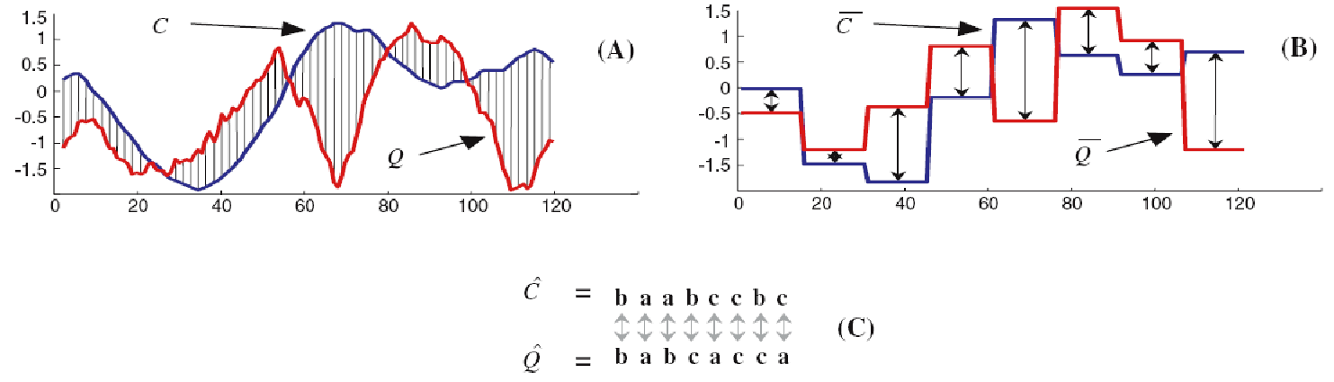
Symbolic Aggregate approXimation, SAX
baabccbc
Notes:
The winner here is SAX.
Time series -> PAA -> SAX -> String!
Lower bounding of distance, need clarifying slide too I guess.

Slide 6
SAX & Time series indexing

Slide 7
Clustering

Slide 8
Sequential pattern

Slide 9
Software process discovery

Slide 10
Software process discovery

