Slide 1
Evaluation of Jupiter:
A Lightweight Code Review Framework
Takuya Yamashita
Collaborative Software Development Laboratory
Information & Computer Sciences
University of Hawaii at Manoa
Honolulu HI 96822

Slide 2
Outline
Introduction
Related Work
Jupiter Code Review System
Evaluation
Results & Conclusions
Lessons Learned

Slide 3
What is Code Review?
Code review is peer review of computer source code intended to find and fix mistakes overlooked in the initial development phase, improving overall code quality [Wikipedia, the free encyclopedia]

Slide 4
Code Review removes many bugs
Can remove 93 percent of faults by inspection [Ackerman, 86]
Can find 11,557 faults from 7,000 inspection meeting [Weller, 93].
Can find 67 percent of faults before unit testing [Fagan, 76]

Slide 5
Problems of Code Review
Code review is costly [Glass]
Each participant is trained in not only the tool but also the structured review process, including the defined roles of participants, product checklist, and forms and report [O'Neill]
Code review costs twelve hours per participant acquiring knowledge, skills and behaviors for code inspection [O'Neill]
Disciplined review process loses review performance [Emden]
The time for review might not be allowed frequently because of the tight software development process even though it helps finding defects [Wiegers]

Slide 6
Review Tool Challenge for Code Review
Support a review process with a review tool in order to overcome the code review problems
  Customize useful functions for an IDE
    Easy to edit and post review issues, etc
  Customize useful functions for a review process
    Support a checklist, etc
  Review metric collection
    Enable team to predict how many materials can be dealt in a time constraint, etc

Slide 7
Review Tool Categories
Sophisticated Review Tool
  a review tool that focuses on one or more review processes with full support for process functions, sometimes including the support of external systems
  Provides one or more review process
  Provides the full functions for the process
  Supports backend systems (e.g. RDBMS)
  Example – CSRS, ASSIST, IBIS, LEAP, etc
Simple Review Tool
  a review tool that supports a variety of review processes with minimal initial overhead
  Almost no installation cost
  Easy to use
  Support for any review processes
  Example – Paper form, Text editor, Text Pad, etc

Slide 8
Problem of Sophisticated Review Tools:
Up Front Overhead
Overhead of Adopting Review Tools
(Up Front Overhead)
  Hard to install and deploy a review tool
    E.g. RDBMS, CM, Web application, etc
  Hard to learn and/or teach the tool
    E.g. How to use sort, filter functions, etc
  Hard to learn and/or teach a process
    E.g. announcement, preparation, review, revision, verification, etc
  Initialize review
    E.g. Making checklist, etc

Slide 9
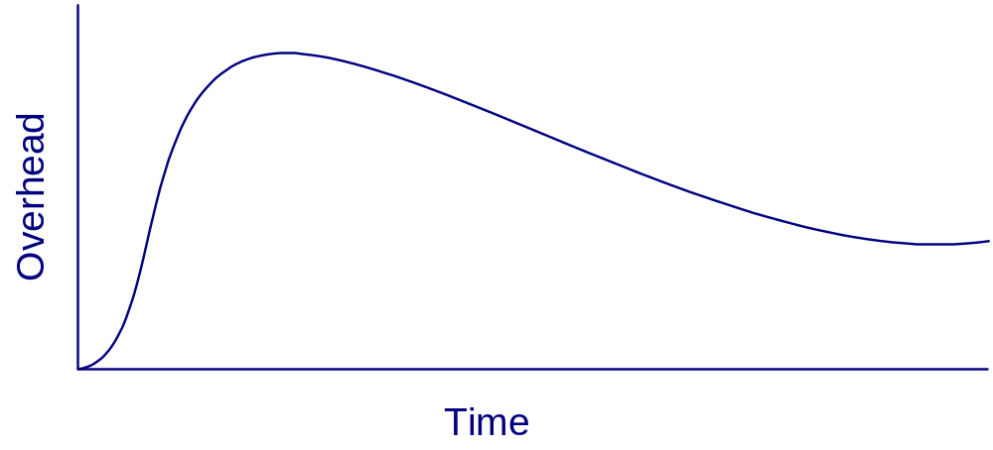
Up Front Overhead
Overhead of Adopting Sophisticated Tools
Review initialization
Learn review process
Learn tool functions
Install review system

Slide 10
Problem of Simple Review Tools:
Back End Overhead
Overhead of Information Management
(Back End Overhead)
  Hard to define review format
    E.g. writing order, using brace, etc
  Hard to maintain category validation
    E.g. validating severity and defect type items, etc
  Hard to manage review issues
    E.g. finding the issues with the highest severity rank, etc

Slide 11
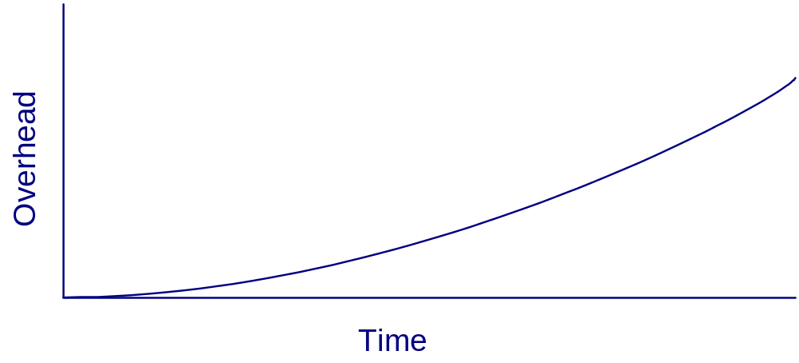
Back End Overhead
Overhead of Information Management in Simple Tools
Manage review issues
Review Initialization
Define and learn review process

Slide 12
My Approach: Jupiter
“Sophisticated Yet Simple” Tool
  Lightweight for Eclipse users
    E.g. Share the functions between Eclipse and Jupiter
  Independent from the external persistent and configuration management system
    E.g. XML file, etc
  Easy to install, update, learn, and use the system
    E.g. Update manager, automated update notification, simple tool functions, etc
  Simple four review phases
    E.g. Configuration, Individual, Team, and Rework phase.

Slide 13
Related Work
Sophisticated Review Tools
  CSRS (Collaborative Software Review System) – formal technical review
  ASSIST (Asynchronous / Synchronous Software Inspection Tool) – Asynchronous /Synchronous review.
    Evaluation of the tool based review and paper based review
  IBIS (Internet-Based Inspection System) – internet based, XML file, XSLT
  LEAP (Lightweight Empirical Automated Portable) toolkit – internet based
    Tool and metric data evaluation

Slide 14
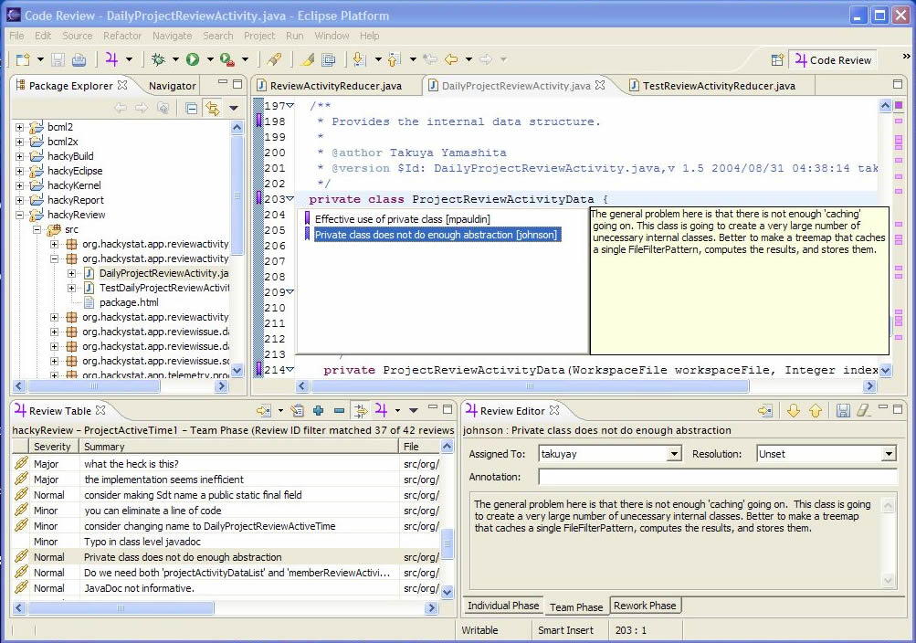
Jupiter plug-in for Eclipse

Slide 15
Four Review Phases
Configuration – to configure review ID, reviewers, and category items
Individual Review – to prepare individual review fast and find as much bugs as possible with in a time limitation
Team Review – to review as much all brought-up review comments as possible and validate them with in a time limitation
Rework – to fix the problems efficiently

Slide 16
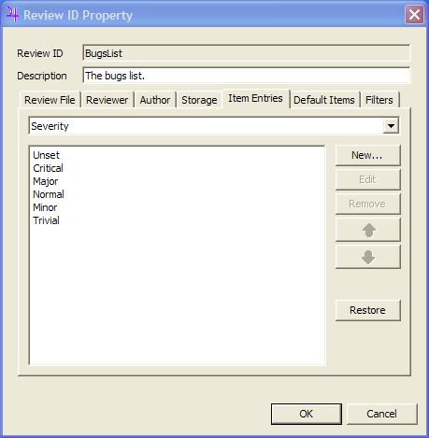
Configuration Phase

Slide 17
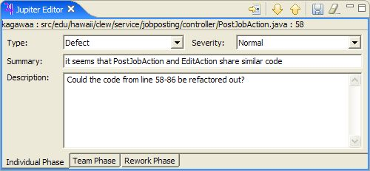
Individual Phase

Slide 18
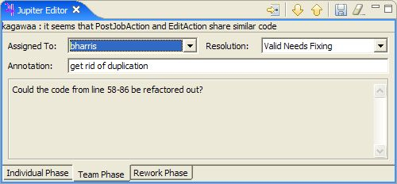
Team Phase

Slide 19
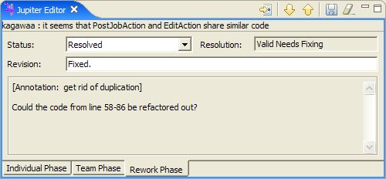
Rework Phase

Slide 20
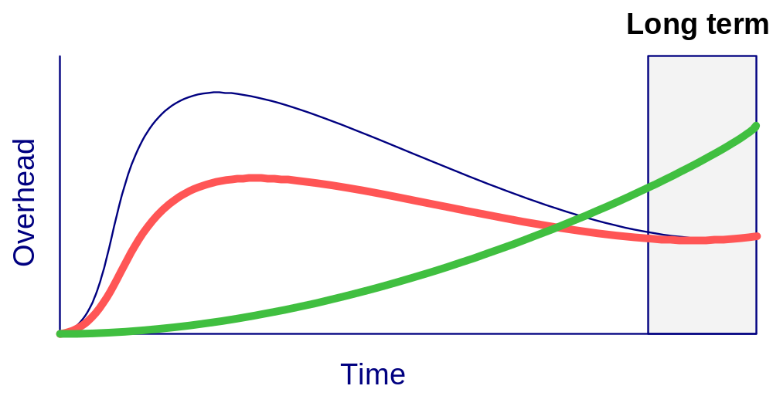
Motivation for the Evaluation
Overhead of the text based review and Jupiter based review
  Jupiter code review is useful and usable?
  Jupiter code review is less overhead in long term?
  Jupiter is adoptable in long term use?
?
?
Text based review
Adoption level
Jupiter based review

Slide 21
Thesis Claim
After initial use of Jupiter, software developer will find the good insight that it more useful and usable than the text based review.
After initial use of Jupiter, software developer will find the good insight its overhead is less than that of the text based review.
After initial use of Jupiter, software developer will find the good insight that it is adoptable in the future.

Slide 22
Subjects
Spring 2005, Dept. of Information and Computer Sciences, University of Hawaii
  9 undergraduate students
  16 graduate students

Slide 23
Evaluation Methodology
Text based code review
  Code review via email.
  Individual phase
  Team phase
  Rework phase
Jupiter based code review
  Code review via Jupiter
  Individual phase
  Team phase
  Rework phases
Questionnaire
  To obtain the student’s opinions of the usefulness and usability, overhead costs, and adoption of both Jupiter and Text-based review tools

Slide 24
Summary of Results
After initial use of Jupiter, software developer will find the good insight that it more useful and usable than the text based review.
Results provide some supporting evidence for this claim
After initial use of Jupiter, software developer will find the good insight it’s overhead is less than that of the text based review.
Results provide some supporting evidence for this claim
After initial use of Jupiter, software developer will find the good insight that it is adoptable in the future.
Results provide some supporting evidence for this claim

Slide 25
Chi-Square Test
H0: Jupiter based review has the same or less usability and utility [overhead] as/than text based review.
H1: Jupiter based review has more usability and utility [overhead] than text based review.

Slide 26
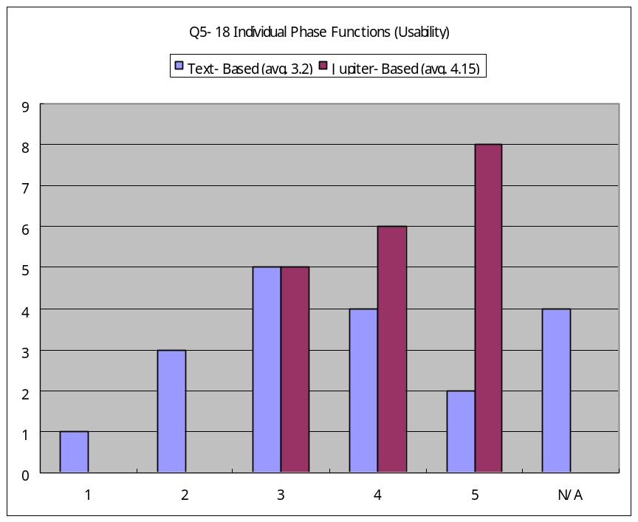
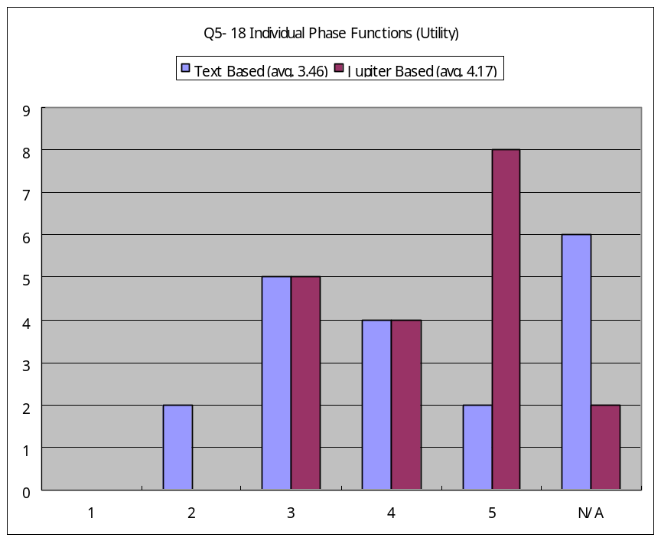
Usability and Utility
(Individual Phase)
Chi-Squared (p<0.01)
Chi-Squared (p<0.05)
Was the individual phase functions (including creating, editing review issues) usable and/or useful?
Results provide supporting evidence for the claim 1.

Slide 27
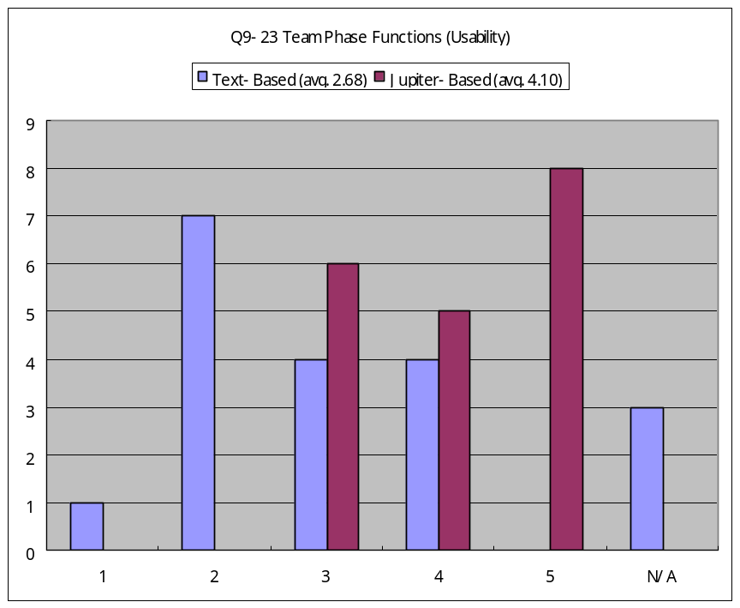
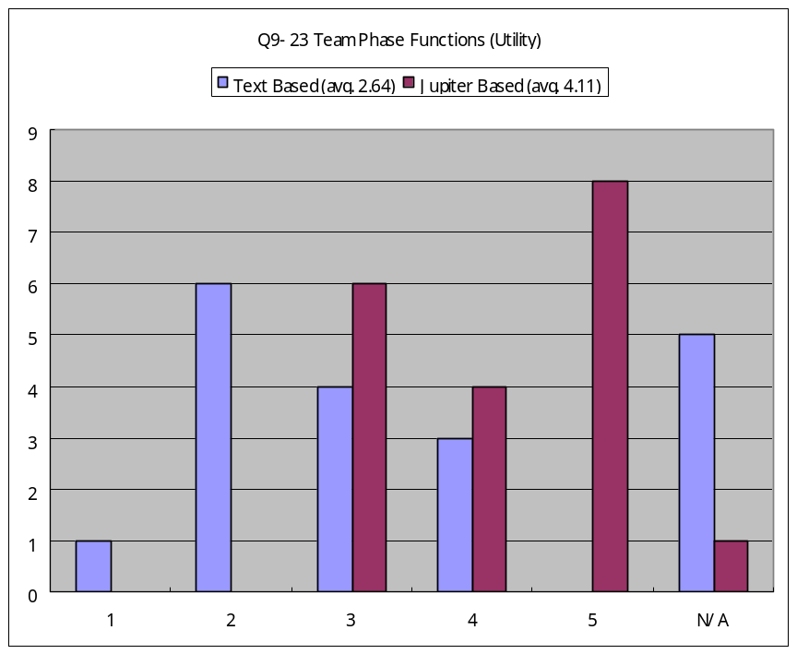
Usability and Utility
(Team Phase)
Chi-Squared (p<0.025)
Chi-Squared (p<0.05)
Was the team phase functions (including managing review issues (sorts, filters), jumping to a target file, having review markers) usable and/or useful?
Results provide supporting evidence for the claim 1.

Slide 28
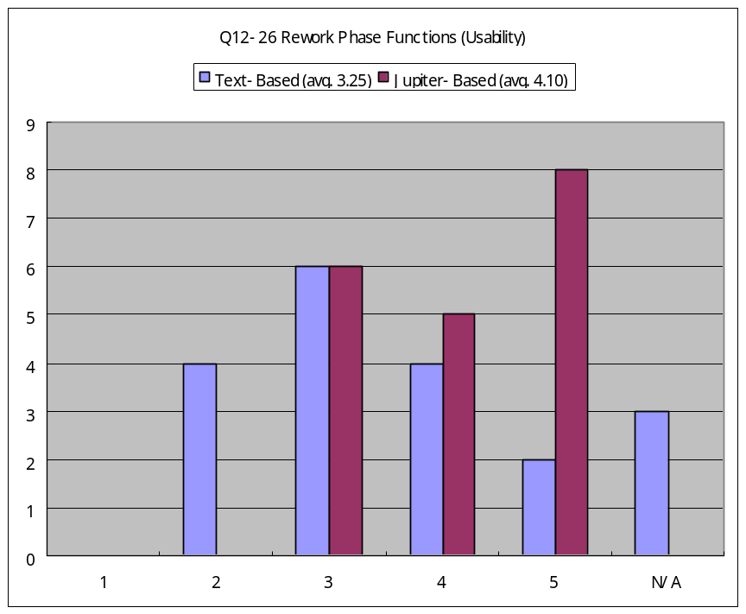
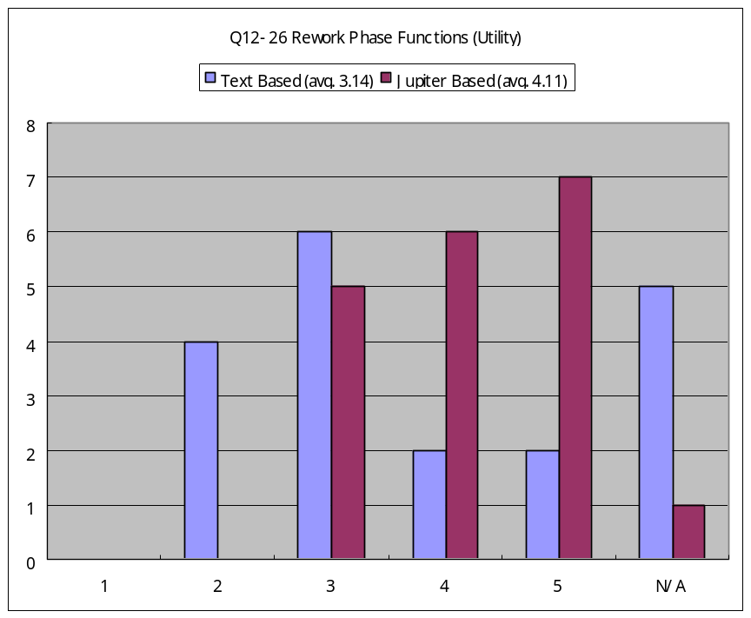
Usability and Utility
(Rework Phase)
Chi-Squared (p<0.01)
Chi-Squared (p<0.01)
Was the rework phase functions (including managing opened or closed review issues (sorts, filters), jumping to a target file, having review markers) usable and/or useful?
Results provide supporting evidence for the claim 1.

Slide 29
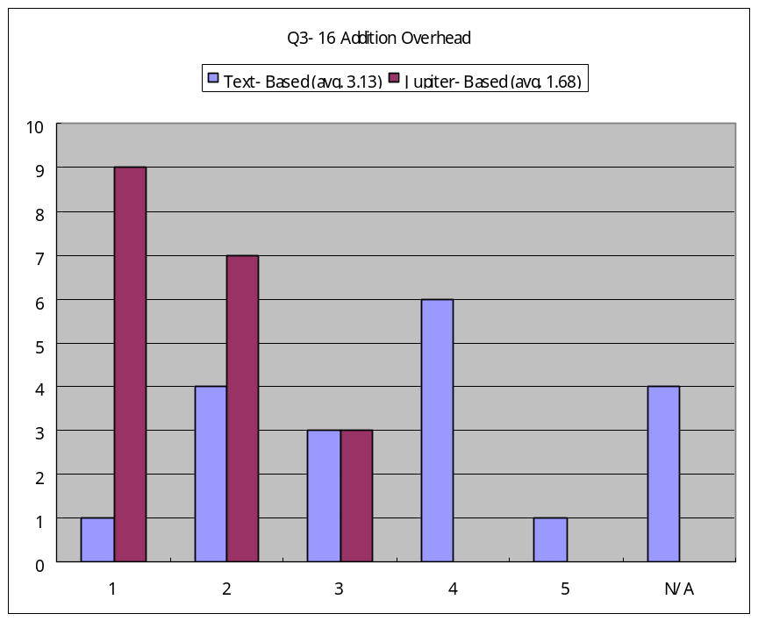
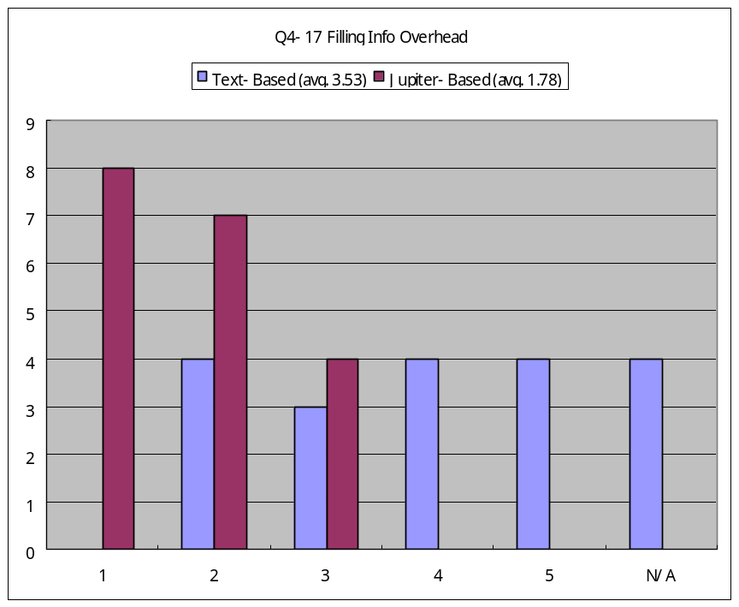
Overhead of the tool functions
(Individual Phase)
Chi-Squared (p<0.01)
Chi-Squared (p<0.025)
Q3: Was the amount of overhead required to add the issue with text based review tool [Jupiter] when an issue was found usable and/or useful?
Q4: Was the amount of overhead required to fill the issue information with the text based review tool [Jupiter] usable and/or useful?
Results provide supporting evidence for the claim 2.

Slide 30
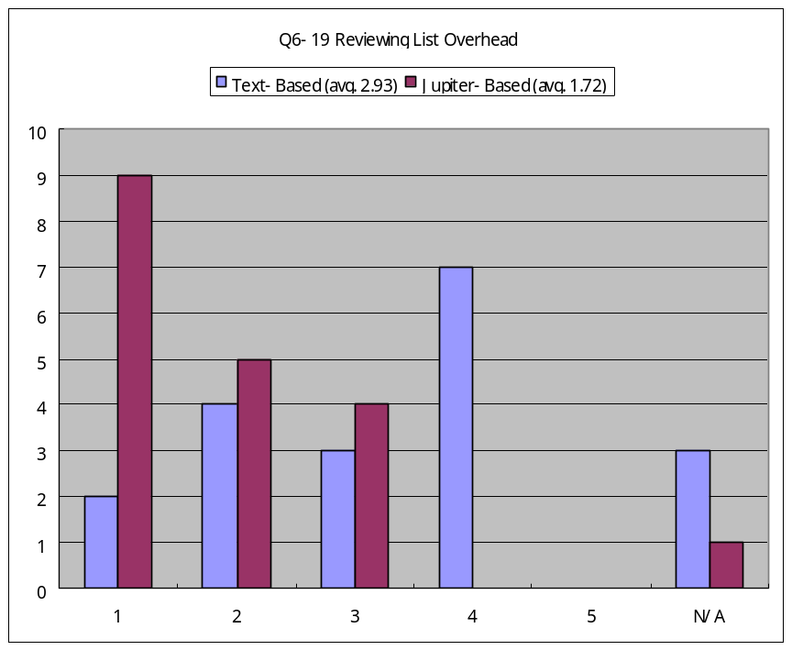
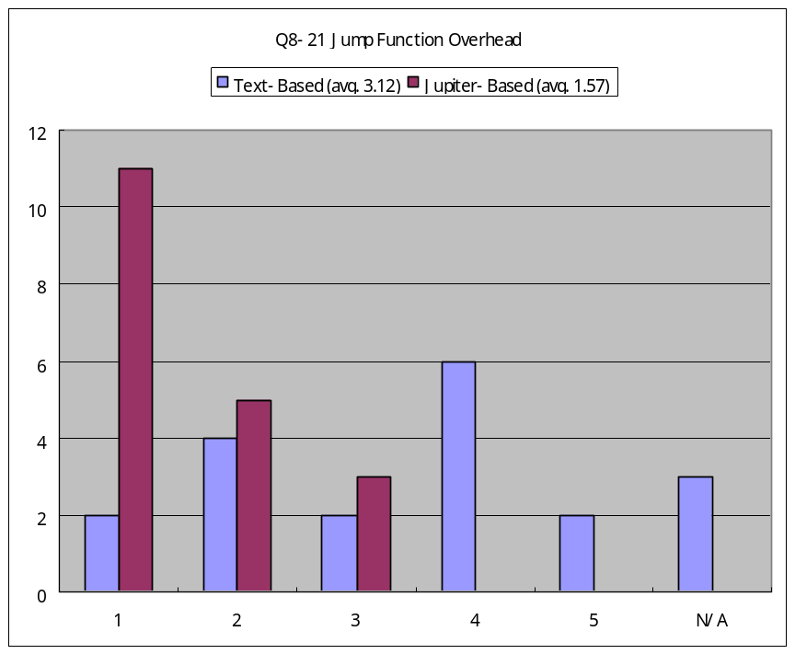
Overhead of the tool functions
(Team Phase) Cont.
Chi-Squared (p<0.01)
Chi-Squared (p<0.01)
Q19: Was the amount of overhead required to review the list of the posted issues with Jupiter in a team high (highest:5)?
Q21: Was the amount of overhead required to jump to the target point of a source code from the list of issues (i.e. Jupiter Issue View, double-clicking on an issue in the list) high (highest:5)?
Results provide supporting evidence for the claim 2.

Slide 31
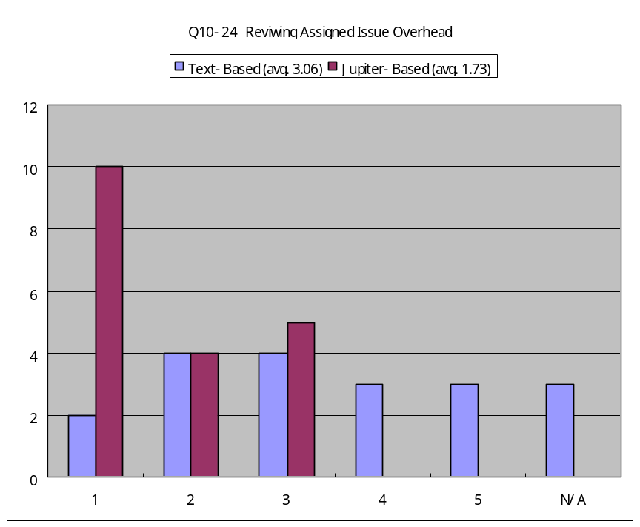
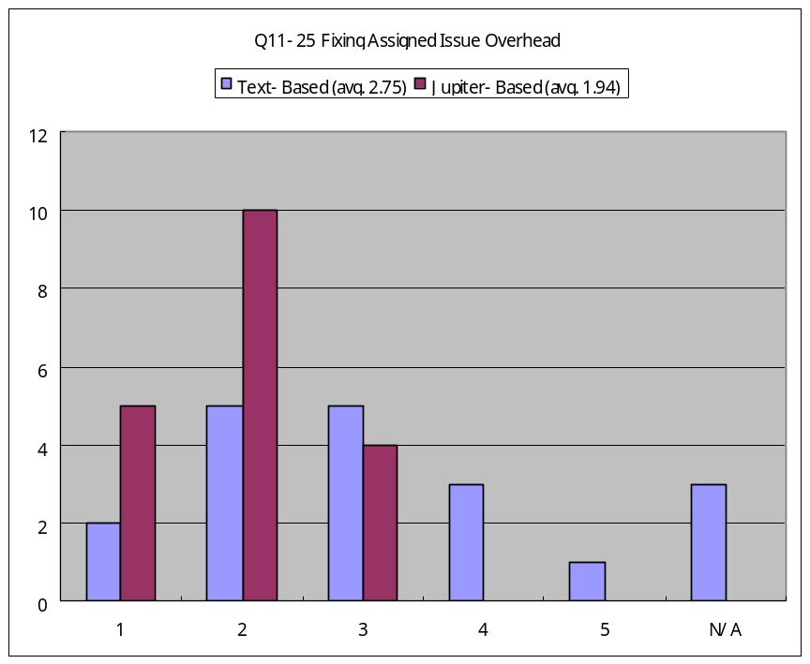
Overhead of the tool functions
(Rework Phase) Cont.
Chi-Squared (p<0.01)
Chi-Squared (p<0.05)
Q24:Was the amount of overhead required to review the assigned issues after team review done high (highest:5)?
Q25: Ws the amount of overhead required to fix the problem which was assigned to you (i.e. find the point of problem, and change (fix) the source code) high (highest:5)?
Results provide supporting evidence for the claim 2.

Slide 32
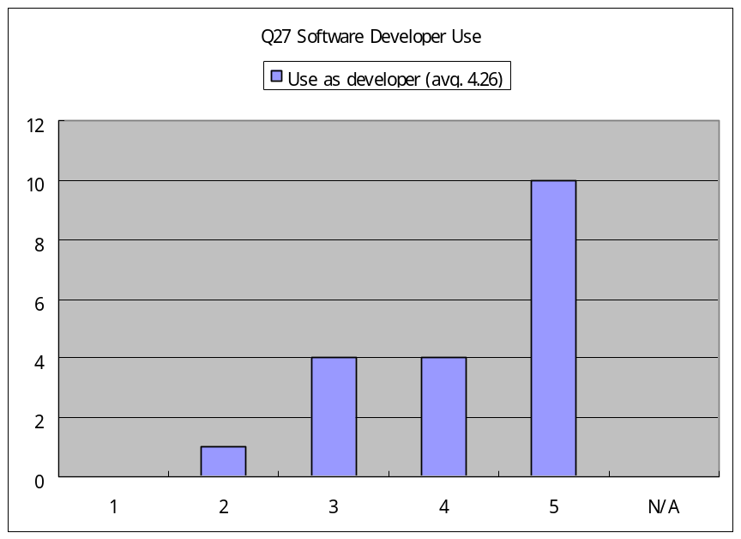
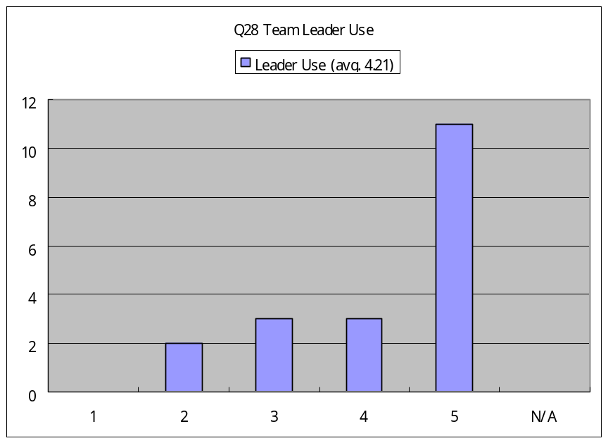
Future Adoption
Q27: If you are a professional software developer, would using Jupiter at your job be feasible?
Q28: If you are a professional team (or project) leader, would using Jupiter at your job be feasible?
Results provide supporting evidence for the claim 3.

Slide 33
Qualitative Results
There were many N/As for the text based review.
  They thought the “email based” review was not the “text based” review.
    The sorting and filtering functions could be clearer. I’ve never used text-based review, so I can not compare (Student I).
  They might omit answering the question because they could not understand what “Utility” meant.

Slide 34
Qualitative Results (cont.)
Don’t update Jupiter frequently.
  Don’t update Jupiter every single week. I don’t feel people like to do update every time they open Eclipse. It is better to release the update every 6 month (Student M).
  Please do not update Jupiter every single week. Though there is not much overhead installing it, it’s not fun to do it every week. Minor fixes: users will not be notice. Go for a major release that all users could use them effectively (Student S).

Slide 35
Qualitative Results (cont.)
There were bugs in a version of Jupiter.
  I had problems with last load (April 05). The error box showed up every command. It could not be fixed (Student O).
The initial overhead of Configuration phase is high
  Setting up initial reviews as leader was not intuitive. But once done a couple of times was very easy (Student B).

Slide 36
Qualitative Results (cont.)
Positive feelings for Jupiter
  Good (Student E).
  A nice feature would be how team reviews online with code (Student R).

Slide 37
Lessons Learned
The evaluation term should be strictly defined
  The “text based” term was not correctly recognized among some students.
The number of the questions in the questionnaire should be small.
  Only 7 students out of 19 students answered the qualitative question.
Jupiter update mechanism worked too well, so that it should not be updated frequently.
  2 students exactly were given the feedback that Jupiter should not be updated frequently.
  It implies that Jupiter update mechanism works well and users perceived the update as soon as I updated.

Slide 38
Lessons Learned (cont.)
Initial overhead in the configuration phase was pretty high
  As a student described, the setting of the review ID configuration in Eclipse was hard to find.
  Actually I provided the instruction in the Jupiter User’s Guide. So I should compensate users for more instructions or provide a configuration menu in the Eclipse main menu.
Jupiter would be used for an online review.
  A student felt it [would be useful.]
  This links to the fact that I received the online review comments for the Jupiter system from Jupiter users.

