Slide 1




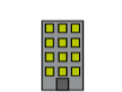
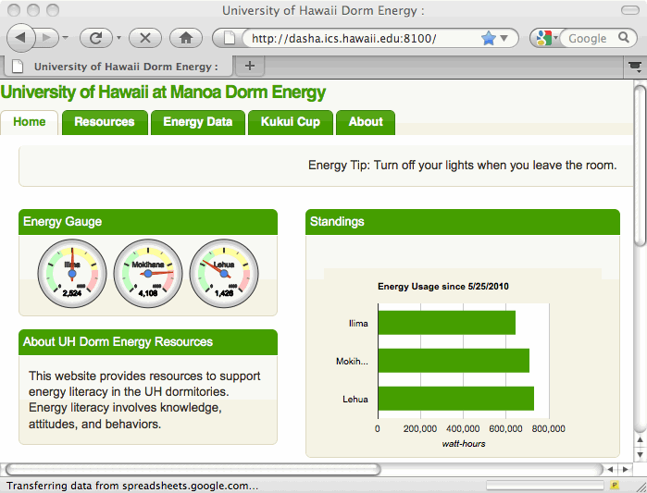
Meters
Dorm
Meters
WattDepot
Sensors
WattDepot
Server
WattDepot
Cloud Cache
Makahiki

