Slide 1
Automated Support for Technical Skill Acquisition and Improvement: An Evaluation of the Leap Toolkit
Cam Moore
Collaborative Software Development Laboratory
Communication & Information Sciences
University of Hawaii, Manoa
cmoore@hawaii.edu
http://csdl.ics.hawaii.edu/Research/LEAP/LEAP.html

Slide 2
Introduction
Software Quality is still a huge problem
Traditional solutions focus on
  The work product
    Formal technical review, formal design
  The development organization
    CMM, Spice, ISO 9000
  The development process
    Cleanroom, Spiral, Waterfall
Recently, researchers have started addressing software quality at the level of individuals.

Slide 3
Software quality improvement at the individual level
Personal Software Process - Humphrey 95
  Manual process
  Defines development processes
  Collects and analyzes data on the individual developer
PSP Studio: East Tennessee State University 1997
  Faithfully automates PSP
  Automates the bookkeeping involved

Slide 4
Other major research
Data Quality issues with PSP - Disney 98
  Serious data quality issues
  Recommended automation
  Classes of errors in PSP data
Controlled Experiment on effects of PSP training: Prechelt and Unger 1999
  Estimation accuracy not significantly better in PSP users
See PSP bibliography for other references.

Slide 5
Important research questions
Can an appropriately design method, in conjunction with automated support address:
  data quality issues identified in Disney98?
  low adoption rate identified in Shostak96?
  estimation problems identified in Prechelt99?

Slide 6
Supporting Software Developer Improvement with LEAP
LEAP is our design philosophy. All LEAP tools must satisfy four major criteria:
  Light weight
  Empirical
  Anti-Measurement dysfunctional and
  Portable
The Leap Toolkit is a reference implementation

Slide 7
Leap Toolkit
The Leap Toolkit is implemented in Java
As of 21 Sep. 1999, the size of the Leap Toolkit is:
  41,000 Lines of Java Code
  1,955 Methods
  272 Classes
  13 Packages
It is available for download from
http://csdl.ics.hawaii.edu/Tools/LEAP/LEAP.html

Slide 8

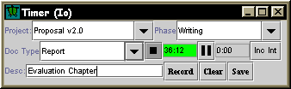
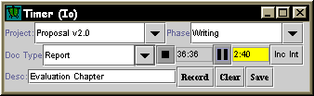
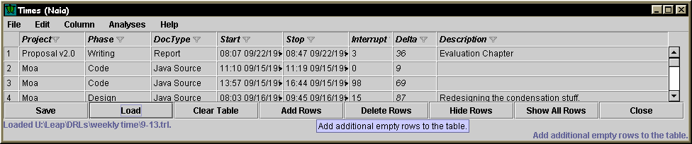
Leap Toolkit: Data Collection
Time
  Io “single line” entry
  Naia Time Table

Slide 9
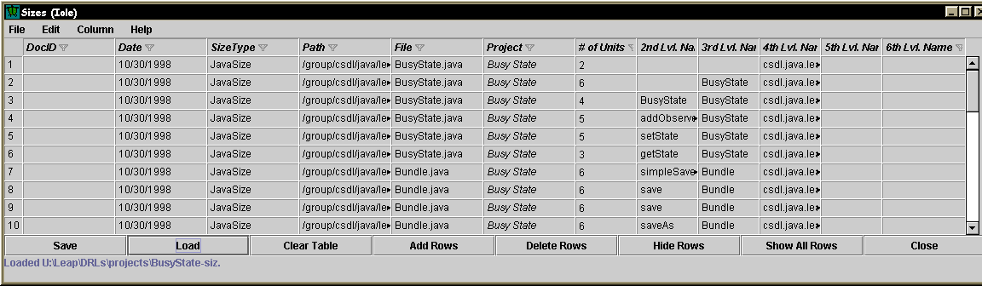
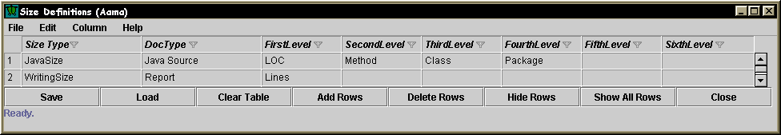
Leap Toolkit: Data Collection
Size
  Hierarchical size

Slide 10
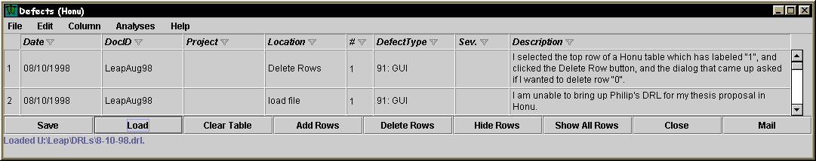
Leap Toolkit: Data Collection
Defects
  Represents some common properties of defects

Slide 11
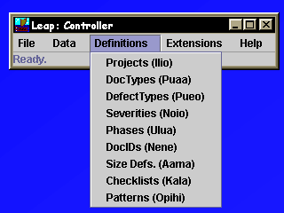
Leap Toolkit: Data Collection
Definitions
  Help in data collection and analysis
  Provides flexibility to the user

Slide 12
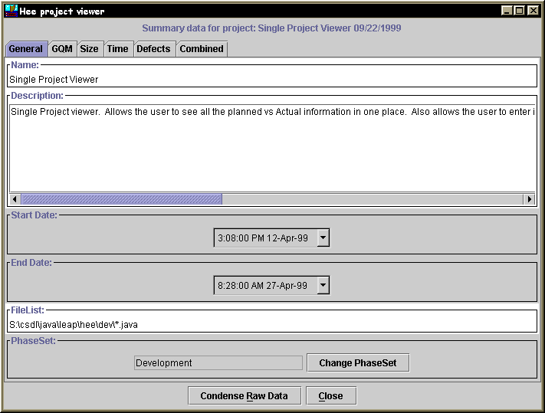
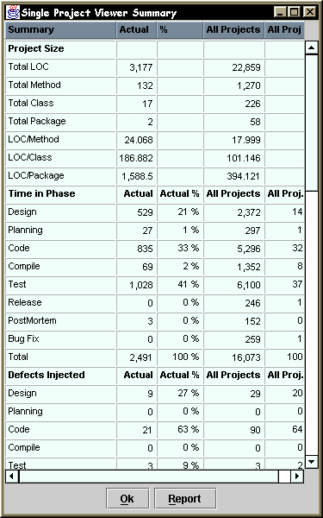
Leap Toolkit: Data Analysis
Project Summary
  Provides an overview of completed projects

Slide 13
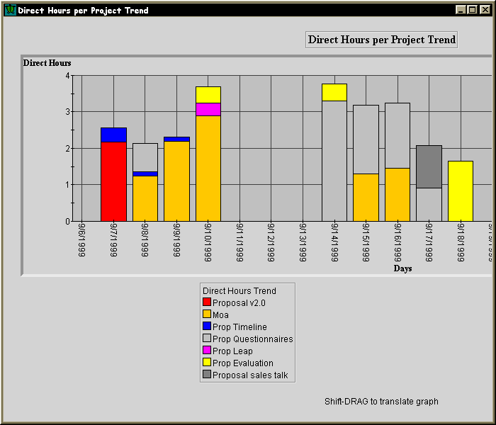
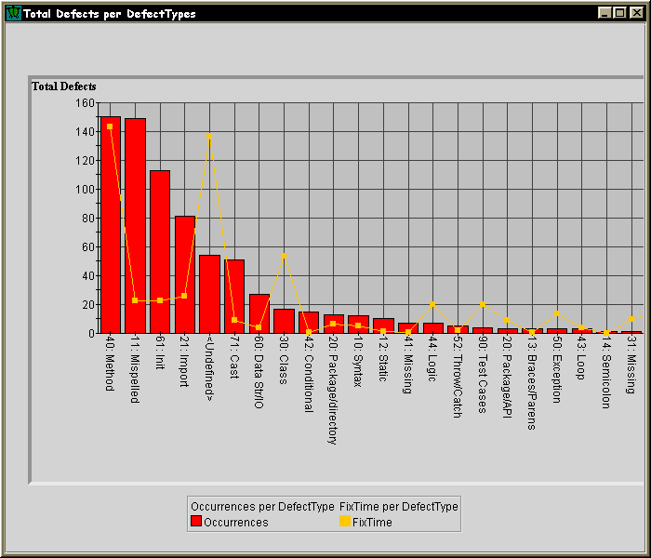
Leap Toolkit: Data Analysis
Primary Data
  Shows trends
  Distributions

Slide 14
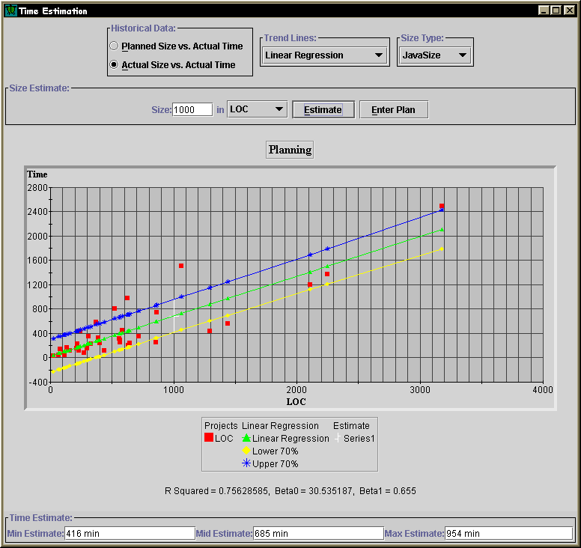
Leap Toolkit: Data Analysis
Estimation
  Historically based
  Size -> time
  Multiple
  estimation models
  Multiple
  Size levels

Slide 15
General Thesis
LEAP provides a more accurate and effective way for developers to collect and analyze their software engineering data than methods designed for manual enactment.

Slide 16
Evaluation
To evaluate this thesis I will break it into 3 hypotheses
  Leap is able to prevent important classes of data error as identified in Disney98.
  Leap implements data collection and analysis that enables sophisticated analysis not available in manual methods such as PSP.
  Leap reduces the level of collection stage errors by reducing the overhead of data collection

Slide 17
Evaluation:
Error Prevention
The design of Leap prevents many of the types of data error found by Disney.
  Automated time data entry
  Automated data analysis
  Data does not have to be transferred between forms

Slide 18
Evaluation:
Sophisticated analyses
Leap allows us to evaluate 14 different quantitative time estimation techniques.
Hypothesis: Different estimation methods are more accurate.
Quantitative Case Study
  15 Students will use Leap while building 10 programs
  Leap will produce the 14 time estimates based upon the student’s size estimate
  Leap will record the actual time spent and size of the projects

Slide 19
Evaluation:
Sophisticated analyses
14 Different Estimation methods
Planned Size
A
Actual Size
C
B
Methods
LOC
Average
Linear
Exponential
Student’s
PSP (A, B, or C)

Slide 20
Evaluation:
Sophisticated analyses
We can calculate the error for each estimation method.
  Prediction Error = | estimate - actual | / actual
  Model: yij = µ + t_{i} + ß_{j} + e_{i}
    yi = the relative prediction error for alternative i
    µ = the overall mean
    t_{i} = the effect of the ith treatment (estimation method)
    ßj = the effect of the jth block (project)
    e_{ij} = residual for the ith and jth treatment
  Null Hypothesis: No difference
    H₀ = µ₁ = µ₂ = µ₃ = ... = µ₁₄
    Where µ_{i} = µ + t_{i}.; i = {1, 2, 3, ... , 14}.

Slide 21
Evaluation:
Sophisticated analyses
Data Analysis
  Randomized Block design, blocking for the project
  Use ANOVA to detect differences between the methods

Slide 22
Evaluation:
Collection error reduction
Very difficult to detect so I will try to detect it by a combination of data analysis and surveys.
Leap Data analysis
  look for time data that ends on 5 minute intervals
  actual data that is a multiple of 5 minutes

Slide 23
Evaluation:
Collection error reduction
Surveys
  4 Anonymous surveys
    Background & Time recording
    Usability, Time recording & estimation
    Time recording, estimation & defects
    Usability, Perceptions & Lessons Learned
  I will look for reported pressure to complete the projects

Slide 24
Time Line
August: Class started
Sept 27: 1st survey
Oct 18: 2nd survey
Nov 22: 3rd survey
Dec 6: 4th survey
Dec 31: Finished with background chapters
Jan 31: Estimation data analysis complete
Feb 14: Survey analysis complete
Feb 24: Dissertation to committee
Mar 16: Dissertation defense
Apr 7: Dissertation to Grad. Division

Slide 25
Future Directions
Replicated studies with more subjects including industrial software developers
Industry adoption of Leap Toolkit
More support for data analysis in Leap Toolkit
Further study into effort estimation
Personal Agents that “observe” the developer

