Slide 1
Start/Stop
Timer
Increment
Interrupt Time
Save Current Entry
Record
Current Entry
Project
Phase
DocType
Pause/Resume
(Interrupt Time)
Description
Clear
Current Entry

Slide 2
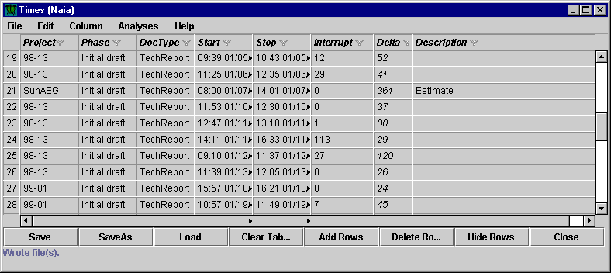
Column Header
(Click to sort by column)
Filter Icon
(Shift-Click)
Menu Bar
Index Numbers
Read-Only Field
(Italicized)
Button Bar

