Slide 1
An Overview of Project LEAP
Philip Johnson
Department of Information & Computer Sciences
University of Hawaii

Slide 2
About CSDL
We grow world-class software engineers through:
  High quality development practice
  “Deep” knowledge of one/more domains
  Development of skills in:
    design
    coding
    presentation
    writing
    research: design→implementation→evaluation
  Industrial internships/collaborations

Slide 3
Project LEAP
Project LEAP is built from three streams of software engineering research and practice:
Project LEAP
Formal Technical Review
Personal Software Process
Measurement Dysfunction

Slide 4
Measurement Dysfunction
When the act of measurement affects the organization in a counter-productive fashion, which leads to results directly counter to those intended by the organization for the measurement.
  Robert Austin, “Measuring and Managing Performance in Organizations”
In essence, “metrics that backfire”.
  Example: Russian Boot Factory
LEAP
FTR
PSP
Measurement Dysfunction

Slide 5
Measurement Dysfunction in
Software Engineering
If management says:
  We must increase productivity.
  We measure productivity by LOC/hour.
Then the likely results are:
  Programmers will not take extra time required to develop reusable code.
  Programmers will spend less time on non-coding activities such as design.
  Real productivity will decrease even though measured productivity will increase.
LEAP
FTR
PSP
Measurement Dysfunction

Slide 6
Formal Technical Review
FTR is any of several structured procedures for improving quality through group review of work products.
Example: Inspection
  Planning: team organization
  Overview meeting: work product intro
  Preparation: individual review
  Review Meeting: joint discussion
  Rework: author fixes
LEAP
FTR
PSP
Measurement Dysfunction

Slide 7
FTR critique
Benefits:
  Does improve quality.
  Supports learning across group.
  Leverages “two heads are better than one”.
  Produces useful measurements.
Problems:
  Often hard to adopt.
  Can be time consuming and expensive.
  Easy to drop during “crunch mode”.
  Prone to measurement dysfunction.
LEAP
FTR
PSP
Measurement Dysfunction

Slide 8
The Personal Software Process
An approach to personal software process improvement involving:
  Adoption of highly structured procedures.
  Collection of defect and time measures.
  Quality improvement through:
    defect management.
    empirically-based time/size estimation.
LEAP
FTR
PSP
Measurement Dysfunction

Slide 9
PSP critique
Benefits:
  Methodologically sound
  Does appear to work in classroom setting
  Data is personal, thus not prone to measure-ment dysfunction.
Problems:
  Extremely time-consuming and difficult
  Hard to adopt in industrial practice
  Accurate data collection and analysis is difficult.
  Sole focus on defects is psychologically discouraging.
LEAP
FTR
PSP
Measurement Dysfunction

Slide 10
The Goal: LEAP
L
  Lightweight, few process constraints
E
  Empirical, both qualitative and quantitative
A
  Anti-measurement dysfunction
  Automated
P
  Portable across projects and jobs
  Personal
  Pattern and defect management
LEAP
FTR
PSP
Measurement Dysfunction

Slide 11
Similarities and Differences
Similarities to PSP:
  Personal data
  Defect,Time Recording
  Planning/Estimation
  Defect reduction
Similarities to FTR:
  Group review
  Learning from others
Differences from PSP:
  Automation essential
  (Potentially) unstructured process
  Low overhead is a key design constraint
  Pattern recording
Differences from FTR:
  Automation essential
  (Potentially) unstructured process
  No management-level support requirements
  Anonymous data

Slide 12
LEAP: The Personal Perspective
(Semi or totally) automated recording of:
  Time spent on development activities
  Defects/Issues resulting from activities
  Work product characteristics (size, type, etc.)
Provides accessible, just-in-time analyses of:
  Effort, defects, work product characteristics
Which leads to:
  Personal insights, documented as patterns.

Slide 13

LEAP: The Group Perspective
Groups of developers share insights:
  Defects they find in each other’s work via review.
  Patterns they have discovered and think might be useful.
But, they do not share measurements!

Slide 14
The Cosmic Duality of Defects and Patterns
Defects
Patterns

Slide 15
Essential LEAP Services
Data classification
  Projects, patterns, defects, phases, document types, document IDs
Data collection
  In-process time, defect, patterns
Data analysis
  Trends, frequencies, relevance
Data distribution
  Email, web

Slide 16
LEAP Overhead
Any time spent recording what you do is time lost for doing real work.
To be useful, Project LEAP must:
  Make process data collection (“recording what you do”) as simple and fast as possible.
  Transform raw data into useful information that stimulates introspection, new patterns, and increased skill.
Project LEAP must accomplish this CHEAPLY, (unlike manual PSP).

Slide 17
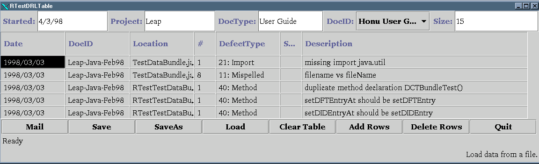
Honu: LEAP Review Tool

Slide 18
Honu Services
Pop-up menus for document type, defect types, etc.
Default values for as many entries as possible.
Built-in support for emailing defects discovered to other reviewers.

Slide 19
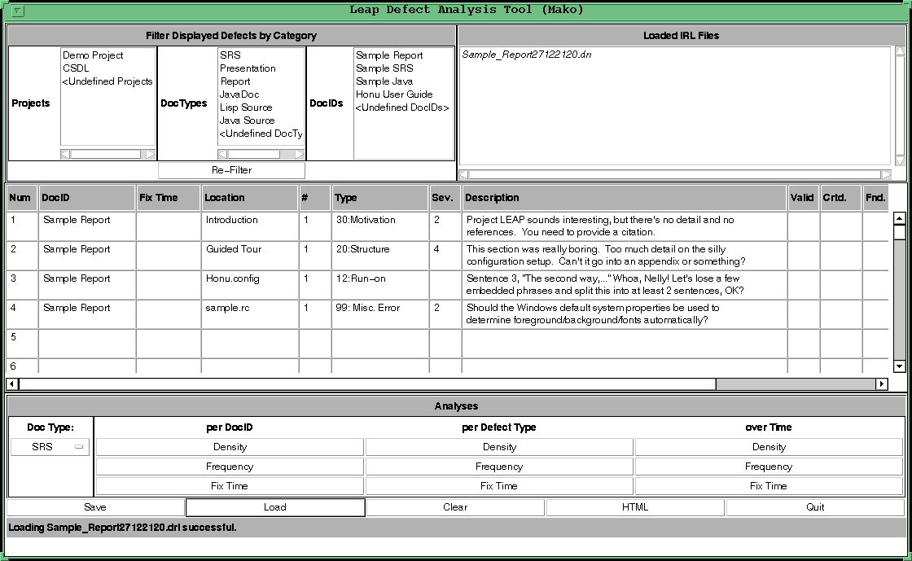
Mako: LEAP Defect Analysis

Slide 20
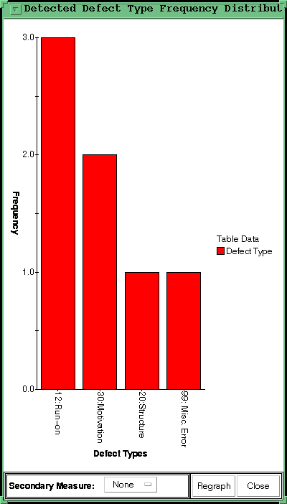
Sample Mako Analysis

Slide 21
Mako Services
Loading multiple files of defect data.
  Both review defects and in-process defects
Filtering, aggregating defects by type, document type, document ID, etc.
Built-in analysis charts to help transform data into useful information.

Slide 22
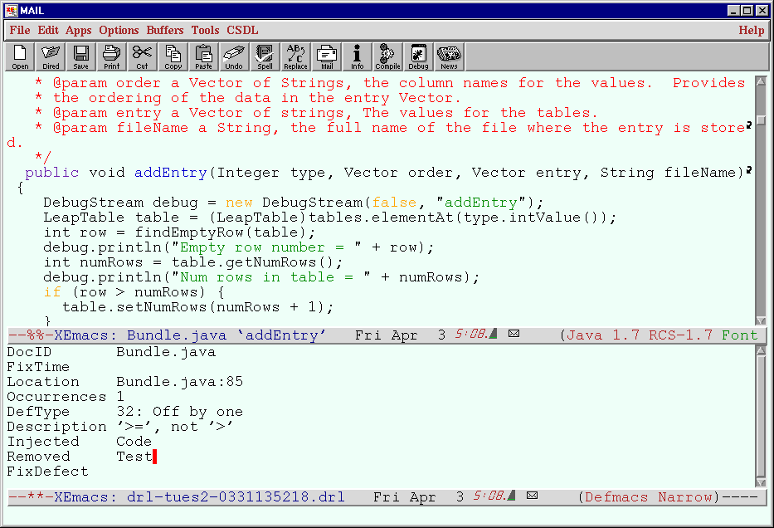
Defmacs

Slide 23
Defmacs Services
Tightly integrated with Emacs editor
Provides low-overhead in-process defect collection via:
  Keystroke invocation with pop-up buffer
  Pop-up menu-based defect data entry
  Context-sensitive defaults.
  Compilation-mode integration

Slide 24
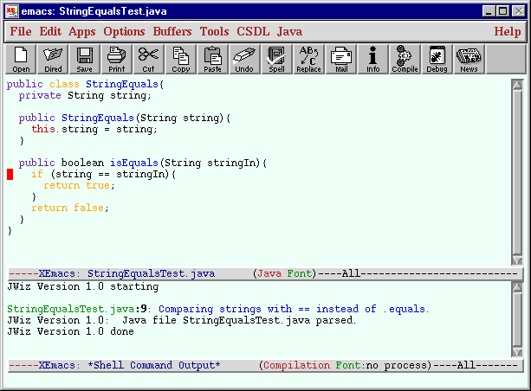
JavaWizard

Slide 25
JavaWizard Services
Automated Detection of certain classes of run-time errors through static analysis.
Emacs interface allows in-process detection and removal of errors.

Slide 26
Leap Research Trajectory
Easy/Finished
Defect Collection
Easy/Ongoing
Defect Analysis
Hard/Future
Time Collection
Very Hard/Future
Time Analysis
Size Collection
Estimation Services
Pattern Collection
Agent-based Services
Public Process Repositories

Slide 27
Agent-based Process Support
In-process defect data
Compiler output
Size/structures
measures
On-demand
or “just in time”
process
insights
Agents
JavaWizard
Group review data
Manual time records
In-process time data

Slide 28
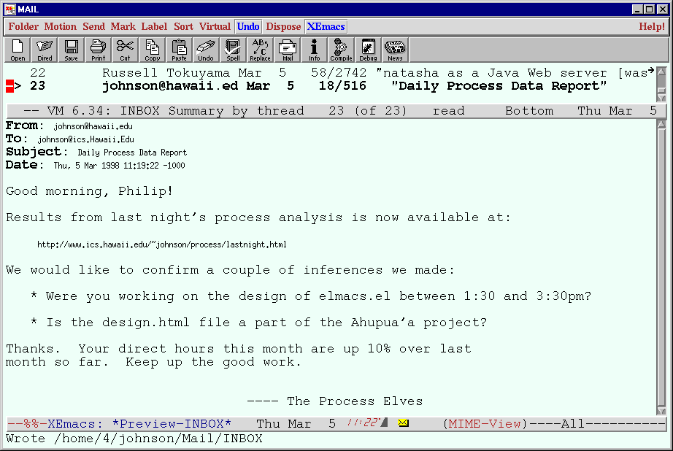
Just-in-time Process Analysis

Slide 29
Near term projects
Hierarchy Tool
JavaRange Enhancements
  Improved Web Interface
  LEAP version
JavaWizard Enhancements
  Improved Web Interface
  LEAP version
Visual Basic versions of:
  DRL, TRL
  Leap interface
Pattern Support
  Pattern Entry Tool
  Pattern Agent
Analysis Enhancements
  Trends
  Comparisons
  Predictions
LEAP agents
  Data merging
  Process inference
  Report generation
  LEAP “Paper Clip Guy”

Slide 30
For More Information
The CSDL Website (with links to both Project LEAP research and the LEAP toolset:)
  csdl.ics.hawaii.edu
The Project-Leap@hawaii.edu mailing list

