Slide 1
Project LEAP: Addressing Measurement Dysfunction in Review
Carleton Moore
Collaborative Software Development Laboratory
Department of Information & Computer Sciences
University of Hawaii
http://csdl.ics.hawaii.edu/

Slide 2
Outline
Problem
Measurement Dysfunction
An alternative Approach: LEAP
Evaluation
Results
Future Directions
Conclusions

Slide 3
Problem
Trying to improve Formal Technical Review (FTR) quality often leads to Measurement Dysfunction.
Collect metrics on the FTR practice to help improve future FTRs.
FTR
Practice
Modify
Evaluate
Metrics
FTR
Metrics

Slide 4
Measurement Dysfunction
When the act of measurement affects the organization in a counter-productive fashion, which leads to results directly counter to those intended by the organization for the measurement.
  Robert Austin, “Measuring and Managing Performance in Organizations”
In essence, “metrics that backfire”.
  Example: Russian Boot Factory

Slide 5
Measurement Dysfunction in
FTR
Goal: Increase the number of “important” defects found
  Defect severity inflation/deflation
Goal: Improve FTR defect detection
  Defect density inflation
Goal: Reviewers prepared for review
  Reviewer preparation time inflation
Goal: Improve defect detection rate
  Defect discovery inflation

Slide 6
The Alternative: LEAP
Focus on individual reviewers
  Better reviewers => Better reviews
Tools and processes must obey LEAP constraints:
  Lightweight, few process constraints
  Empirical, both qualitative and quantitative
  Anti-measurement dysfunction
  Personal, sensitive data is private
http://csdl.ics.hawaii.edu/Tools/LEAP/LEAP.html

Slide 7
LEAP: The Personal Perspective
(Semi or totally) automated recording of:
  Time spent on review activities
  Defects/Issues resulting from activities
  Work product characteristics (size, type, etc.)
Provides accessible, just-in-time analyses of:
  Effort, defects, work product characteristics
Which leads to:
  Personal insights, documented as checklists

Slide 8

LEAP: The Group Perspective
Groups of reviewers share insights:
  Defects they find in each other’s work via review.
  Checklists they have developed based upon their private data.
But, they do not share measurements!

Slide 9
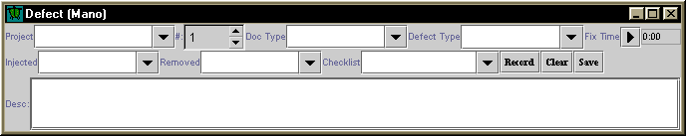
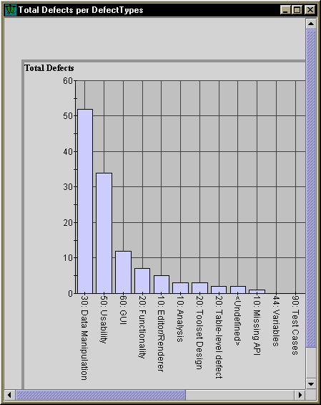
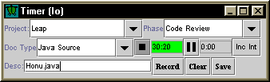
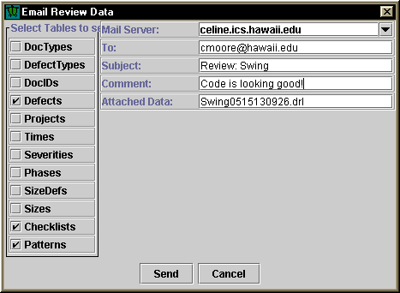
Essential LEAP Services
Data collection
  In-process time,
  defects,
  checklists
Data analysis
  Trends,
  frequencies,
  relevance
Data distribution
  Email, web

Slide 10
Evaluation
Use LEAP toolkit for reviews
  Internal CSDL use of LEAP for review
  Industrial adoption
Leap Data Obfuscater & Web Site
  Obfuscate identifying information in Leap data
  Publish
    Defects
    Checklists
    Patterns

Slide 11
Results
Internal CSDL usage:
  Code reviews
  Technical report reviews
  LEAP tool kit defect reporting
  No effort data exchanged
  Just Defects and Checklists
LEAP used and evaluated by over 5 organizations

Slide 12
More Results
Implemented a LEAP data obfuscater
LEAP used in 2 software engineering classes

Slide 13
Future Directions
Industry & academic adoption of Leap for review and process improvement
Investigation of Reviews using Leap
Online repository of Leap data
  Common defects
  Checklists
  Patterns

Slide 14
Conclusions
FTR is subject to Measurement Dysfunction
Focusing on individual reviewers can improve FTR
LEAP helps improve reviewers and reduce Measurement Dysfunction

