Slide 1
Investigating Individual Software Development: An Evaluation of the Leap Toolkit
Cam Moore
Collaborative Software Development Laboratory
Communication & Information Sciences
University of Hawaii, Manoa
cmoore@hawaii.edu
http://csdl.ics.hawaii.edu/Research/LEAP/LEAP.html

Slide 2
Outline
Why Is Quality Software Development Important?
Solutions
Thesis
Evaluation
Contributions & Future Directions

Slide 3
Problem
Every Software developer wishes they got home earlier and spent less of their weekend at work.
Software is often:
  Late
    Windows 2000
  Over budget
    DIA baggage control
  Full of defects
    Therac-25
Problem
Solutions
Leap
Evaluation
Contributions

Slide 4
Solutions
Developer Based (PSP, Leap)
1990s
Organization Based (CMM, ISO 9000)
1980s
Product Based (Testing, Review)
1970s
Hope Based (Try Harder)
1960s
Problem
Solutions
Leap
Evaluation
Contributions

Slide 5
Problems with traditional solutions
Many software process improvement initiatives suffer from one or more of the following problems:
  Heavy weight development constraints
  Organization-level analysis and
  improvement
  Measurement Dysfunction
  Manual Data Collection
Problem
Solutions
Leap
Evaluation
Contributions

Slide 6
Supporting Software Developer Improvement with LEAP
LEAP is our design philosophy. All LEAP tools must satisfy four major criteria:
  Light weight
  Empirical
  Anti-Measurement dysfunctional and
  Portable
The Leap toolkit is a reference
implementation
Problem
Solutions
Leap
Evaluation
Contributions

Slide 7
Leap Toolkit
Started August 1997
Over 25 public releases
As of 17 Apr. 2000, the size of the Leap Toolkit is:
  44KLOC of Java,
  2156 Methods,
  311 Classes and,
  14 Packages
It is available for download from
http://csdl.ics.hawaii.edu/Tools/LEAP/LEAP.html
Problem
Solutions
Leap
Evaluation
Contributions

Slide 8
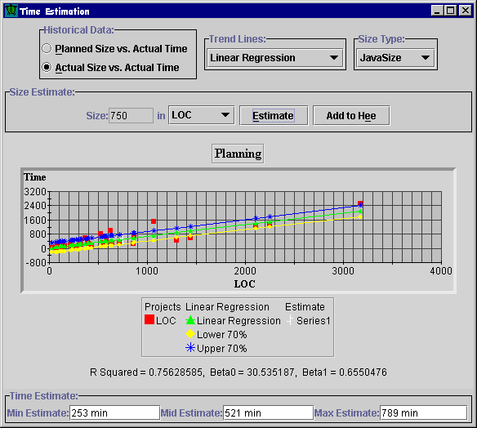

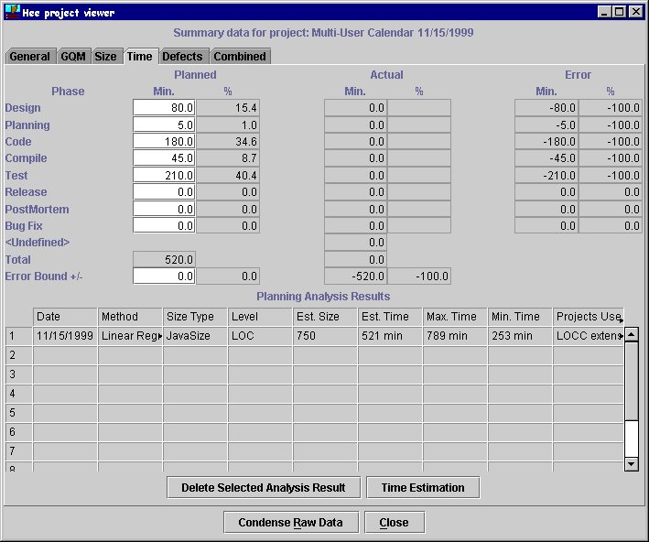
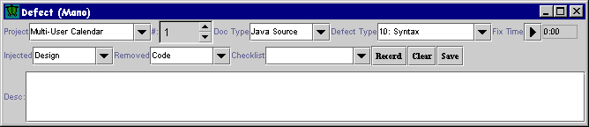
Leap Toolkit

Slide 9
General Thesis
LEAP provides a more accurate and effective way for developers to collect and analyze their software engineering data than methods designed for manual enactment.
Problem
Solutions
Leap
Evaluation
Contributions

Slide 10
Evaluation
To evaluate this thesis I broke it into 3 claims:
I. Leap is able to prevent important classes of data error as identified in Disney98.
II. Leap reduces the level of collection stage errors by reducing the overhead of data collection.
III. Leap implements data collection and analyses that enable sophisticated analysis not
available in manual methods such as PSP.
Problem
Solutions
Leap
Evaluation
Contributions

Slide 11
I: Preventing data error
I. Leap is able to prevent important classes of data error as identified in Disney98.
Disney’s research discovered the following problems with manual PSP data:
  Students had a 5% error rate in their data
  These errors were significant
    Time estimation
    Incorrect Yield
Even 95% accuracy is not good enough
Problem
Solutions
Leap
Evaluation
Contributions

Slide 12
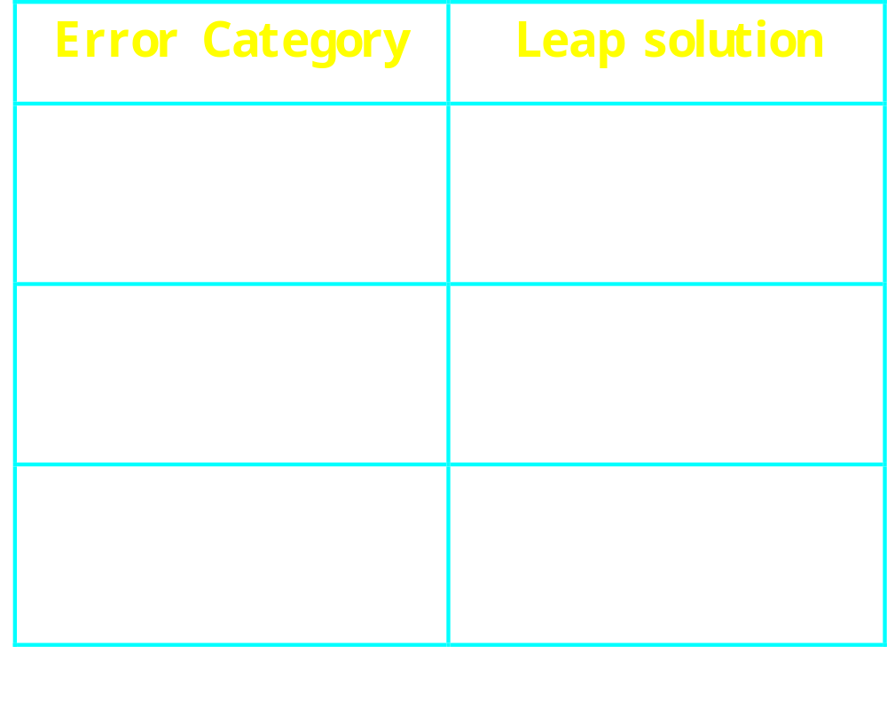
I: Preventing data error
The design and implementation of the Leap toolkit address the data error categories:
Problem
Solutions
Leap
Evaluation
Contributions

Slide 13
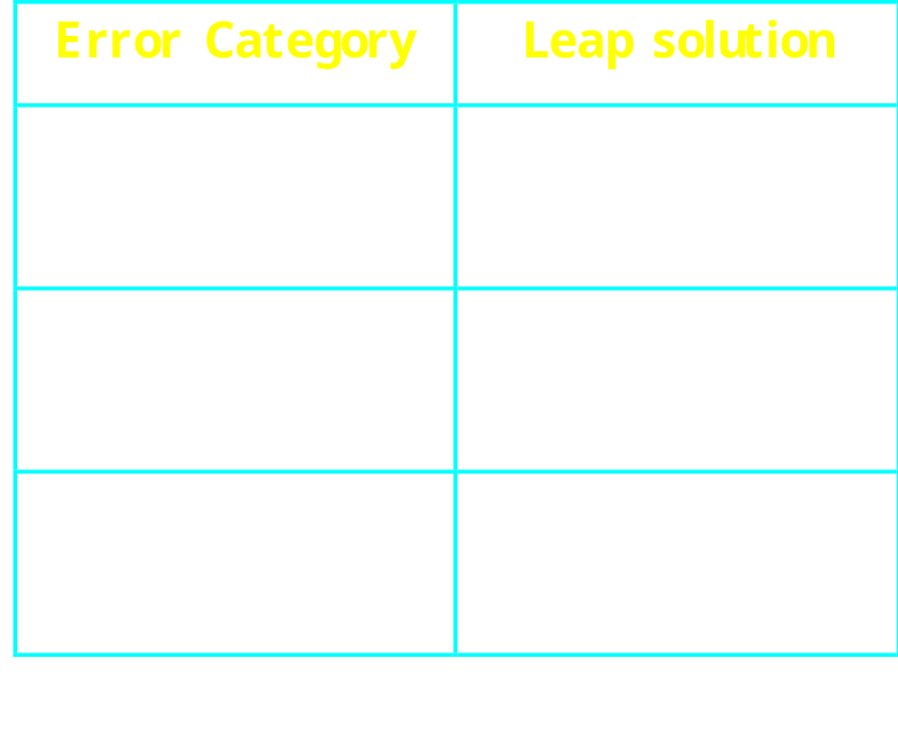
I: Preventing data error
Data error categories (cont):
Problem
Solutions
Leap
Evaluation
Contributions

Slide 14
II: Reducing collection error
II. Leap reduces the level of collection stage errors by reducing the overhead of data collection.
Case Study:
  16 Students used Leap while developing 8 Java programs in ICS 613
  Data collection:
    4 surveys conducted (# responses)
    Interviews (11 conducted)
    Students’ Leap data (16 data sets)
Problem
Solutions
Leap
Evaluation
Contributions

Slide 15
II: Reducing collection error
The students were asked to collect three types of data:
  Defects
    Students used many different collection methods
  Size
    LOCC used for collecting size data
  Time
    Two different time collection tools
Problem
Solutions
Leap
Evaluation
Contributions

Slide 16
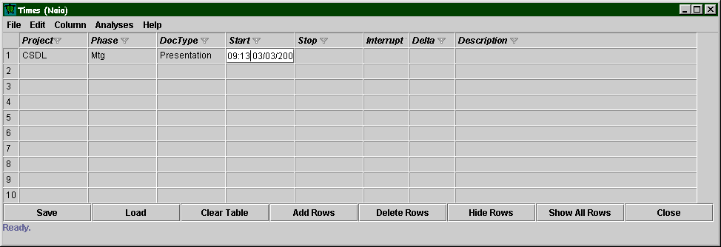
II: Reducing collection error
First method of time collection in Leap
  Naia
Problem
Solutions
Leap
Evaluation
Contributions

Slide 17
II: Reducing collection error
Second method of time collection in Leap
  Io
Problem
Solutions
Leap
Evaluation
Contributions

Slide 18
II: Reducing collection error
Using Naia for data entry makes data entry harder
  Students using Naia said data collection was neutral to hard
  Students using Io said data collection was easy to neutral
Problem
Solutions
Leap
Evaluation
Contributions

Slide 19
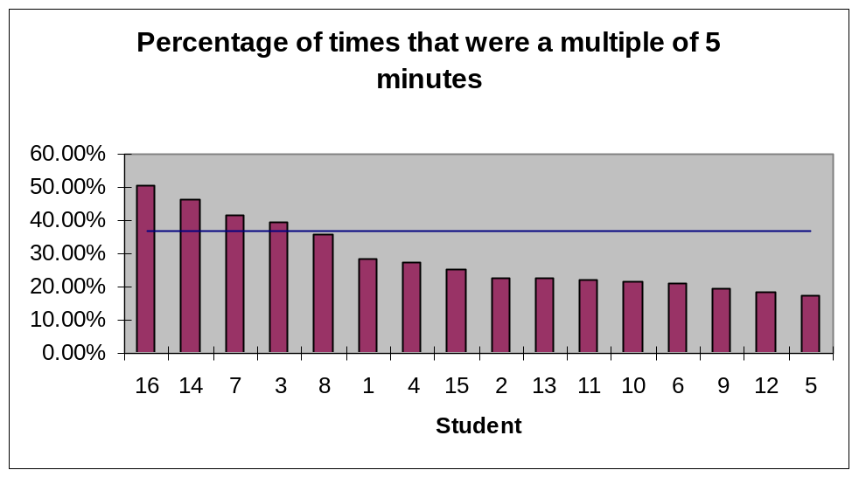
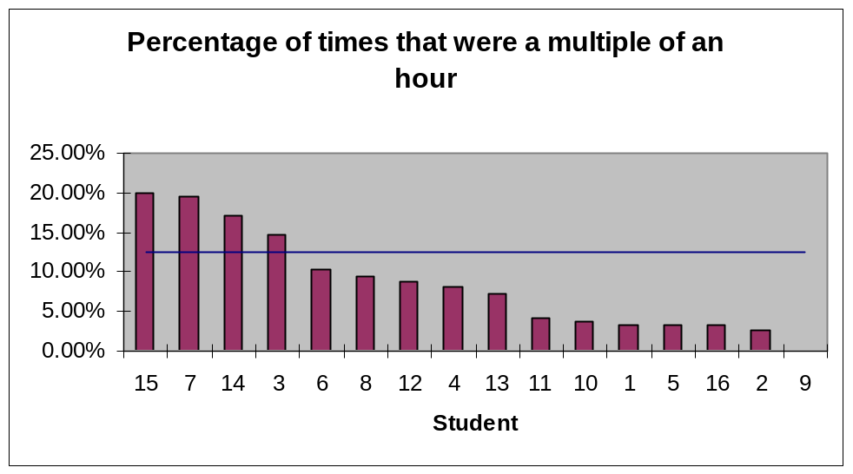
II: Reducing collection error
Types of time collection errors
  Missing time
  Added time
  Rounding
Reported use of Naia has high correlation to rounded times

Slide 20
III: Empirical Investigation
III. Leap implements data collection and analyses that enable sophisticated analysis not
available in manual methods such as PSP.
Leap allowed me to evaluate 14 different quantitative time estimation techniques.
Planned Size
A
Actual Size
C
B
Methods
LOC
Problem
Average
Linear
Exponential
Solutions
Leap
PSP (A, B, or C)
Evaluation
Student’s
Contributions

Slide 21
III: Empirical Investigation
I used Leap to calculate the prediction error for each estimation method.
  Prediction Error = | estimate - actual |
  Compared methods for each student
  Compared methods for the whole class
actual
Problem
Solutions
Leap
Evaluation
Contributions

Slide 22
III: Empirical Investigation
Individual Students’ Results:
3 of the 16 students had significantly better estimation methods
  2 students, their own estimation methods were best (F = 3.93, p < 0.001), (F = 2.25, p = 0.019)
  1 student, exponential regression using actual LOC was best (F = 2.34, p = 0.014)
  5 students, own estimates best
Problem
Solutions
Leap
Evaluation
Contributions

Slide 23
III: Empirical Investigation
Class’ Results:
The students’ own estimates were the most accurate (F = 3.75, p <0.001)
Ignoring the students’ estimates, the Exponential Regression using actual methods was the best (F = 2.40, p = 0.005)
The PSP’s time estimation method was
6th
Problem
Solutions
Leap
Evaluation
Contributions

Slide 24
Contributions
The Leap toolkit
  An effective tool for software developer improvement
    Reduces overhead
    Flexible
    Portable
  A novel software engineering tool for:
    Education
    Research
Problem
Solutions
Leap
Evaluation
Contributions

Slide 25
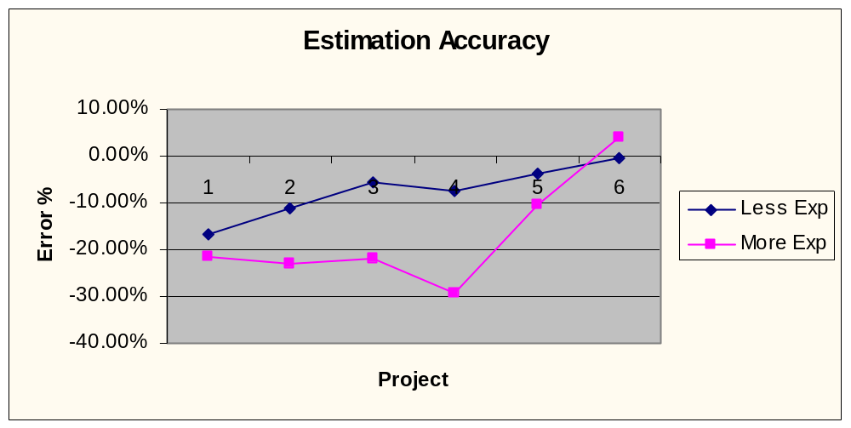
Contributions
The results of the estimation experiment
  Insight into better software estimation techniques
Experience may lead to over-confidence
Problem
Solutions
Leap
Evaluation
Contributions

Slide 26
Future Directions
Replicated studies with more subjects including industrial software developers
Industry adoption of Leap Toolkit
More support for data analysis in Leap Toolkit
Further study into effort estimation
Personal Agents that “observe” the
developer
Problem
Solutions
Leap
Evaluation
Contributions

Slide 28
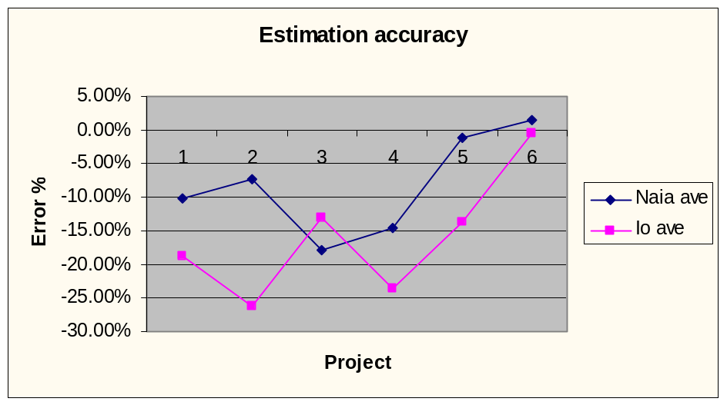
Results: Case Study
Estimation accuracy unaffected by rounding error
  No significant difference between the estimation accuracies of the class (F = 1.71, p = 0.07)
  No significant difference between Naia and Io users (F = 2.70, p = 0.10)

Slide 29
Results: Case Study
There was very little evidence of measurement dysfunction
  Grades not based upon estimation accuracy
  Students did not compare their Leap data
  Most students felt little pressure to make their data look “good”
    Most said they felt less pressure
    Two with increasing remained very
    low

Slide 30
Results: Case Study
Students showed traditional software developer improvements
  Increased Productivity
  Improved size estimation skills
  Improved time estimation skills

Slide 31
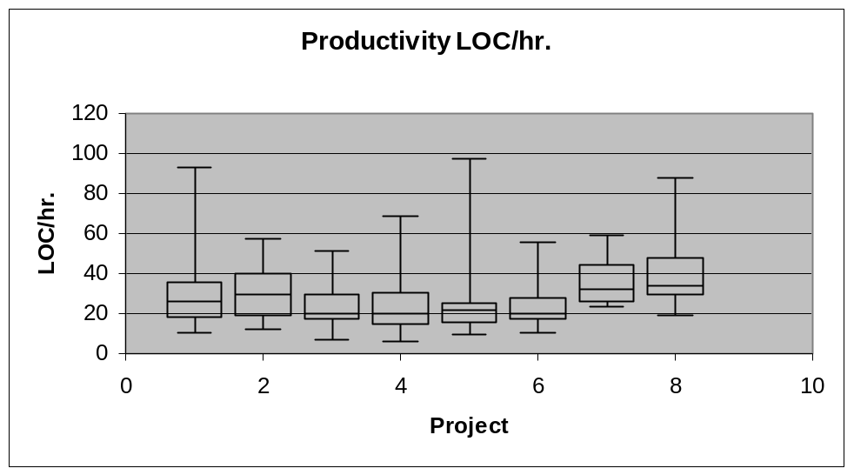
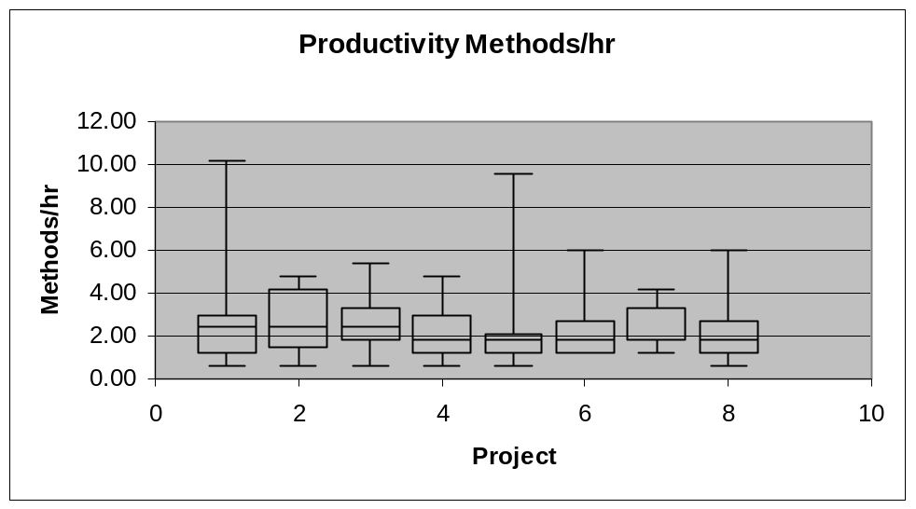
Increased Productivity
LOC
  Equal
  Slight improvement
Methods
  Equal

Slide 32
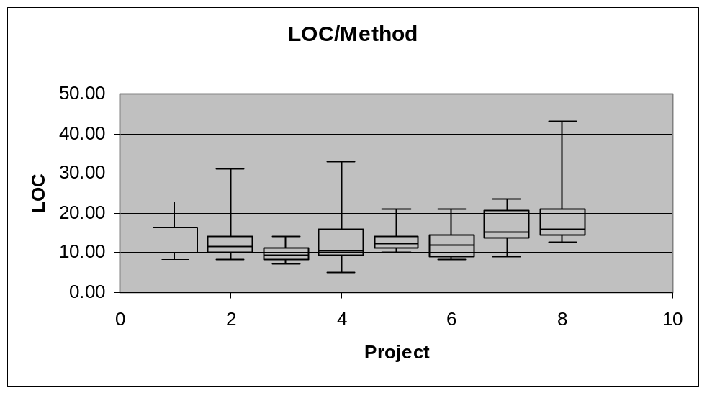
Productivity
Size of methods increased
  Projects changed from Command line to GUI
  Last few project were more complicated
Problem
Solutions
Leap
Evaluation
Contributions

Slide 33
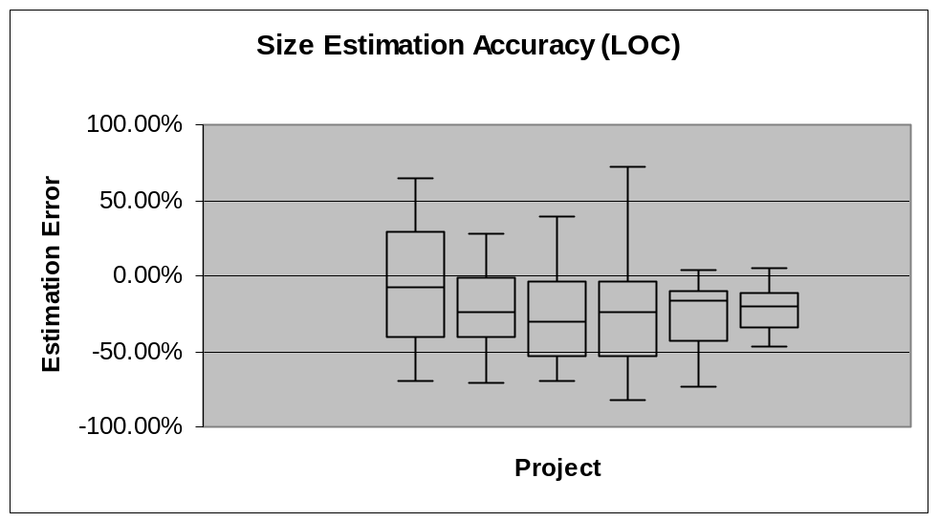
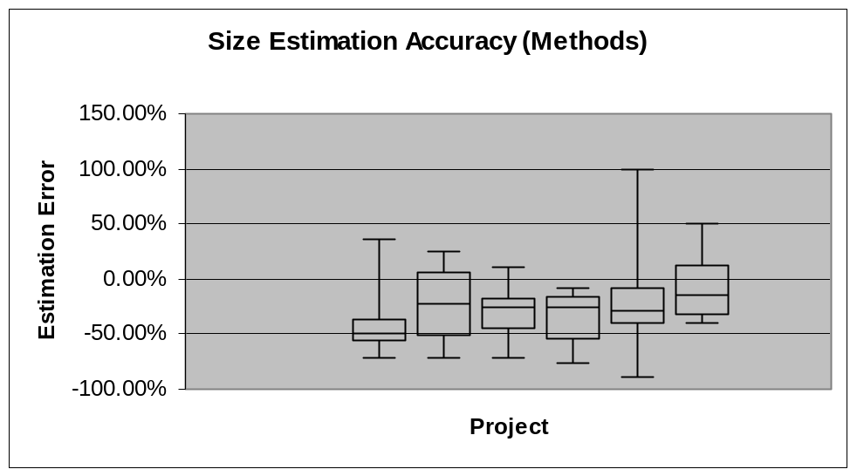
Improved Size Estimation
LOC
  Steady
  Underestimation
Methods
  Improvement
  Better
  Designs?

Slide 34
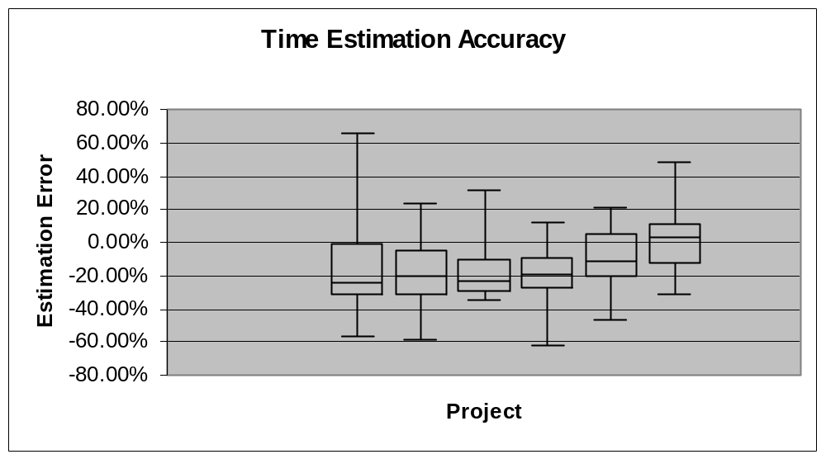
Improved Time Estimation
Class’ time estimation accuracy
  Under estimated
  Range consistent

