Slide 1
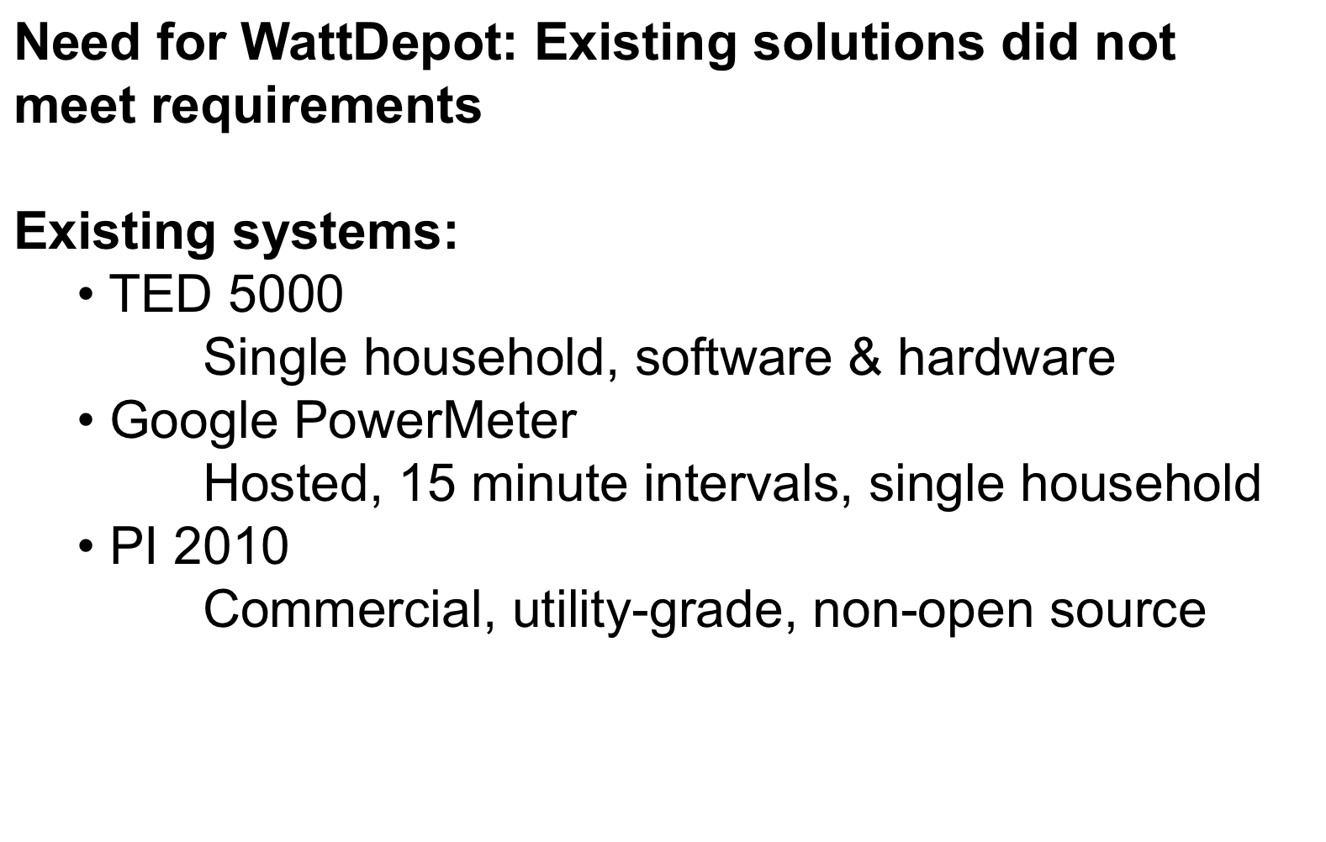
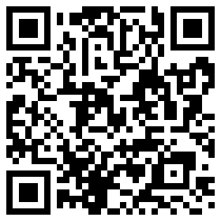
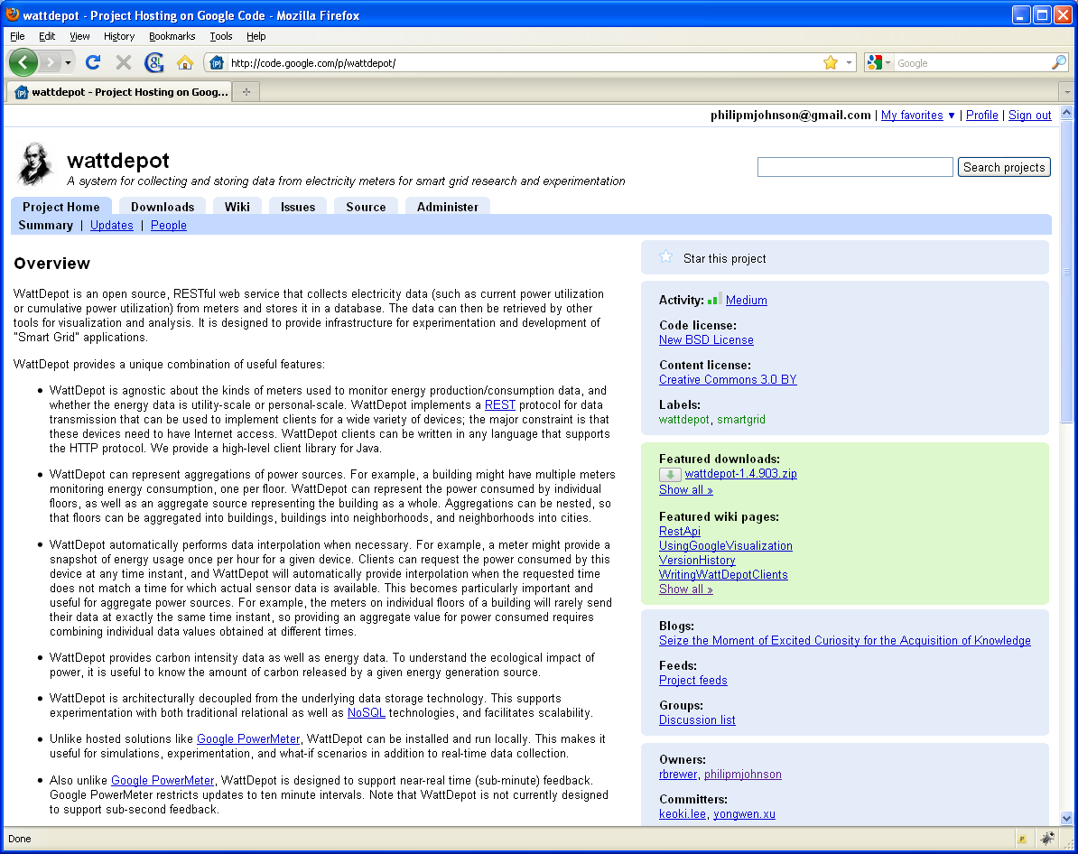

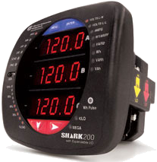

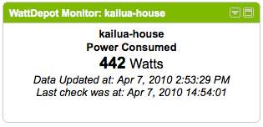
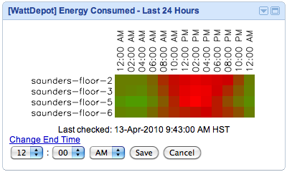
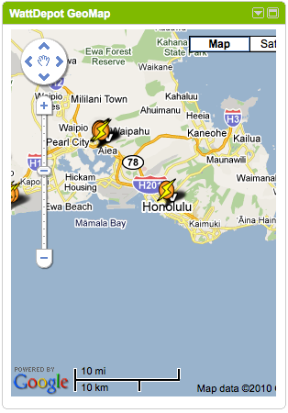

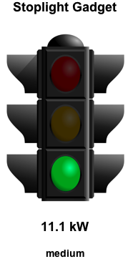

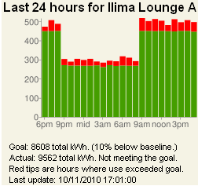
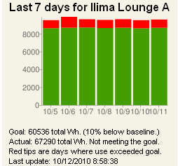
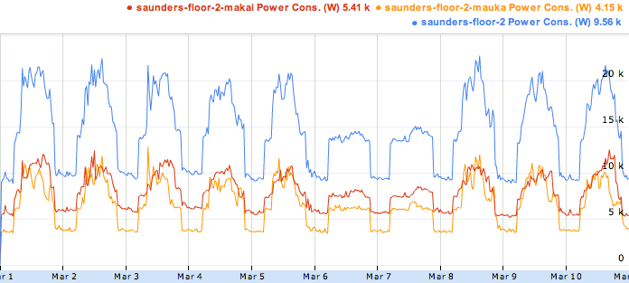
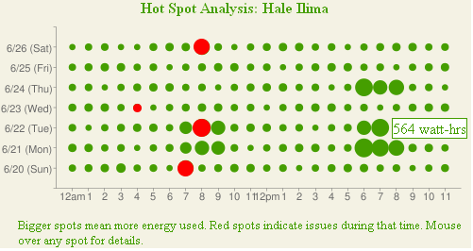
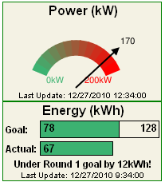
WattDepot: Open Source Software for
Energy Data Collection and Analysis
Collaborative Software Development Lab
Information and Computer Sciences
University of Hawaiʻi at Mānoa
Philip M. Johnson
johnson@hawaii.edu
Robert S. Brewer
rbrewer@lava.net
About Sensors
Motivation and Goals
Getting the system
Software to collect data
  Interface to specific meters
  Store data in server via HTTP
Designed for flexibility
  Encapsulates vendor-specific code
  Any platform or language
  Just needs to output XML over HTTP
Current implementations
  TED 5000 home energy meter
  Veris power meters
  Modbus/TCP meters
WattDepot was created to collect & analyze energy data for the study of change in energy use behaviors
WattDepot Requirements
  Data collection from many meters (1 < x < 100)
  Sub-minute data collection
  Easy to simulate sensor data
  Internet-accessible repository
  Visualization variety & flexibility
  Open source
WattDepot is hosted at Google Code, available for download and modification:
http://code.google.com/p/wattdepot/
About Servers
Architecture
Central data repository
  RESTful HTTP API
  Pluggable back-end database
  Data represented as XML or JSON
  Devices represented as Sources
Server-side capabilities
  Simple carbon emission calculation
  Aggregation of sources (virtual sources)
  Data interpolation
Devices
Meters
WattDepot
Sensors
WattDepot
Clients
WattDepot
Server
HTTP
HTTP
Future Directions
Privacy
  Sources are currently public or private
  Limited authentication support
  All current applications use public data
  Essential for single household data
Data aggregation
  Combining data from multiple sources
  Needed when comparing private data
  Can be performed in server
Sensors
  Support additional meters
  Particularly for renewable energy
Scalability
  High data rates untested in real-world
  Support for thousands of meters
Virtual sources and
the timestamp problem
Derby DB
(pluggable)
Virtual sources combine sub-sources
Saunders Hall
Applications
Saunders Hall
Floor 2
Saunders Hall
Floor 2 North
Saunders Hall
Floor 2 South
Kukui Cup Dorm Energy Competition
  • Study of sustainable behavioral changes in energy use among college freshmen
  • UH Mānoa campus in Fall 2011
  • 30 floor-level energy meters
  • Near-realtime data collection (10-15 s)
  • ~780 participating residents
  • Website provides variety of goal-based energy visualizations to participants
  • Website hosts energy-related activities designed to improve energy literacy
  • Participants earn Kukui Nut points
Other applications
• Tracking PV production on UHM campus
• Tracking 7000 utility customer’s usage (University of Skövde)
Kukui Cup Visualizations
But meter clocks may not be synchronized
Date & Time | Saunders Floor 2 N | Saunders Floor 2 S
Mar 1, 2010 12:01:00 AM | 5453 W
Mar 1, 2010 12:01:02 AM |  | 3562 W
Mar 1, 2010 12:15:00 AM | 5500 W
Mar 1, 2010 12:15:02 AM |  | 3547 W
WattDepot performs linear interpolation between data points, solving timestamp problem
Support
• Renewable Energy and Island Sustainability (REIS) Center,
University of Hawaiʻi at Mānoa
• National Science Foundation grant IIS-1017126
• University of Hawaiʻi Office of Facilities Management
Poster presented at Behavior, Energy, and Climate Change conference (BECC 2010), Sacramento CA

