Slide 1
Project LEAP
Software Developer Improvement
Cam Moore
Collaborative Software Development Laboratory
Dept. of Information & Computer Sciences
University of Hawaii, Manoa
cmoore@hawaii.edu
http://csdl.ics.hawaii.edu/Research/LEAP/LEAP.html

Slide 2
Problem
We need high quality software:
  On time
  On budget
  Satisfies customers
Traditional organizational quality improvement efforts, “Top-down”
  Capability Maturity Model
  ISO 9000
  Clean Room Development

Slide 3
Success Factors
Traditional “top-down” quality improvement requires
  Long term “Champions”
  Stable developer, product, and market focus
  Significant financial and administrative costs

Slide 4
Issues with Top-Down Improvement
But “Internet Time” works against this!
  Shortened time to market
  Faster release cycles
  Reduced development budgets
  Increased organizational volatility
Measurement Dysfunction
  Measurement can make things worse
  Lack of data privacy promotes inaccuracy

Slide 5
Bottom-up Improvement
“Bottom-up” approaches focus on providing individual developers with the insights necessary to acquire and improve their technical skills.
High quality software development organizations require highly skilled software developers.
Personal Software Process (Humphrey 95)

Slide 6
Some Issues With PSP
Data Quality
  Manual Processes and Analyses
  Data Collection
Measurement Dysfunction
  Data given to Management
Adoption
  High Overhead
  Highly Constrained Process
  Management Commitment

Slide 7
LEAP Design Requirements
In Project LEAP, the tools and methods for software developer improvement must satisfy four major criteria:
  Light-weight
  Empirical
  Anti-Measurement Dysfunction
  Portable

Slide 8
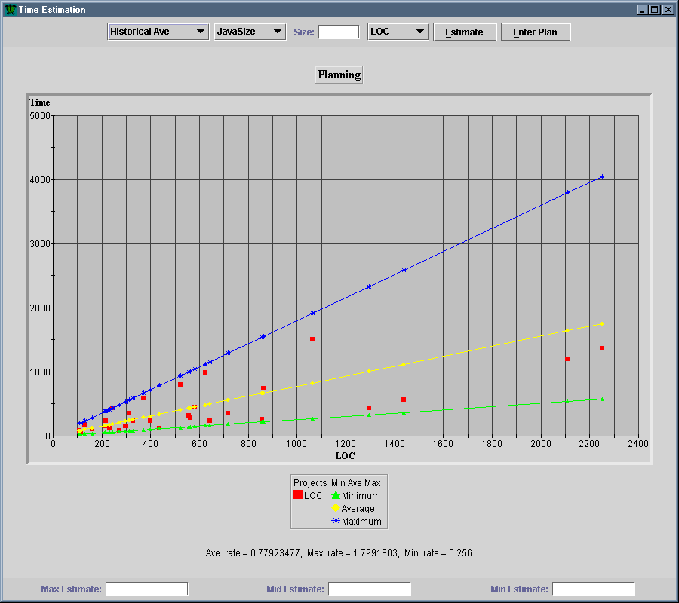
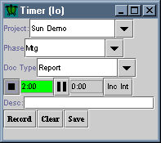
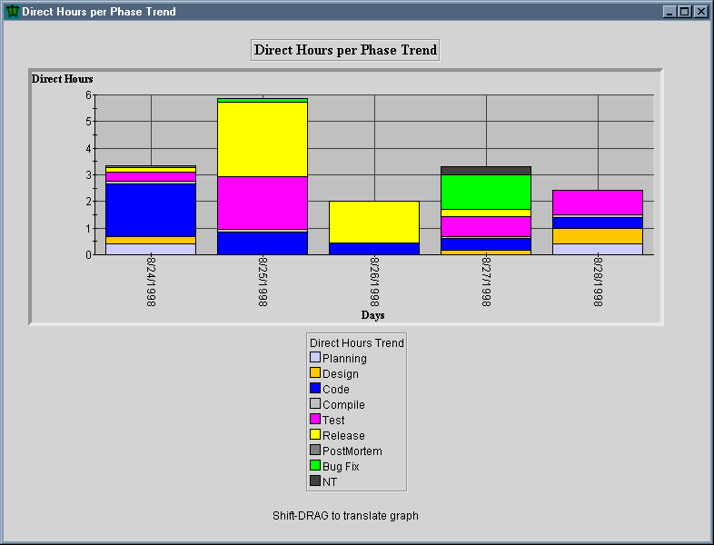
Current State of Project LEAP
Leap Tool Set available for download
  http://csdl.ics.hawaii.edu/Tools/LEAP/LEAP.html
  Implemented entirely in Java
  Used in two software engineering classes

Slide 9
Research Focus
PSP is highly constrained
  Controls process variation
  Allows manual implementation
Example: PSP time estimation
  Rigid boundaries between A,B,C methods
  Only use LOC for size estimate
  Linear Regression has constraints beta0 >, beta1 negative
Can relaxation of constraints through automation improve time estimation?

Slide 10
PSP Time Estimation Method
Size Estimate
Obtain
data
Plan
Regression
valid
Yes
Choice A
Calculate
Time &
Prediction
Interval
Regression
Plan V Act
No
Actual
Regression
valid
Yes
Choice B
Calculate
Time &
Prediction
Interval
Regression
Act V Act
No
Choice C
Calculate
Time &
Shortest,
Longest
Productivity
LOC/hr

Slide 11
Experiment
Subjects
  ~20 graduate ICS students
Tasks
  Develop 7-10 Java programs
  Produce estimated
  development time
  using eight different
  procedures:
  Determine PSP estimate
  Students produce own estimate
Average
C
Regression
A
B
Methods
LOC
Plan Size
Actual Size
Student

Slide 12
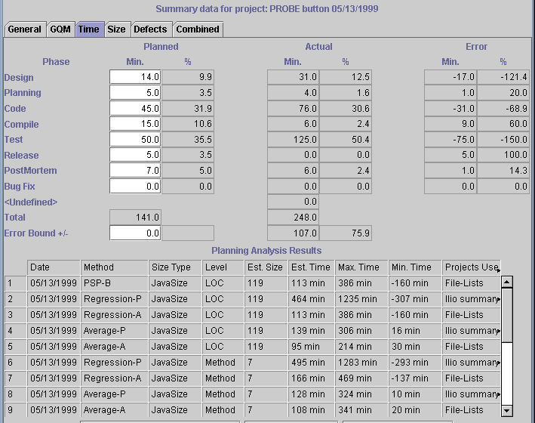
Data Collection
Leap Tool Set will record the estimated development time
  Student’s
  estimate
  Estimates
  from the 8
  procedures

Slide 13
Data Analysis
I will calculate the error between the estimated times and the actual time for each project and student
The procedure with the lowest error is the best procedure for the individual student
Outcomes to be investigated
  Is the PSP estimate the best of the 8?
  Can the student estimate better than the 8?

Slide 14
Contributions
Leap Tool Set
  Developer improvement support
  Instrument for analyzing the development process
Insight into empirical process improvement
  Data Collection
  Analysis
Insight into planning and estimation
  Estimation methods

Slide 15
Future Directions
Research into other assumptions in PSP
  Code completely before compiling
  Yield & Cost Performance Index
Further industry adoption of Leap for process improvement
Investigation of Review using Leap
Online repository of obfuscated Leap data

Slide 16
Impact
Better Software Developers
  Individual software developers will gain important technical skills
  Developers will have more control over their software development
Improved Corporate Software Development
  Better project estimation
  Higher quality software
Further insight into software development
  Patterns
  Checklists

