Slide 1
Lessons Learned from Teaching Reflective Software Engineering using the Leap toolkit
Cam Moore
Collaborative Software Development Laboratory
Communication & Information Sciences
University of Hawaii, Manoa
cmoore@hawaii.edu
http://csdl.ics.hawaii.edu/Research/LEAP/LEAP.html
http://csdl.ics.hawaii.edu/techreports/99-01.html

Slide 2
Reflective Software Engineering
People learn from their own experience.
Reflective software engineering uses:
  A simple set of skills
  Simple tool support
To facilitate students’ ability to learn from their experiences

Slide 3
Supporting Software Developer Improvement with LEAP
LEAP is our design philosophy. All LEAP tools must satisfy four major criteria:
  Light weight
  Empirical
  Anti-Measurement dysfunctional and
  Portable

Slide 4
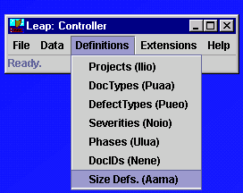
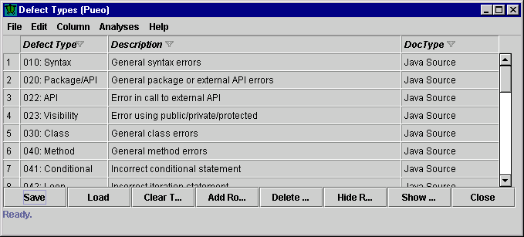
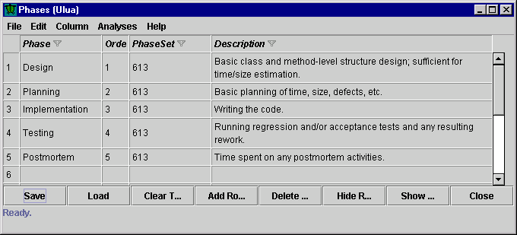
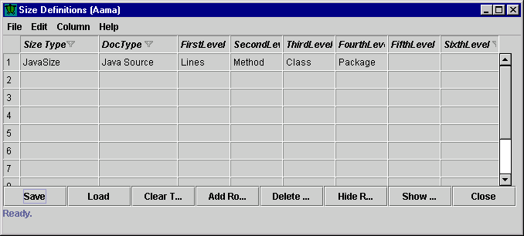
Leap Examples: Our Definitions
Defect types
Development phases
Size

Slide 5

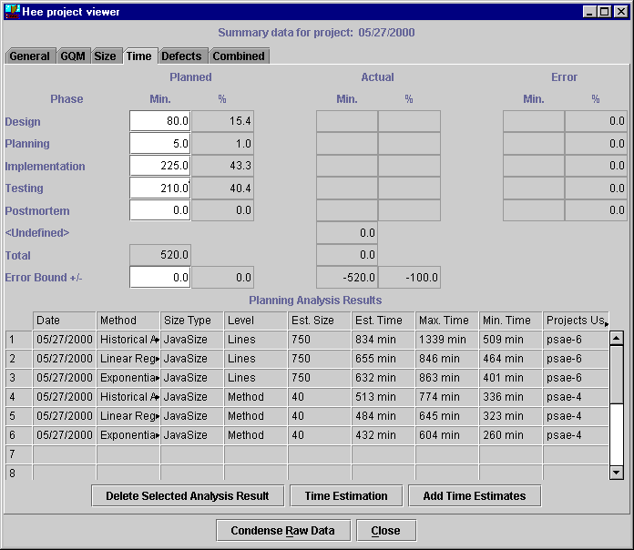
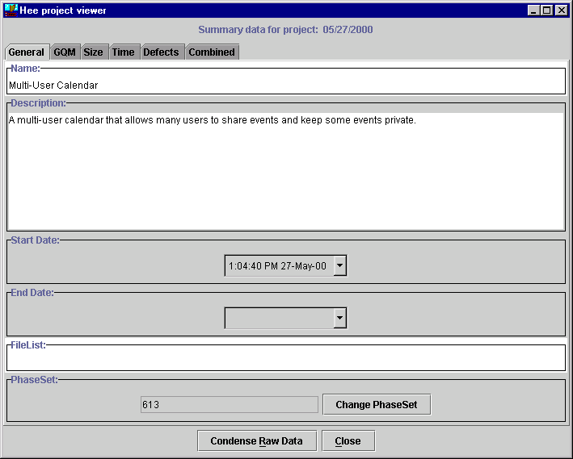
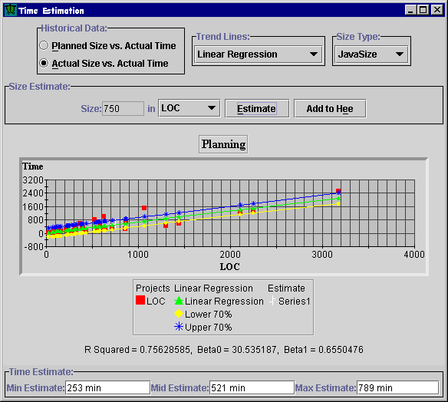
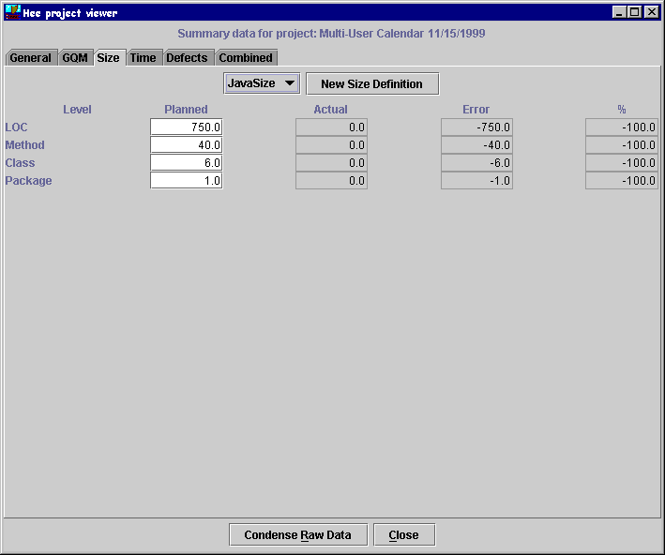
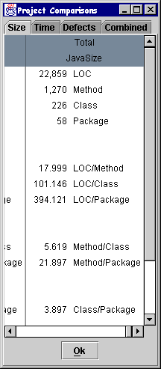
Leap Examples: Using Leap
Starting a new Project
  Multi-User Calendar extension
  Java
User can make
their estimate
based upon the
other estimates
5 trends x
3 grainsizes x
2 sets of data =
30 different choices

Slide 6
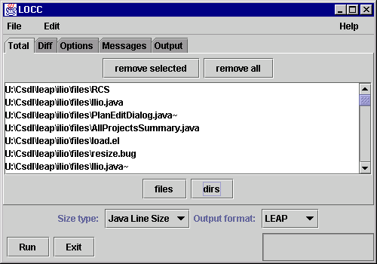
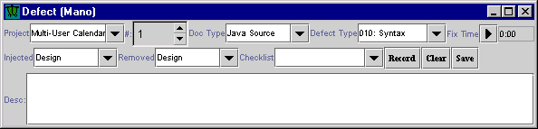
Leap Examples: Using Leap
Collecting data
  Time
  Size
  Defects

Slide 7
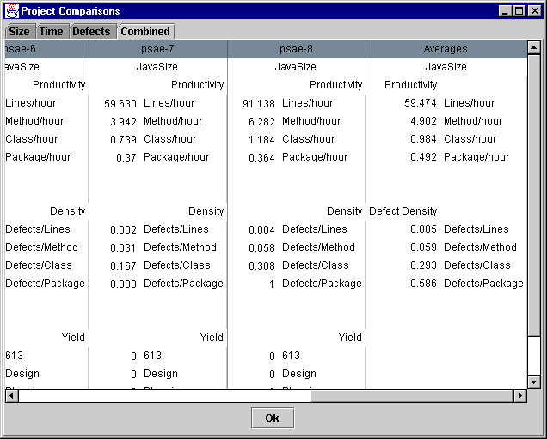
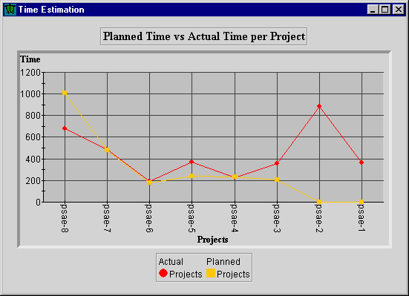
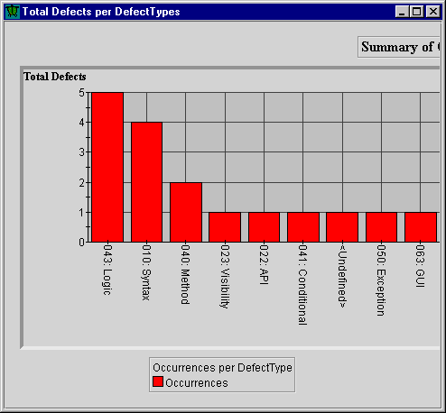
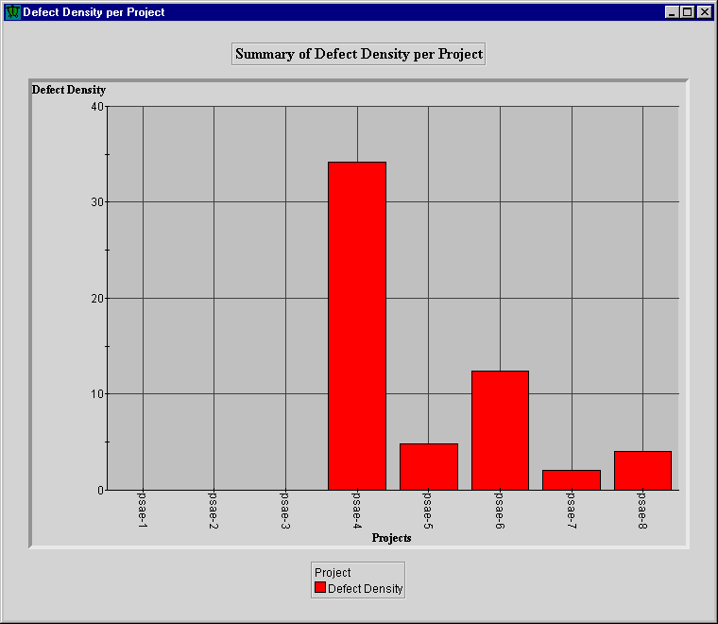
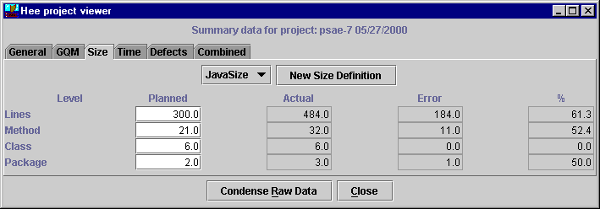
Leap Examples: Using Leap
Postmortem

Slide 8
Lessons Learned
Leap allowed me to evaluate 14 different quantitative time estimation techniques.
Planned Size
A
Actual Size
C
B
Methods
LOC
Problem
Average
Linear
Exponential
Solutions
Leap
PSP (A, B, or C)
Evaluation
Student’s
Contributions

Slide 9
Lessons Learned
Providing multiple estimates appears to improve overall estimation accuracy
The students’ own estimates were the most accurate estimation method.
Ignoring the students’ estimates, the Exponential Regression using actual methods was the best
The PSP’s time estimation method was
6th

Slide 10
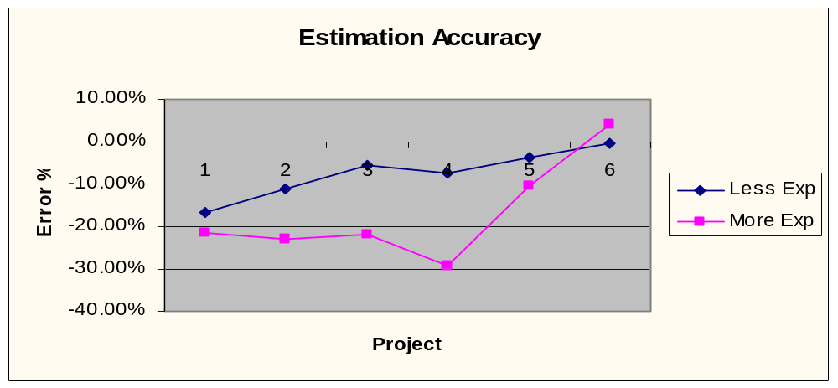
Lessons Learned
Experience may initially lead to over-confidence
  Experienced programmers tended to underestimate more
  Experienced programmers had > 5 years experience
  After 5 project - no difference

Slide 11
Lessons Learned
To reduce measurement dysfunction, make the results less visible
  With paper reports, students compared their “productivity”
  With reports on floppy disks, no comparisons between students

Slide 12
Lesson Learned
Data collection must be easy
  Low overhead on students
  Low overhead on system

Slide 13
Lesson Learned
Partial data collection is powerful
  Collecting only time was found to be useful
  Collecting time and size was useful
  Partial defect collection was useful

Slide 14
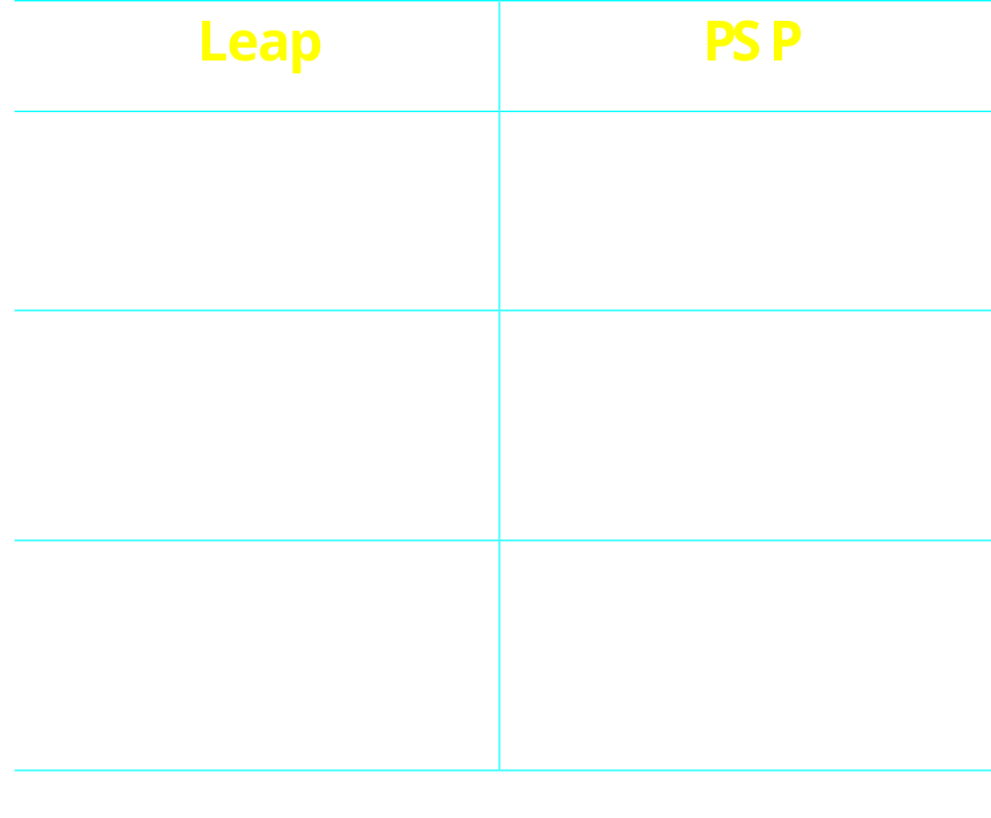
Leap vs PSP

Slide 16
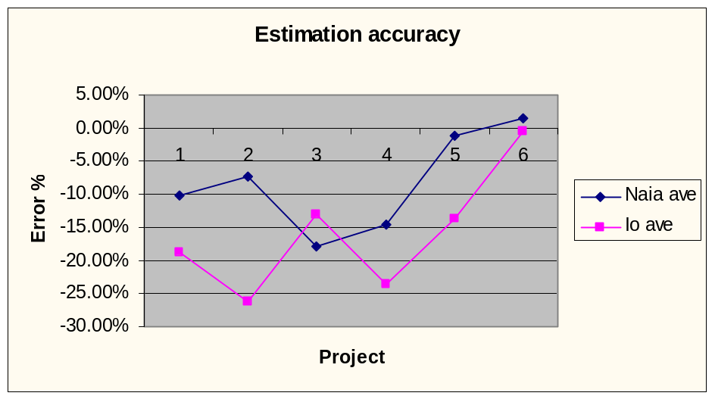
Lessons Learned
Estimation accuracy unaffected by rounding error
  No significant difference between the estimation accuracies of the class
  No significant difference between Naia and Io users

