Slide 1
Lessons Learned from Teaching Reflective Software Engineering using the Leap toolkit
Cam Moore
Collaborative Software Development Laboratory
Communication & Information Sciences
University of Hawaii, Manoa
cmoore@hawaii.edu
http://csdl.ics.hawaii.edu/Research/LEAP/LEAP.html
http://csdl.ics.hawaii.edu/techreports/99-01.html

Slide 2
Reflective Software Engineering
People learn from their own experience.
Reflective software engineering uses:
  A simple set of skills
  Simple tool support
To facilitate students’ ability to learn from their experiences

Slide 3
Supporting Software Developer Improvement with LEAP
LEAP is our design philosophy. All LEAP tools must satisfy four major criteria:
  Light weight
  Empirical
  Anti-Measurement dysfunctional and
  Portable

Slide 4
Leap Examples: Our Definitions
Size
Development phases
Defect types

Slide 5
Leap Examples: Using Leap
Project Definition
Collecting data
Postmortem

Slide 6
Lessons Learned
The students’ own estimates were the most accurate estimation method.
Ignoring the students’ estimates, the Exponential Regression using actual methods was the best (F = 2.40, p = 0.005)
The PSP’s time estimation method was
6th

Slide 7
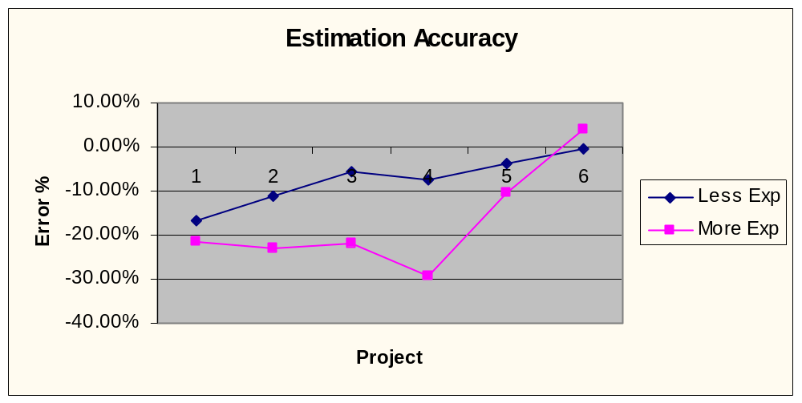
Lessons Learned
Experience may initially lead to over-confidence
  Experienced programmers tended to underestimate more
  After 5 project - no difference

Slide 8
Lessons Learned
To reduce measurement dysfunction, make the results less visible
  With paper reports, students compared their “productivity”
  With reports on floppy disks, no comparisons between students

Slide 9
Lesson Learned
Data collection must be easy
  Lower overhead, less collection errors
  Tools should work with the student
Partial data collection is powerful

Slide 11
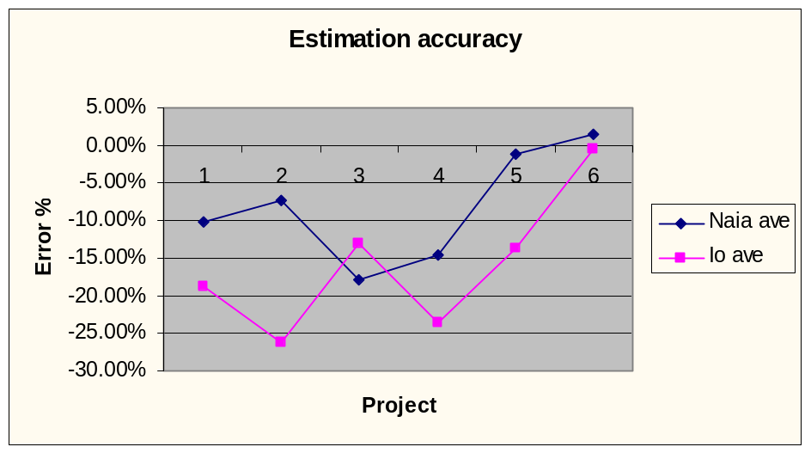
Lessons Learned
Estimation accuracy unaffected by rounding error
  No significant difference between the estimation accuracies of the class
  No significant difference between Naia and Io users

