Slide 1

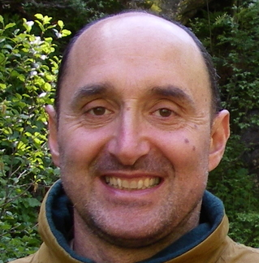
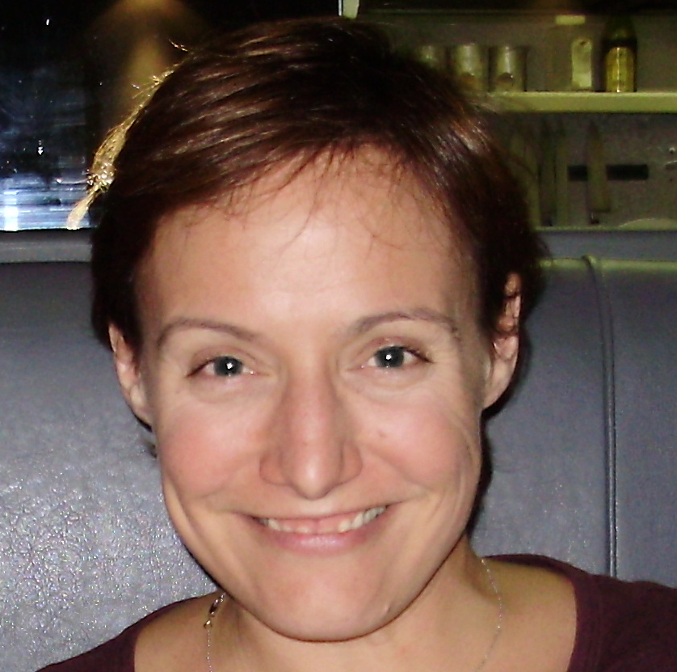
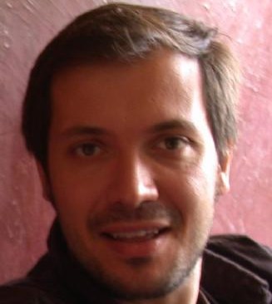
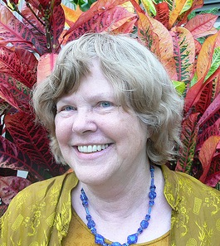
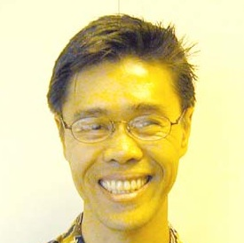
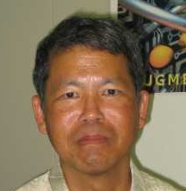
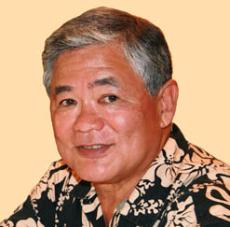
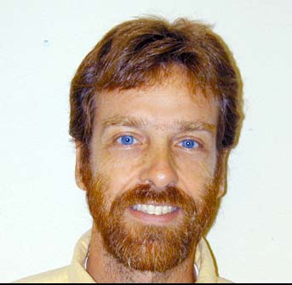
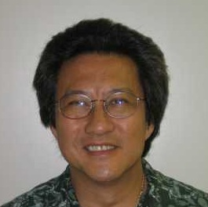
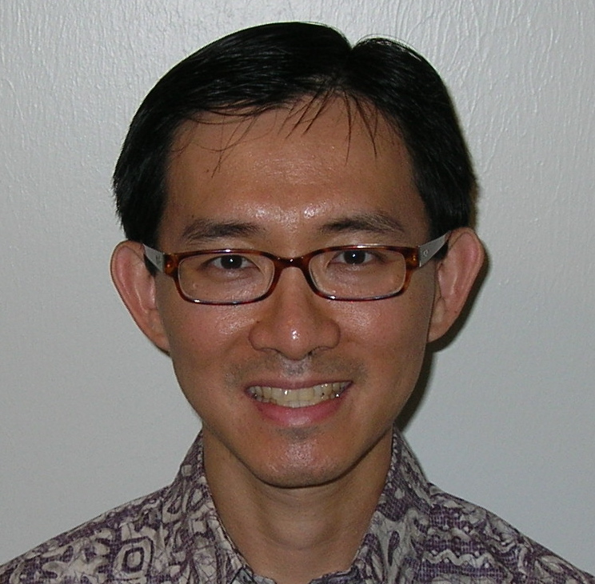
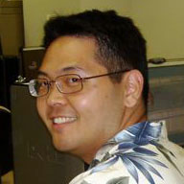
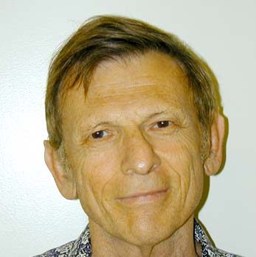
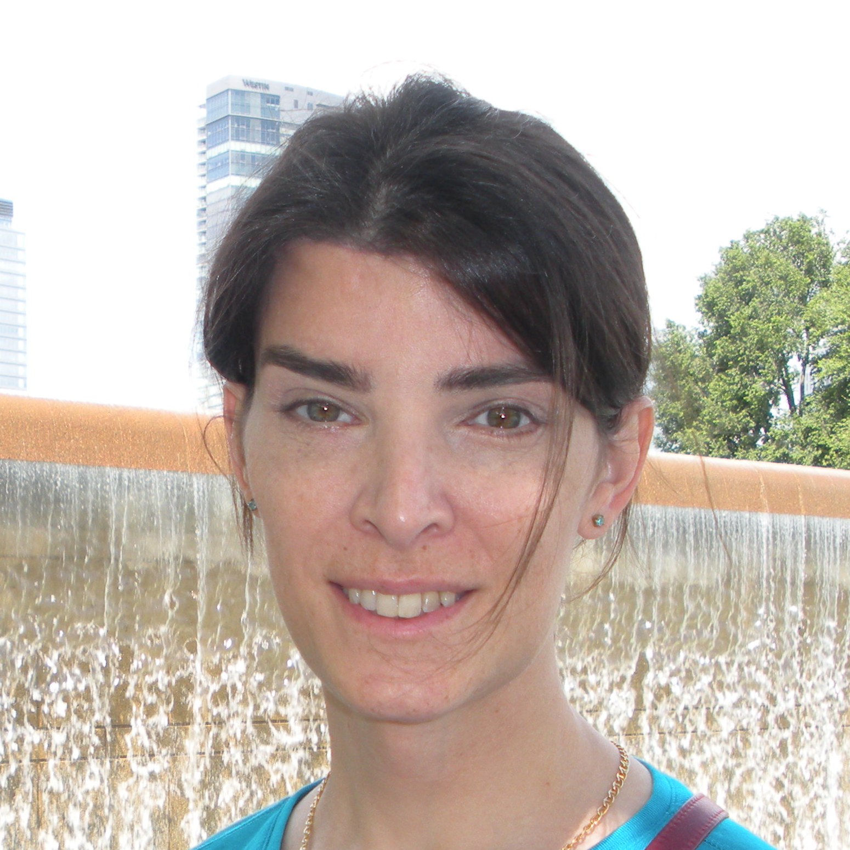
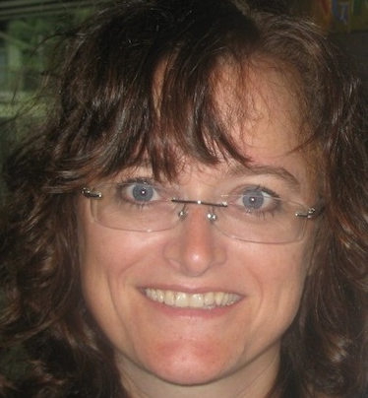
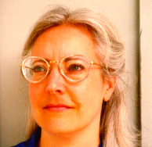

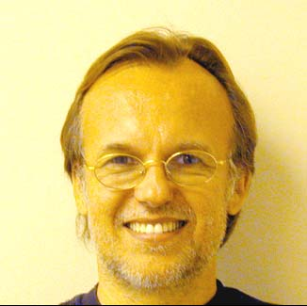
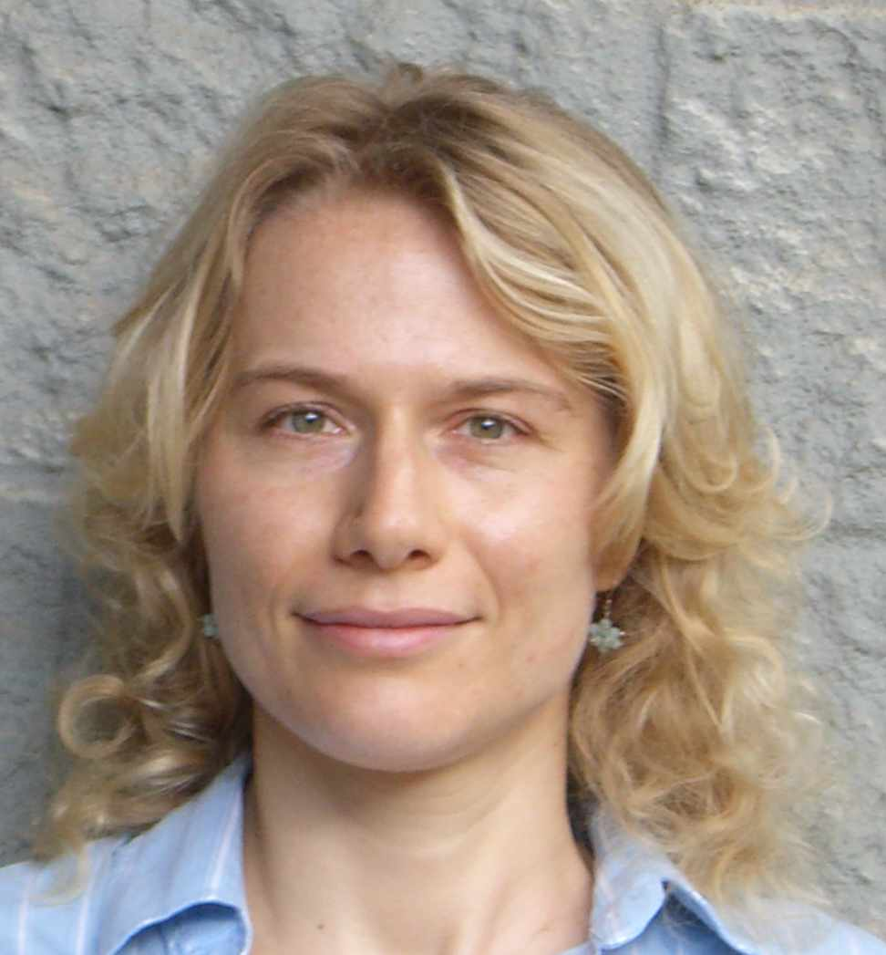

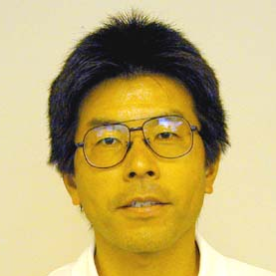

Department of Information and Computer Sciences
Faculty (ICS)
Kyungim Baek
Assistant Professor
POST 314F, 956-8560
kyungim@hawaii.edu
Specialty: computer vision
Edo Biagioni
Associate Professor
POST 311B, 956-3891
esb@hawaii.edu
Specialty: networking
Kim Binsted
Associate Professor
POST 303D, 956-6107
binsted@hawaii.edu
Specialty: artificial intelligence
Henri Casanova
Associate Professor
Graduate Chair
POST 310C, 956-2649
henric@hawaii.edu
Specialty: high performance computing
Martha Crosby
Professor
Chair
POST 317, 956-3500
crosby@hawaii.edu
Specialty: human computer interaction
David Chin
Professor
POST 303C, 956-8162
chin@hawaii.edu
Specialty: artificial intelligence
Curtis Ikehara
Assistant Professor
POST 306B, 956-3581
cikehara@hawaii.edu
Specialty: human computer interaction
Stephen Itoga
Professor
POST 305F, 956-9639
itoga@hawaii.edu
Specialty: online education
Philip Johnson
Professor
Associate Chair
POST 307A, 956-3489
johnson@hawaii.edu
Specialty: software engineering
Gerald Lau
Assistant Specialist
POST 303A, 956-5428
glau@hawaii.edu
Specialty: program development
Lipyeow Lim
Assistant Professor
POST 303E, 956-3495
lipyeow@hawaii.edu
Specialty: databases
Michael-Brian Ogawa
Assistant Specialist
POST 312B, 956-5069
ogawam@hawaii.edu
Specialty: intro curriculum
David Pager
Professor
POST 314C, 956-6068
pager@hawaii.edu
Specialty: compilers
Julia Patriarche
Assistant Professor
POST 311A, 956-0435
julia4@hawaii.edu
Specialty: medical informatics
Guylaine Poisson
Assistant Professor
POST 310B, 956-3496
guylaine@hawaii.edu
Specialty: bioinformatics
Nancy Reed
Associate Professor
POST 303E, 956-8498
nreed@hawaii.edu
Specialty: artificial intelligence
Scott Robertson
Associate Professor
Undergraduate Chair
POST 306C, 956-2023
scottpr@hawaii.edu
Specialty: human computer interaction
Jan Stelovsky
Associate Professor
POST 305C, 956-7175
janst@hawaii.edu
Specialty: multimedia
Susanne Still
Assistant Professor
POST 303F, 956-5816
sstill@hawaii.edu
Specialty: machine learning
Dennis Streveler
Professor
POST 305B, 956-3487
strev@hawaii.edu
Specialty: medical informatics
Kazuo Sugihara
Associate Professor
POST 314H, 956-6439
sugihara@hawaii.edu
Specialty: robotics
Daniel Suthers
Professor
POST 309B, 956-3890
suthers@hawaii.edu
Specialty: human computer interaction

