Slide 1
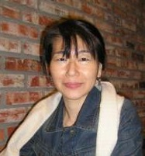
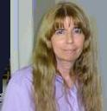
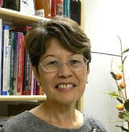
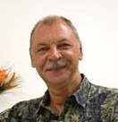
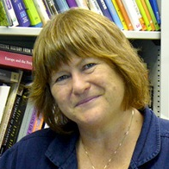
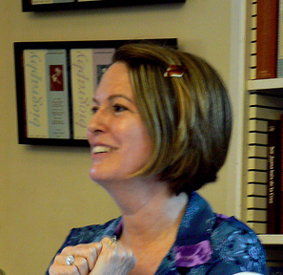
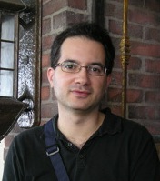
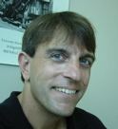
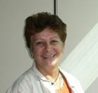

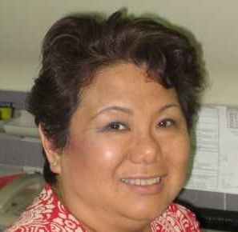
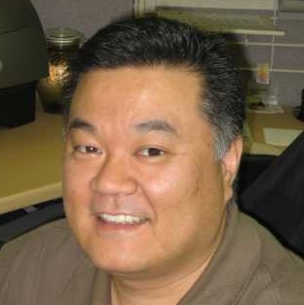
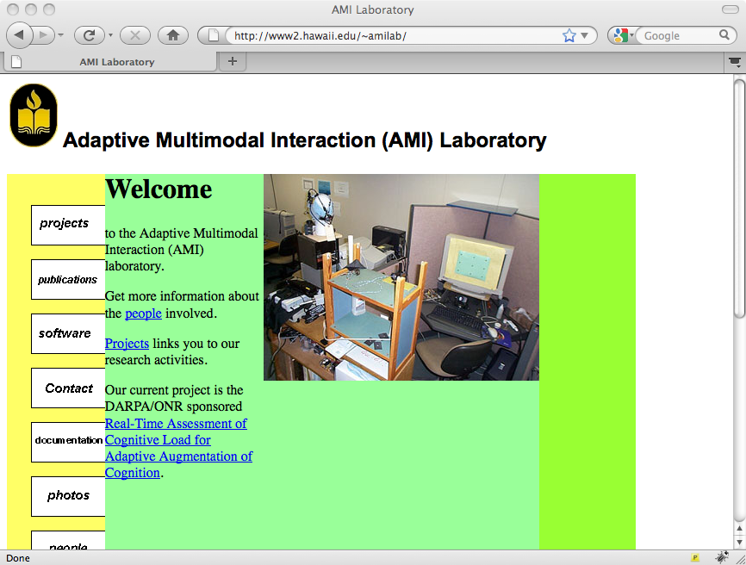
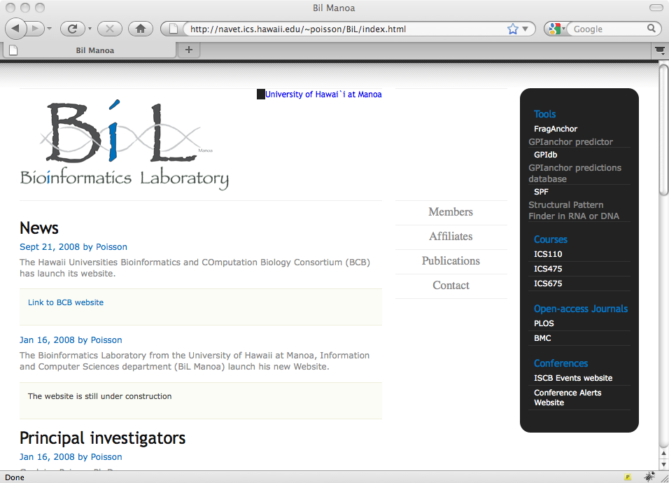

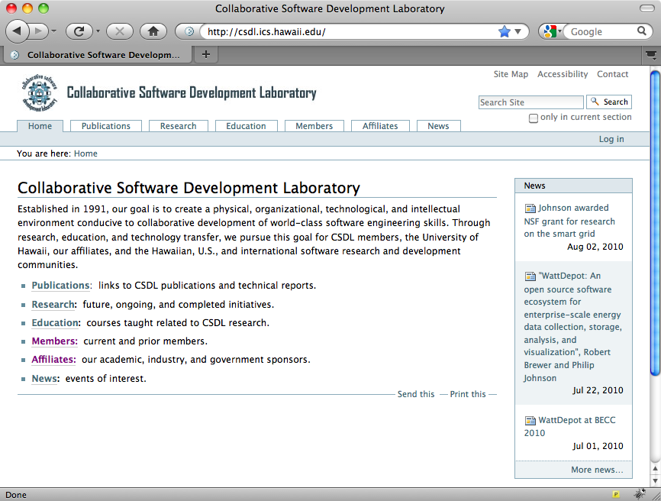
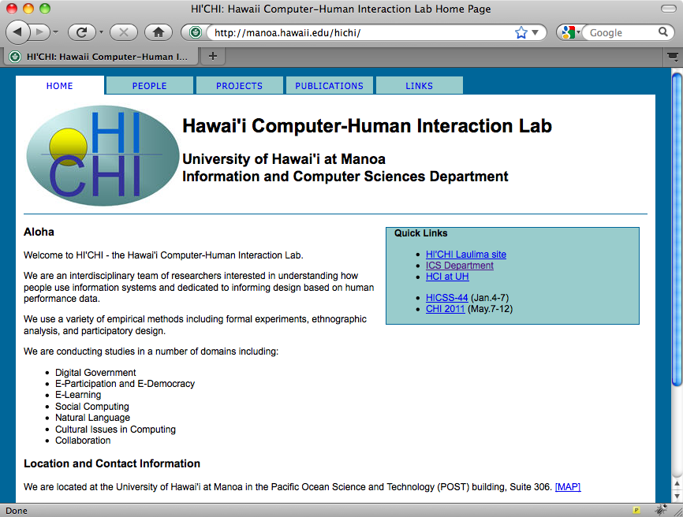
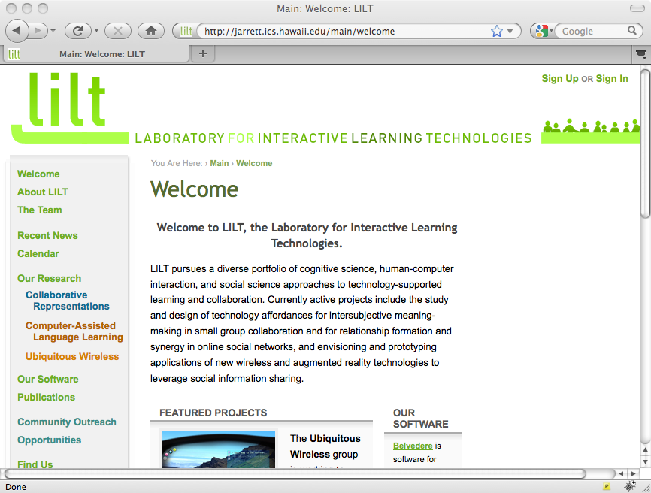
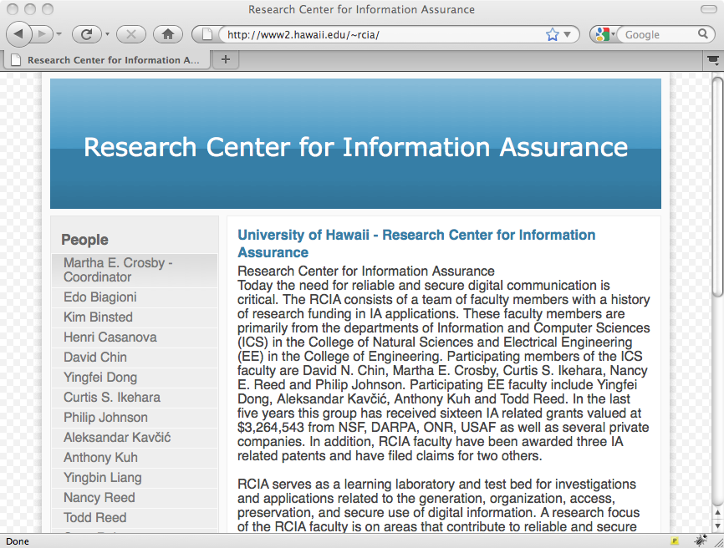
Department of Information and Computer Sciences
Faculty (LIS)
Noriko Asato
Assistant Professor
HL 3E, 956-5821
asaton@hawaii.edu
Specialty: asian librarianship
Donna Bair-Mundy
Instructor
HL 3B, 956-9518
donnab@hawaii.edu
Violet Harada
Professor
HL 2F, 956-5814
vharada@hawaii.edu
Specialty: school library management
Peter Jacso
Professor
HL 2I, 956-5817
jacso@hawaii.edu
Specialty: digital libraries
Rebecca Knuth
Professor
HL 3D, 956-5810
knuth@hawaii.edu
Specialty: international librarianship
Diane Nahl
Professor
HL 3C, 956-5809
nahl@hawaii.edu
Specialty: affective computing
Andrew Wertheimer
Associate Professor
HL 2G, 956-5812
wertheim@hawaii.edu
Specialty: history of libraries
Faculty (ICS+LIS)
Rich Gazan
Assistant Professor
HL 2H, 956-6703
POST 314D, 956-3887
gazan@hawaii.edu
Specialty: social aspects of IT
Luz Quiroga
Assistant Professor
HL 2J, 956-5838
POST 314E, 956-9988
lquiroga@hawaii.edu
Specialty: personalization
Staff
Andreas Koga
IT Specialist
POST 314, 956-7639
akoga@hawaii.edu
Janice Oda-Ng
Department Secretary
POST 317, 956-7420
odang@hawaii.edu
Nolan Oshiro
IT Specialist
POST 314, 956-7639
noshiro@hawaii.edu
Wesley Sugimoto
Fiscal Specialist
POST 303B, 956-7322
wesleysu@hawaii.edu
Research Groups
Adaptive Multimodal
Interaction Lab
Directors: David Chin, Martha Crosby,
Curtis Ikehara, Jan Stelovsky
http://www2.hawaii.edu/~amilab
Bioinformatics Laboratory
Directors: Guylaine Poisson,
Kyungim Baek
http://navet.ics.hawaii.edu/~poisson/BiL
Concurrency Research Group
Director: Henri Casanova
http://navet.ics.hawaii.edu/~casanova/corg
Collaborative Software
Development Lab
Director: Philip Johnson
http://csdl.ics.hawaii.edu
Hawaii Computer-Human
Interaction Lab
Director: Scott Robertson
http://manoa.hawaii.edu/hichi
Laboratory for Interactive
Learning Technologies
Director: Daniel Suthers
http://lilt.ics.hawaii.edu
Research Center for
Information Assurance
Director: Martha Crosby
http://www2.hawaii.edu/~rcia

