Slide 1
Investigating Individual Software Development: An Evaluation of the Leap Toolkit
Cam Moore
Collaborative Software Development Laboratory
Communication & Information Sciences
University of Hawaii, Manoa
cmoore@hawaii.edu
http://csdl.ics.hawaii.edu/Research/LEAP/LEAP.html

Slide 2
Outline
Why Is Quality Software Development Important?
Solutions
Thesis
Evaluation
Results
Contributions & Future Directions

Slide 3
Problem
Every Software developer wishes they got home earlier and spent less of their weekend at work.
Software is often:
  Late
    Windows 2000
  Over budget
    DIA baggage control
  Full of defects
    Therac-25
Problem
Solutions
Evaluation
Results
Contributions

Slide 4
Solutions
Hope Based (Try Harder)
1960s
Product Based (Testing, Review)
1970s
Organization Based (CMM, ISO 9000)
1980s
Developer Based (PSP, Leap)
1990s
Problem
Solutions
Evaluation
Results
Contributions

Slide 5
Problems with traditional solutions
Many software process improvement initiatives suffer from one or more of the following problems:
  Heavy weight development constraints
  Organization-level analysis and
  improvement
  Manual Data Collection
  Measurement Dysfunction
Problem
Solutions
Evaluation
Results
Contributions

Slide 6
Supporting Software Developer Improvement with LEAP
LEAP is our design philosophy. All LEAP tools must satisfy four major criteria:
  Light weight
  Empirical
  Anti-Measurement dysfunctional and
  Portable
The Leap toolkit is a reference
implementation
Problem
Solutions
Evaluation
Results
Contributions

Slide 7
Leap Toolkit
Started August 1997
Over 25 public releases
As of 17 Apr. 2000, the size of the Leap Toolkit is:
  44KLOC of Java,
  2156 Methods,
  311 Classes and,
  14 Packages
It is available for download from
http://csdl.ics.hawaii.edu/Tools/LEAP/LEAP.html
Problem
Solutions
Evaluation
Results
Contributions

Slide 8
General Thesis
LEAP provides a more accurate and effective way for developers to collect and analyze their software engineering data than methods designed for manual enactment.
Problem
Solutions
Evaluation
Results
Contributions

Slide 9
Evaluation
To evaluate this thesis I broke it into 3 hypotheses
  Leap is able to prevent important classes of data error as identified in Disney98.
  Leap reduces the level of collection stage errors by reducing the overhead of data collection.
  Leap implements data collection and analyses that enable sophisticated analysis not available
  in manual methods such as PSP.
Problem
Solutions
Evaluation
Results
Contributions

Slide 10
Evaluation:
The design and implementation of Leap prevents many of the types of data error found by Disney.
  Automated time data entry
  Automated data analysis
  Data does not have to be
  transferred between forms
  Default values
Problem
Solutions
Evaluation
Results
Contributions

Slide 11
Case Study Design
Case Study:
  16 Students used Leap while developing 8 Java programs in ICS 613
  Data collection:
    4 surveys conducted (# responses)
    Interviews (11 conducted)
    Students’ Leap data (16 data sets)
Problem
Solutions
Evaluation
Results
Contributions

Slide 12
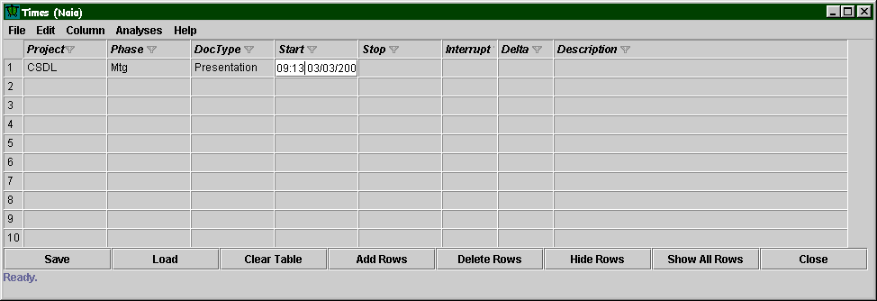
Results: Case Study
Two methods for time collection in Leap
  Io
  Naia

Slide 13
Questionnaire Data
Using Naia for data entry makes data entry harder
  Students using Naia said data collection was neutral to hard
  Students using Io said data collection was easy to neutral
Using Io is easy and there is less
indication of rounding
Problem
Solutions
Evaluation
Results
Contributions

Slide 14
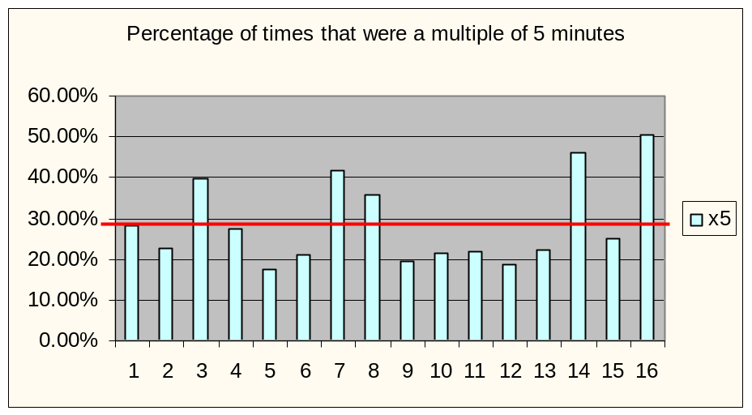
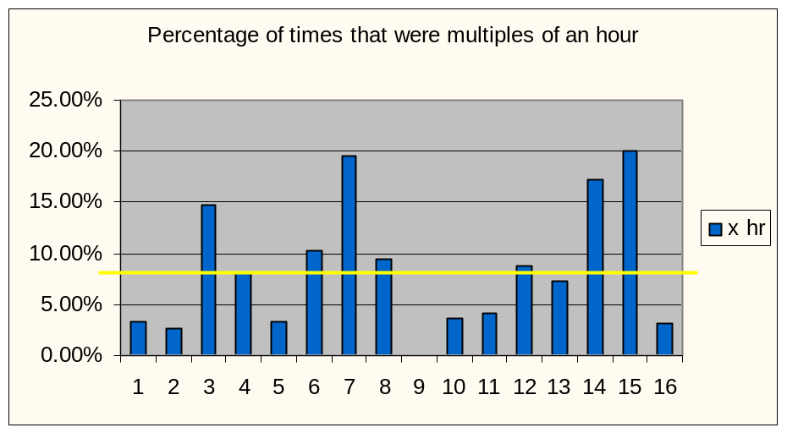
Results: Reduced Collection Error
Types of time collection errors
  Missing time
  Added time
  Rounding
Reported use of Naia has high correlation to rounded times

Slide 15
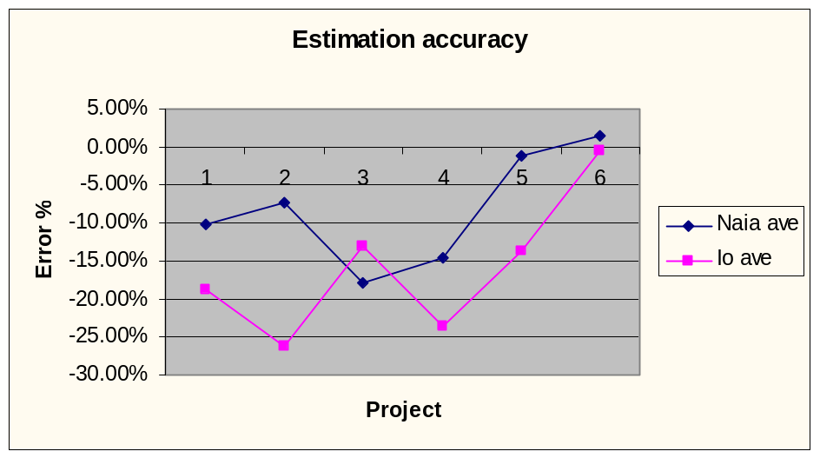
Results: Case Study
Estimation accuracy unaffected by rounding error
  No significant difference between the estimation accuracies of the class (F = 1.71, p = 0.07)
  No significant difference between Naia and Io users (F = 2.70, p = 0.10)
Problem
Solutions
Evaluation
Results
Contributions

Slide 16
Results: Case Study
There was very little evidence of measurement dysfunction
survey/interview - response pressure
manual paper share w/ others: Leap-diskette
  Dr. Johnson did not grade based upon estimation accuracy
  Students did not compare their Leap data
  Most students felt little pressure to make their data look “good”
    Most said they felt less pressure
    Two with increasing remained very
    low
Problem
Solutions
Evaluation
Results
Contributions

Slide 17
Results: Case Study
Students showed traditional software developer improvements
  Increased Productivity
  Improved size estimation skills
  Improved time estimation skills
Problem
Solutions
Evaluation
Results
Contributions

Slide 18
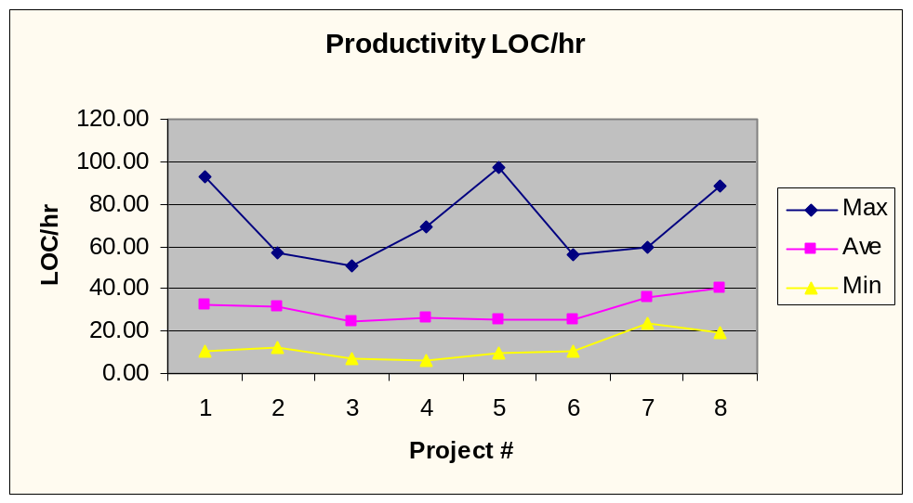
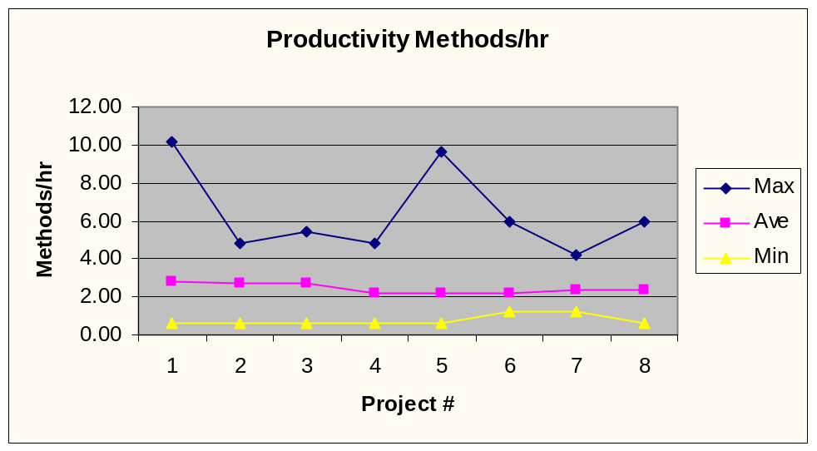
Increased Productivity
LOC
  Improved
Methods
  equal

Slide 19
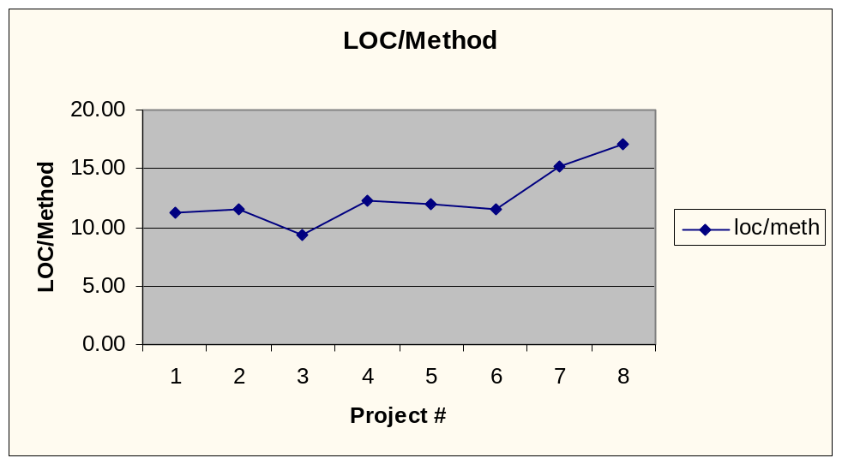
Productivity
Size of methods increased
  Projects changed from Command line to GUI
  Last few project were more complicated
Problem
Solutions
Evaluation
Results
Contributions

Slide 20
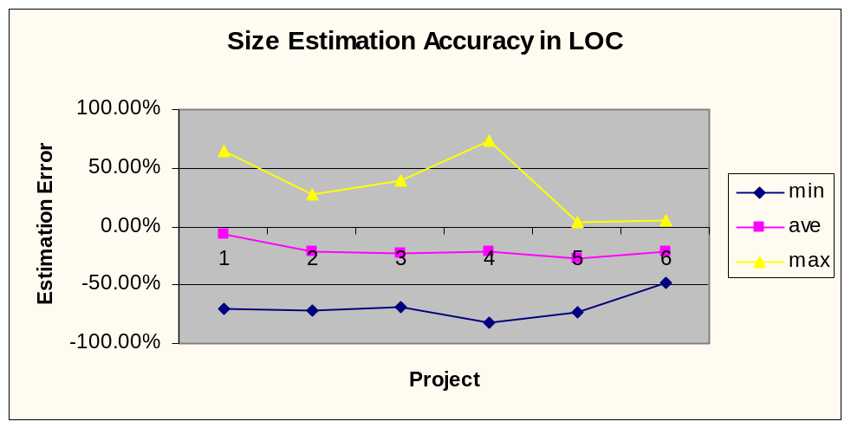
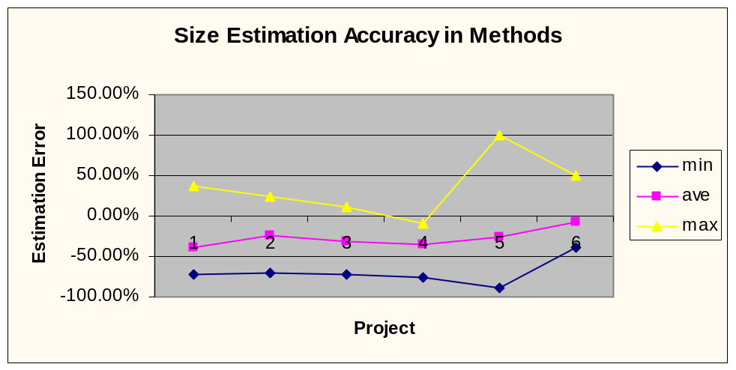
Improved Size Estimation
LOC
  Steady
  Underestimation
Methods
  Improvement
  Better
  Designs?

Slide 21
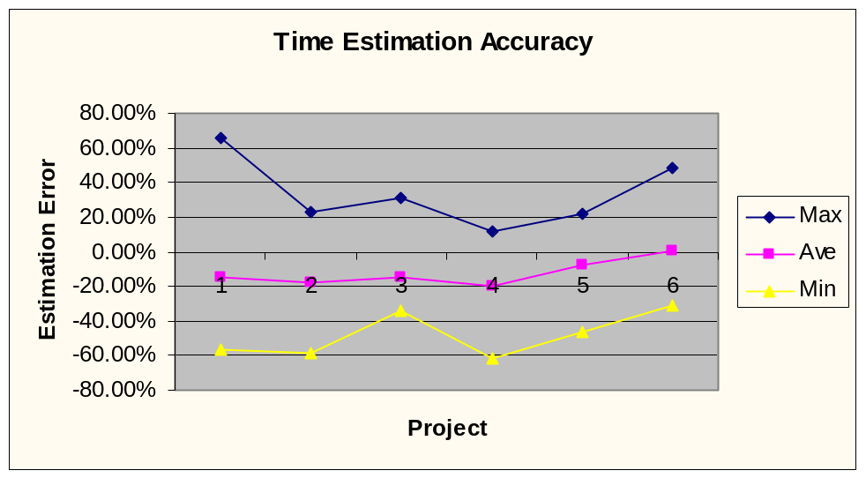
Improved Time Estimation
Class’ time estimation accuracy
  Under estimated
  Range consistent
Problem
Solutions
Evaluation
Results
Contributions

Slide 22
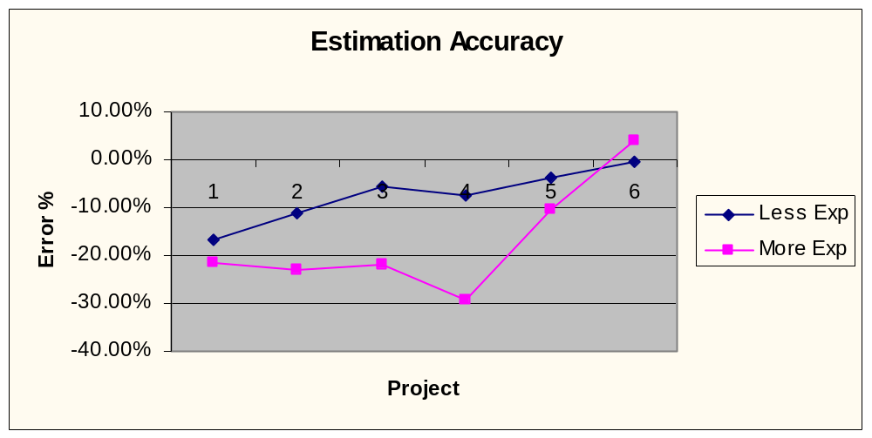
Results: Case Study
Experience may lead to over-confidence
  Experienced programmers underestimated
  Less experienced - gradual improvement
  Both equally accurate by the 6th project
Problem
Solutions
Evaluation
Results
Contributions

Slide 23
Results: Empirical Investigation
Individual Students’ Results:
  3 students had significantly better estimation methods
    2 students, their own estimation methods were best (F = 3.93, p < 0.001), (F = 2.25, p = 0.019)
    1 student, exponential regression using actual LOC was best (F = 2.34, p = 0.014)
Problem
Solutions
Evaluation
Results
Contributions

Slide 24
Results: Empirical Investigation
Class’ Results:
There was a significantly better method for estimating time
  The students’ own estimates (F = 3.75, p <0.001)
Problem
Solutions
Evaluation
Results
Contributions

Slide 25
Results: Empirical Investigation
Class’ Result cont.
Ignoring the students’ estimates, there is a significantly better estimation method
  Exponential Regression using actual methods (F = 2.40, p = 0.005)
The PSP’s time estimation method was
6th
Problem
Solutions
Evaluation
Results
Contributions

Slide 26
Contributions
The Leap toolkit
  An effective tool for software developer improvement
    Reduces overhead
    Flexible
    Portable
  A novel software engineering education tool
  A tool for investigating software development
The results of the estimation experiment
  Insight into better software estimation techniques
Problem
Solutions
Evaluation
Results
Contributions

Slide 27
Future Directions
Replicated studies with more subjects including industrial software developers
Industry adoption of Leap Toolkit
More support for data analysis in Leap Toolkit
Further study into effort estimation
Personal Agents that “observe” the
developer
Problem
Solutions
Evaluation
Results
Contributions

