Slide 1
Project LEAP
Software Developer Improvement
Cam Moore
Collaborative Software Development Laboratory
956-6920
cmoore@hawaii.edu
http://csdl.ics.hawaii.edu/Research/LEAP/LEAP.html

Slide 2
Problem
We need high quality software:
  On time
  On budget
  Satisfies customers
Traditional top-down quality improvement efforts
  Capability Maturity Model
  ISO 9000
  Clean Room Development

Slide 3
Problem continued
Traditional top-down quality improvement requires
  Long term “Champions”
  Stable developer, product, and market focus
  Significant financial and administrative costs

Slide 4
Issues with Top-Down Improvement
But “Internet Time” works against this!
  Shortened time to market
  Faster release cycles
  Reduced development budgets
  Increased organizational volatility
Measurement Dysfunction
  Organizational focus
  Use of data for evaluation

Slide 5
Bottom-up Improvement
The focus is on providing individual developers with the insights necessary to acquire and improve their technical skills.
High quality software development organizations require highly skilled software developers.
Personal Software Process (Humphrey 95)

Slide 6
Some Issues With PSP
Data Quality
  Manual Processes and Analyses
  Data Collection
Measurement Dysfunction
  Data given to Management
Adoption
  High Overhead

Slide 7
LEAP Design Requirements
In Project LEAP, the tools and methods for software developer improvement must satisfy four major criteria:
  Light-weight
  Empirical
  Anti-Measurement Dysfunction
  Portable

Slide 8
Current State of Project LEAP
Leap Tool Set available for download
  http://csdl.ics.hawaii.edu/Tools/LEAP/LEAP.html
Leap Tool Set used in two software engineering classes

Slide 9
Research Questions
The Leap Toolkit allows us to investigate some of the assumptions in the PSP.
Is the PSP’s procedure for estimating development time correct?
Hypothesis:
  PSP’s focus on estimating using LOC is not optimal for all developers.

Slide 10
Experiment
Subjects
  Graduate ICS students
Tasks
  Develop 7-10 Java programs
  Produce estimated development time using four different procedures:
    Linear regression of LOC
    Historical average of LOC
    Linear regression of methods
    Historical average of methods

Slide 11
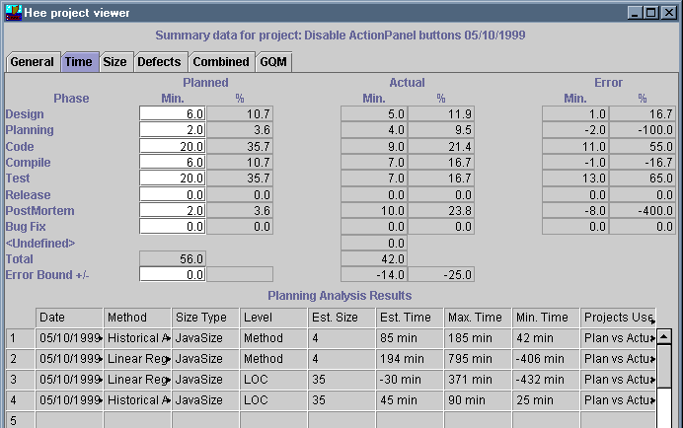
Data Collection
Leap Tool Set will record the estimated development time
  Student’s estimate
  Four estimates from the procedures

Slide 12
Data Analysis
I will calculate the error between the estimated times and the actual time for each project and student
The procedure with the lowest error is the best procedure for the individual student
Possible outcomes
  LOC wins for all students
  Using methods wins for some students
  No difference between LOC and methods

Slide 13
Future Directions
Research into other assumptions in PSP
  Code completely before compiling
  Yield & Cost Performance Index
Institutional adoption of Leap for process improvement
Enhanced Leap Review support tools
Web based Patterns and Checklists repository

Slide 14
Impact
Better Software Developers
  Individual software developers will gain important technical skills
  Developers will have more control over their software development
Improved Corporate Software Development
  Better project estimation
  Higher quality software
Further insight into software development
  Patterns
  Checklists

Slide 15
