Slide 1
Investigating Individual Software Development: An Evaluation of the Leap Toolkit
Cam Moore
Collaborative Software Development Laboratory
Communication & Information Sciences
University of Hawaii, Manoa
cmoore@hawaii.edu
http://csdl.ics.hawaii.edu/Research/LEAP/LEAP.html

Slide 2
Outline
Why Is Quality Software Development Important?
Traditional Solutions
LEAP: Giving developers more control and insight
Thesis
Evaluation
Anticipated Contributions & Future Directions

Slide 3
Software Development Problem
Every Software developer wishes they got home earlier and spent less of their weekend at work.
Software is often
  Late
    Windows 2000
  Over budget
    DIA baggage control
  Full of defects
    Therac-25
The Leap toolkit attempts to give
software developers the skills they
need to address these problems
Problem
Traditional Solutions
LEAP
Evaluation
Contributions

Slide 4
Traditional Solutions
Older Traditional solutions focus on
  The work product
  The development organization
  The development process
Developer Based (PSP, Leap)
1990s
Organization Based (CMM, ISO 9000)
1980s
Product Based (Testing, Review)
1970s
Hope Based (Try Harder)
1960s
Problem
Traditional Solutions
LEAP
Evaluation
Contributions

Slide 5
Software quality improvement at the individual level
Personal Software Process - Humphrey 95
  Goals:
    High quality efficient software development
    Increased estimation accuracy
  Defines development processes
  The individual developer collects
  and analyzes their own data
  Manual process
Problem
Traditional Solutions
LEAP
Evaluation
Contributions

Slide 6
Research on the PSP
Evaluations of the PSP
  Improved Estimation Accuracy
  Improved Productivity
  Reduced Defect Density
  Little Industry adoption
Data Quality issues with PSP - Disney 98
  Serious data quality issues
  Recommended automation
  Classes of errors in PSP data
Problem
Traditional Solutions
LEAP
Evaluation
Contributions

Slide 7
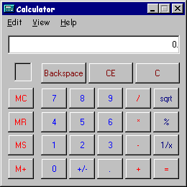
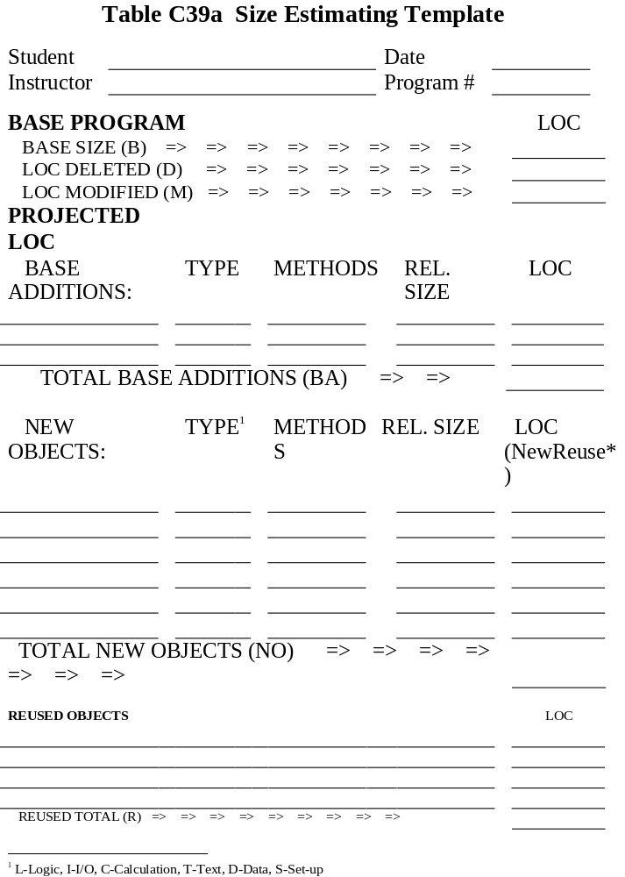

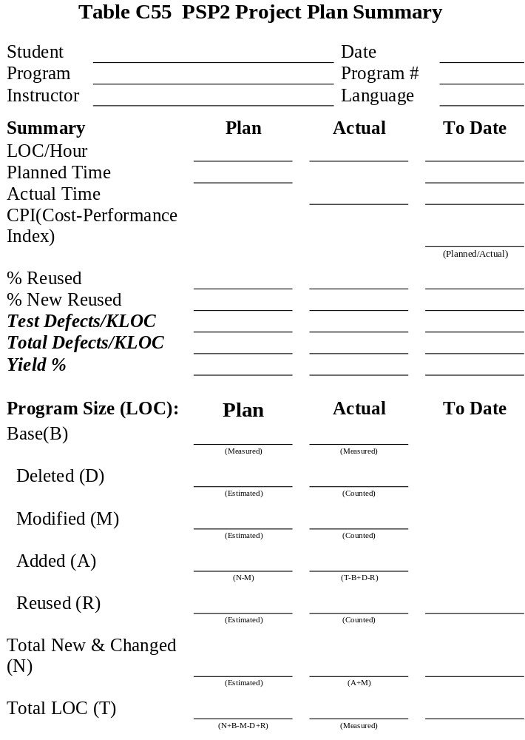

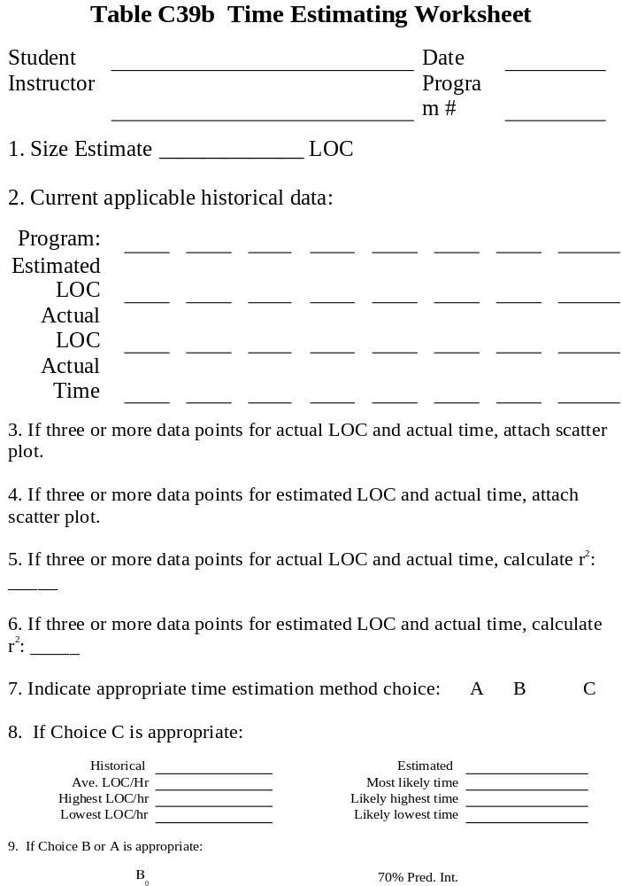

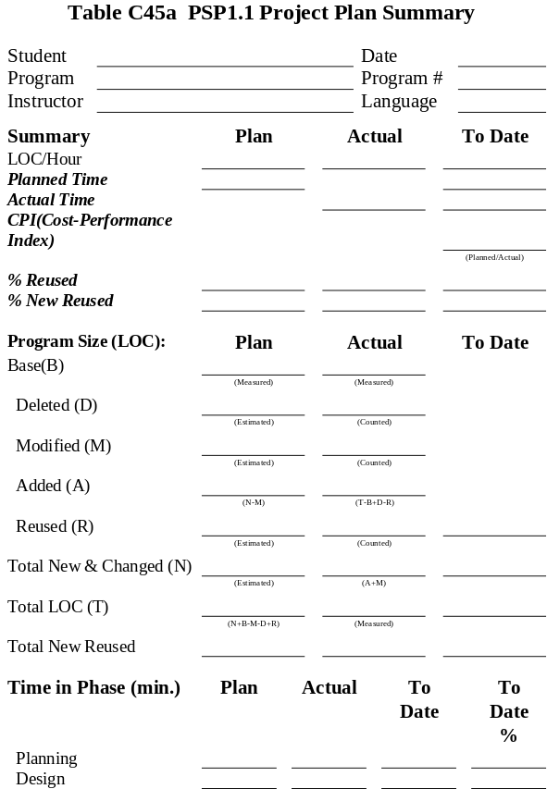
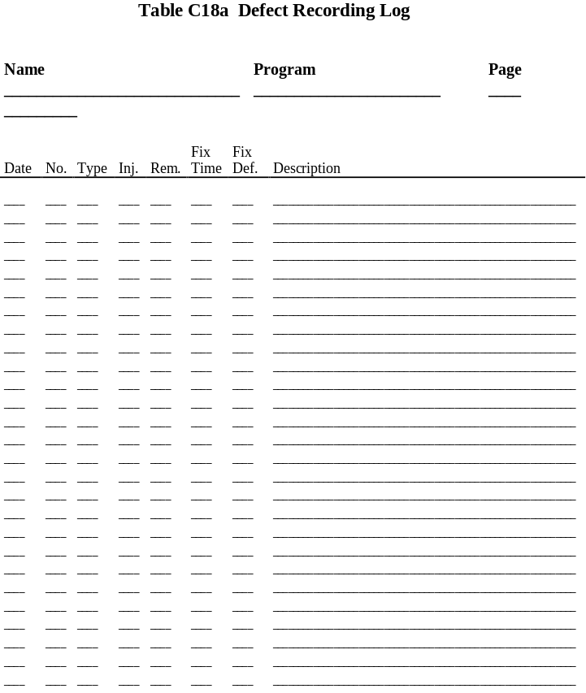
Using the PSP
Starting a new Project
  Multi-User Calendar extension
  Java

Slide 8
Problems with traditional solutions
Many software process improvement initiatives suffer from one or more of the following problems:
  Heavy weight development constraints
  Manual Data Collection
  Organization-level analysis and
  improvement
  Measurement Dysfunction
Problem
Traditional Solutions
LEAP
Evaluation
Contributions

Slide 9
Supporting Software Developer Improvement with LEAP
LEAP is our design philosophy. All LEAP tools must satisfy four major criteria:
  Light weight
  Empirical
  Anti-Measurement dysfunctional and
  Portable
The Leap toolkit is a reference
implementation
Problem
Traditional Solutions
LEAP
Evaluation
Contributions

Slide 10
Leap Toolkit
Started August 1997
Over 25 public releases
As of 21 Sep. 1999, the size of the Leap Toolkit is:
  41,000 Lines of Java Code
  1,955 Methods
  272 Classes
  13 Packages
It is available for download from
http://csdl.ics.hawaii.edu/Tools/LEAP/LEAP.html

Slide 11

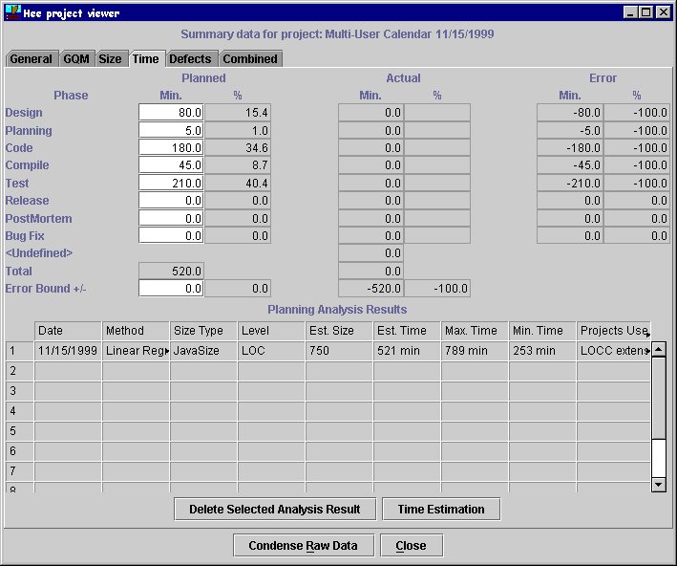
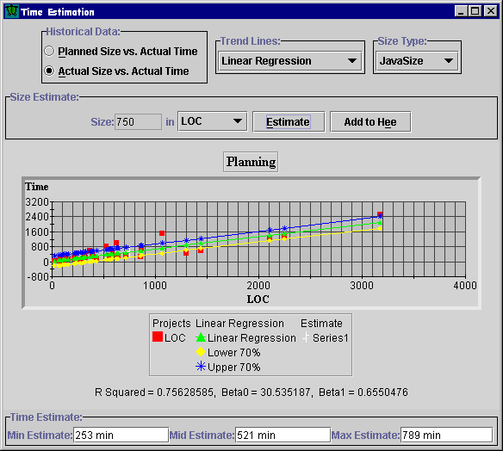
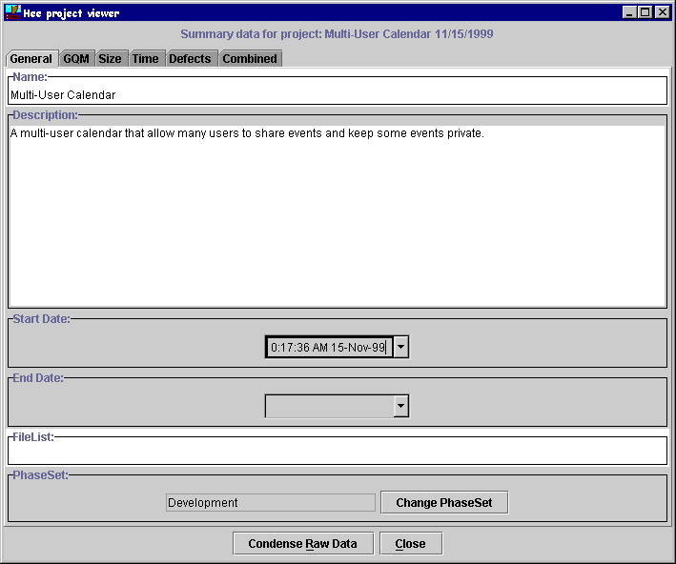
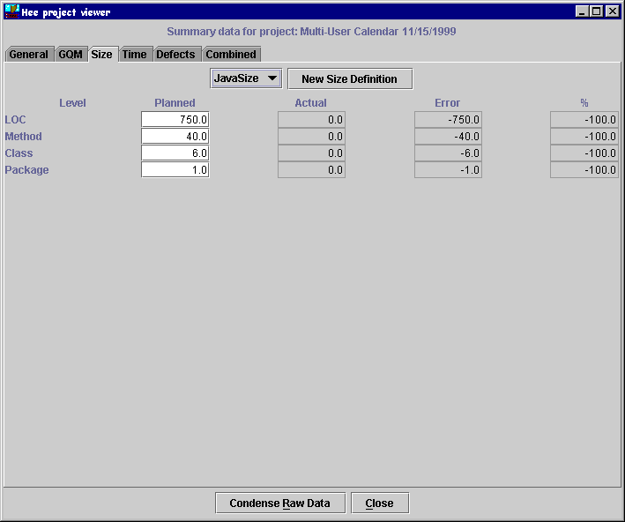
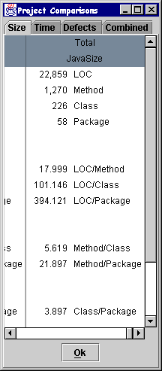
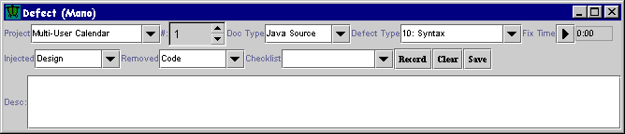
Using the Leap toolkit
Starting a new Project
  Multi-User Calendar extension
  Java
Problem
Traditional Solutions
LEAP
Evaluation
Contributions

Slide 12
General Thesis
LEAP provides a more accurate and effective way for developers to collect and analyze their software engineering data than methods designed for manual enactment.
Problem
Traditional Solutions
LEAP
Evaluation
Contributions

Slide 13
Evaluation
To evaluate this thesis I will break it into 3 hypotheses
  Accuracy
    Leap is able to prevent important classes of data error as identified in Disney98.
    Leap reduces the level of collection stage errors by reducing the overhead of data collection.
  Effectiveness
    Leap implements data collection and analysis that enables sophisticated analysis not available
    in manual methods such as PSP.
Problem
Traditional Solutions
LEAP
Evaluation
Contributions

Slide 14
Evaluation - Accuracy:
Error Prevention
H1: Leap is able to prevent important classes of data error as identified in Disney98.
The design of Leap prevents many of the types of data error found by Disney.
  Automated time data entry
  Automated data analysis
  Data does not have to be
  transferred between forms
Problem
Traditional Solutions
LEAP
Evaluation
Contributions

Slide 15
Evaluation - Accuracy:
Collection error reduction
H2: Leap reduces the level of collection stage errors by reducing the overhead of data collection.
Very difficult to detect so I will try to detect it by a combination of data analysis and surveys.
Problem
Traditional Solutions
LEAP
Evaluation
Contributions

Slide 16
Evaluation - Accuracy:
Collection error reduction
Study:
  16 Students will use Leap while developing 8 Java programs in ICS 613
  The students turn in their programs
  and their Leap data
Leap Data analysis
  look for time data that ends on 5
  minute intervals
  actual data that is a multiple of 5
  minutes
Problem
Traditional Solutions
LEAP
Evaluation
Contributions

Slide 17
Evaluation - Accuracy:
Collection error reduction
Surveys
  4 Anonymous surveys over the course of the class
    Background & Time recording
    Usability, Time recording & estimation
    Time recording, estimation & defects
    Usability, Perceptions & Lessons Learned
How did the students use Leap?
  Pressure to complete the projects
  Accuracy of Leap Data
  Tool use
Problem
Traditional Solutions
LEAP
Evaluation
Contributions

Slide 18
Evaluation - Effectiveness:
Sophisticated analyses
H3: Leap implements data collection and analysis that enables sophisticated analysis not available
in manual methods such as PSP.
Leap allows us to evaluate 14 different quantitative time estimation techniques.
Hypothesis: Some estimation methods
are more accurate than others.
Problem
Traditional Solutions
LEAP
Evaluation
Contributions

Slide 19
Evaluation - Effectiveness:
Sophisticated analyses
Quantitative Case Study
  16 Students will use Leap while building 8 programs
  Leap will record the students’ size
  and time estimates and the actual time
  and size of the projects
Problem
Traditional Solutions
LEAP
Evaluation
Contributions

Slide 20
Evaluation - Effectiveness:
Sophisticated analyses
14 Different Estimation methods - based upon historical size and time data
Planned Size
A
Actual Size
C
B
Methods
LOC
Average
Linear
Exponential
Problem
Student’s
PSP (A, B, or C)
Traditional Solutions
LEAP
Evaluation
Contributions

Slide 21
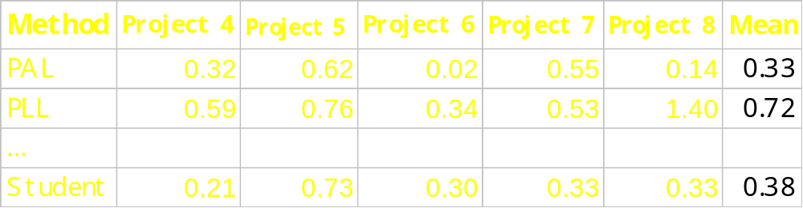
Evaluation - Effectiveness:
Sophisticated analyses
I can calculate the prediction error for each estimation method.
  Prediction Error = | estimate - actual | / actual
  Null Hypothesis: No difference in the prediction errors
    H₀ : µ₁ = µ₂ = µ₃ = ... = µ₁₄
Problem
Traditional Solutions
LEAP
Evaluation
Contributions

Slide 22
Evaluation - Effectiveness:
Sophisticated analyses
Data Analysis
  Randomized Block design, blocking for the project
  Use ANOVA to detect differences between the prediction errors
  Compare methods for each student
  Compare methods for the whole class
Problem
Traditional Solutions
LEAP
Evaluation
Contributions

Slide 23
Time Line
August: Class started
Sept 4: 1st survey
Nov 1: 2nd survey
Nov 22: 3rd survey
Dec 6: 4th survey
Dec 31: Finished with background chapters
Jan 31: Estimation data analysis complete
Feb 14: Survey analysis complete
Feb 24: Dissertation to committee
Mar 16: Dissertation defense
Apr 7: Dissertation to Grad. Div.
Problem
Traditional Solutions
LEAP
Evaluation
Contributions

Slide 24
Anticipated Contributions
The Leap toolkit
  An effective tool for software developer improvement
    Reduces overhead
    Flexible
    Portable
  A novel software engineering education tool
  A tool for investigating software development
The results of the estimation experiment
  Insight into better software estimation techniques
Problem
Traditional Solutions
LEAP
Evaluation
Contributions

Slide 25
Future Directions
Replicated studies with more subjects including industrial software developers
Industry adoption of Leap Toolkit
More support for data analysis in Leap Toolkit
Further study into effort estimation
Personal Agents that “observe” the
developer
Problem
Traditional Solutions
LEAP
Evaluation
Contributions

