Slide 1
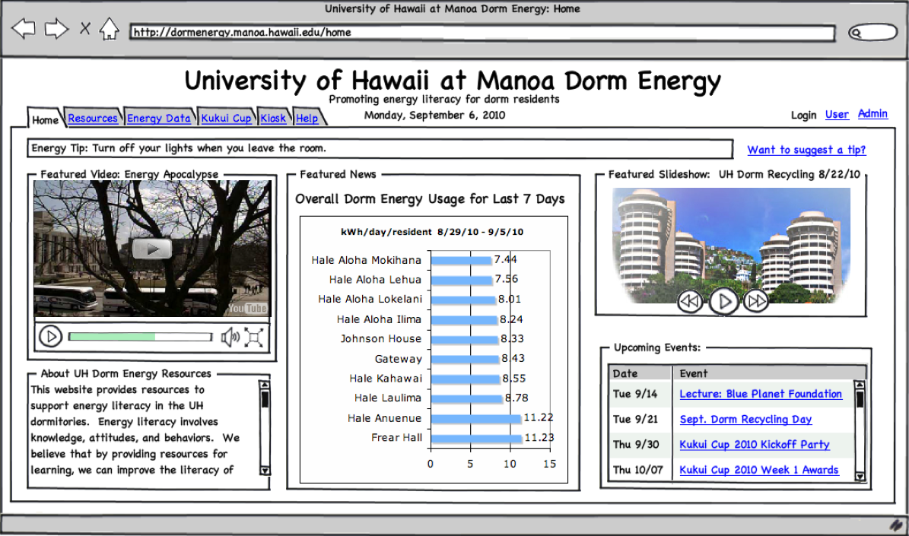
Floor-level Metering
Ethernet
WattDepot
Repository
Dormitory
Web Application

