Slide 1
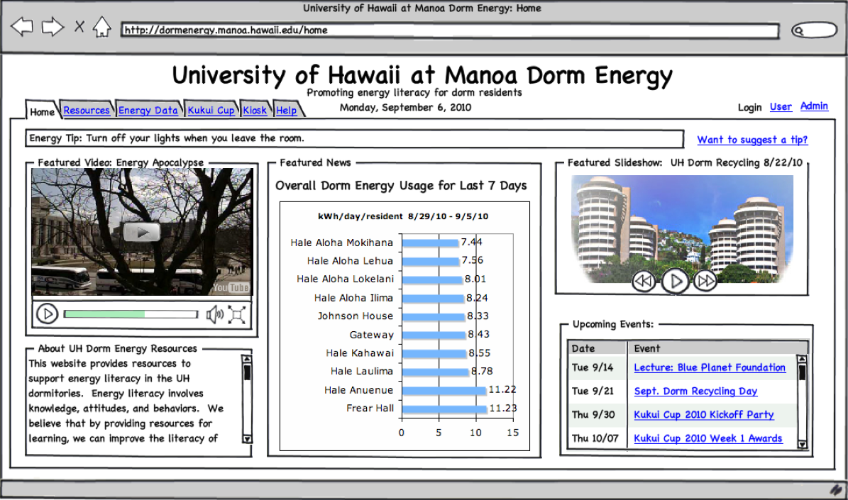
Floor-level Metering
TCP/IP
WattDepot
Repository
Dormitory
Web Application

