Slide 1



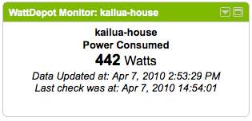
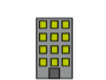
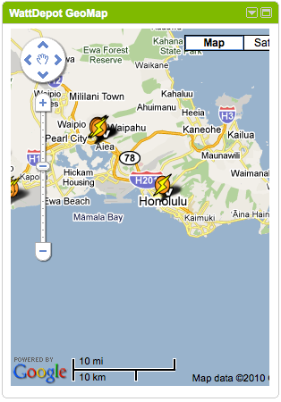

Devices
Meters
WattDepot
Sensors
WattDepot
Clients
WattDepot
Server
Meters

