Slide 1
Evaluation of Jupiter:
A Lightweight Code Review Framework
Takuya Yamashita
Collaborative Software Development Laboratory
Information & Computer Sciences
University of Hawaii at Manoa
Honolulu HI 96822

Slide 2
Outline
Introduction
Related Work
Jupiter Code Review System
Evaluation
Results
User’s voice
Future Directions

Slide 3
Introduction

Slide 4
Code Review removes many bugs
Can remove 93 percent of faults by inspection [Ackerman, 86]
Can find 11,557 faults from 7,000 inspection meeting [Weller, 93].
Can find 67 percent of faults before unit testing [Fagan, 76]

Slide 5
Problems of Code Review
Review is costly
  Inspections are extremely costly [Glass]
Disciplined review loses review performance
  Inspection is a systematic and disciplined process… These strict process results in performance loss [Emden, et al]
Review process is not managed well
  Too much material is assigned in time constraint [Wiegers]

Slide 6
Different Type of Review Tools helps review processes
Full Functioned Review Tools
  CSRS (Collaborative Software Review System) – formal technical review
  ASSIST (Asynchronous / Synchronous Software Inspection Tool) – Asynchronous /Synchronous review.

Slide 7
Different Type of Review Tools helps review processes (cont.)
Lightweight Review Tools
  IBIS (Internet-Based Inspection System) – internet based, XML file, XSLT
  LEAP (Lightweight Empirical Automated Portable) toolkit – internet based,
  Jupiter (Lightweight Code Review Tool) – client based, XML,

Slide 8
Problems of Review Tools
Overhead to the tool adoption (Sophisticated Tools)
  hard to learn and/or teach a tool
  hard to learn and/or teach a process
Overhead to the information management (Simple Tools)
  hard to maintain review issues
  hard to manage process requirement

Slide 9
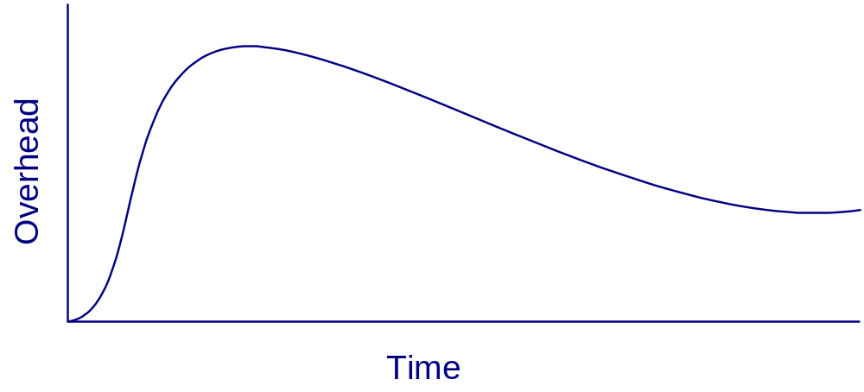
Overhead of the Sophisticated Tool
Overhead to the Use of Sophisticated Tool
Review initialization
Learn review process
Learn tool functions
Install review system

Slide 10
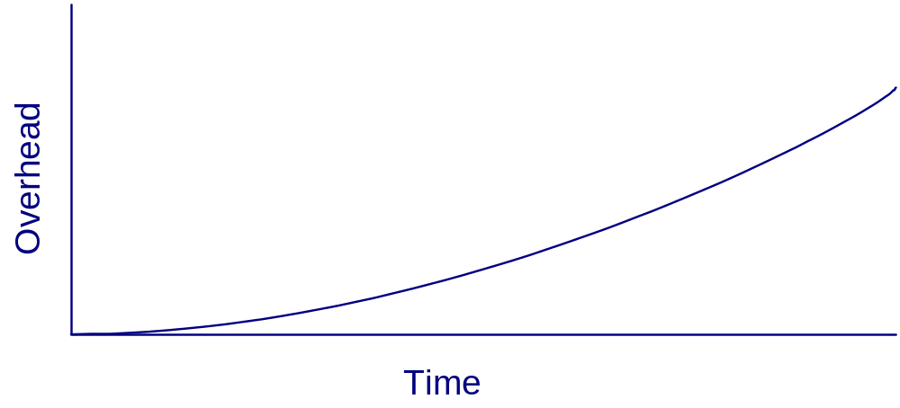
Overhead of the Simple Tool
Overhead to the use of Simple Tool
Manage review issues
Add review issues
Define writing format

Slide 11
My Approach: Jupiter
Lightweight
  Independent from the external persistent and configuration management system
  Easy to install, update, and use the system
  Simple four review phases.

Slide 12
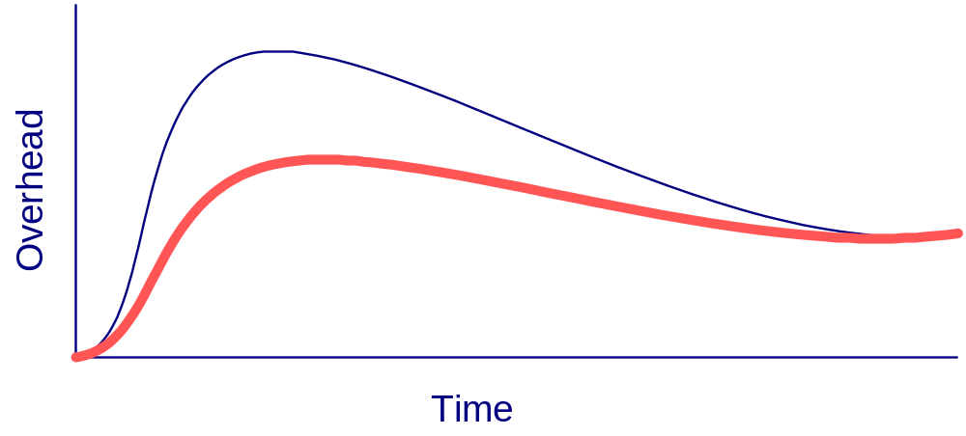
Overhead of Jupiter
Overhead to the use of Jupiter
Simple phases
Easy use
System independence

Slide 13
Related Work

Slide 14
Research on Code Review Tools
Lightweight Code Review Tools
  LEAP - tool and metric data evaluation
  Jupiter – the text based vs. Jupiter based review

Slide 15
Jupiter Code Review System

Slide 16
Jupiter Code Review Tool
Eclipse plug-in (http://eclipse.org)
Open source – CPL license
Free – free of charge
Cross platform – Windows, Linux, MacOSX
XML data storage – XML based review file
Sorting and Filtering – sort and filter by categories.
File Integration – jump back and forth between review comments and source code
Simple Phases – Configuration, Individual, Team, and Rework phase

Slide 17
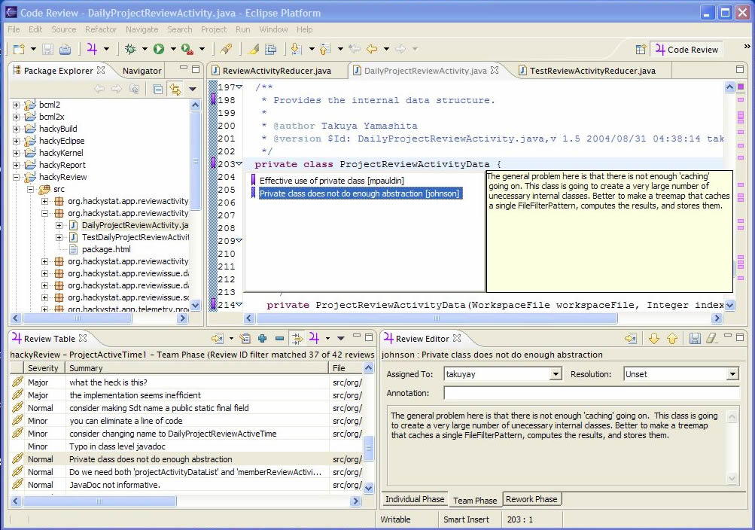
Jupiter plug-in for Eclipse

Slide 18
Four Review Phase
Configuration – to configures review ID, reviewers, and category items
Individual Review – to prepare individual review fast and find as much bugs as possible with in a time limitation
Team Review – to review as much all brought-up review comments as possible and validate them with in a time limitation
Revision – to fix the problems efficiently

Slide 19
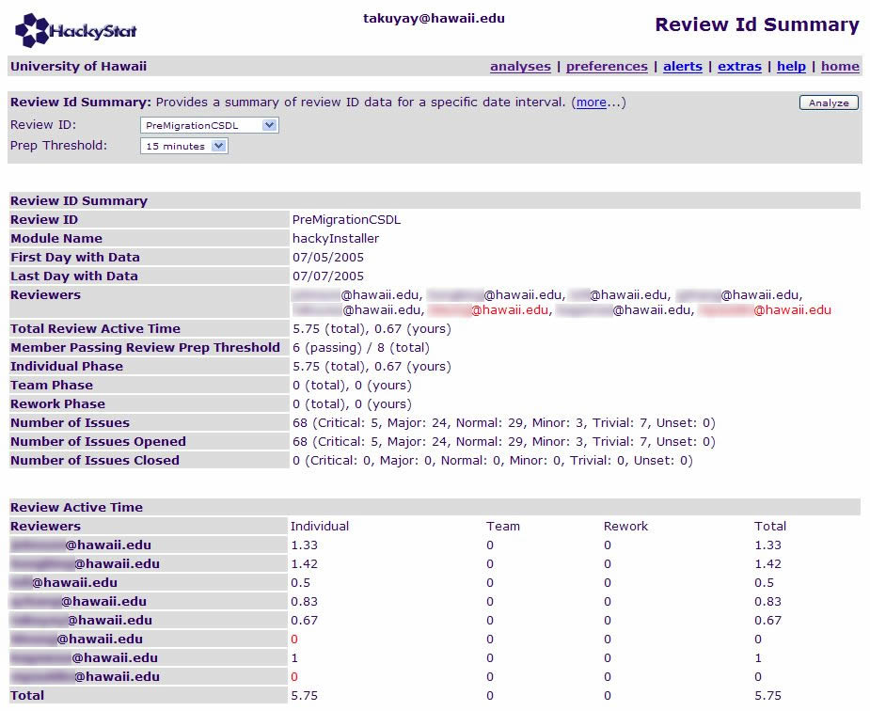
Review ID Summary

Slide 20
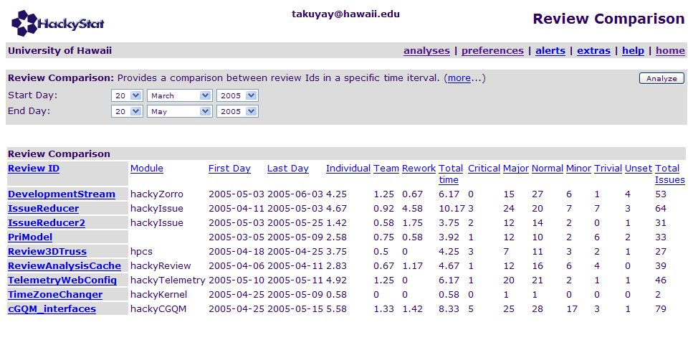
Review ID Comparison

Slide 21
Jupiter Code Review
CSDL Team
  Has used it for almost 2 years.
  At least 17 code reviews.
Other organizations
  Ebay, Nokia, e-sim, etc
  Have started to use it.

Slide 22
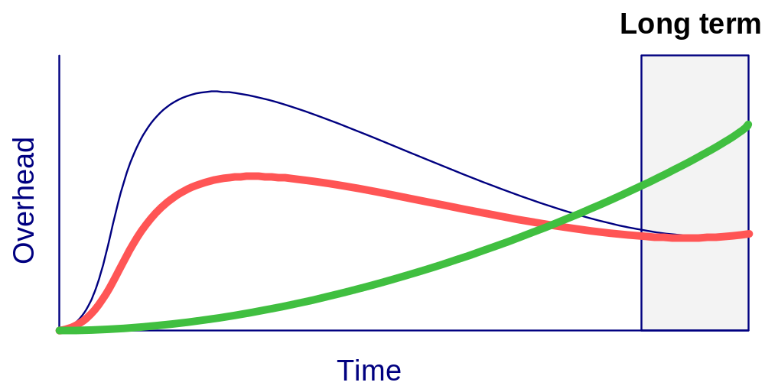
Overhead of the tool based reviews
Overhead of the text based review and Jupiter based review
  Jupiter code review is useful and usable?
  Jupiter code review is less overhead in long term?
  Jupiter is adoptable in long term use?
Text based review
Jupiter based review

Slide 23
Thesis Claim
After initial use of Jupiter, software developer will find the good insight that it more useful and usable than the text based review.
After initial use of Jupiter, software developer will find the good insight it’s overhead is less than that of the text based review.
After initial use of Jupiter, software developer will find the good insight that it is adoptable in the future.

Slide 24
Evaluation

Slide 25
Subjects
  9 ICS undergraduates in University of Hawaii at Manoa in Spring 2005
  16 ICS gradutaes in University of Hawaii at Manoa in Spring 2005

Slide 26
Evaluation Methodology
Text based code review
  Code review via email.
  Individual phase
  Team phase
  Rework phase
Jupiter based code review
  Code review via Jupiter
  Individual phase
  Team phase
  Rework phases
Questionnaire
  To determine if the Jupiter based code review is more useful and usable than the text base review, less overhead, and adoptable.

Slide 27
Results

Slide 28
Thesis Claim
After initial use of Jupiter, software developer will find the good insight that it more useful and usable than the text based review.
Results supports the claim
After initial use of Jupiter, software developer will find the good insight it’s overhead is less than that of the text based review.
Results supports the claim
After initial use of Jupiter, software developer will find the good insight that it is adoptable in the future.
Results supports the claim

Slide 29
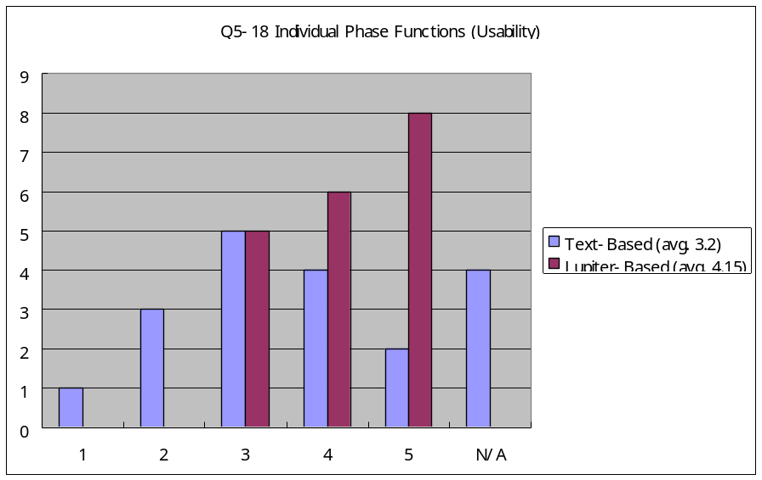
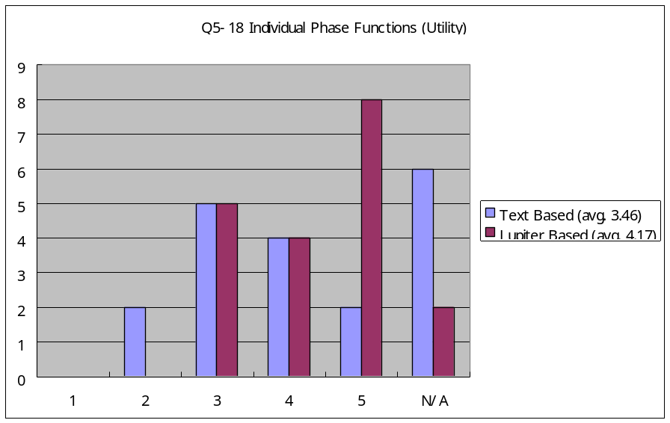
Usability and Utility
(Individual Phase)
Results supports the claim 1.

Slide 30
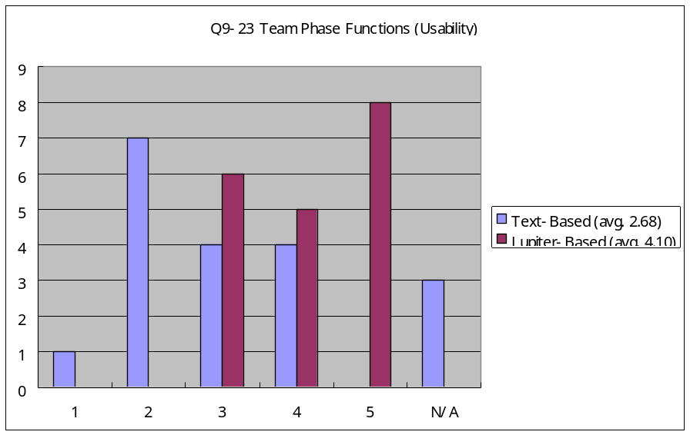
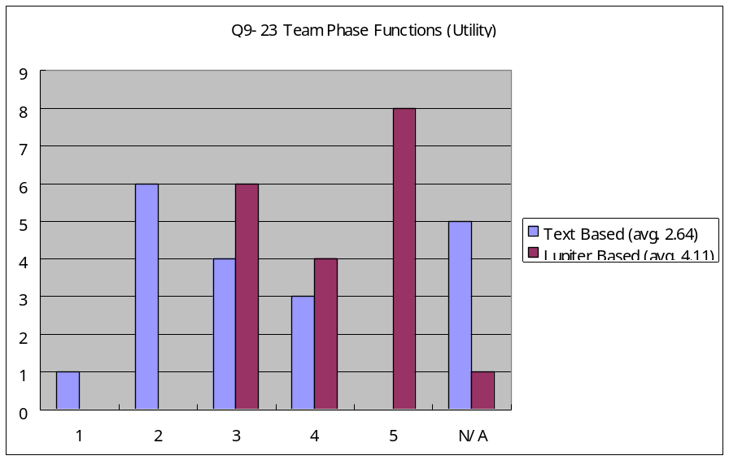
Usability and Utility
(Team Phase)
Results supports the claim 1.

Slide 31
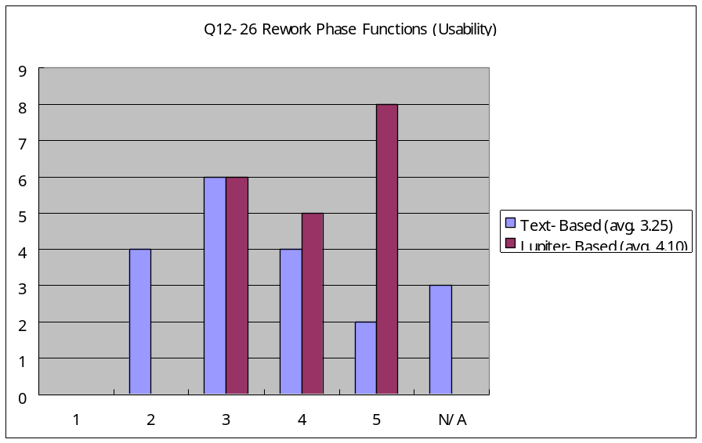
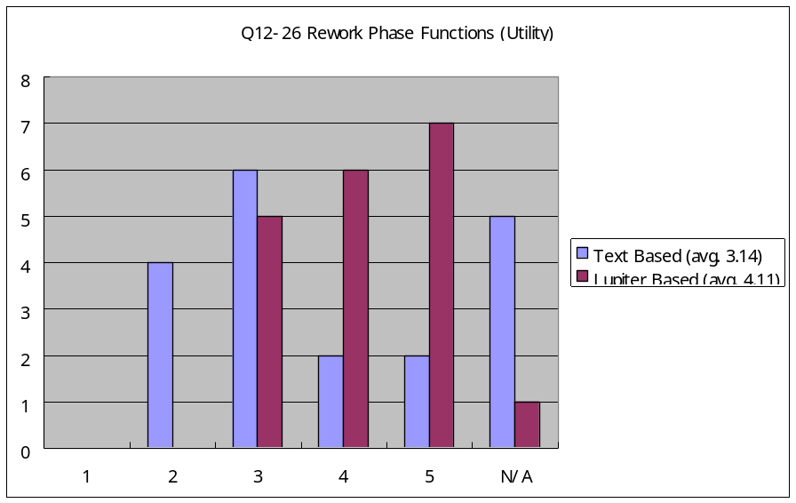
Usability and Utility
(Rework Phase)
Results supports the claim 1.

Slide 32
Overhead of the tool functions
[Add the charts of the function overhead]

Slide 33
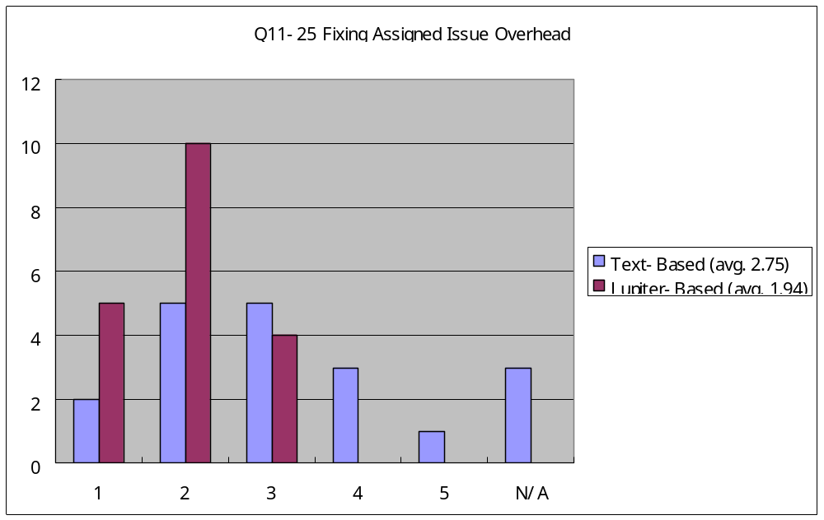
Fixing Assigned Issue Overhead (Rework)
The text based review has similar curve of the Jupiter based review
  Students felt that the text based review did not have much overhead.

Slide 34
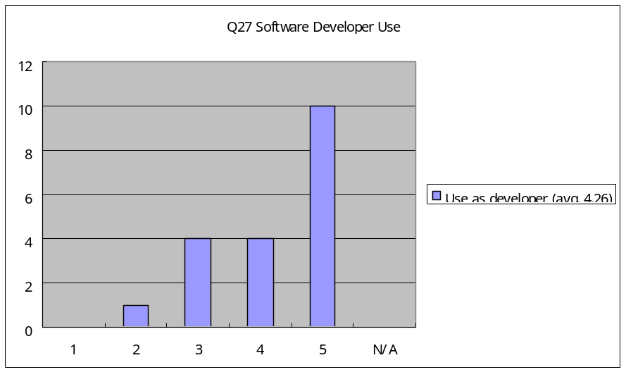
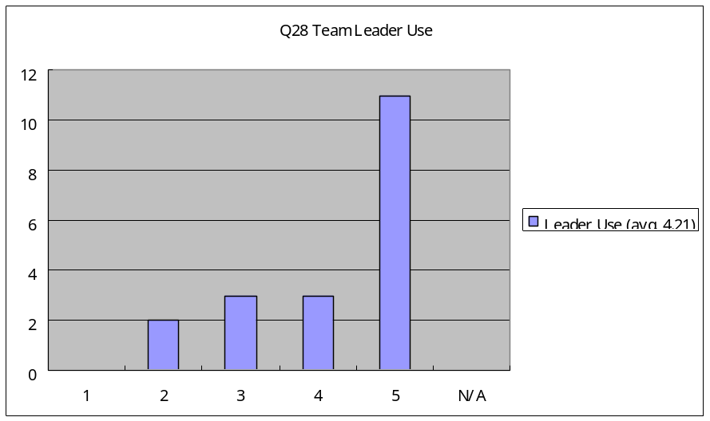
Future Adoption
Results supports the claim 3.
  Most students are willing to use Jupiter in the future

Slide 35
Observations
There were many N/As for the text based review.
  They thought the “email based” review was not the “text based” review.
    The sorting and filtering functions could be clearer. I’ve never used text-based review, so I can not compare (Student I).
  They might omit answering the question because they could not understand what “Utility” meant.

Slide 36
Observations (cont.)
Jupiter update mechanism worked too well.
  Don’t update Jupiter every single week. I don’t feel people like to do update every time they open Eclipse. It is better to release the update every 6 month (Student M).
  Please do not update Jupiter every single week. Though there is not much overhead installing it, it’s not fun to do it every week. Minor fixes: users will not be notice. Go for a major release that all users could use them effectively (Student S).

Slide 37
Observations (cont.)
There were bugs in a version of Jupiter.
  I had problems with last load (April 05). The error box showed up every command. It could not be fixed (Student O).
The initial overhead of Configuration phase is high
  Setting up initial reviews as leader was not intuitive. But once done a couple of times was very easy (Student B).

Slide 38
Observations (cont.)
Positive feelings for Jupiter
  Good (Student E).
  A nice feature would be how team reviews online with code (Student R).

Slide 39
Result Conclusions
  The results provide supporting evident that Jupiter based review is less overhead than the text based review.
  The results provide supporting evidence that Jupiter based review is more useful and usable than the text based review
  More research and evaluations are needed

Slide 40
Evaluation Limitations
One way evaluation
  Text based review -> Jupiter based review
  Didn’t conduct the reverse evaluation.
Different review materials between groups
  Each group used the group’s source code.
Some Bias for Jupiter
  Jupiter was developed at CSDL in the UH.

Slide 41
User’s voice

Slide 42
User’s voice
[Add the user’s voice I got via emails]

Slide 43
Future Directions

Slide 44
Future Directions
Improvements to Jupiter Evaluation
  More data and reverse order evaluation to determine the usability and utility
Improvements to Jupiter Code Review Tool
  More research to determine what the users need to support general review processes.
Evaluation of the Jupiter Code Review Tool with Hackystat system
  More research to determine collecting review metric data improve a review process or the analysis tool is useful and usable.
Open Source Community
  More development for the Jupiter community makes people adopt Jupiter itself and research software review by using Jupiter

Slide 45
Any Questions?

