Slide 1
Active RC Low-Pass
Order 2 | Cutoff Frequency: 10,000 Hz
File 065 / 100 | Variant 5

Slide 2
Filter Theory & Transfer Function
Transfer Function H(s) — Active RC Low-Pass Order 2 H(s) = ωc² / (s² + s·ωc/Q + ωc²) [2nd-order section] ωc = 2π × 10,000 rad/s Op-amp topology: Sallen-Key Number of 2nd-order stages: 1 Unity-gain configuration (K=1) DC gain: 0 dB

Slide 3
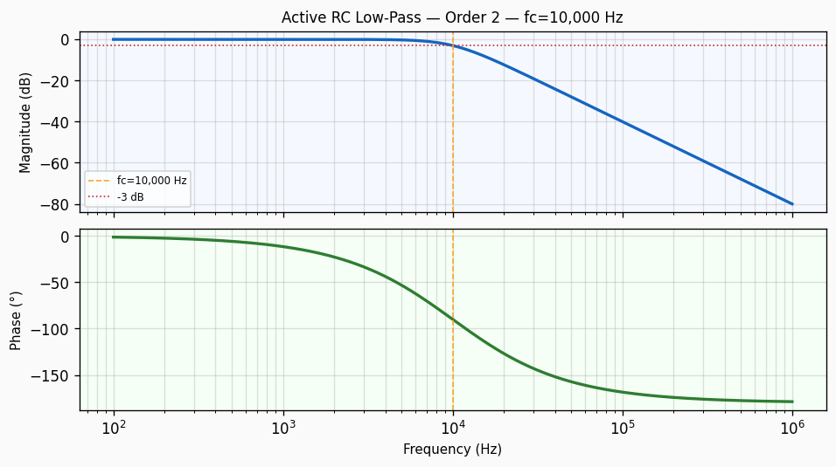
Frequency Response — Bode Plot
Bode plot of Active RC Low-Pass order 2 filter. Top panel: magnitude response in dB showing -3 dB cutoff at 10,000 Hz with a roll-off of approximately 40 dB/decade. Bottom panel: phase response in degrees.

Slide 4
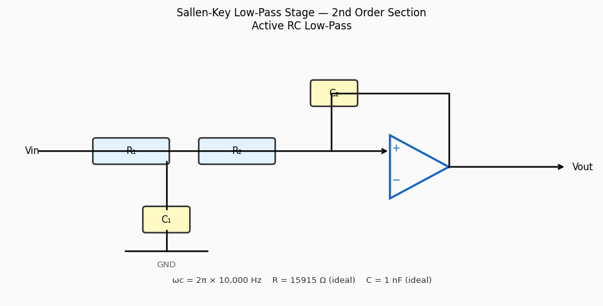
Circuit / Block Diagram
Sallen-Key topology for Active RC Low-Pass order 2. The circuit uses two resistors R₁, R₂ and two capacitors C₁, C₂ around an op-amp in unity-gain configuration to realise a 2nd-order low-pass section with cutoff frequency 10,000 Hz.

Slide 5
Design Parameters
Parameter | Value
Filter Family | Active RC Low-Pass
Filter Type | Low-Pass
Filter Order (N) | 2
Cutoff Frequency (fc) | 10,000 Hz
Angular Cutoff (ωc) | 62831.85 rad/s
Passband Gain (0 Hz) | 0 dB
-3 dB Frequency | 10,000 Hz
Roll-off Rate | 40 dB/decade
Op-Amp Topology | Sallen-Key
Ideal Capacitor (C) | 1 nF
Ideal Resistor (R) | 15915 Ω

Slide 6
Real-World Applications
• Instrumentation amplifier output smoothing at 10,000 Hz • Sensor conditioning circuit for MEMS accelerometers • Loop filter in phase-locked loop (PLL) synthesisers • Anti-aliasing for low-speed (audio-band) delta-sigma ADCs • Low-pass reconstruction filter after DAC in control systems
Filter: Active RC Low-Pass | fc = 10,000 Hz | Order = 2

