Slide 1
Bessel Low-Pass
Order 7 | Cutoff Frequency: 3,000 Hz
File 048 / 100 | Variant 8

Slide 2
Filter Theory & Transfer Function
Transfer Function H(s) — Bessel Order 7 H(s) = d₀ / Bₙ(s/ωc) Bₙ = Bessel polynomial of order 7 ωc = 2π × 3,000 rad/s Maximally flat group delay Preserves waveform shape in passband Roll-off: slower than Butterworth

Slide 3
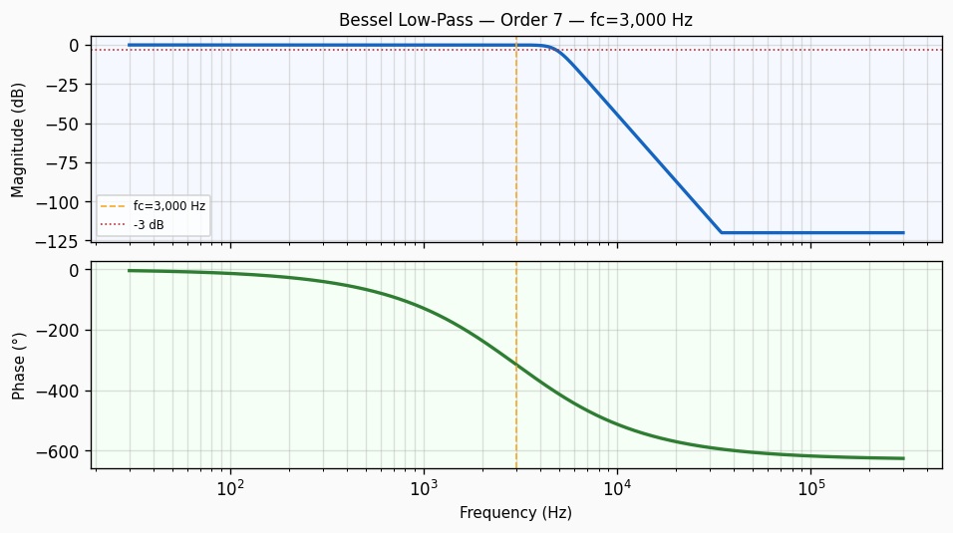
Frequency Response — Bode Plot
Bode plot of Bessel Low-Pass order 7 filter. Top panel: magnitude response in dB showing -3 dB cutoff at 3,000 Hz with a roll-off of approximately 140 dB/decade. Bottom panel: phase response in degrees.

Slide 4
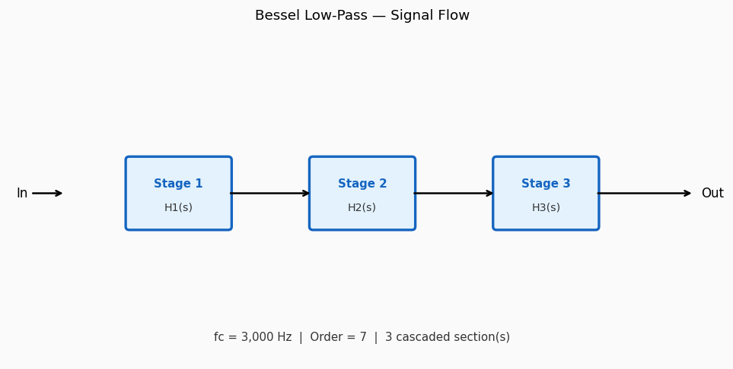
Circuit / Block Diagram
Cascade block diagram for Bessel Low-Pass order 7. The design is decomposed into 3 second-order section(s), each realising a pair of complex conjugate poles near cutoff 3,000 Hz.

Slide 5
Design Parameters
Parameter | Value
Filter Family | Bessel Low-Pass
Filter Type | Low-Pass
Filter Order (N) | 7
Cutoff Frequency (fc) | 3,000 Hz
Angular Cutoff (ωc) | 18849.56 rad/s
Passband Gain (0 Hz) | 0 dB
-3 dB Frequency | 3,000 Hz
Roll-off Rate | 140 dB/decade

Slide 6
Real-World Applications
• Pulse shaping in digital communications (minimum ISI) • Group-delay equalisation in multi-channel audio systems • Waveform preservation in oscilloscope input paths • Radar pulse processing requiring constant group delay • Control system compensation for minimum phase distortion
Filter: Bessel Low-Pass | fc = 3,000 Hz | Order = 7

