Slide 1
Butterworth High-Pass
Order 4 | Cutoff Frequency: 500 Hz
File 012 / 100 | Variant 2

Slide 2
Filter Theory & Transfer Function
Transfer Function H(s) — Butterworth Order 4 |H(jω)|² = 1 / [1 + (ω/ωc)^8] ωc = 2π × 500 rad/s ≈ 3141.6 rad/s 3 dB cutoff: 500 Hz Maximally flat passband (no ripple) Roll-off: 80 dB/decade beyond ωc

Slide 3
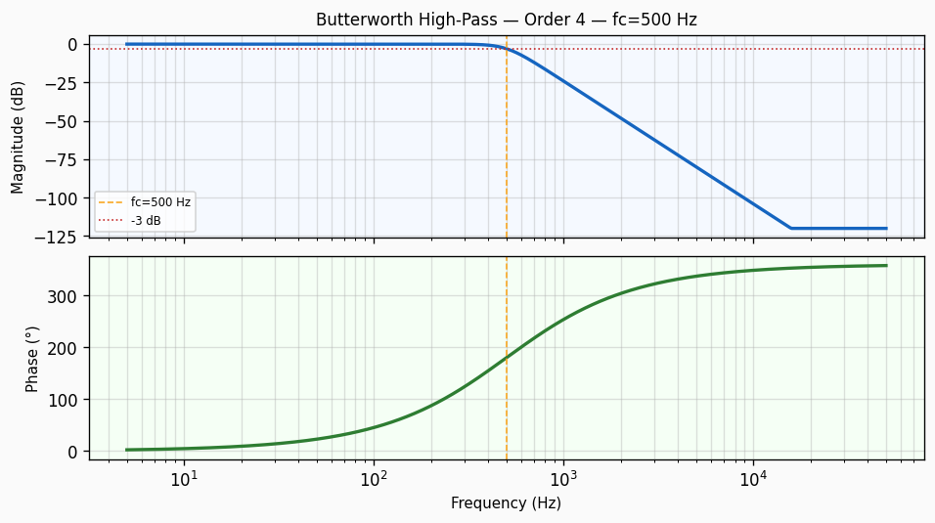
Frequency Response — Bode Plot
Bode plot of Butterworth High-Pass order 4 filter. Top panel: magnitude response in dB showing -3 dB cutoff at 500 Hz with a roll-off of approximately 80 dB/decade. Bottom panel: phase response in degrees.

Slide 4
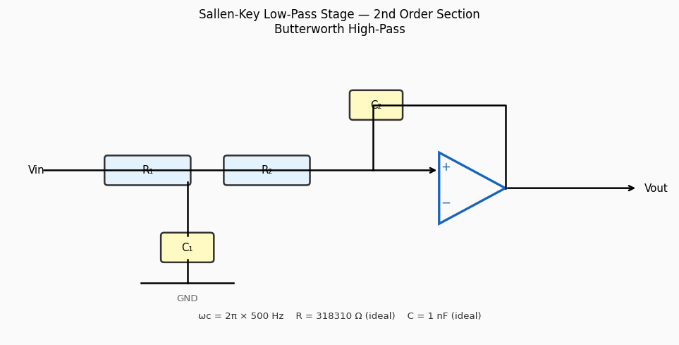
Circuit / Block Diagram
Sallen-Key topology for Butterworth High-Pass order 4. The circuit uses two resistors R₁, R₂ and two capacitors C₁, C₂ around an op-amp in unity-gain configuration to realise a 2nd-order low-pass section with cutoff frequency 500 Hz.

Slide 5
Design Parameters
Parameter | Value
Filter Family | Butterworth High-Pass
Filter Type | High-Pass
Filter Order (N) | 4
Cutoff Frequency (fc) | 500 Hz
Angular Cutoff (ωc) | 3141.59 rad/s
Passband Gain (0 Hz) | 0 dB
-3 dB Frequency | 500 Hz
Roll-off Rate | 80 dB/decade

Slide 6
Real-World Applications
• DC-blocking in microphone pre-amplifier circuits • Removal of low-frequency mechanical vibration interference • Coupling filter in AC-coupled differential amplifier inputs • High-pass shelving EQ in professional audio mastering • Seismic noise rejection in structural health monitoring
Filter: Butterworth High-Pass | fc = 500 Hz | Order = 4

