Slide 1
Butterworth Low-Pass
Order 6 | Cutoff Frequency: 5,000 Hz
File 003 / 100 | Variant 3

Slide 2
Filter Theory & Transfer Function
Transfer Function H(s) — Butterworth Order 6 |H(jω)|² = 1 / [1 + (ω/ωc)^12] ωc = 2π × 5,000 rad/s ≈ 31415.9 rad/s 3 dB cutoff: 5,000 Hz Maximally flat passband (no ripple) Roll-off: 120 dB/decade beyond ωc

Slide 3
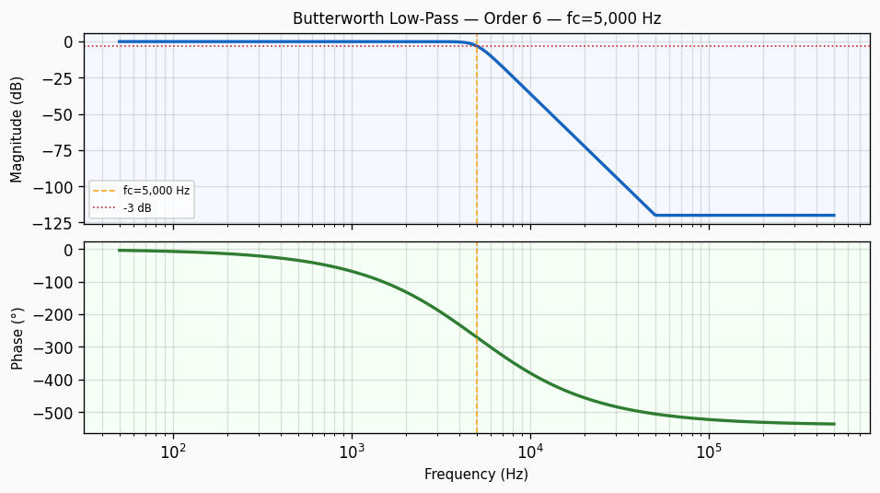
Frequency Response — Bode Plot
Bode plot of Butterworth Low-Pass order 6 filter. Top panel: magnitude response in dB showing -3 dB cutoff at 5,000 Hz with a roll-off of approximately 120 dB/decade. Bottom panel: phase response in degrees.

Slide 4
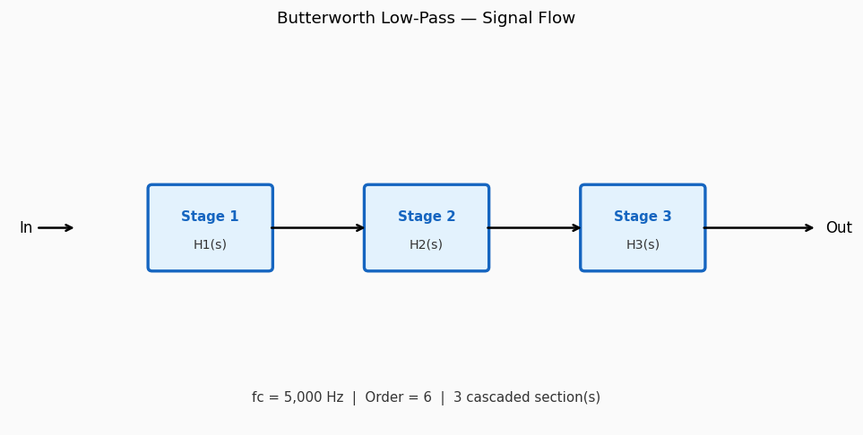
Circuit / Block Diagram
Sallen-Key topology for Butterworth Low-Pass order 6. The circuit uses two resistors R₁, R₂ and two capacitors C₁, C₂ around an op-amp in unity-gain configuration to realise a 2nd-order low-pass section with cutoff frequency 5,000 Hz.

Slide 5
Design Parameters
Parameter | Value
Filter Family | Butterworth Low-Pass
Filter Type | Low-Pass
Filter Order (N) | 6
Cutoff Frequency (fc) | 5,000 Hz
Angular Cutoff (ωc) | 31415.93 rad/s
Passband Gain (0 Hz) | 0 dB
-3 dB Frequency | 5,000 Hz
Roll-off Rate | 120 dB/decade

Slide 6
Real-World Applications
• Anti-aliasing filter before ADC sampling in data acquisition systems • Audio signal smoothing in professional mixing consoles • DC power supply ripple rejection in instrumentation amplifiers • Vibration sensor conditioning in industrial IoT edge devices • Baseband filtering in software-defined radio (SDR) receivers
Filter: Butterworth Low-Pass | fc = 5,000 Hz | Order = 6

