Slide 1
Chebyshev Type-I Low-Pass
Order 4 | Cutoff Frequency: 500 Hz | Passband Ripple: 0.1 dB
File 023 / 100 | Variant 3

Slide 2
Filter Theory & Transfer Function
Transfer Function H(s) — Chebyshev Type I Order 4 |H(jω)|² = 1 / [1 + ε²·Tₙ²(ω/ωc)] ε² = 10^(Rp/10) - 1, Rp = 0.1 dB Tₙ = Chebyshev polynomial of order 4 ωc = 2π × 500 rad/s Passband ripple: 0.1 dB Steeper roll-off than Butterworth for same order

Slide 3
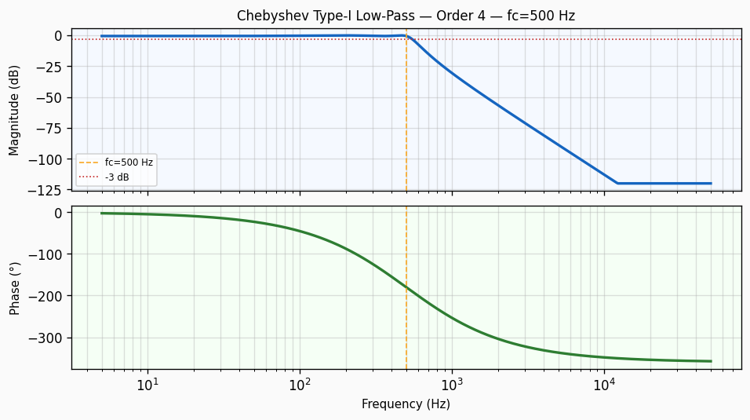
Frequency Response — Bode Plot
Bode plot of Chebyshev Type-I Low-Pass order 4 filter. Top panel: magnitude response in dB showing -3 dB cutoff at 500 Hz with a roll-off of approximately 80 dB/decade. Bottom panel: phase response in degrees.

Slide 4
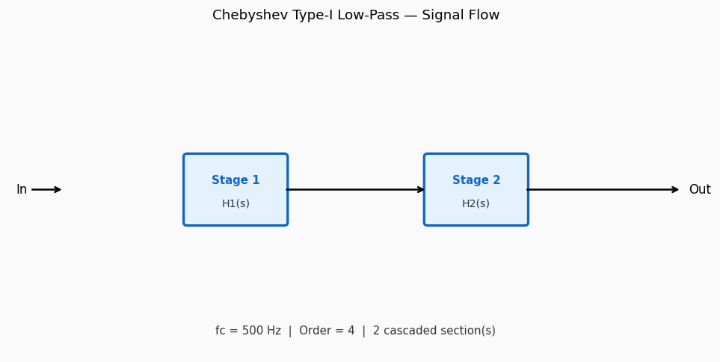
Circuit / Block Diagram
Cascade block diagram for Chebyshev Type-I Low-Pass order 4. The design is decomposed into 2 second-order section(s), each realising a pair of complex conjugate poles near cutoff 500 Hz.

Slide 5
Design Parameters
Parameter | Value
Filter Family | Chebyshev Type-I Low-Pass
Filter Type | Low-Pass
Filter Order (N) | 4
Cutoff Frequency (fc) | 500 Hz
Angular Cutoff (ωc) | 3141.59 rad/s
Passband Gain (0 Hz) | 0 dB
-3 dB Frequency | 500 Hz
Roll-off Rate | 80 dB/decade
Passband Ripple | 0.1 dB

Slide 6
Real-World Applications
• Steeper anti-aliasing where slight passband ripple is acceptable • Channel selection in narrow-band RF receiver front-ends • Harmonic rejection in precision measurement equipment • Video signal bandwidth limiting for broadcast standards • Medical ECG signal processing — power-line noise rejection
Filter: Chebyshev Type-I Low-Pass | fc = 500 Hz | Order = 4

