Slide 1
Chebyshev Type-II Low-Pass
Order 2 | Cutoff Frequency: 10,000 Hz | Passband Ripple: 60 dB
File 035 / 100 | Variant 5

Slide 2
Filter Theory & Transfer Function
Transfer Function H(s) — Chebyshev Type II Order 2 |H(jω)|² = 1 / [1 + 1/(ε²·Tₙ²(ωs/ω))] Stopband attenuation: 60 dB ωs = 2π × 10,000 rad/s (stopband edge) Flat passband, equiripple stopband Order: 2

Slide 3
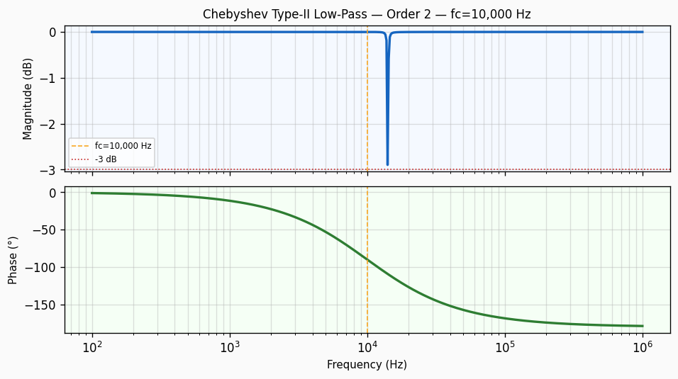
Frequency Response — Bode Plot
Bode plot of Chebyshev Type-II Low-Pass order 2 filter. Top panel: magnitude response in dB showing -3 dB cutoff at 10,000 Hz with a roll-off of approximately 40 dB/decade. Bottom panel: phase response in degrees.

Slide 4
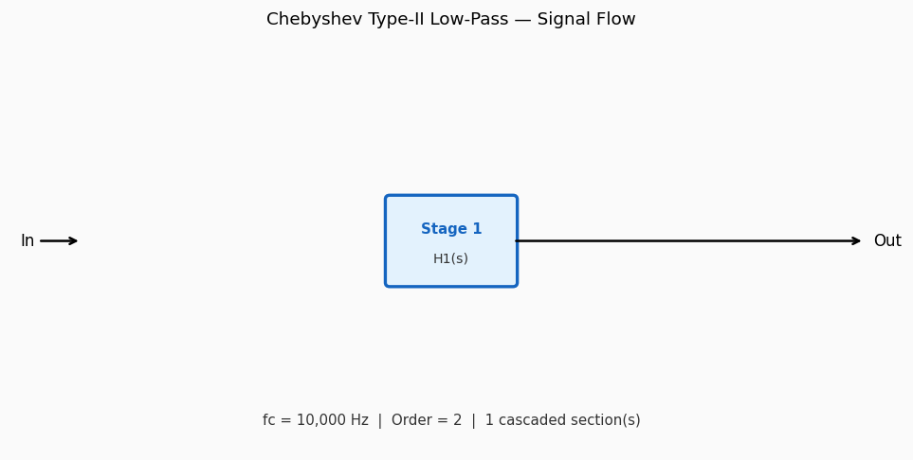
Circuit / Block Diagram
Cascade block diagram for Chebyshev Type-II Low-Pass order 2. The design is decomposed into 1 second-order section(s), each realising a pair of complex conjugate poles near cutoff 10,000 Hz.

Slide 5
Design Parameters
Parameter | Value
Filter Family | Chebyshev Type-II Low-Pass
Filter Type | Low-Pass
Filter Order (N) | 2
Cutoff Frequency (fc) | 10,000 Hz
Angular Cutoff (ωc) | 62831.85 rad/s
Passband Gain (0 Hz) | 0 dB
-3 dB Frequency | 10,000 Hz
Roll-off Rate | 40 dB/decade
Minimum Stopband Attenuation | 60 dB

Slide 6
Real-World Applications
• Stopband-critical filtering in telephony channel banks • Interference suppression in GPS front-end receiver chains • Image rejection in superheterodyne radio architectures • Flat passband required: medical imaging signal chains • High-fidelity audio crossover networks (subwoofer isolation)
Filter: Chebyshev Type-II Low-Pass | fc = 10,000 Hz | Order = 2

