Slide 1
Digital FIR Filter
Order 128 | Cutoff Frequency: 15,000 Hz
File 099 / 100 | Variant 9

Slide 2
Filter Theory & Transfer Function
Transfer Function H(z) — Digital FIR Taps=128 H(z) = Σ h[n]·z⁻ⁿ, n = 0…127 Design: windowed-sinc (Hamming window) Sampling rate: fs = 150,000 Hz Normalized cutoff: ωd = 2π·15,000/150,000 = 0.6283 rad Non-recursive (FIR) — linear phase guaranteed Group delay: 64 samples

Slide 3
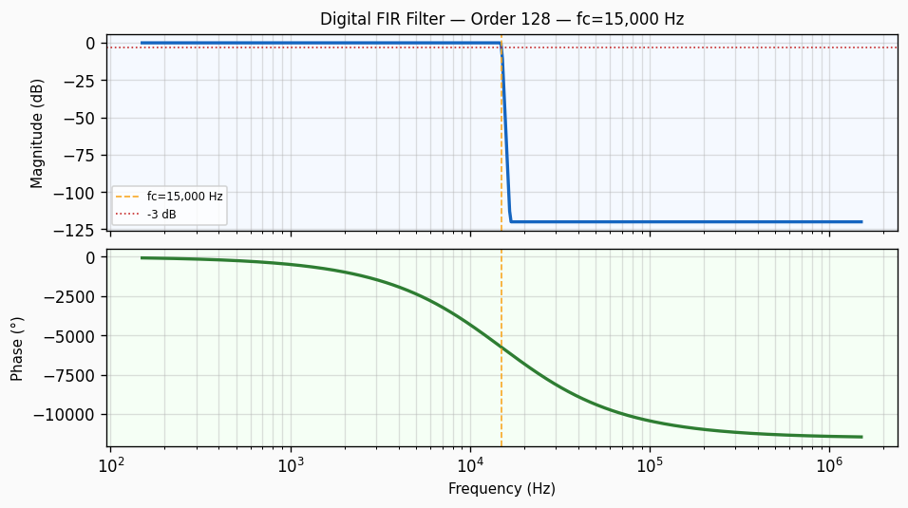
Frequency Response — Bode Plot
Bode plot of Digital FIR Filter order 128 filter. Top panel: magnitude response in dB showing -3 dB cutoff at 15,000 Hz with a roll-off of approximately 2560 dB/decade. Bottom panel: phase response in degrees.

Slide 4
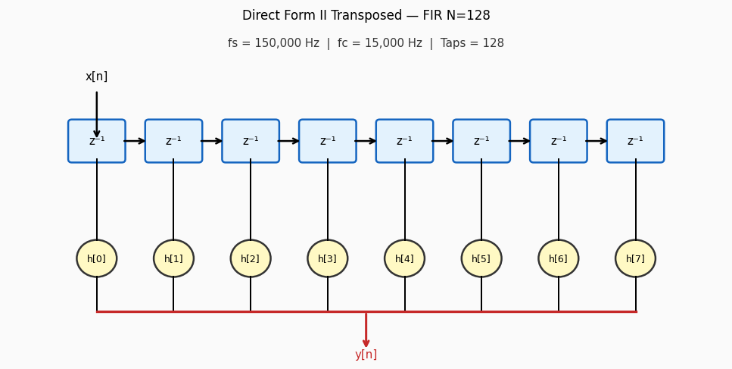
Circuit / Block Diagram
Direct Form II transposed signal-flow graph for a FIR filter of order 128. Each z⁻¹ block represents a one-sample delay register. Coefficients h[n] are multiplied and summed to form the output y[n].

Slide 5
Design Parameters
Parameter | Value
Filter Family | Digital FIR Filter
Filter Type | Band-Pass
Filter Order (N) | 128
Cutoff Frequency (fc) | 15,000 Hz
Angular Cutoff (ωc) | 94247.78 rad/s
Passband Gain (0 Hz) | 0 dB
-3 dB Frequency | 15,000 Hz
Roll-off Rate | 2560 dB/decade
Sampling Rate (fs) | 150,000 Hz
Nyquist Frequency | 75,000 Hz
Normalised Cutoff (ωd) | 0.6283 rad/sample
Window Function | Hamming
Linear Phase | Yes
Group Delay | 64 samples

Slide 6
Real-World Applications
• Linear-phase FIR for matched filtering in digital communications • Pulse-shaping (root-raised cosine) in QAM modem transmitters • 15,000 Hz decimation filter before sample-rate reduction • Noise-reduction preprocessing in hearing aid DSP chips • Anti-imaging reconstruction filter after DAC upsampling
Filter: Digital FIR Filter | fc = 15,000 Hz | Order = 128

