Slide 1
Digital IIR Filter
Order 8 | Cutoff Frequency: 8,000 Hz
File 087 / 100 | Variant 7

Slide 2
Filter Theory & Transfer Function
Transfer Function H(z) — Digital IIR Order 8 H(z) = B(z) / A(z) = Σbₖz⁻ᵏ / (1 + Σaₖz⁻ᵏ) Design: Bilinear transform from analog prototype Sampling rate: fs = 80,000 Hz Normalized cutoff: ωd = 2π·8,000/80,000 = 0.6283 rad Filter order: 8 | Coefficients: 9 Recursive (feedback) structure

Slide 3
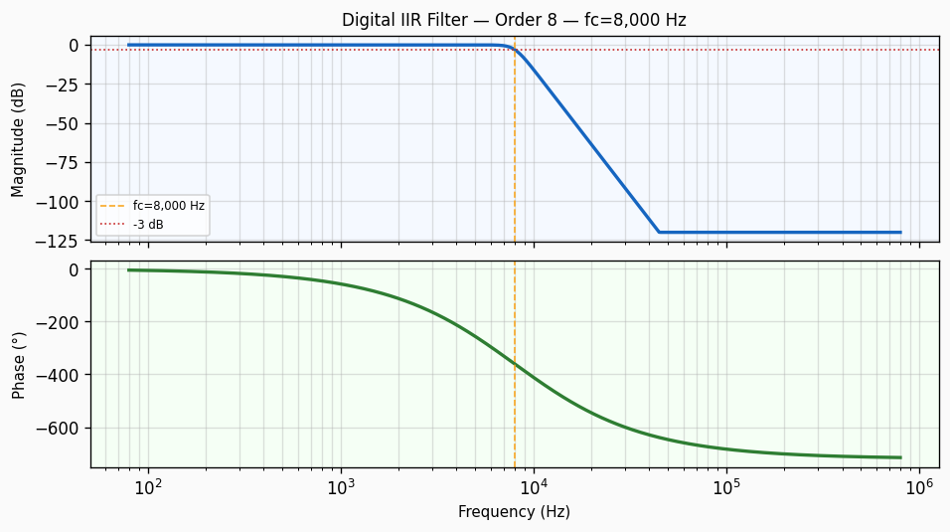
Frequency Response — Bode Plot
Bode plot of Digital IIR Filter order 8 filter. Top panel: magnitude response in dB showing -3 dB cutoff at 8,000 Hz with a roll-off of approximately 160 dB/decade. Bottom panel: phase response in degrees.

Slide 4
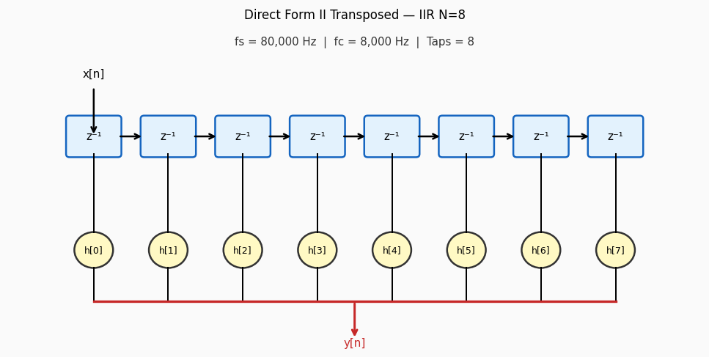
Circuit / Block Diagram
Direct Form II transposed signal-flow graph for a IIR filter of order 8. Each z⁻¹ block represents a one-sample delay register. Coefficients h[n] are multiplied and summed to form the output y[n].

Slide 5
Design Parameters
Parameter | Value
Filter Family | Digital IIR Filter
Filter Type | Band-Pass
Filter Order (N) | 8
Cutoff Frequency (fc) | 8,000 Hz
Angular Cutoff (ωc) | 50265.48 rad/s
Passband Gain (0 Hz) | 0 dB
-3 dB Frequency | 8,000 Hz
Roll-off Rate | 160 dB/decade
Sampling Rate (fs) | 80,000 Hz
Nyquist Frequency | 40,000 Hz
Normalised Cutoff (ωd) | 0.6283 rad/sample

Slide 6
Real-World Applications
• Real-time audio effects processing on DSP microcontrollers • Recursive Butterworth implementation in FPGA signal chains • 8,000 Hz lowpass post-processing in embedded sensor fusion • Speech enhancement preprocessing in voice recognition engines • Power spectral density estimation in industrial vibration analysis
Filter: Digital IIR Filter | fc = 8,000 Hz | Order = 8

